Slide 2
Part I: Dog Traits

Slide 3
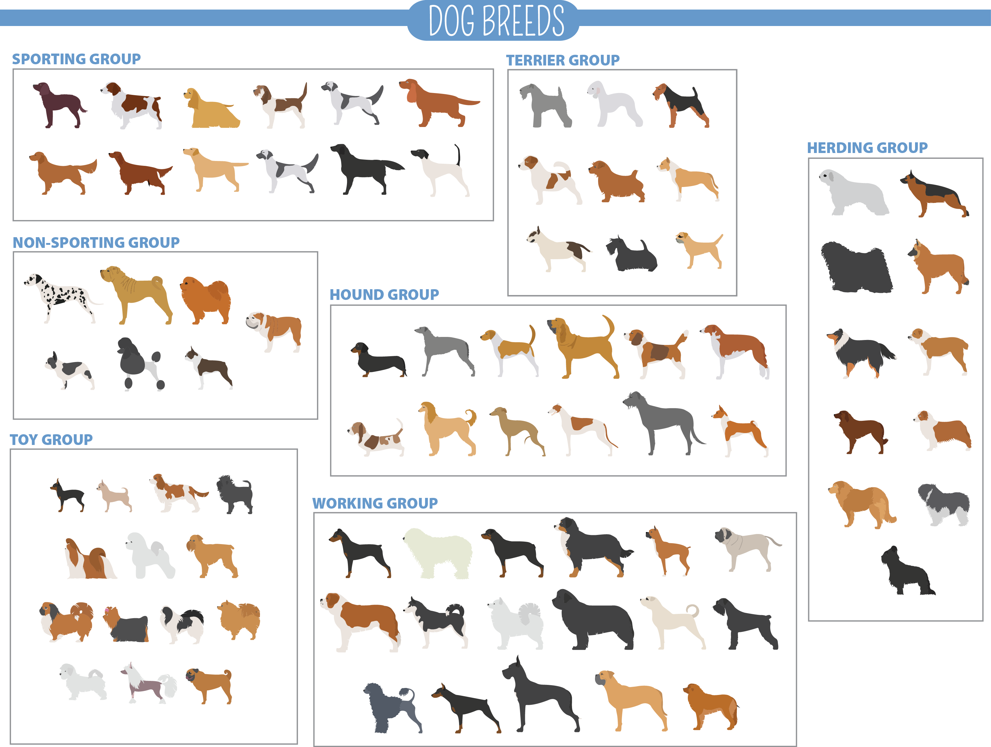
Part I
Name variations, or differences, you see between the dogs.

Slide 4
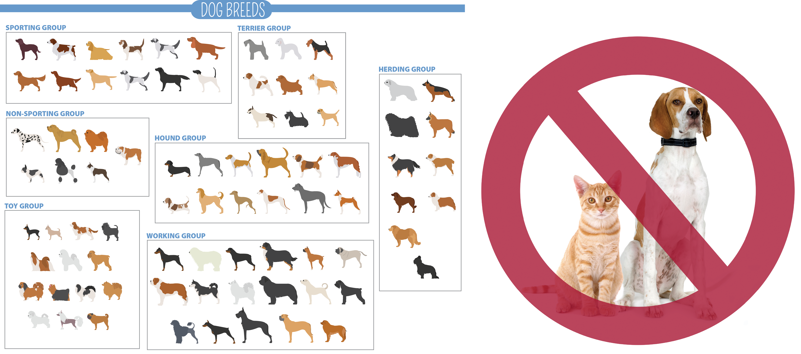
Species vs. Breed
All the variations you see are called breeds because the dogs can still reproduce to make fertile offspring.
When animals can’t reproduce together to make fertile offspring, it is because they are different species.

Slide 5
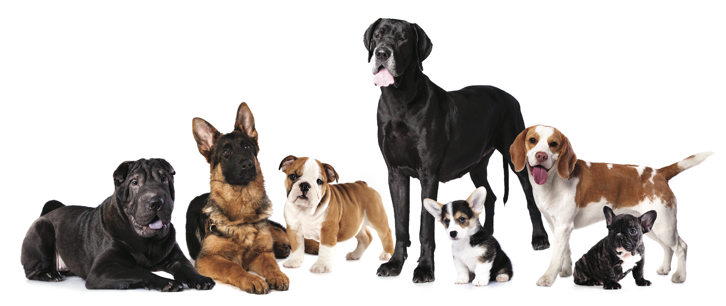
Make a Hypothesis
Why do you think variations in dogs exist ?

Slide 6
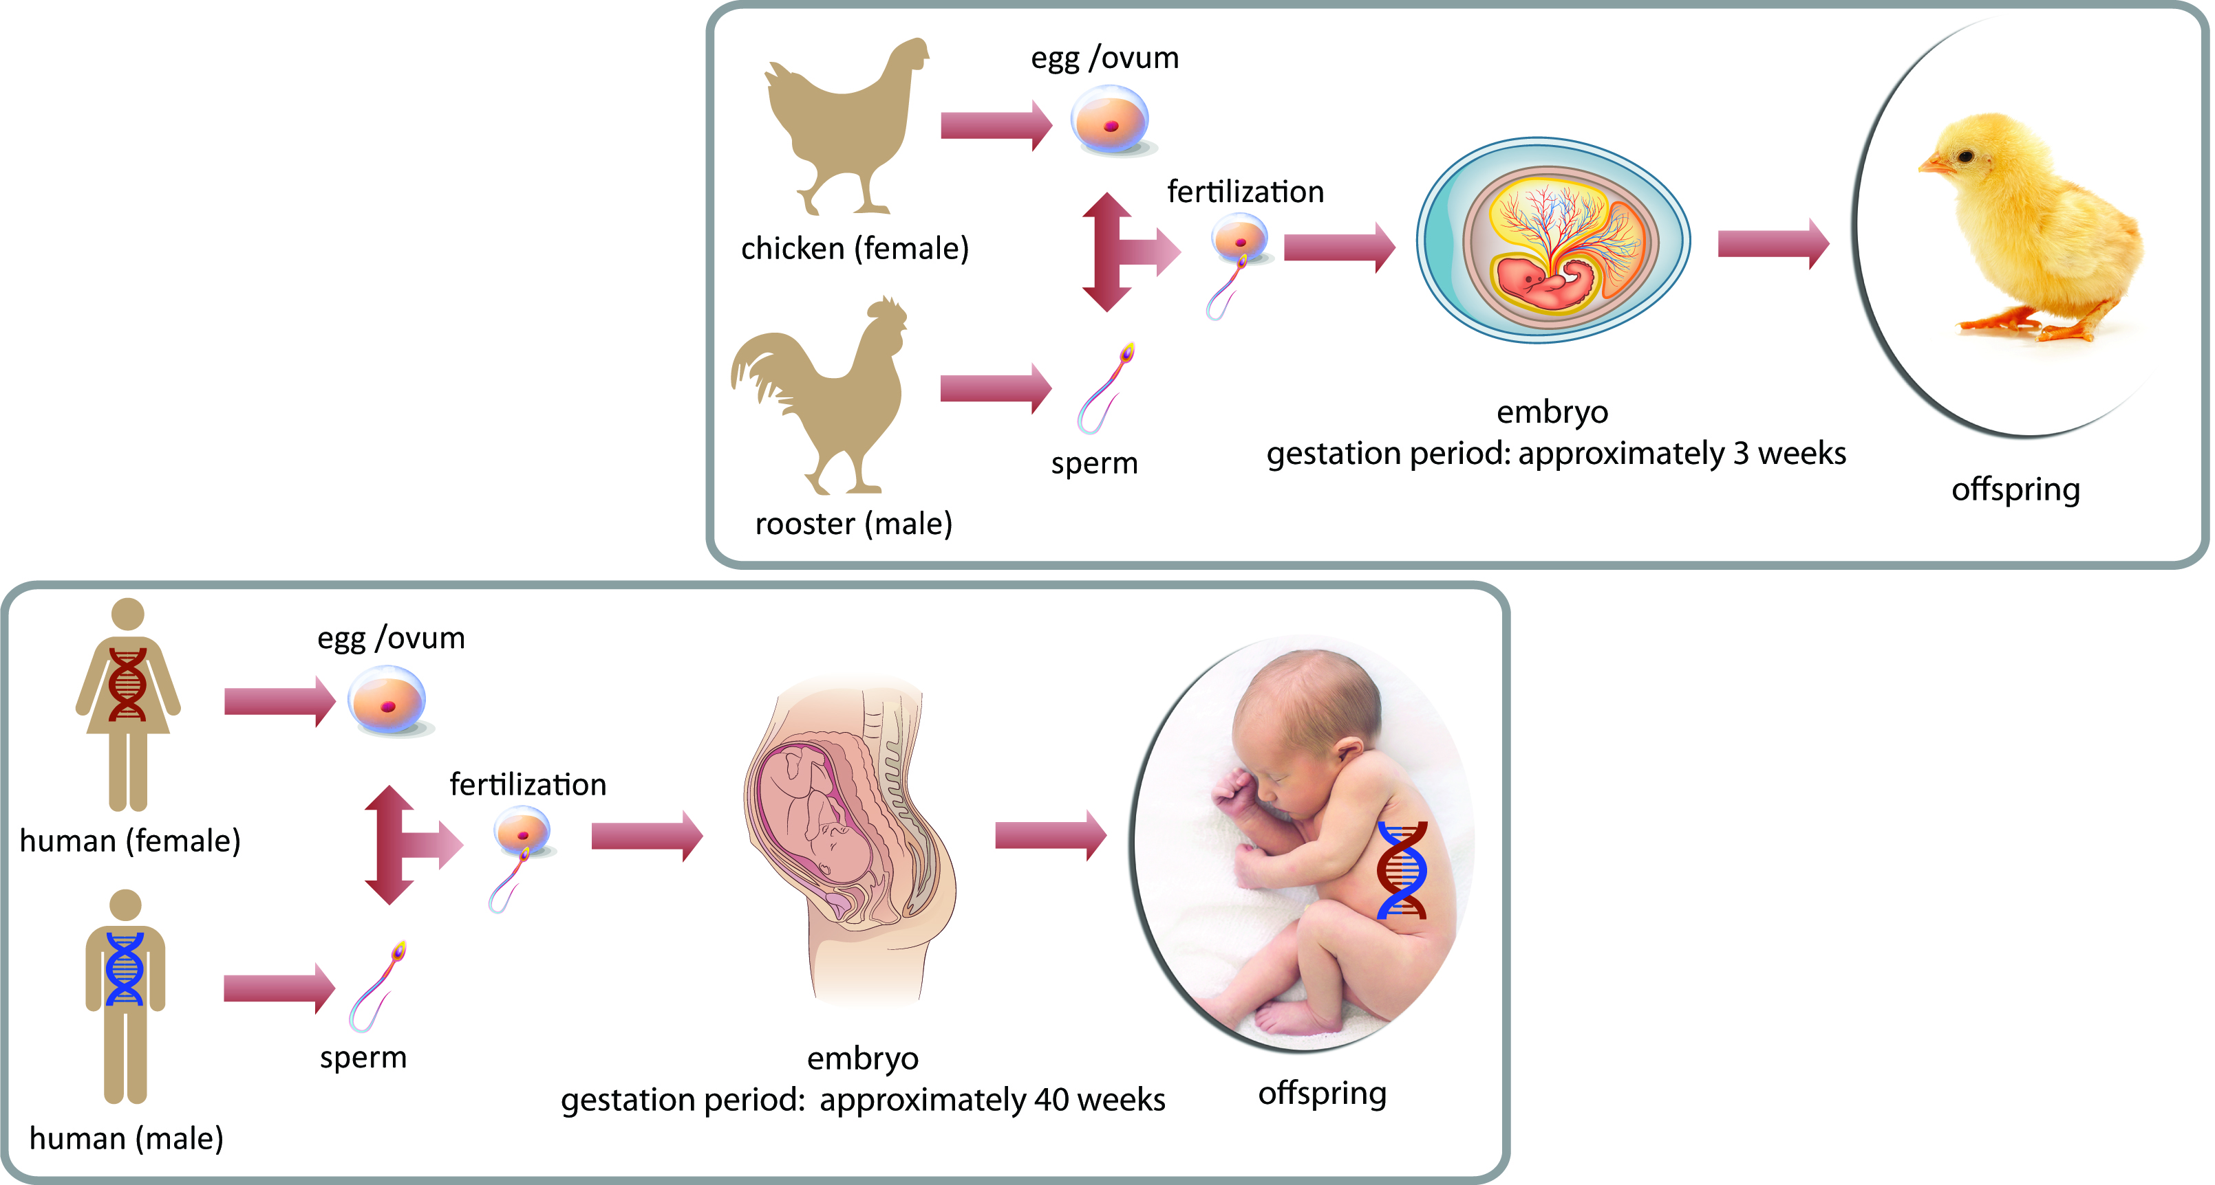
Sexual Reproduction
Requires that an egg and sperm join to make the offspring.

Slide 7
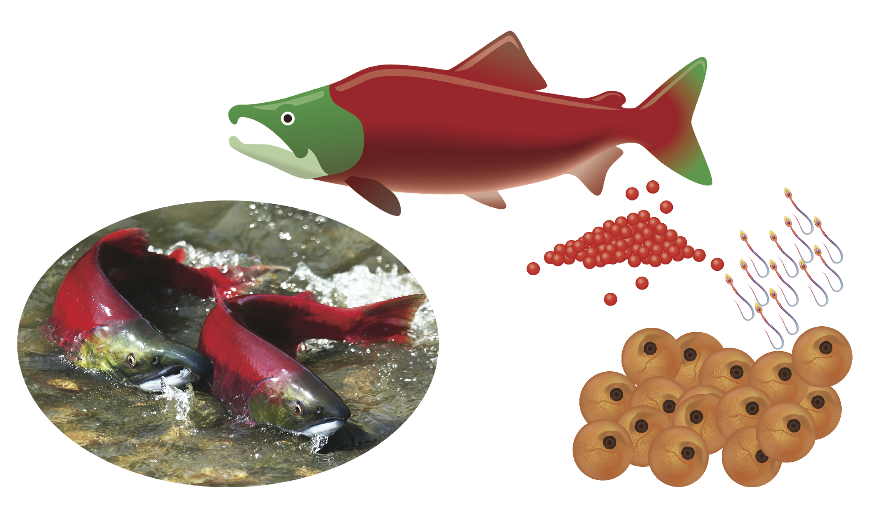
Fish Have Sexual Reproduction
Female lays eggs and male releases sperm in the water.
Baby fish developing in eggs
Parents

Slide 8
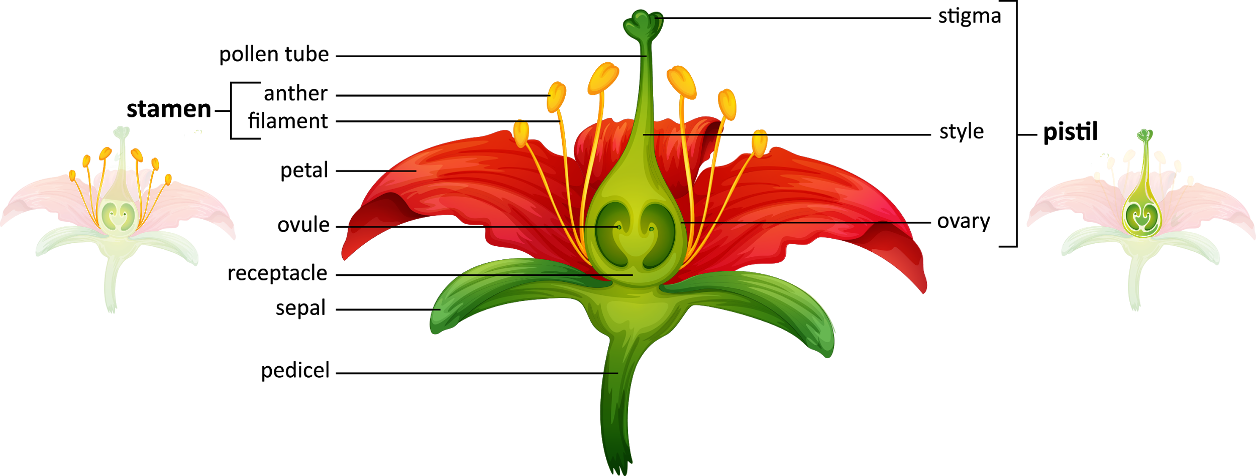
Flowers Have Sexual Reproduction

Slide 9
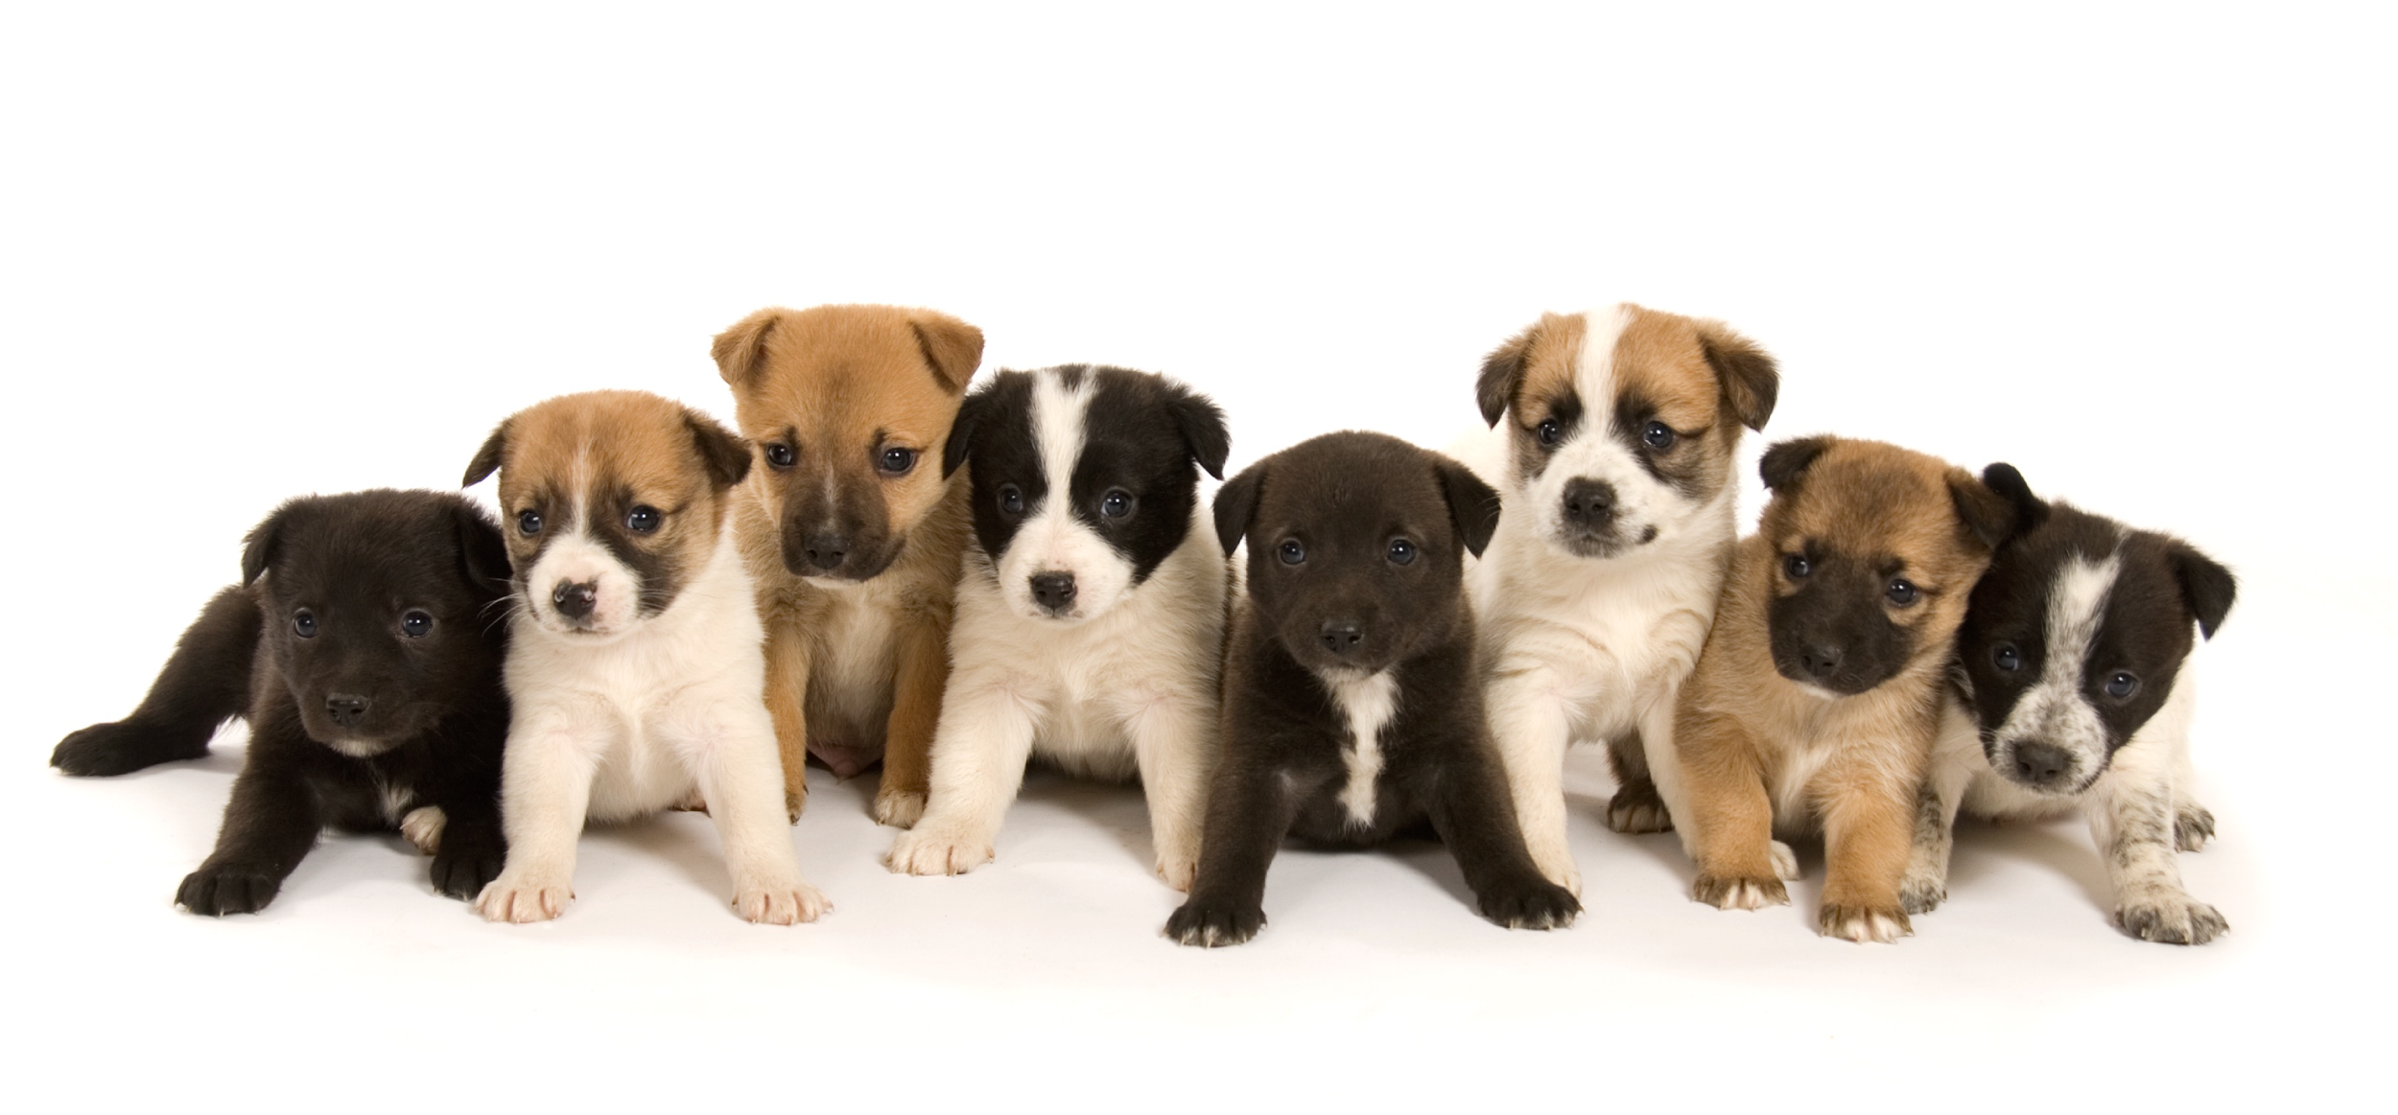
Part II: Dog Family

Slide 10
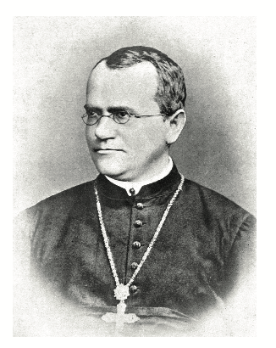
Father of Genetics: Gregor Mendel
In 1863, Mendel discovered that there was something in cells that controlled pea plant traits.
He called these “things” that controlled pea plants traits factors.
We now refer to factors as genes and alleles.

Slide 11
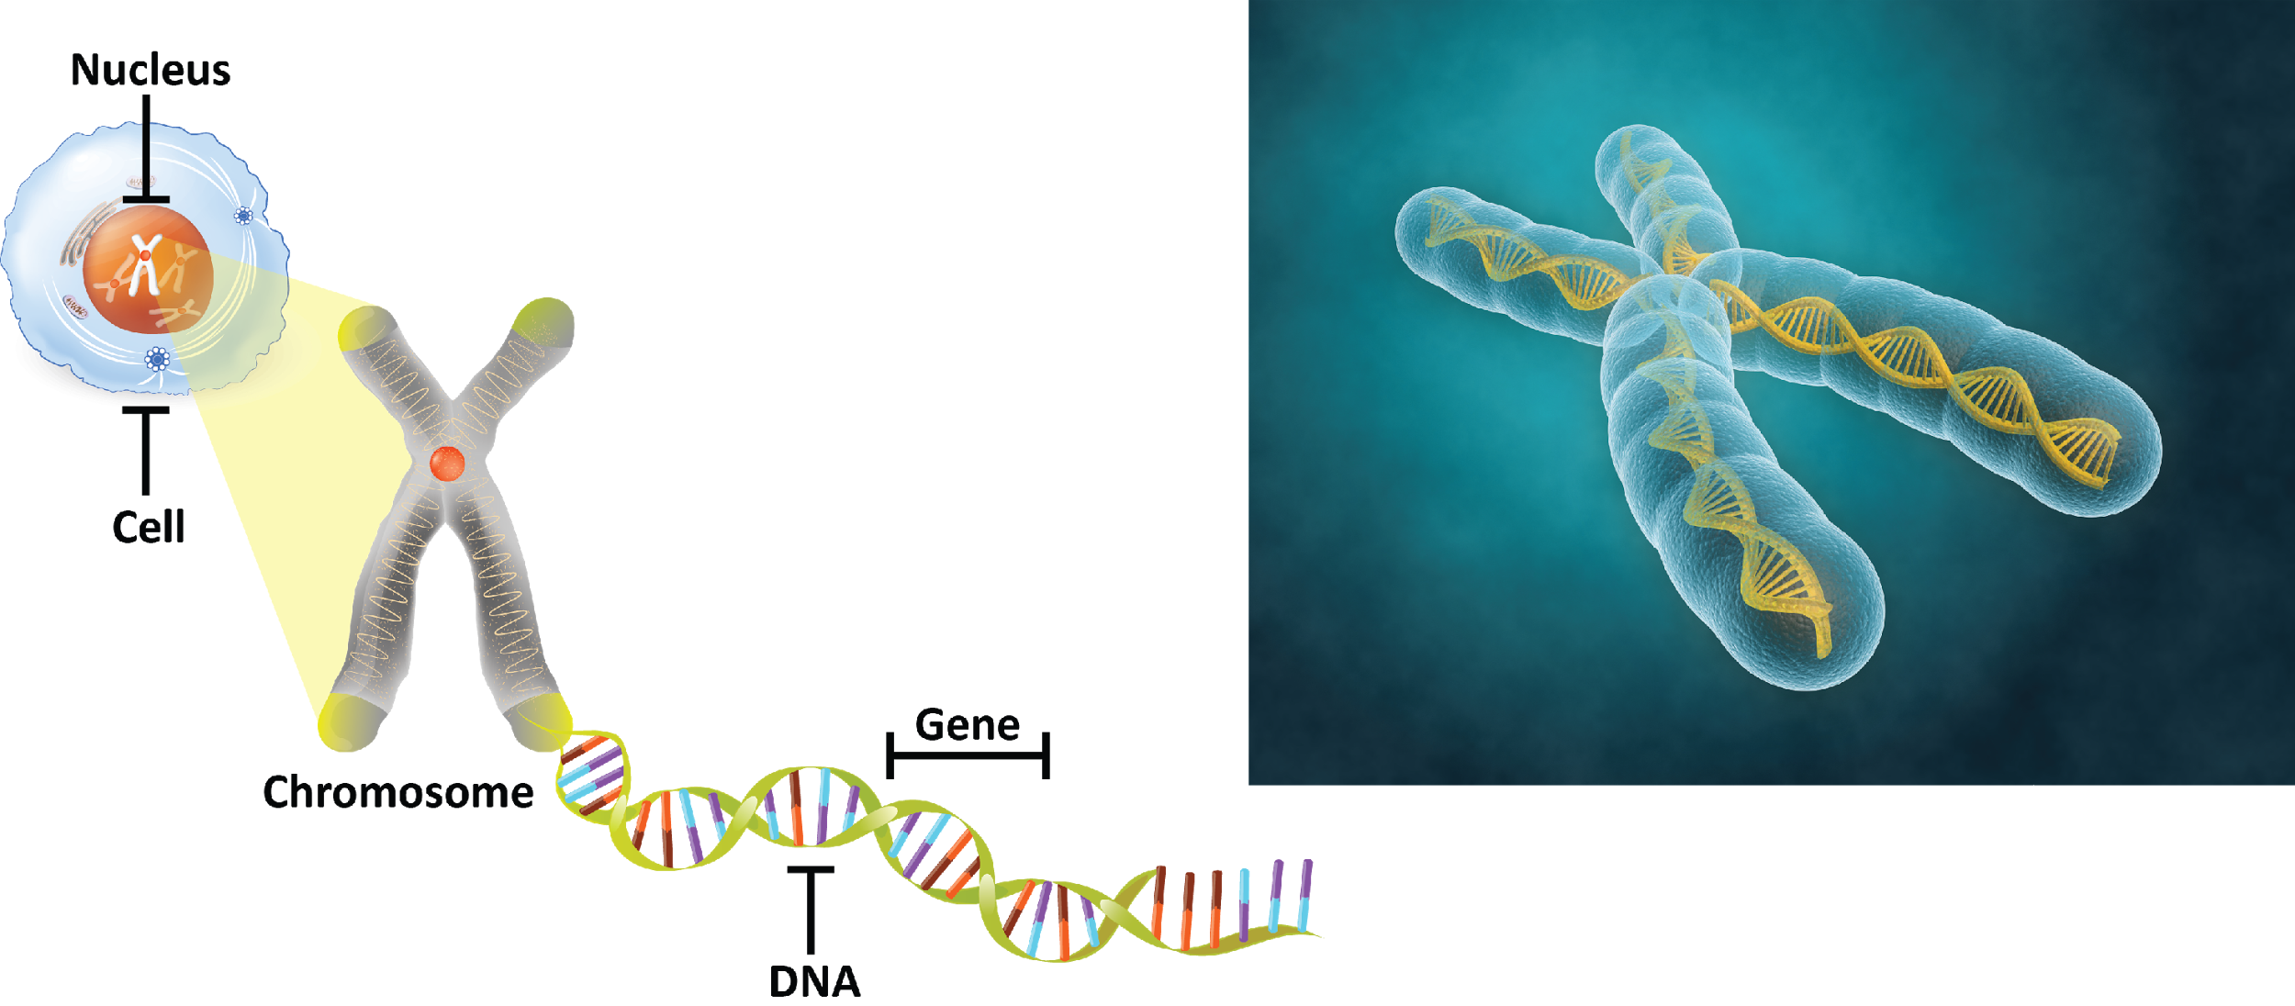
A Chromosome:
is a long strand of DNA made of many genes
is found in the nucleus of plants and animals

Slide 12
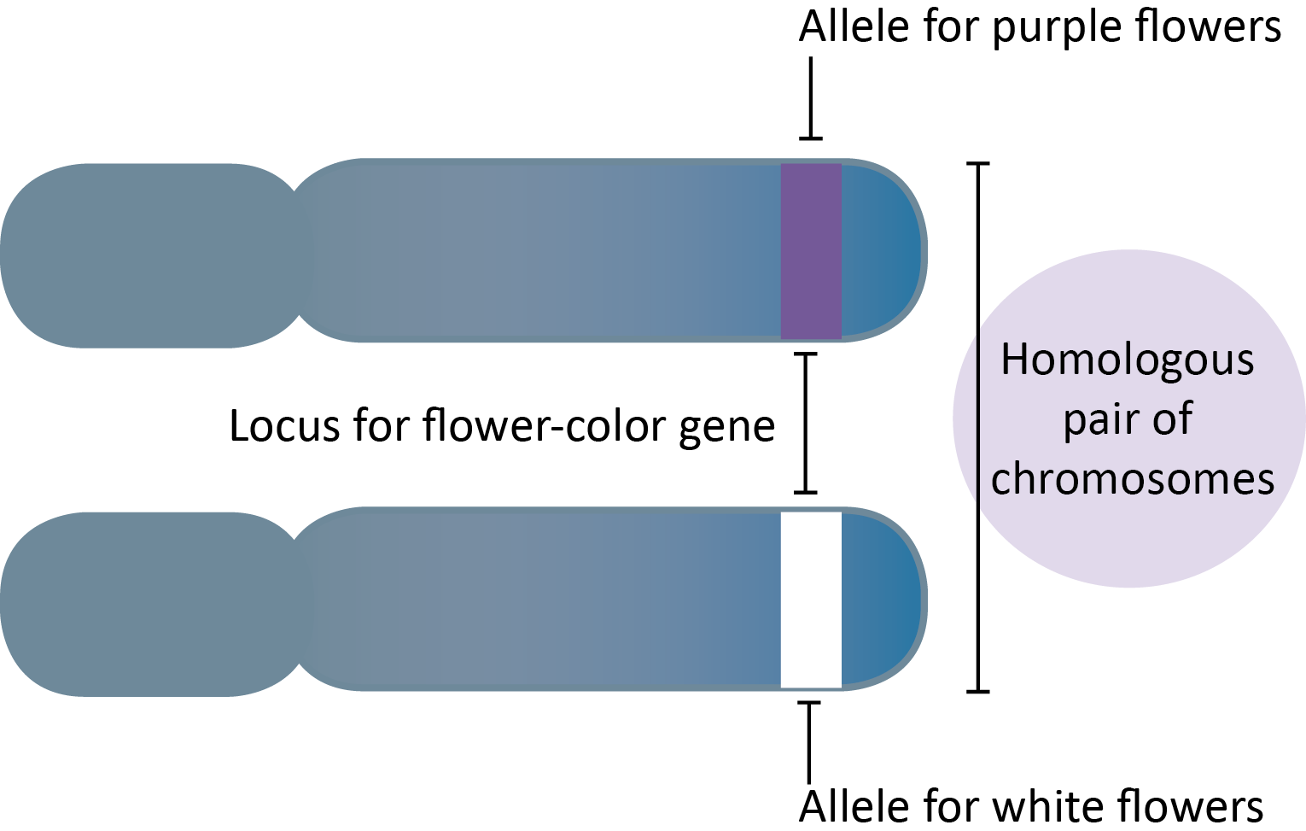
Vocabulary
Gene: A small part of a chromosome made of DNA that codes for a certain trait (flower color)
Allele: Different variations of a gene (white or purple)
Trait: The characteristics you see in an organism (flower color)

Slide 13
Heredity

Slide 14
Fill in the blanks about eye color trait with Gene or Allele or Trait.

Slide 15
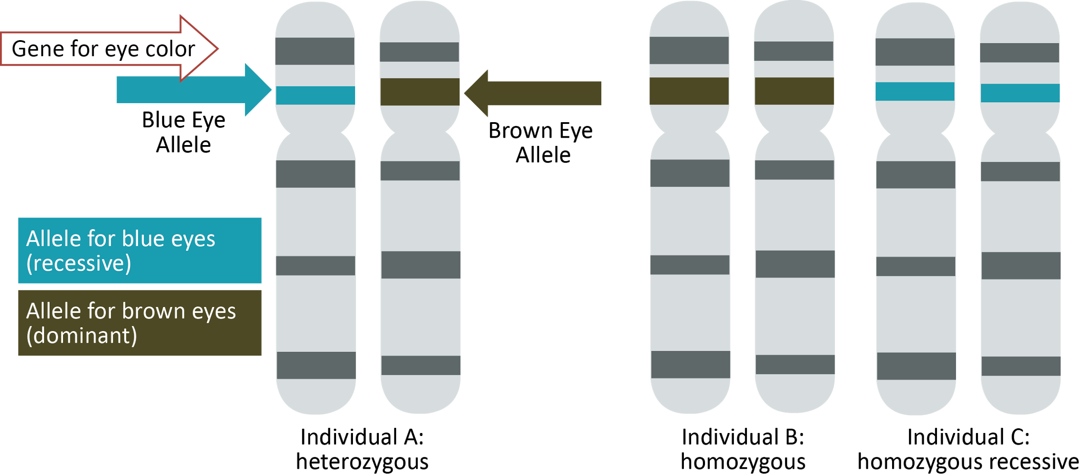
Gene Vs. Allele … Again
These chromosomes have a gene for eye color on them. There are two alleles that will fit in the eye color gene spot, blue or brown.

Slide 16
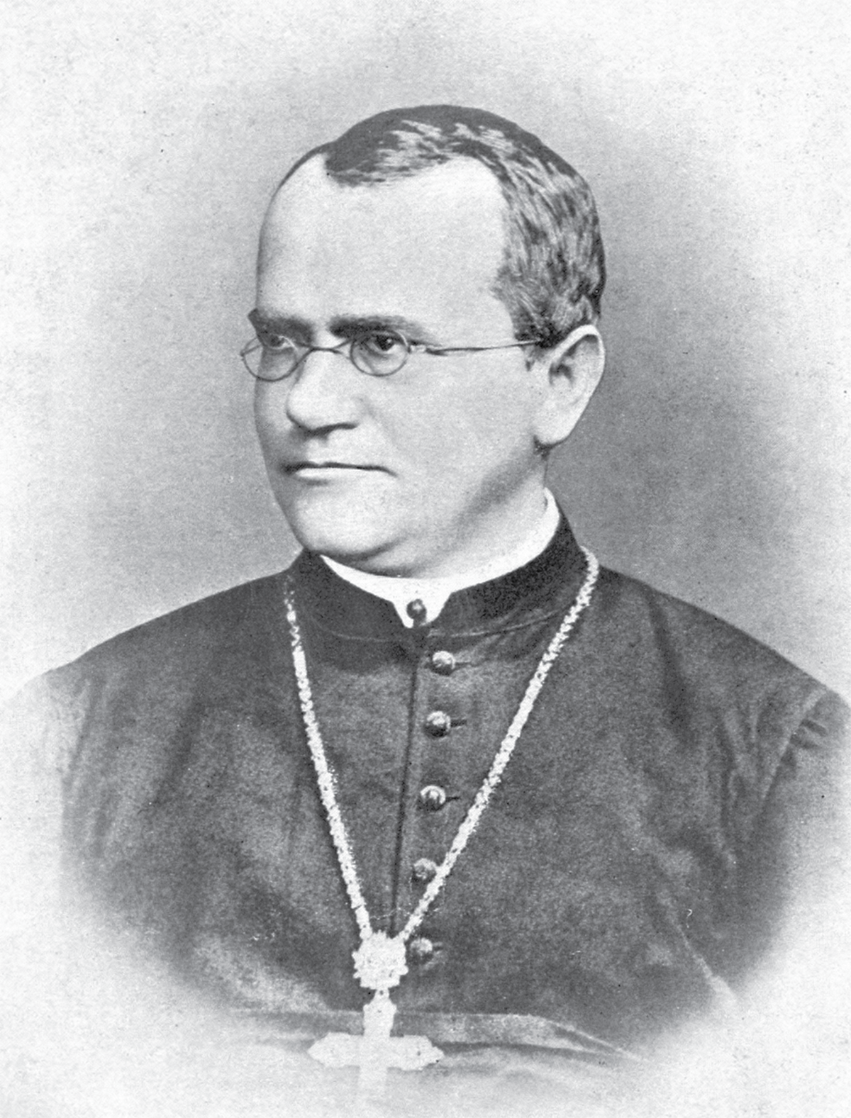
Watch a short video introducing you to Gregor Mendel and Genetics
Gregor Mendel's Work

Slide 17
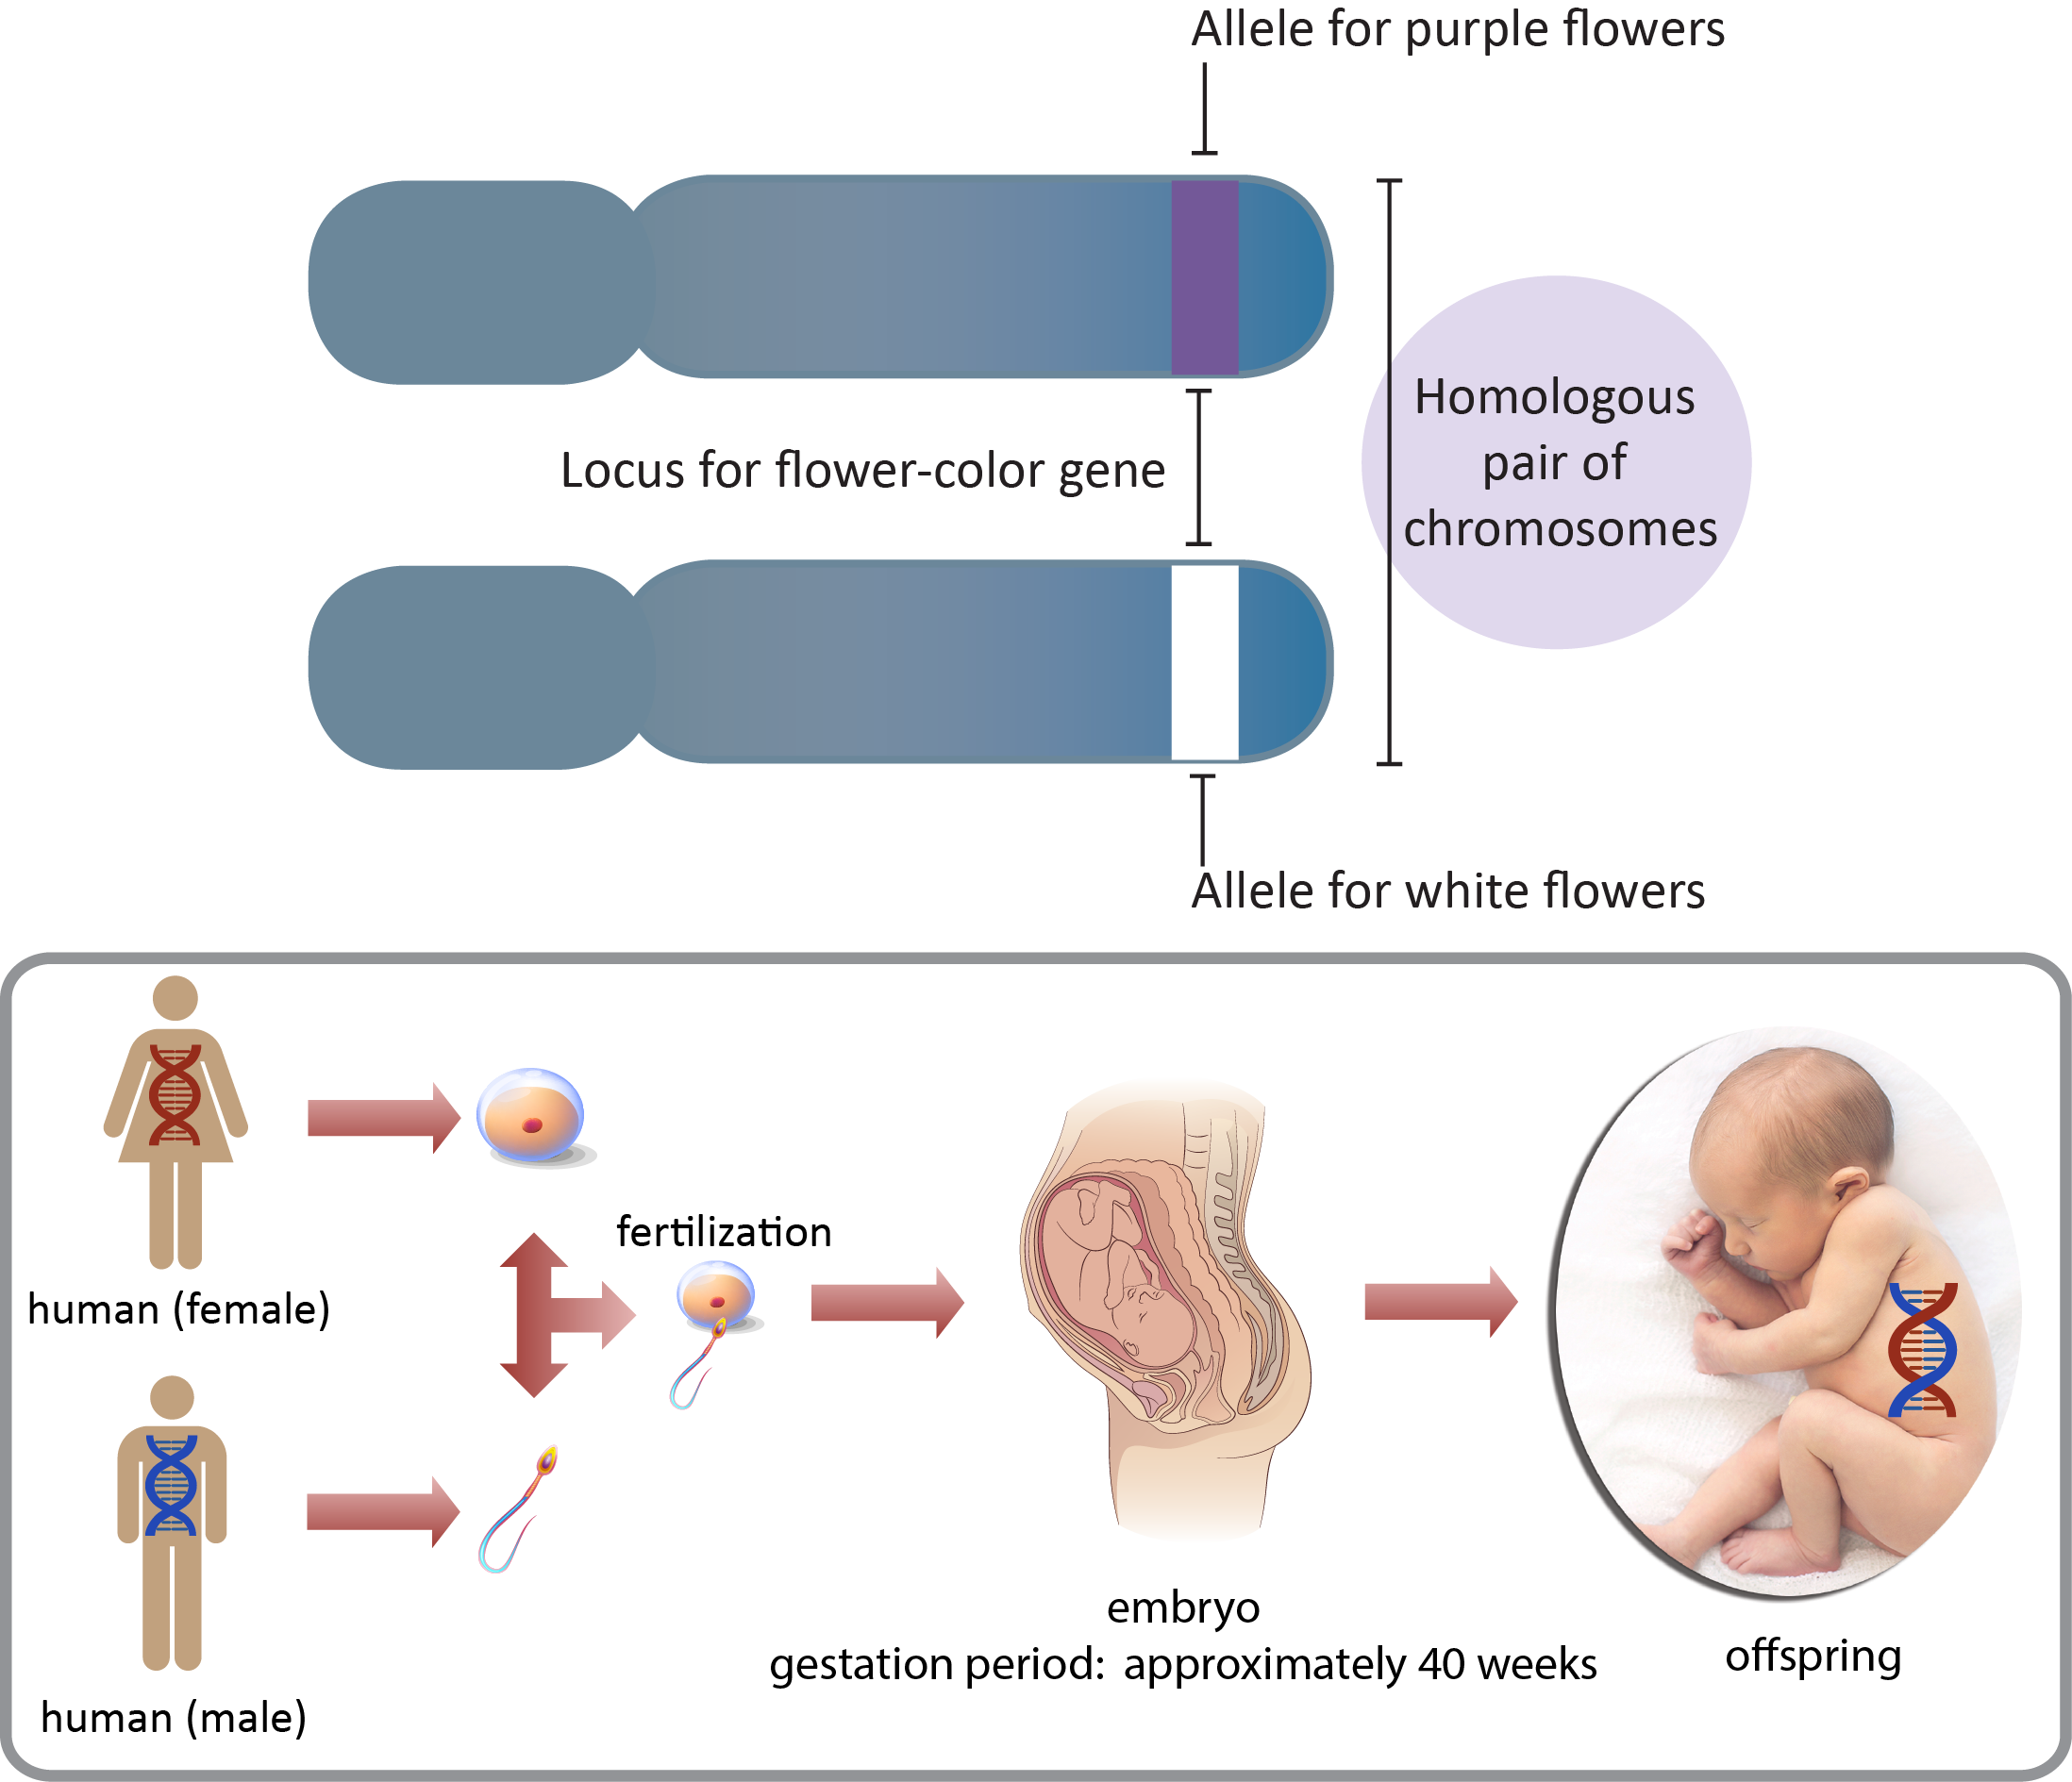
Review of Mendel’s Work:
There are 2 alleles for every trait.
One allele comes from mom and one allele come from dad.
Therefore… We get half our DNA from mom and half our DNA from dad!

Slide 18
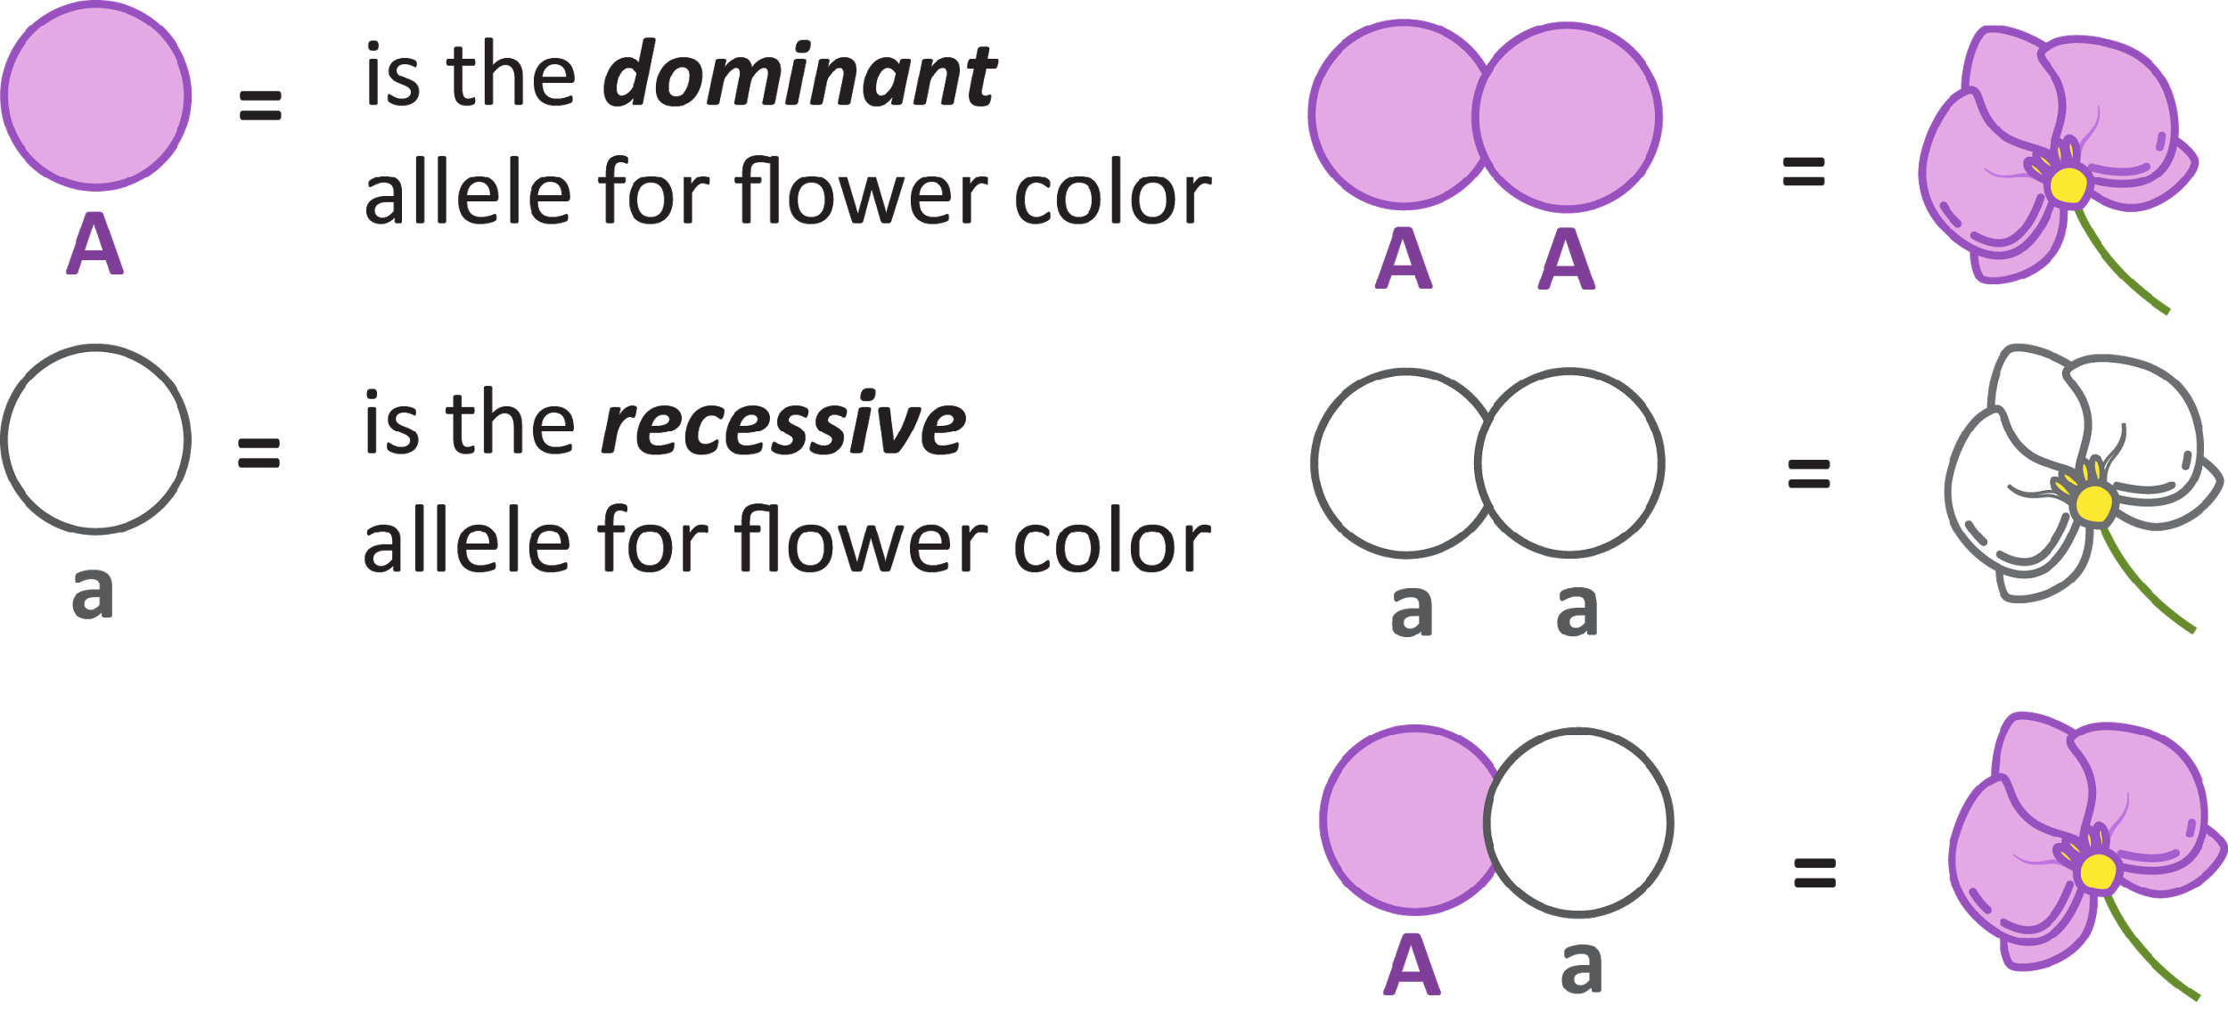
Dominant vs. Recessive Traits
Some traits are dominant (A) or overriding. We usually see these more often.
Some traits are recessive (a) or often hidden by the dominant trait. These traits are usually seen less often.

Slide 19
Allele Combinations
The dominant allele’s symbol is a capital letter (T).
The recessive allele’s symbol is lowercase letter (t).
The dominant trait shows up with one or two dominant alleles.
The recessive trait shows up with only one allele.
The alleles you have | What you look like
TT | Tall
Tt | Tall
tt | Short

Slide 20
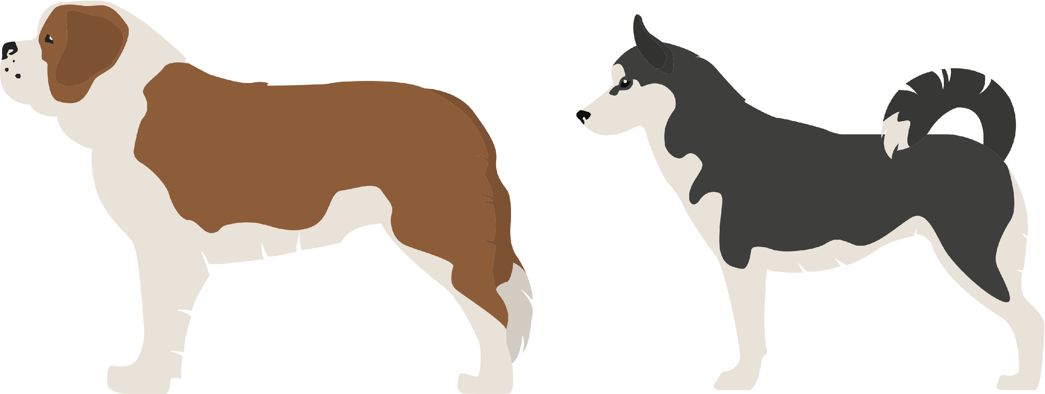
Identify Mom and Dad Dog Traits and Alleles
Pick 2 Parent Dogs
Use the Dog Traits and Alleles Resource Card to determine traits and alleles.
Example
Dominate Trait: TT or Tt for Curved Tail Flip a coin for alleles
Recessive Trait: tt for Straight Tail

Slide 21
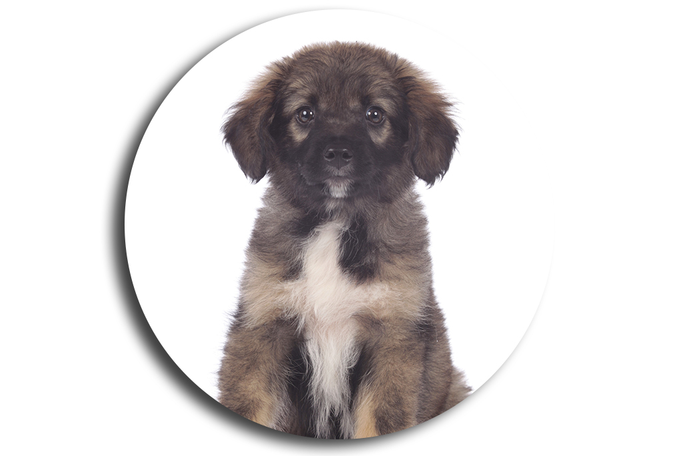
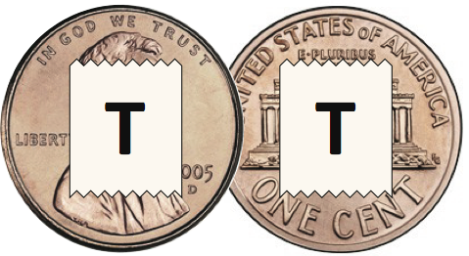
Make a Puppy
Flip one penny that matches mom’s alleles to get one puppy allele.
Flip one penny that matches dad’s alleles to get another puppy allele.
Repeat for every trait.

Slide 22
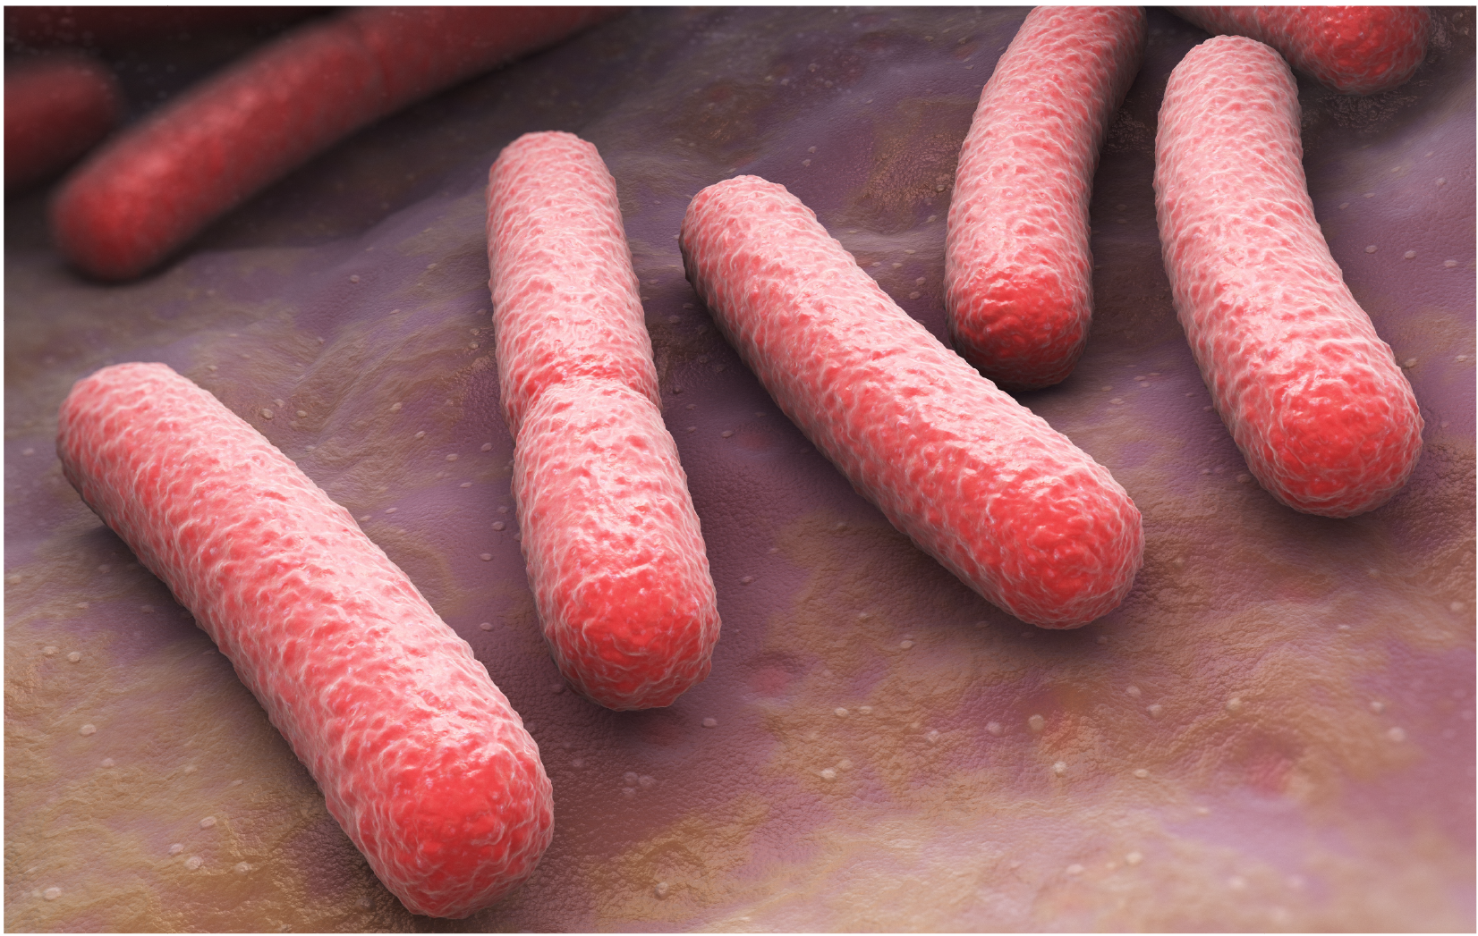
Parts IV & V: Bacteria

Slide 23
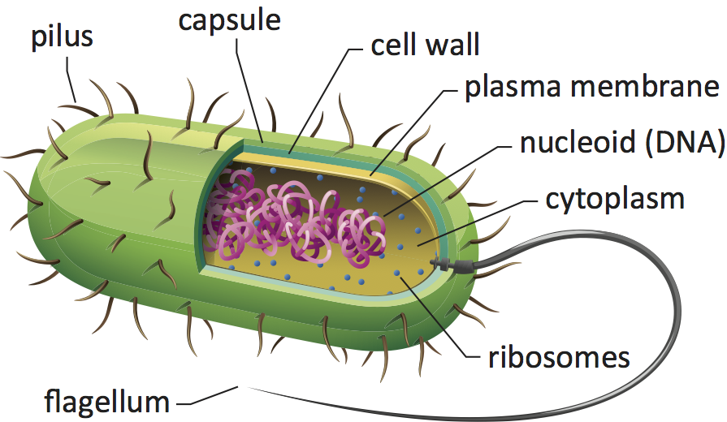
Parts of a bacteria:

Slide 24
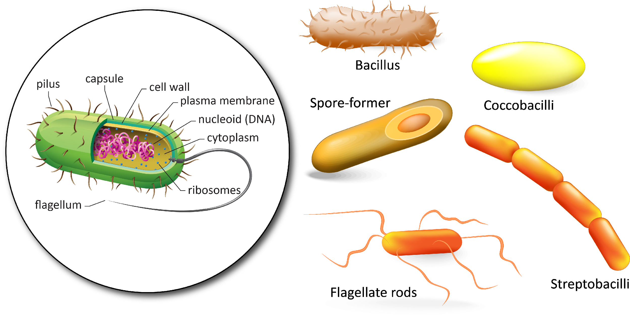
Identify different traits of bacteria

Slide 25
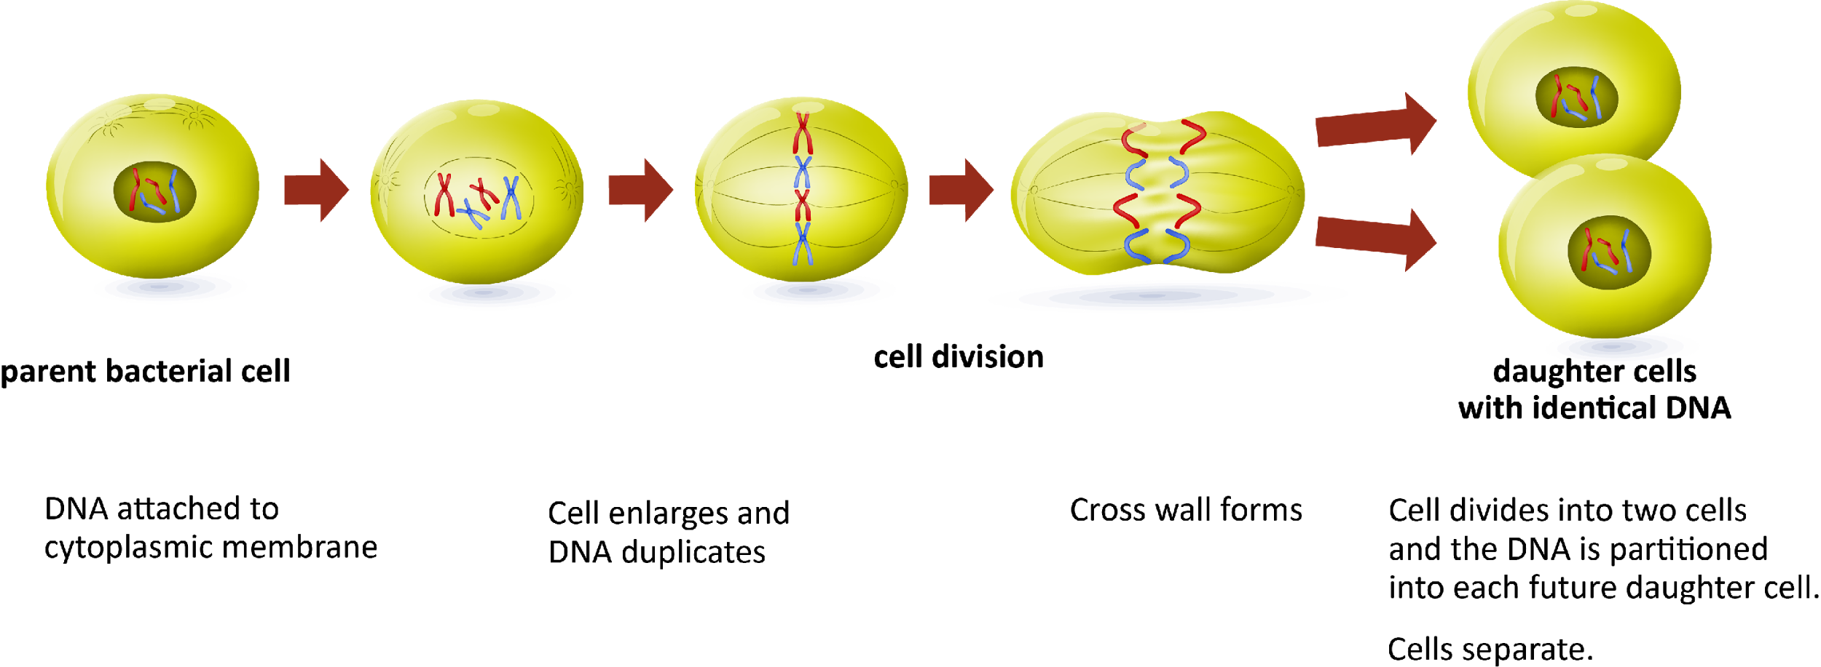
Asexual Reproduction in Bacteria
Binary Fission—a process where one cell divides to form two identical cells. This is an example of asexual reproduction.

Slide 26
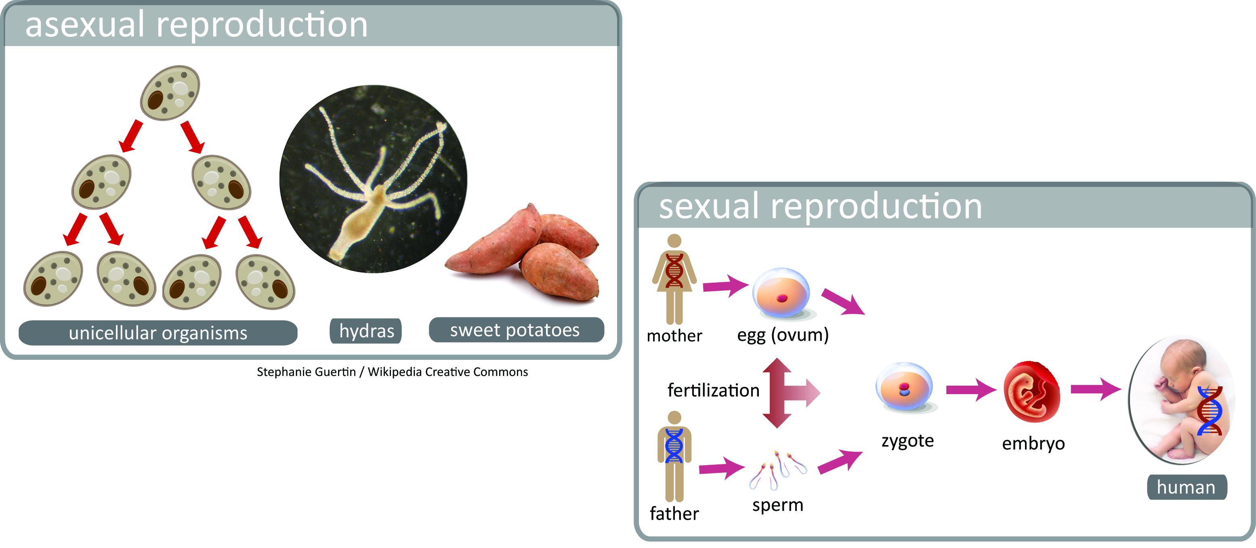
Asexual vs. Sexual Reproduction
ART PENDING

Slide 27
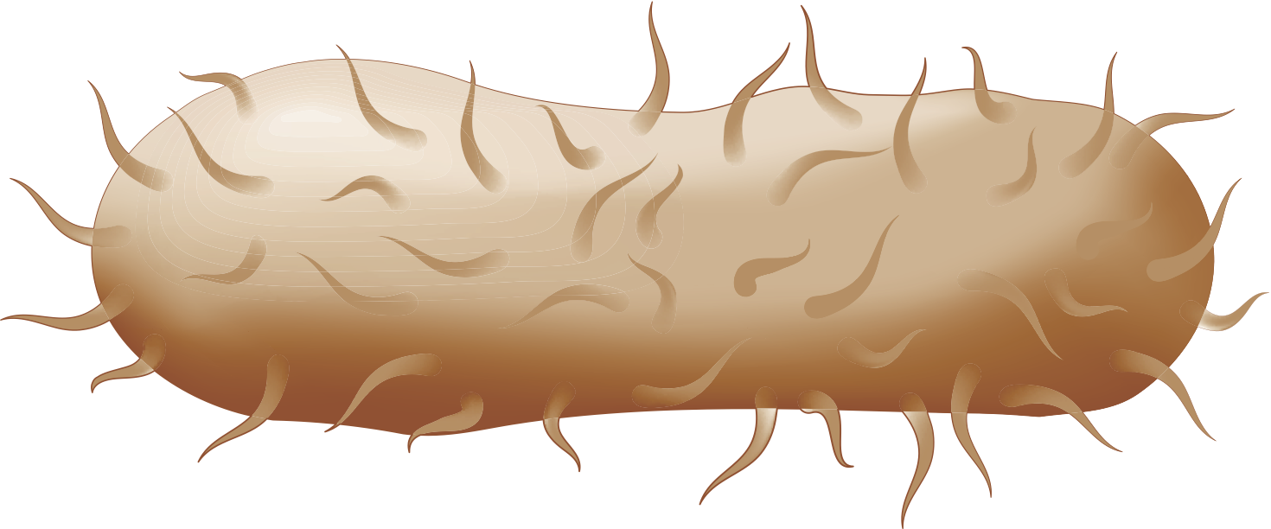
Part V: Bacteria Family
Pick 1 Parent Bacteria
Use the Bacteria Trait Resource Card to determine traits and alleles.
R or D or S or …
Bacteria only have 1 chromosome so they only have
one allele for each trait.

Slide 28
Part V: Bacteria Family
Make a Baby Bacteria
Design a method to flip a penny to find the baby bacteria allele
?

Slide 29
A review video:
Comparing Sexual and Asexual Reproduction
Notes:
http://study.com/academy/lesson/sexual-reproduction-inheriting-genes-from-each-parent.html

