Slide 1


Slide 2
Scientific Explanations
    Help us understand how the world works
    Include evidence so we can decide if the explanations are valid

Slide 3
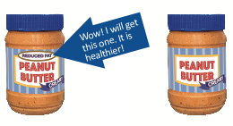
Peanut Butter Example
Claim: The reduced-fat peanut butter is
healthier than the regular peanut butter.

Slide 4
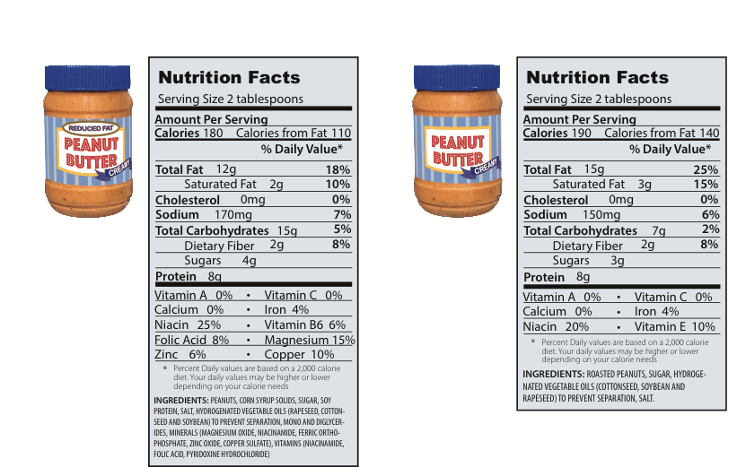
Claim: The reduced-fat peanut butter is healthier than the regular peanut butter.

Slide 5
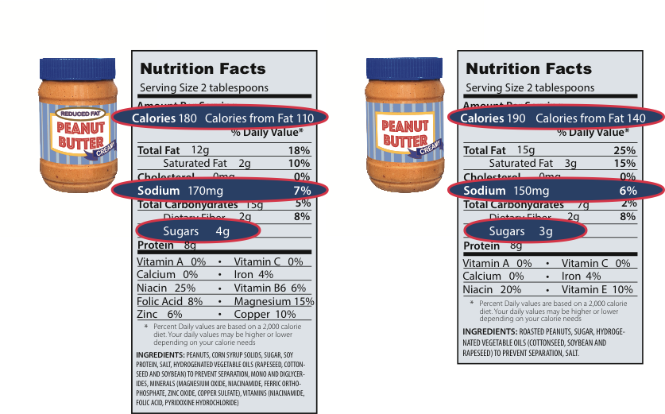
Claim: The reduced-fat peanut butter is healthier than the regular peanut butter.

Slide 6
Structure of a Scientific Explanation
  Claim: Provides a possible answer to a big question or a solution to a problem.
  Evidence: Provides data or information that supports or disproves the claim. The evidence can come from an investigation, observations, reading materials, and/or published data.
  Reasoning: Provides a justification that links the claim and the evidence. The reasoning should involve a scientific principle or idea to describe why the evidence supports the claim.

Slide 7
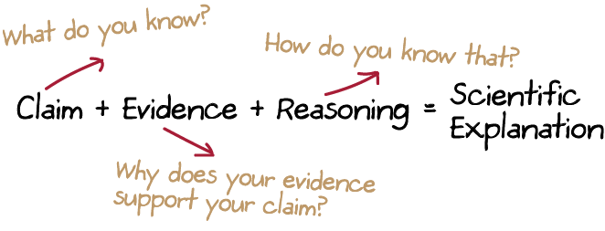
Summary

Slide 8
Construct a Scientific Explanation
  Make a Claim
  Your teacher is holding a cup of water with no lid.
  Ask the question:
  What will happen when my teacher turns the cup of water upside down?
  Make a claim:
  If my teacher turns the cup of water upside down, the water will….

Slide 9
Construct a Scientific Explanation
  Support Your Claim with Evidence
    What evidence do you need to support your claim?
    Gather evidence with your teacher.
  Write your observations as you gather the evidence with your teacher.

Slide 10
Construct a Scientific Explanation
  Write Your Evidence to Support or Refute Your Claim
  Evidence:
  I found that when I turned the cup over 10 times….

Slide 11
Construct a Scientific Explanation
  Use Reasoning to Link Evidence with Claim
    What is the science that explains why the water spills out?
    What do you know about how the world works that you can use to explain what happens?
    To get you started….
  I know that [your claim] is supported by [your evidence] because ….

Slide 12
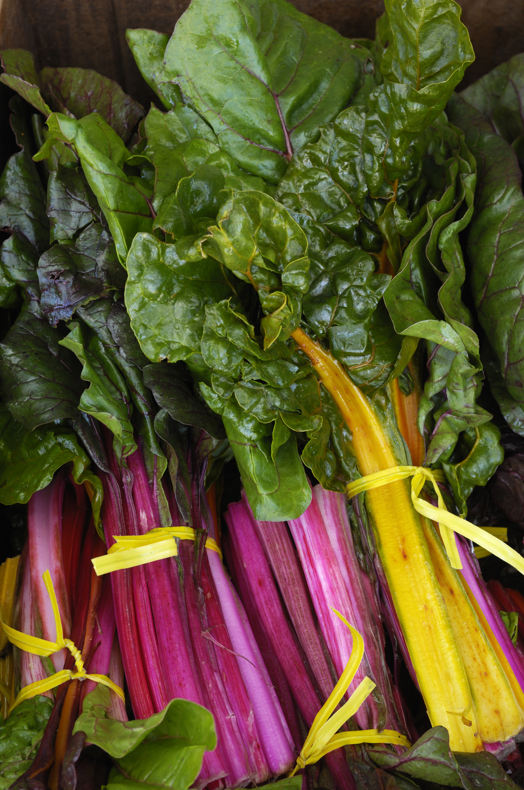
Read this scientific explanation.
Is it valid? Why or why not?
    Claim: Eating leafy greens
    boosts intelligence.
    Evidence: A study shows that
    young children who eat leafy
    greens at least three to five days
    per week have higher test scores
    on tests in math and reading than
    kids who eat little to no
    leafy greens.
    Reasoning: Leafy greens must
    have some vitamins that increase brain power.

Slide 13
Evaluating Scientific Explanations
    Do you agree or disagree with this scientific explanation? Why or why not?
    What might be some other interpretations of
    the evidence?
    Are there other reasons or factors in the study that may impact the accuracy of the scientific explanation?

Slide 14
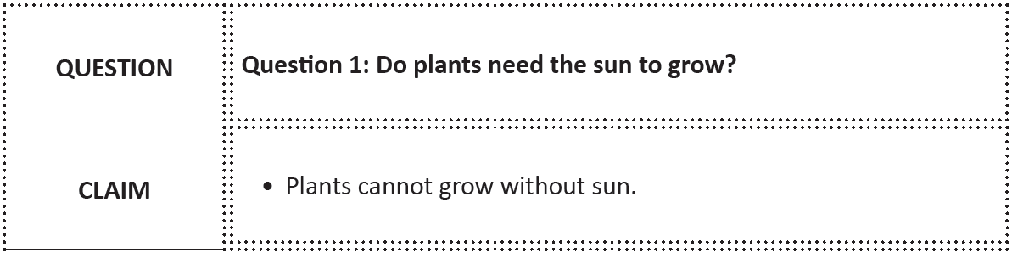
Sample Setup for Pieces of Scientific Explanation
Remember:
Pay attention to what other group members need. (Broken Circles)
Play your role in the group. (Role Playing)
Help others do things for themselves and be concise. (Master Designer)
Listen and pay attention to what is being said and everyone contributes.
(Four-Stage Rocket)

