Slide 2
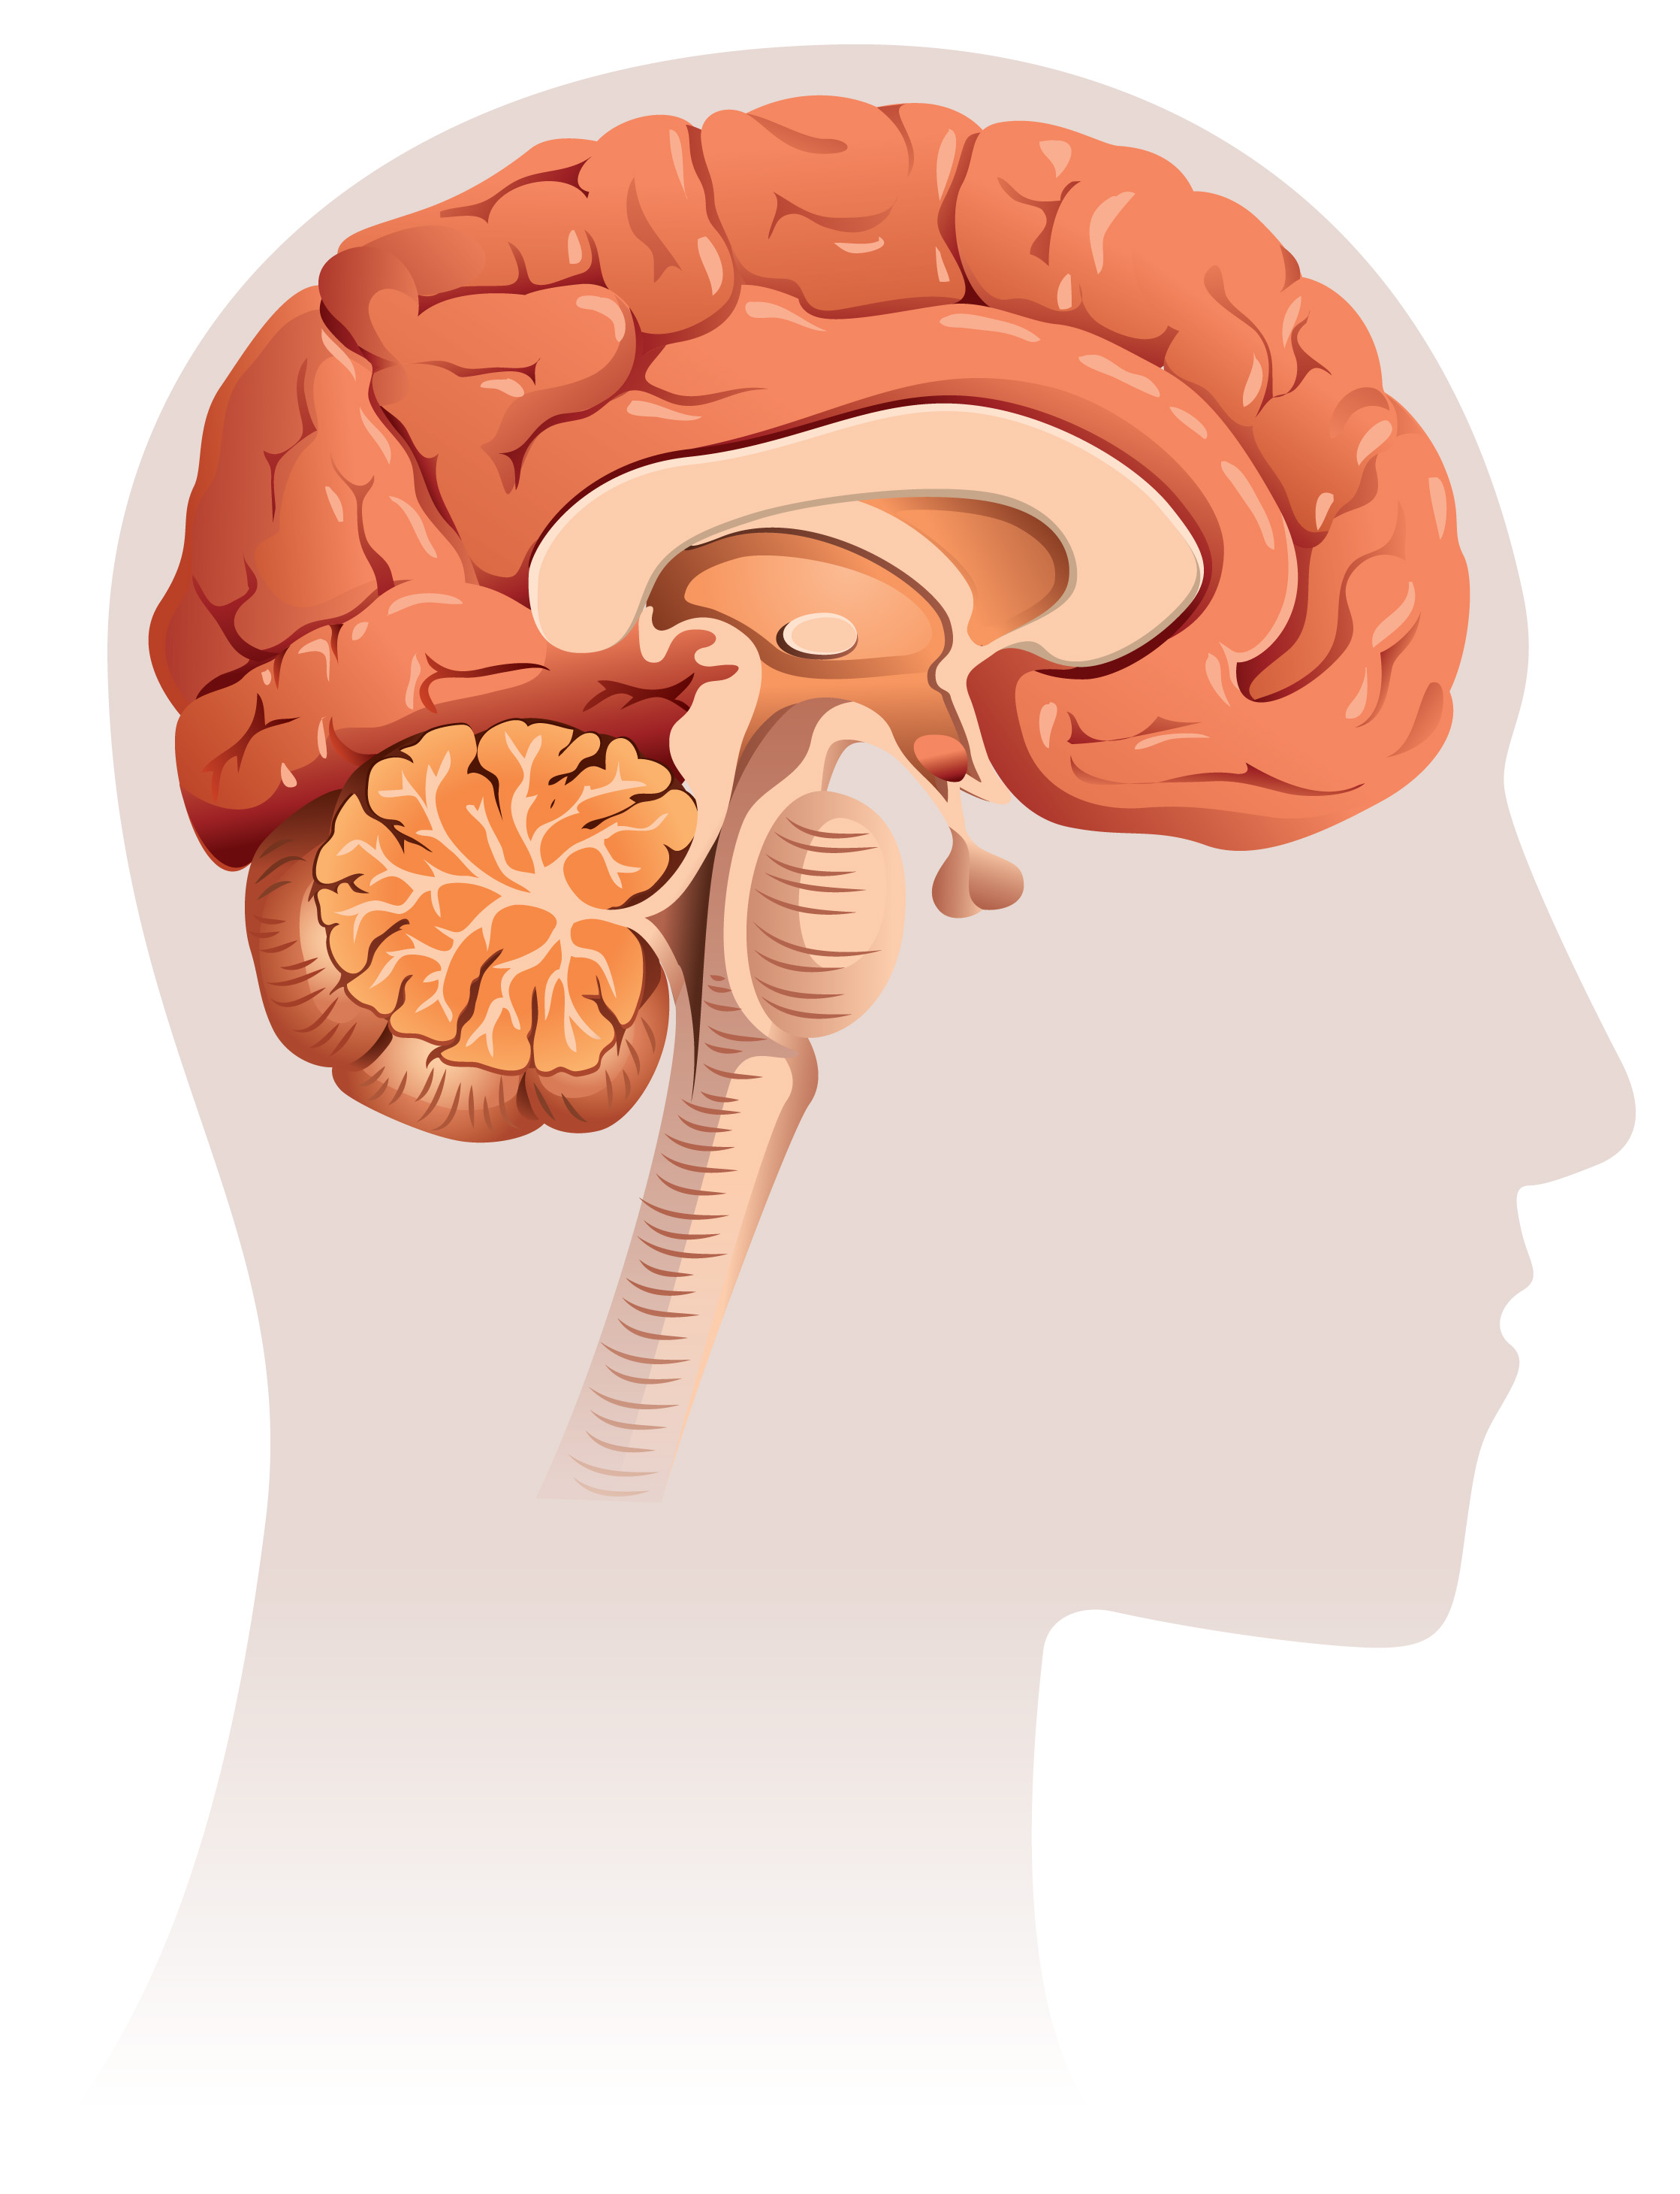
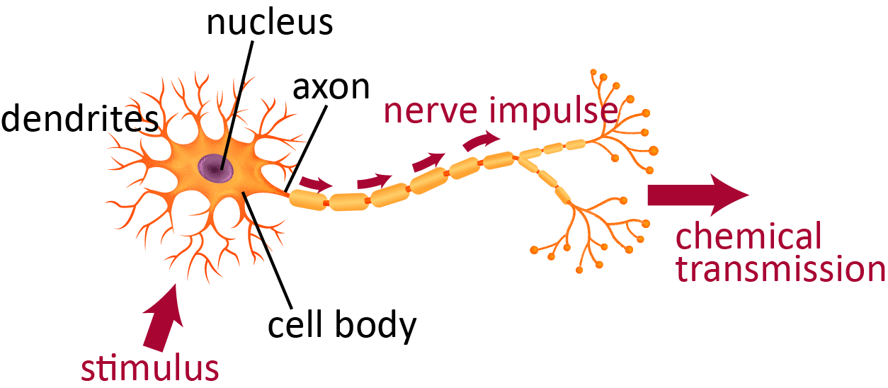
In Task 4, you will
Watch nervous system videos and write down facts.
Discuss pictures of the nervous system.
Research one of the five senses.
Choose an activity that involves one of your senses.
Draw pictures to show the neural pathway, starting at the stimuli and ending at the response.
Present your sense pathway.

Slide 3
Let’s watch a short video about the nervous system!
Take notes on your Nervous System Diagram.
Nervous System video link
Notes:
Start video at 2:50

Slide 4
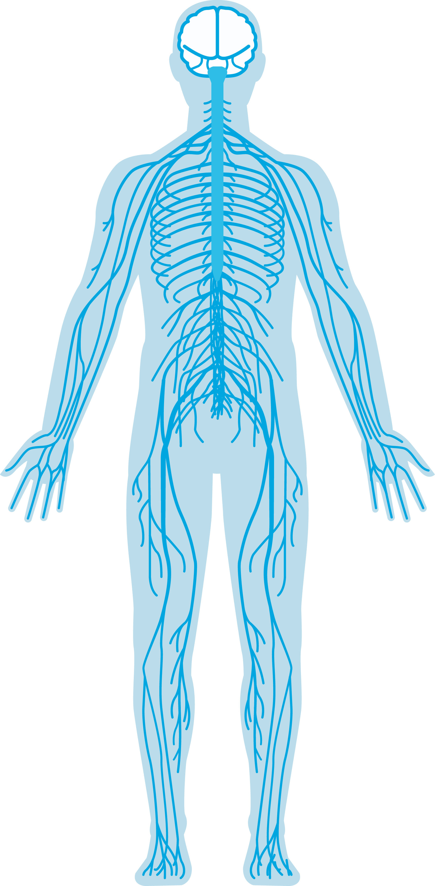
Parts of the Nervous System
brain
spinal cord
nerves

Slide 5
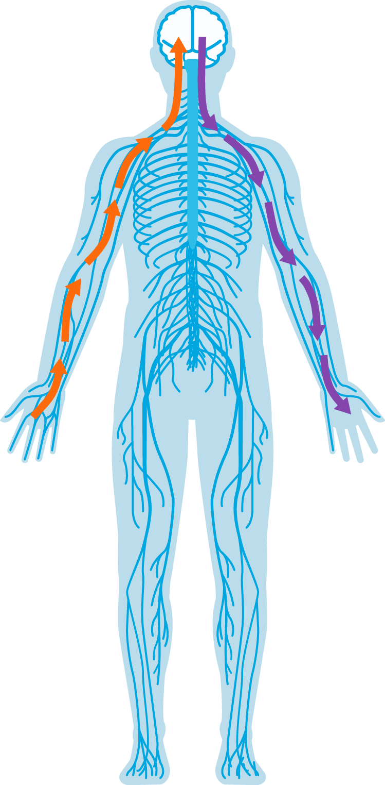
Sensory and Motor Nerves
sensory nerves
send the message to the brain
motor nerves
send the message to the body

Slide 6
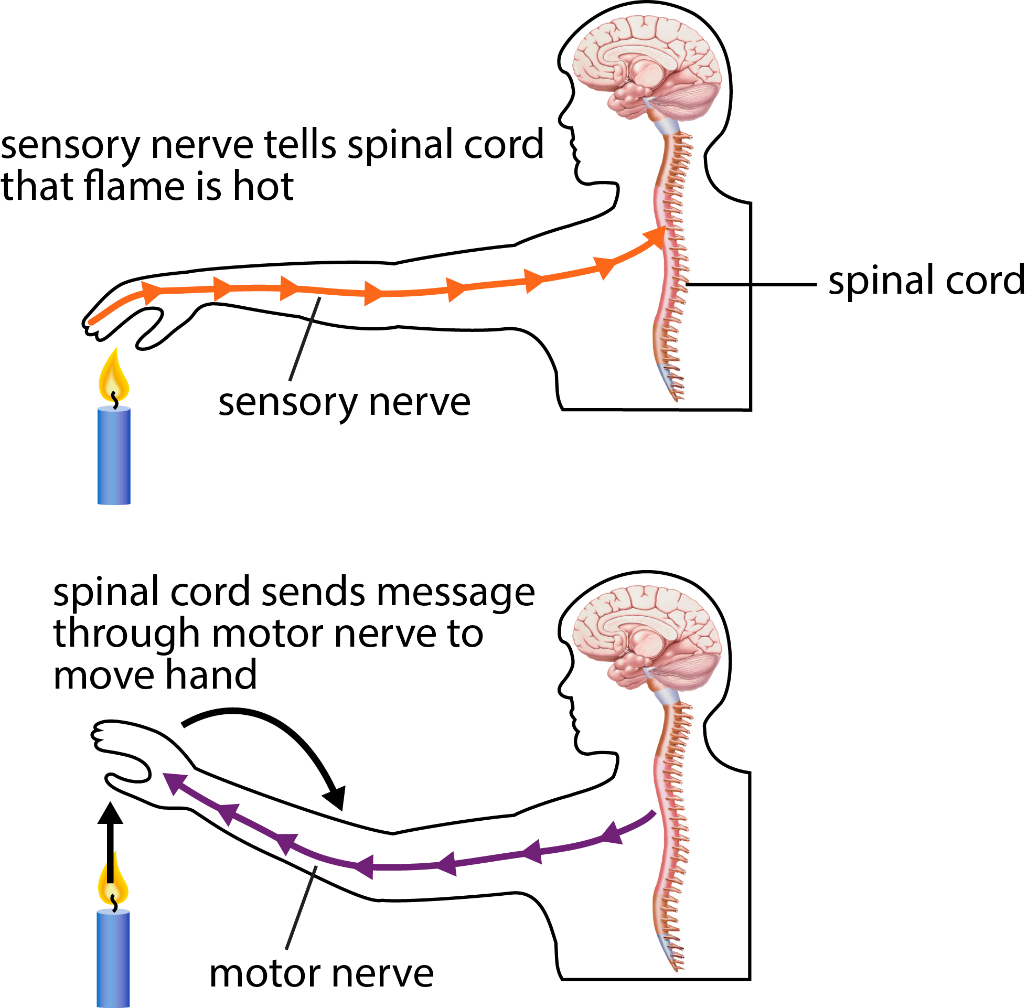
Sensory and Motor Nerves
sensory nerve
message to the brain
motor nerve
message to the muscle

Slide 7
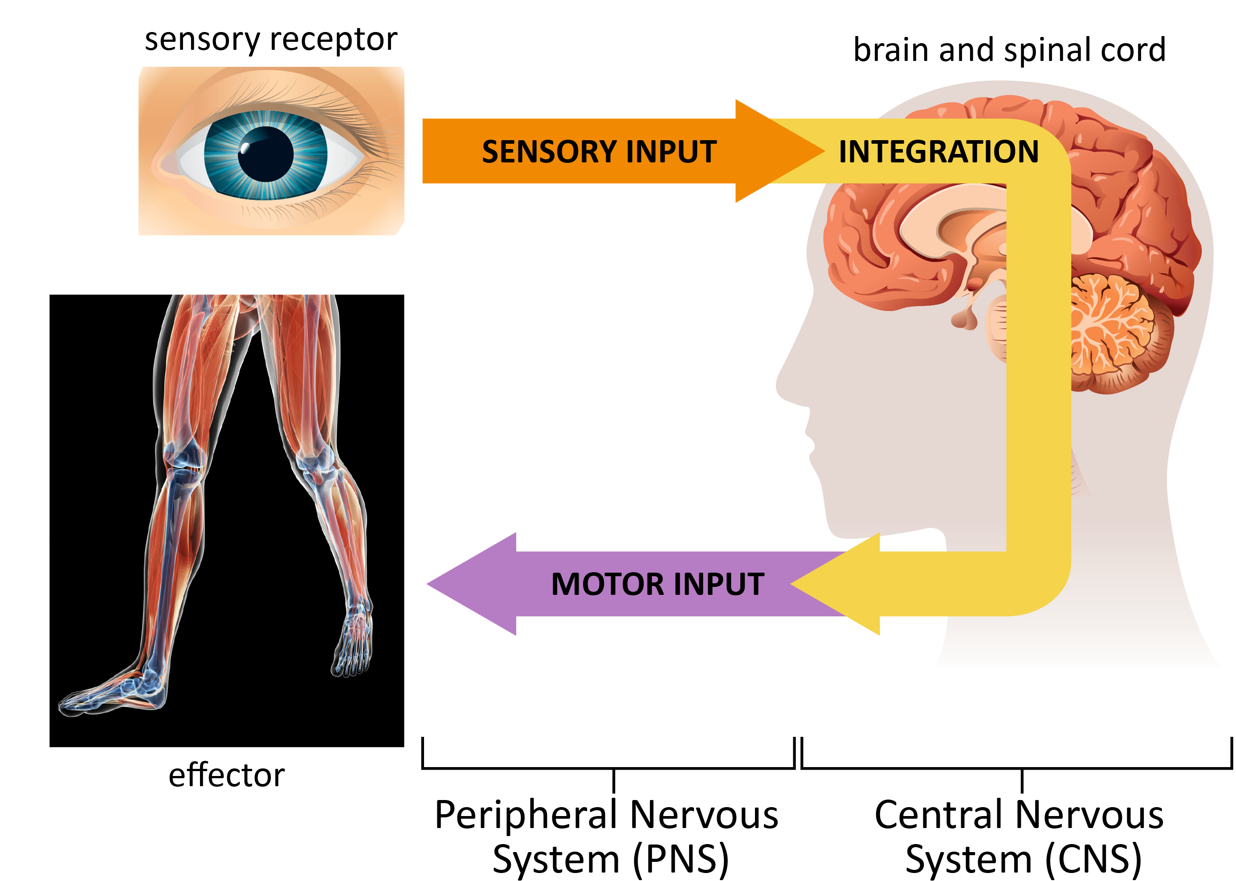
Sensory Nerves versus Motor Nerves

Slide 8
The Neuron
message out
message in

Slide 9
A Neuron Pathway
One nerve attached to another neuron attached to another nerve
neuron 1
neuron 2

Slide 10
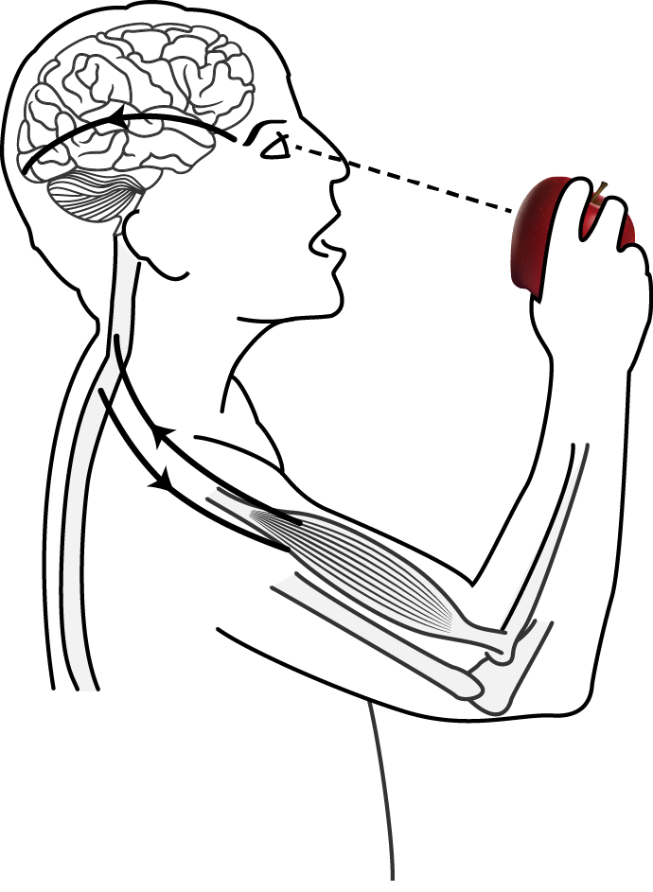
Label the Following
sensory nerve
spinal cord
brain
motor nerve
skin (touch organ)
apple (stimulus)
move apple to mouth (response)
muscle

Slide 11
Write the order of body parts from the time the person sees the apple (stimulus) until the time he moves apple to mouth (response)
.
Possible Order
apple (stimulus)
skin (touch organ)
sensory nerve
spinal cord
brain
spinal cord
motor nerve
muscle
moves apple to mouth (response)

Slide 12
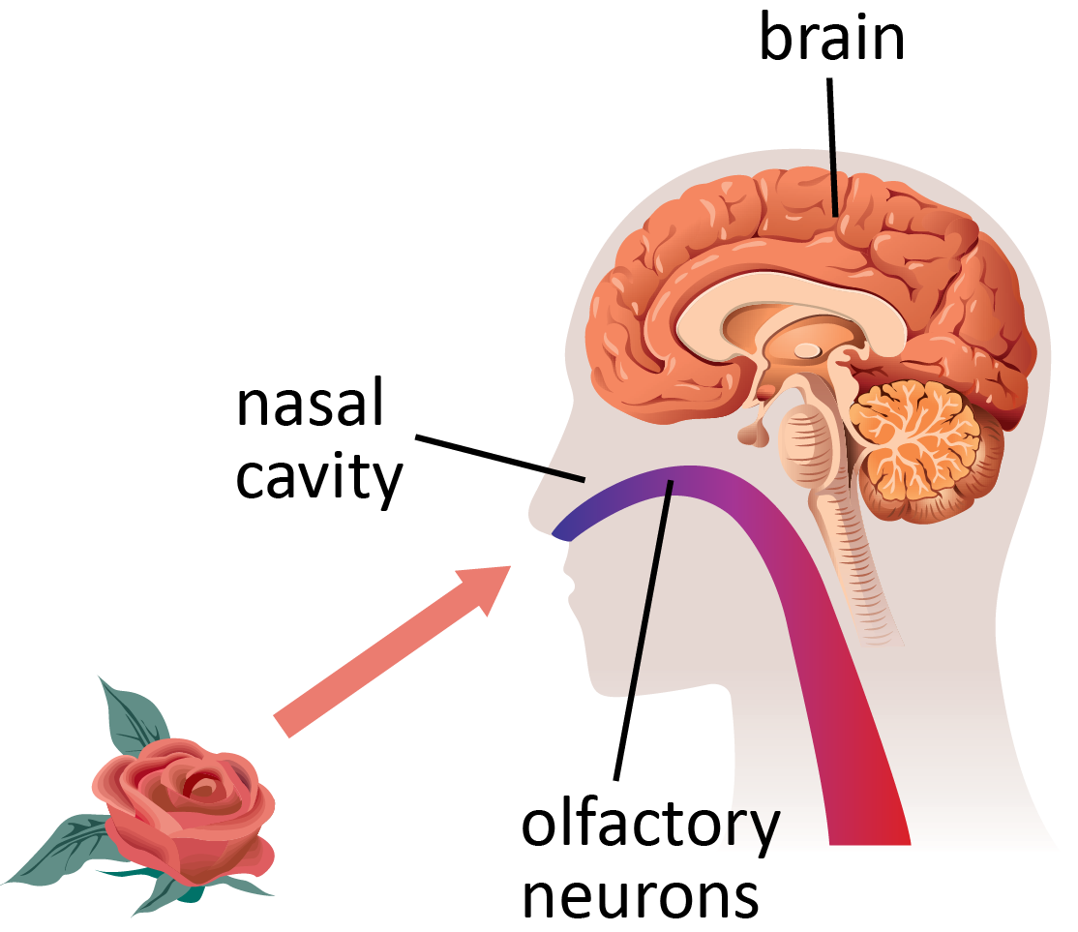
Another Example: Sense of Smell
Stimulus = scent of a rose
Sensory receptors in the nose
detect the stimulus
Nerve carries signal to the brain
Brain processes signal
A memory: “Roses smell sweet.”
A behavior: “I think I’ll smell this rose!”

Slide 13
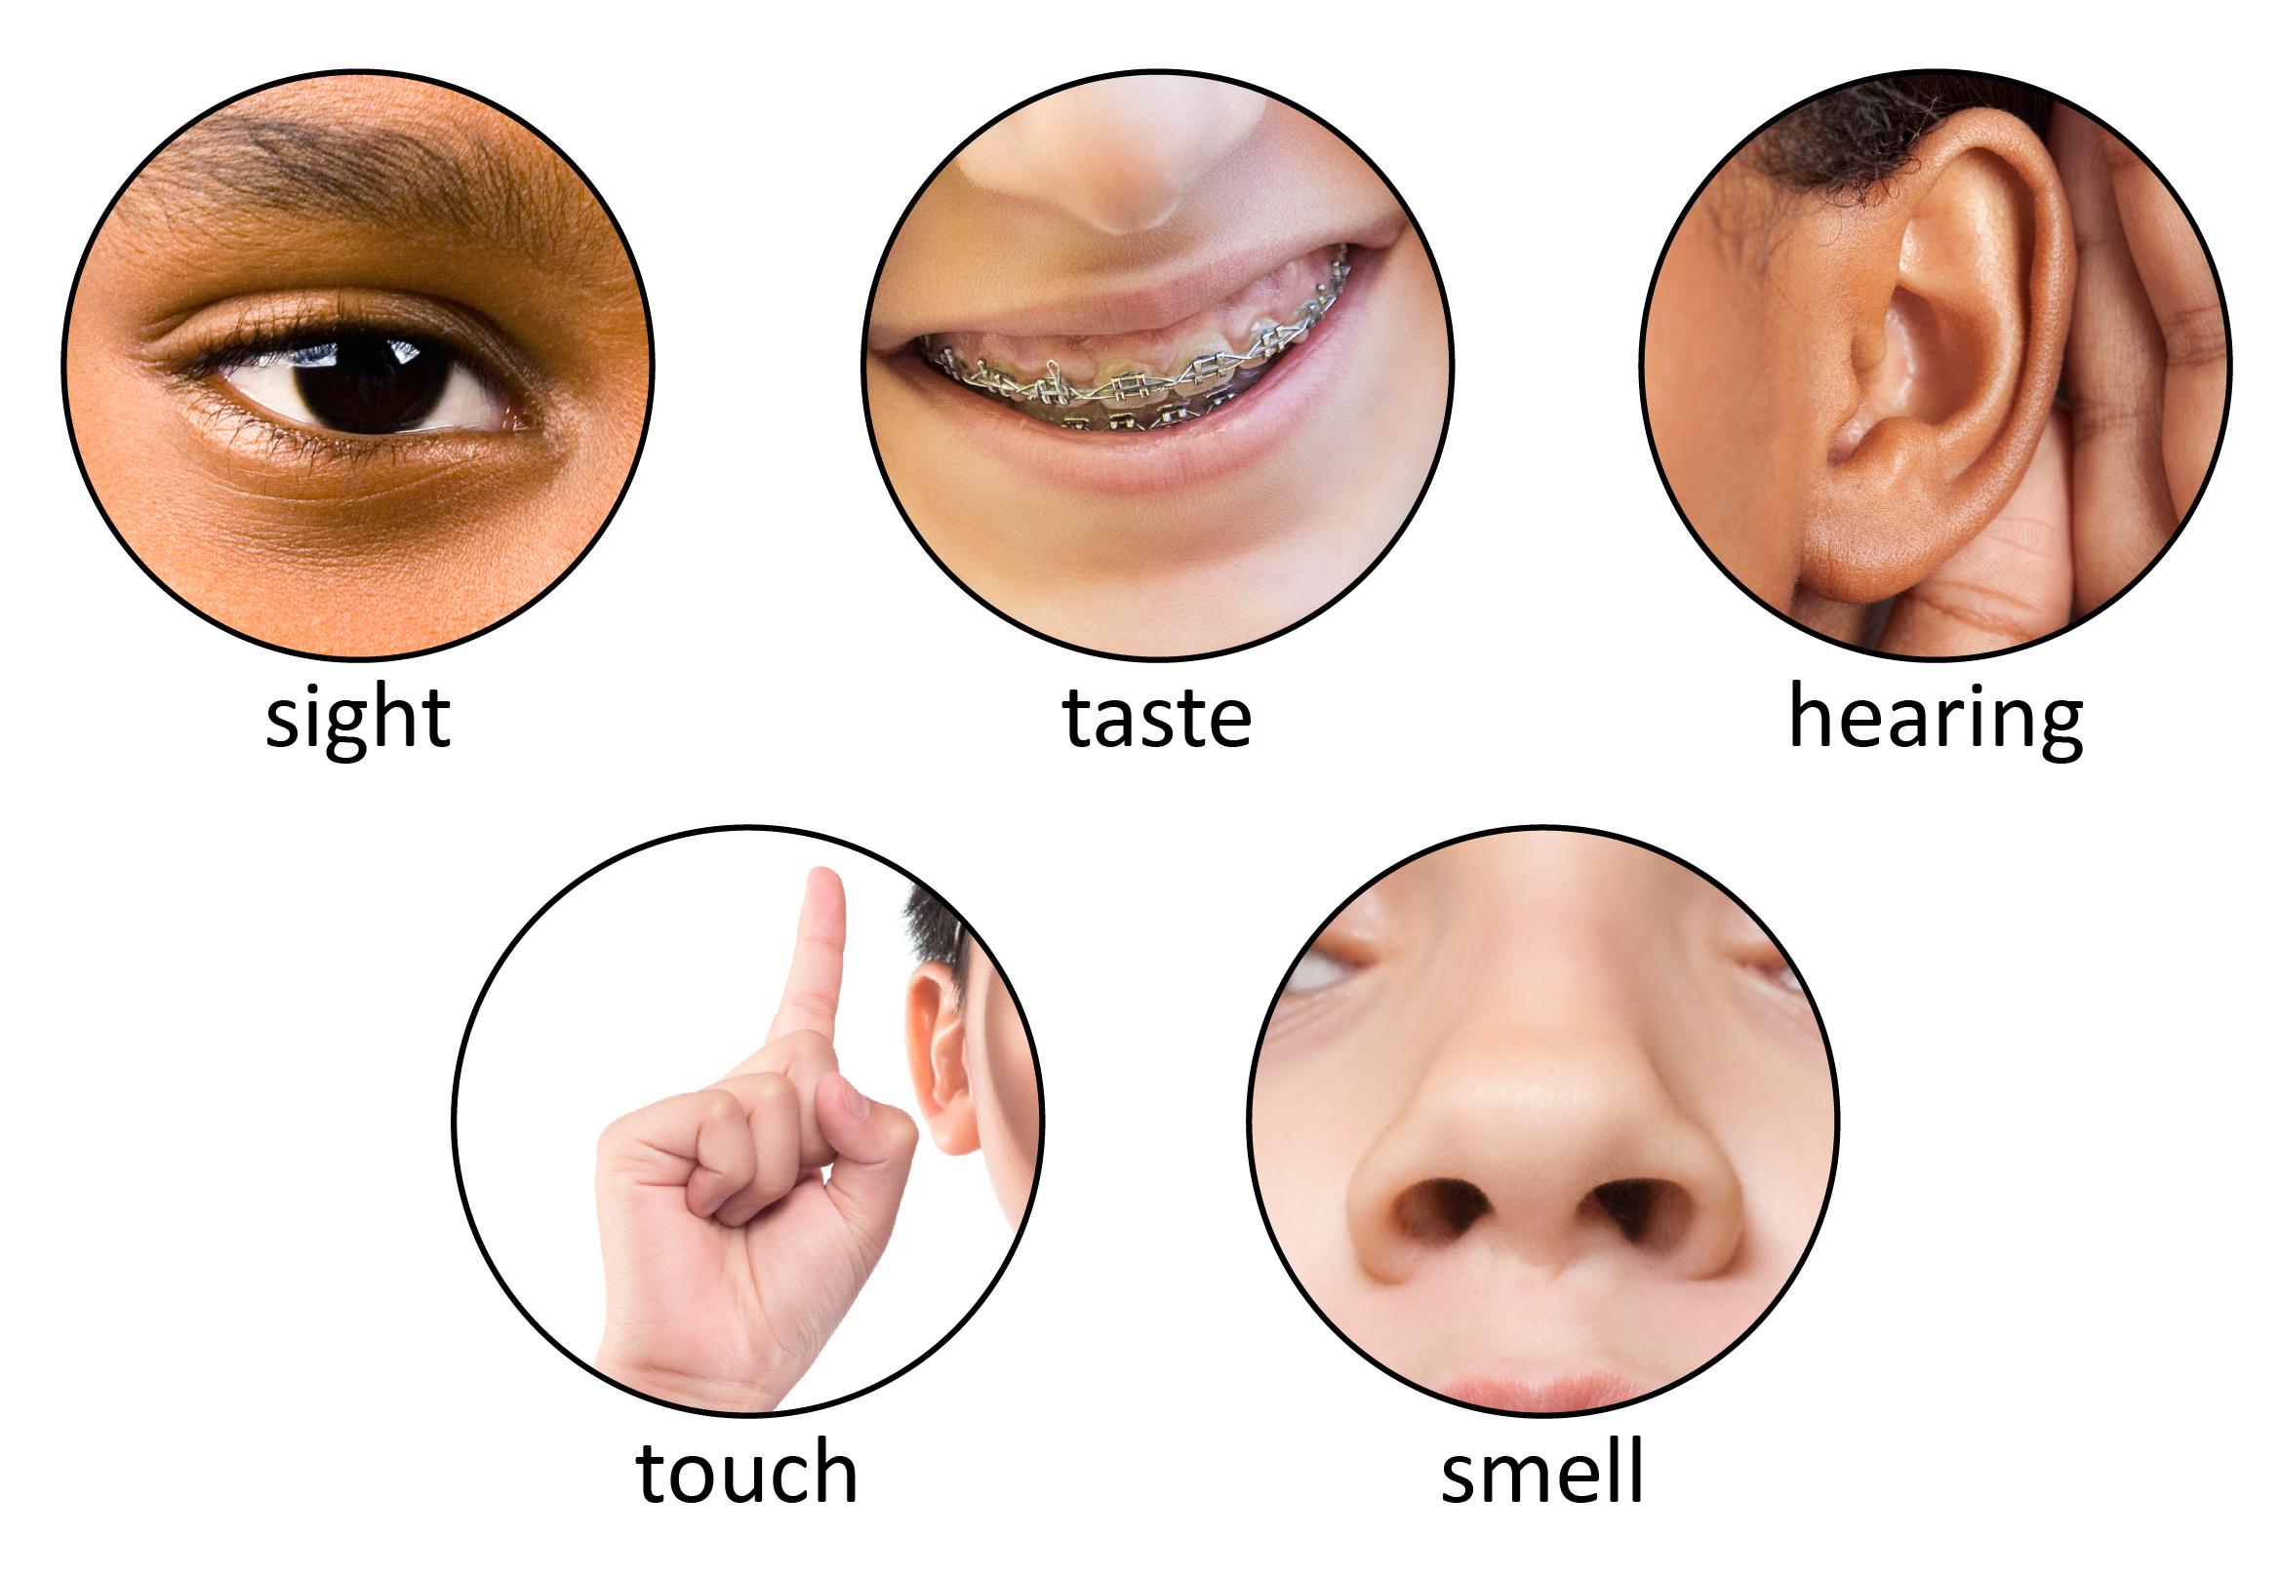
Five Senses

Slide 14
Since we don’t have any computers at our desk, let’s watch a video about all our senses…
Five Senses Human Body Part 1 video link
Five Senses Human Body Part 2 video link

