Slide 2
Your Task
You and your team will design a playground.
You will present your playground and highlight why your playground is fun, safe, and promotes fitness.
Playground Requirements
Playground systems, features, and activities fit within the designated play area.
The design includes activities students say are “fun.”
The playground includes activities that promote fitness.
It meets the ground-cover guidelines for safety.

Slide 3
Playground Equipment
Describe playground equipment or features that you have seen before.
What do you think is the difference between an individual feature and a playground system?

Slide 4
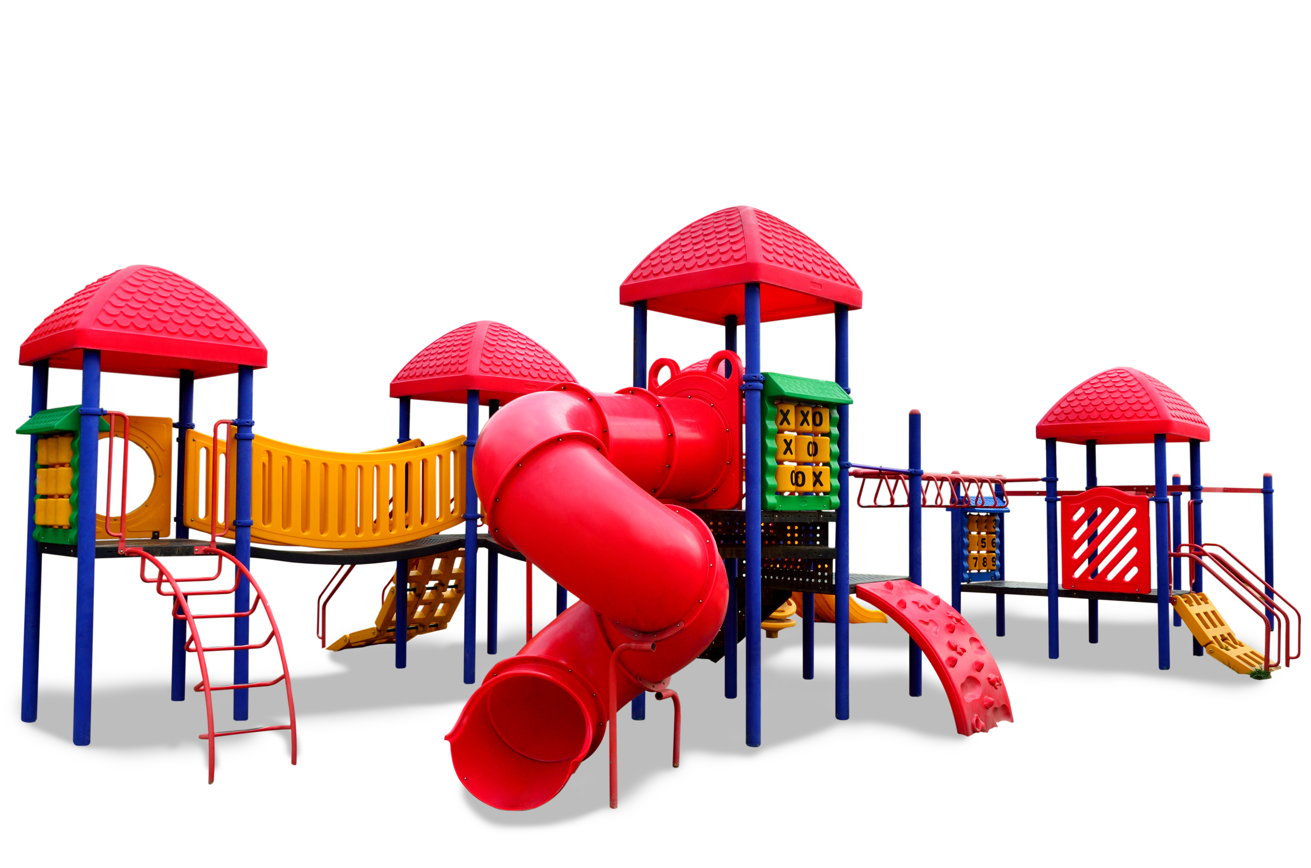
Playground System
Describe this structure.
What do you think makes this a system rather than an individual feature?

Slide 5
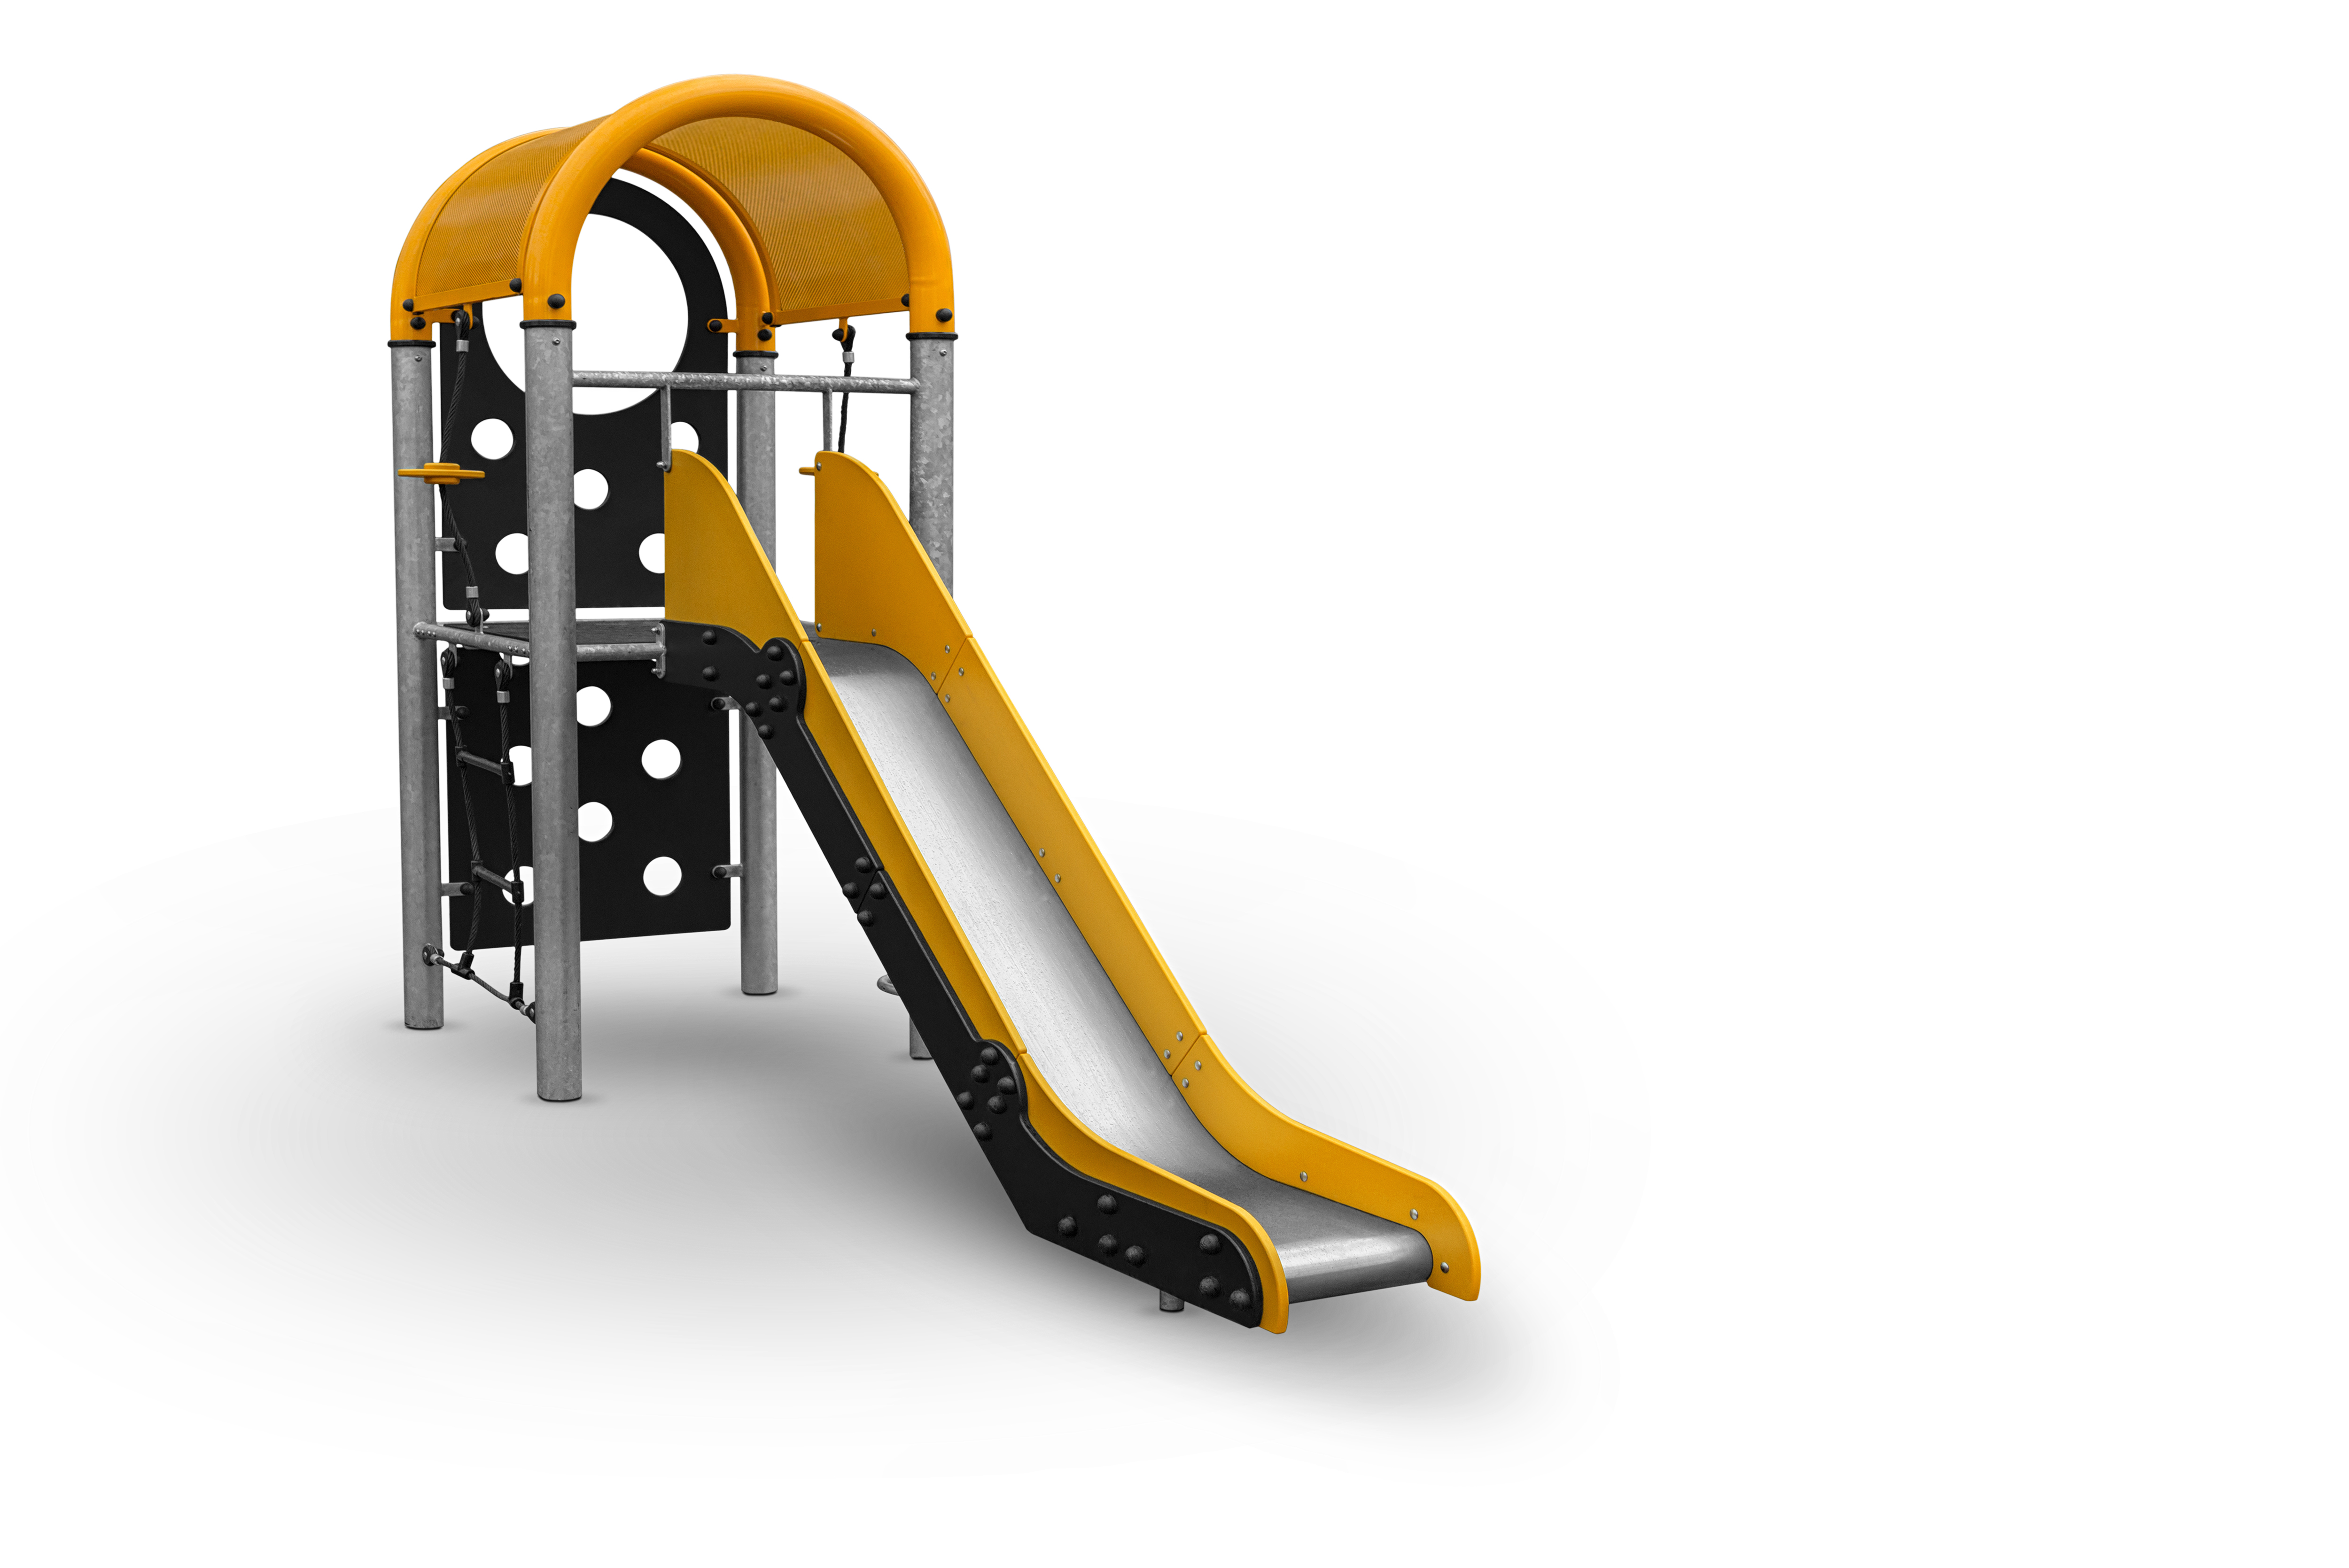
Individual Feature
Describe this structure.
What do you think makes this an individual feature rather than a system?

Slide 6
Considerations for Your Team
Your ideal playground must include at least one of each:
A playground system
An individual feature (stand-alone slide, swings, sandbox, etc.)
An activity (tennis, basketball, soccer, horseshoes, etc.)
How might you decide what to include in your playground?
Can you think of anything that may limit your choices?

Slide 7
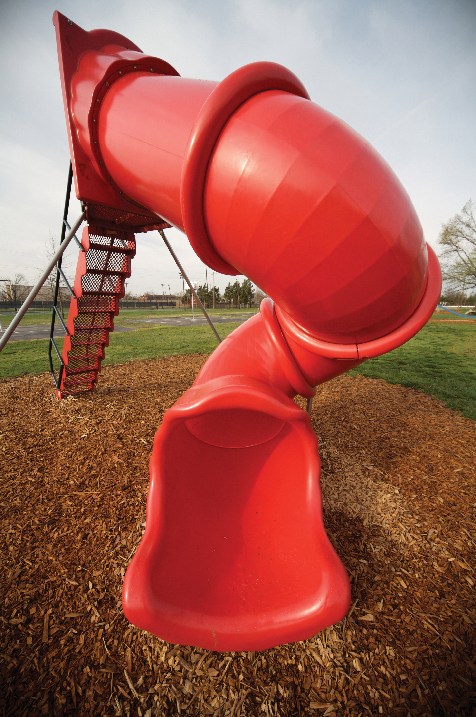
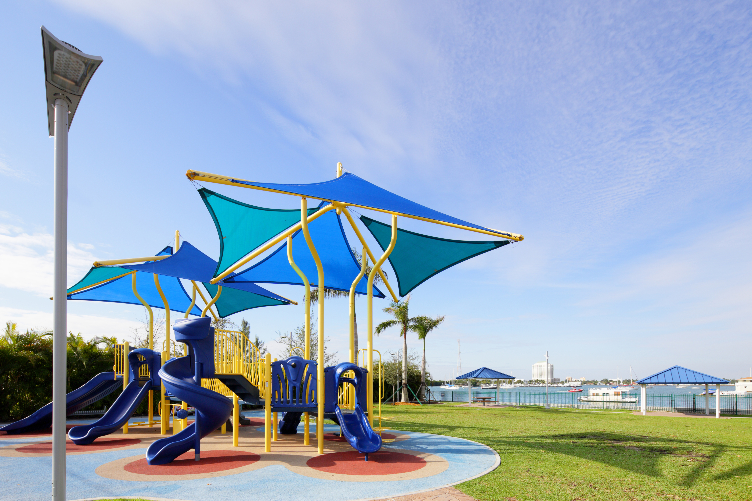
Use Zone
Playground systems, individual features, and activities have a “use zone.”
Examine both pictures.
What do you think is the use zone?
Use Zones
Use zones include the area under and around the equipment.
This area must be clear of all obstacles and have soft landing material to protect from falls.

Slide 8
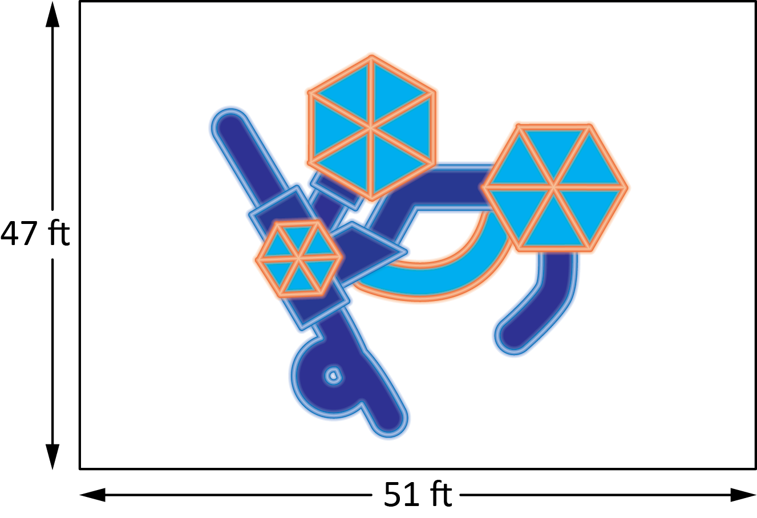
Area of Use Zone
This is a top view of a system.
What is the general shape of the use zone for this system?
What is the area of the use zone for this playground system?
Explain your process for determing the area.

Slide 9
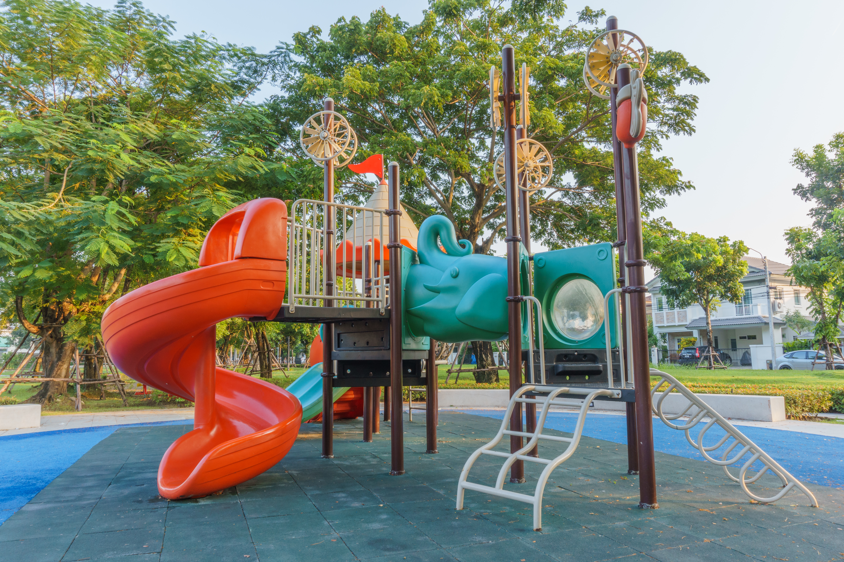
Critical Information for Each System and Feature
What does all this mean?
Voltage
3D-1811
Ages: 5–12
Capacity: 47
Use Zone: 36′ x 26′
Fall Height: 96″
Approximate List Price: $22,600

Slide 10
Critical Information: Name and Model Number
Carefully record the name and model number or web page for each item you want to consider using in your playground.
Voltage
3D-1811
Ages: 5–12
Capacity: 47
Use Zone: 36′ x 26′
Fall Height: 96″
Approximate List Price: $22,600

Slide 11
Critical Information: Ages
Voltage
3D-1811
Ages: 5–12
Capacity: 47
Use Zone: 36′ x 26′
Fall Height: 96″
Approximate List Price: $22,600
Provide the age range suggested for this playground item.

Slide 12
Critical Information: Capacity
Capacity is the number of people that can be on this item at one time.
How might the capacity of a playground item affect your decisions as you plan your playground?
Voltage
3D-1811
Ages: 5–12
Capacity: 47
Use Zone: 36′ x 26′
Fall Height: 96″
Approximate List Price: $22,600

Slide 13
Critical Information: Use Zone
Use zone is the rectangular space around this item that is required for students to play on.
What does 36′ x 26′ mean?
What is the area of this use zone?
Voltage
3D-1811
Ages: 5–12
Capacity: 47
Use Zone: 36′ x 26′
Fall Height: 96″
Approximate List Price: $22,600

Slide 14
Critical Information: Fall Height
Fall height is the greatest distance a student could possibly fall if they were to fall off this equipment.
What does 96′′ mean?
Why do you think the fall height is important?
Voltage
3D-1811
Ages: 5–12
Capacity: 47
Use Zone: 36′ x 26′
Fall Height: 96″
Approximate List Price: $22,600

Slide 15
Critical Information: Price
Voltage
3D-1811
Ages: 5–12
Capacity: 47
Use Zone: 36′ x 26′
Fall Height: 96″
Approximate List Price: $22,600
Price is the cost to purchase this item.
What is the price for this system?

Slide 16
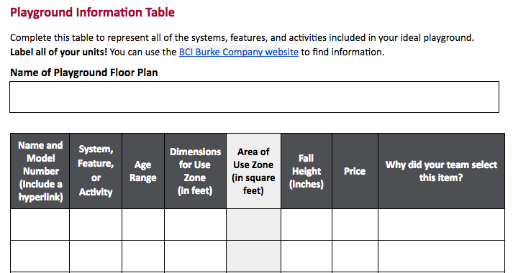
Organizing and Recording Critical Information
Each team will use the Playground Information Table to record and organize the critical information.
Examine the table.
What information is provided from our example?
Voltage
3D-1811
Ages: 5–12
Capacity: 47
Use Zone: 36′ x 26′
Fall Height: 96″
Approximate List Price: $22,600
STUDENT EDITION
Which columns require your team to complete a calculation or make a decision?

Slide 17
Consider Your Team Roles as You Make Decisions
Budget Specialist
Why should we choose one material or piece of equipment over another?
How much does that material or equipment cost?
Public Interest Specialist
Is this equipment or activity fun?
Does it promote safety?
Does it promote fitness?
Environmental Area Specialist
How much space will this item use within our playground?
Is there another item we could use that takes up less space but is just as fun, safe, or fitness promoting?
Safety Specialist
What is the fall height for every item we select?
What is the use zone for every item we want to include in the playground?

Slide 18
Goals for Remainder of Class
Research and review playground systems, individual features, and activities.
Discuss each item you want to include in your playground system.
As your team makes decisions, record the model number and other information in your Playground Information Table so you can find your choice again when you visit the website in the future.

