Slide 1
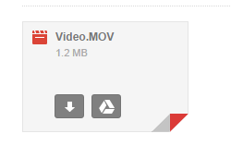
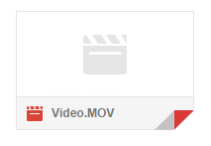
Uploading your GS Video
Your Video needs to Be IN your Google Drive
Your video should be in your email...
Click Here!
When you scroll over ...

Slide 2
Uploading your Video
Now in your Drive, rename your file:
Then Here!
There is an option called “Rename”
Click Here!

Slide 3
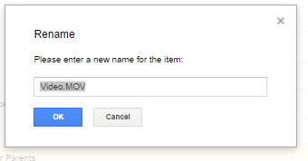
Name your Video
Follow the guideline provided below to name your video:
GS - First name last initial - Topic

Slide 4
Create an account on desmos.com
Go to desmos.com
Click “Launch Calculator”

Slide 5
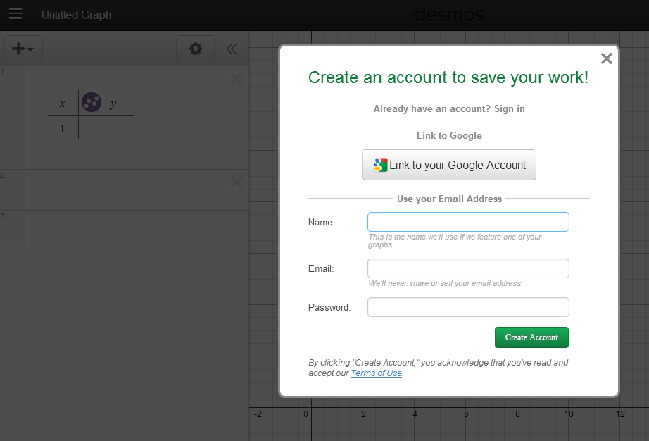
Create an account on desmos.com
Click Here!
Then Here!

Slide 6
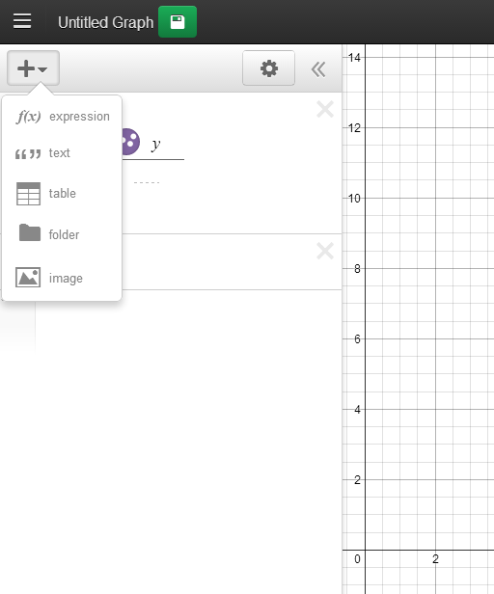
desmos.com
Click Here!
Then Here!

Slide 7
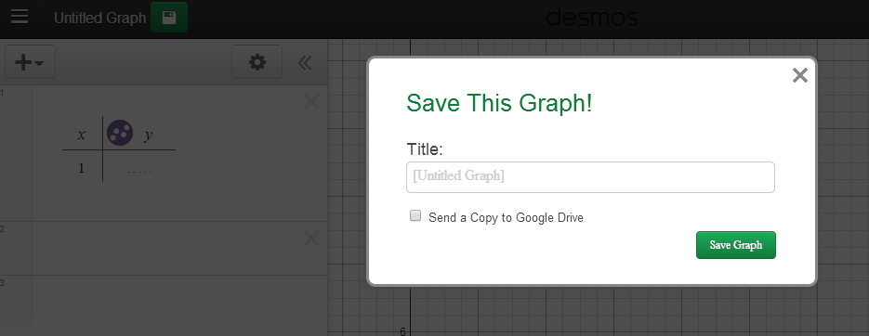
Name your desmos.com file
Click Here!
GS - First name last initial - Topic
Then Here!

Slide 8
For Next class (Next Monday or Tuesday):
#1 Analyze your video (which has been uploaded into drive or you tube)
Create a table of values for your variable over time.
#2 Enter those values into the table on desmos
You will need your completed table in desmos for our next class!

