Slide 1
Graphing Stories
Relay Races & Acting

Slide 2
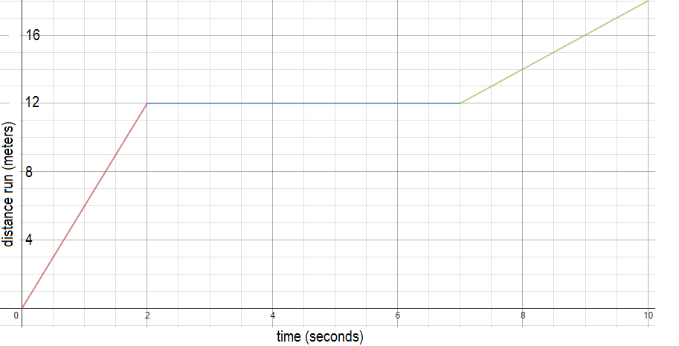
Warm-Up:
Write a 1-2 sentence description of the situation that is graphed below.

Slide 3
Today’s Objectives
continue sharpening our graphing skills
practice interpreting graphs and acting them out
reflect on our progress

Slide 4
Math Race Activity
groups of 5-6 (join with 1 other group)
roles:
3 runners (including at least 1 who can do pushups)
1 timer (needs to be exact!)
1 facilitator (keeps the task cards / organizes the team)
the goal: graph each runner’s distance from the starting point over time.
please stay with your group!
Notes:
photocopy task cards; graph cards for each group

Slide 5
Graphing the Races
Use your group’s data to graph each race.
→ No headphones during this time.
When done, discuss:
Which graph was easiest to make? Which graph was hardest? Why?
Why is it important to have the correct times recorded? How did your group do at this?

Slide 6
In Class Break
In class break!
Suggestion: Tell someone near you what you did this weekend.

Slide 7
Acting Out the Graphs
We’ve done a lot with graphing from real-world situations. Now let’s try to go back the other way - to act out a graph that we DON’T know what the situation is!
each graph has the x-axis labeled.
the y-axis is up to you! What process could be represented by this graph?

Slide 8
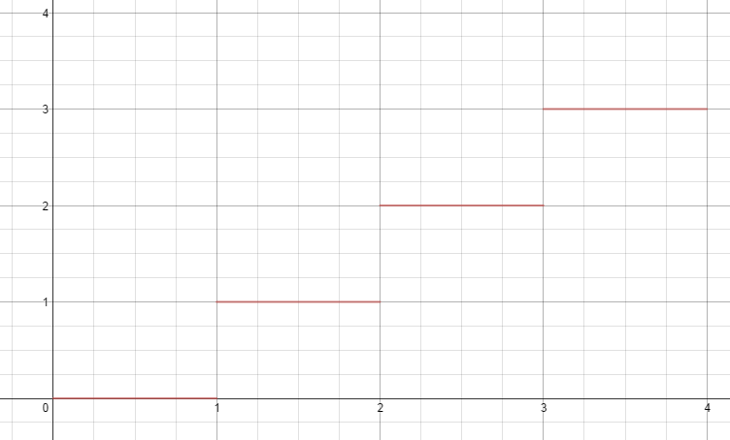
Model:
“step function”
→ grows by 1 each second.
→ not continuous.
time (seconds)

Slide 9
Your Turn
Each group will receive 3 graphs.
Decide what each graph could represent
Prepare a 1-minute skit for each graph
Your group will perform ONE of these skits for the class (randomly selected, so be ready!)
Each group member must participate :) - let’s leave no one behind!

Slide 10
Graphing Stories: HOMEWORK
For our final project, we’ll be making 15-second videos. For HOMEWORK,
make your 15-second video at home or school before Wednesday’s class
come prepared to email your video to upload
→ If you need help: tech experts
→ Reminder of what you signed up for: tinyurl.com/GSsignups

Slide 11
Reflection
How confident do you feel about graphing real-world situations? (individually)
How prepared do you feel to make your own Graphing Story?
How do you feel our class is doing so far on the norms?
leave no one behind
one voice / follow directions

