Slide 1
To make our Infographics,
we will be using a site called Piktochart.

Slide 2
Go to Piktochart.com
Then Click Here!

Slide 3
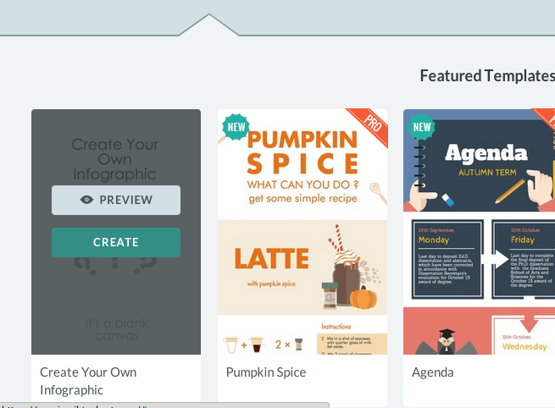
Click Here!
Then Click Here! (this in the lower left corner of the page)

Slide 4
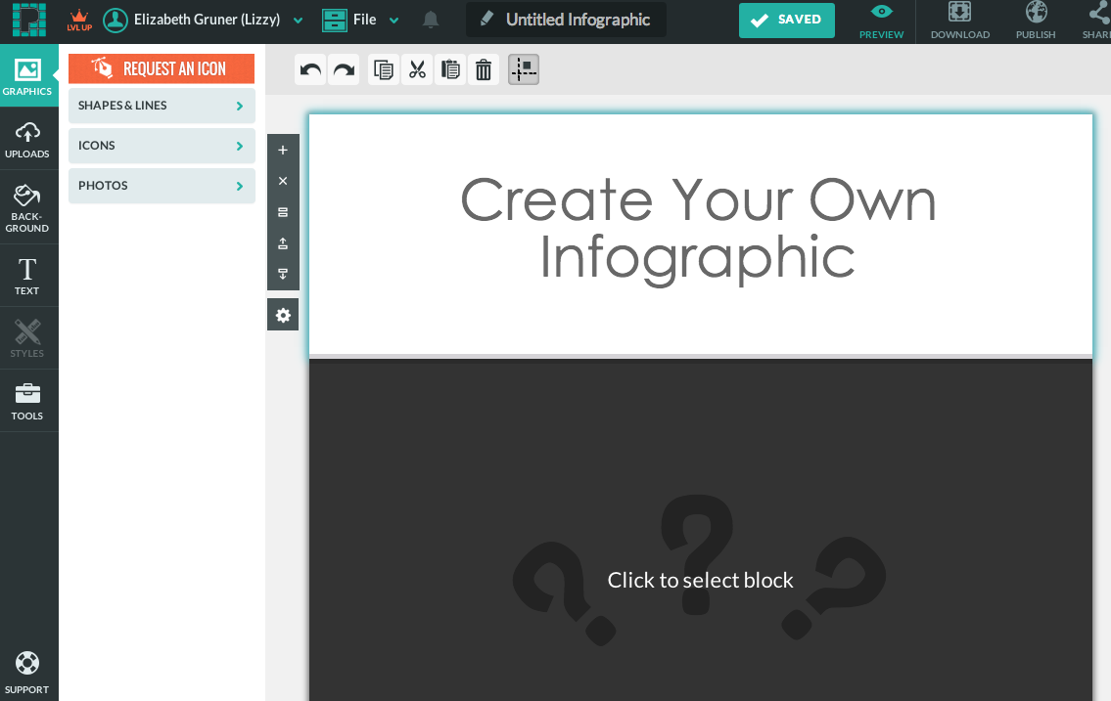
Then Click Here!
Click Here! (to select this block)

Slide 5
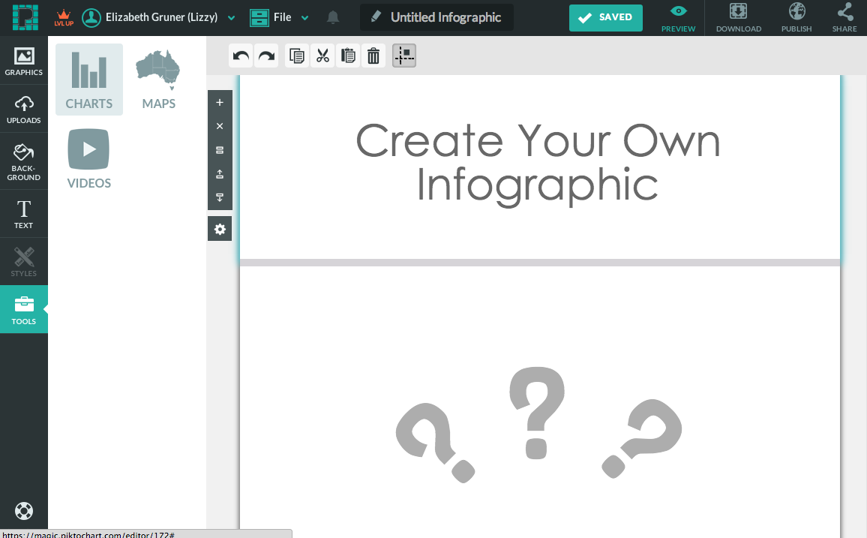
Insert some charts by clicking here!

Slide 6
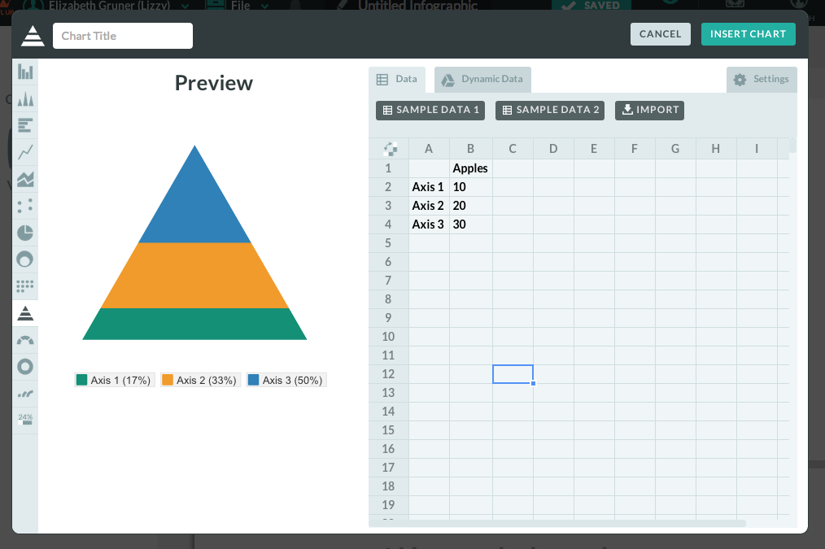
Look at all the options you have for graph types!

Slide 7
Copy & Paste the Data you want to Represent here

Slide 8
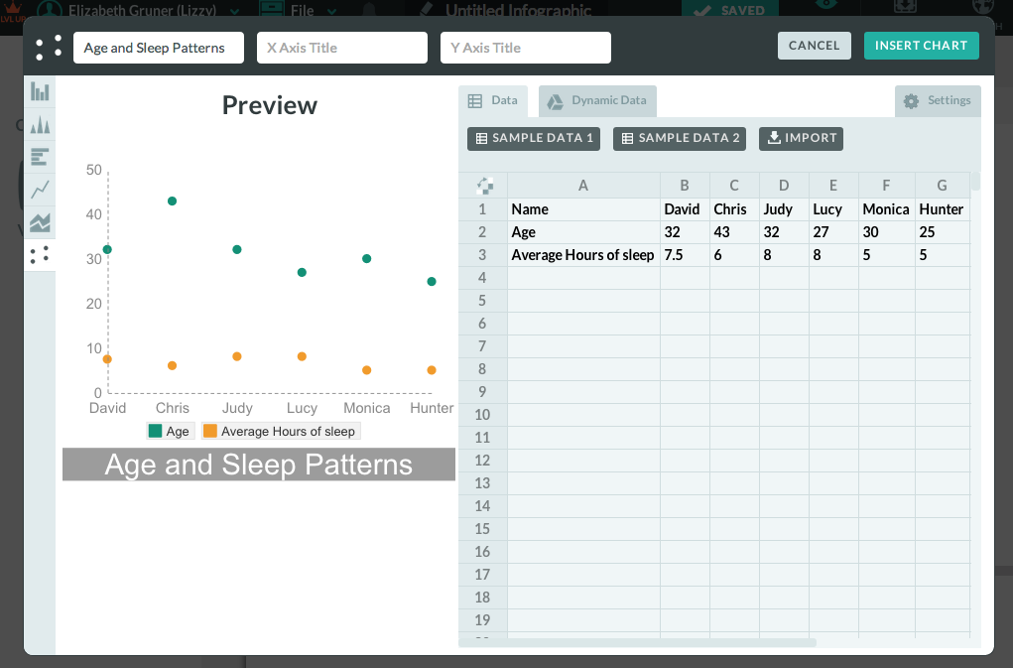
Then Click Here!
Don’t forget a chart title!

Slide 9
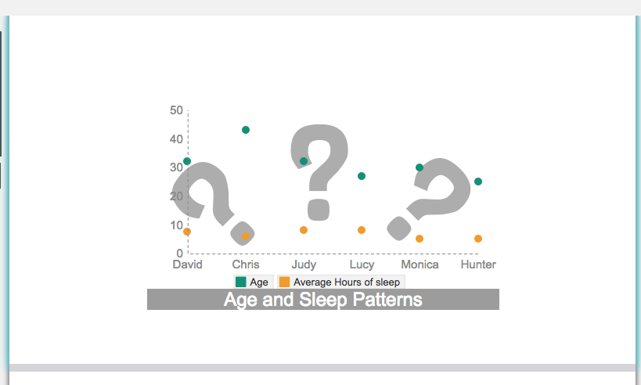
Hooray! You finished one of your graphs! Now go back and make the other ones you need for your Infographic.
Think those ??? look silly? Delete them!
You might also want to select other blocks to spread out your information

