Slide 1
Graphing Stories
Mad Scientist / Brainstorming

Slide 2
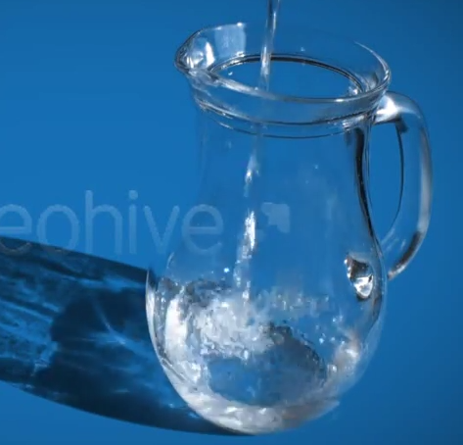
Warm-Up
Watch the following video:
http://tinyurl.com/omkm7du
What could be the independent and dependent variables in this situation?

Slide 3
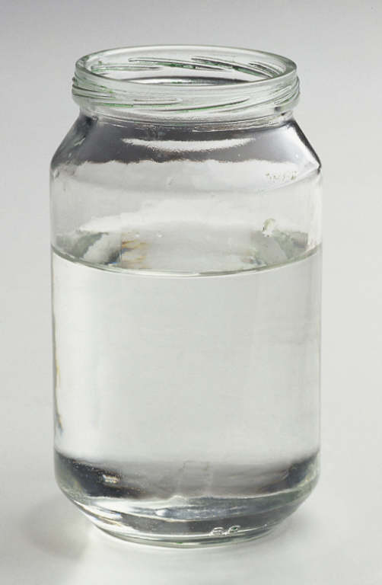
Objectives
practice graphing real-world situations!
choose your topic for your own Graphing Story
Notes:
Just read these

Slide 4
Pouring Water Demo (3 trials)
Watch as water is poured into the jar. Be prepared to sketch a graph that matches!
→ Label the x- and y-axis with the correct variables
→ Plot the start and end points
→ What’s happening in between? Draw the line or curve.

Slide 5
“Mad Scientist”
Head over to:
student.desmos.com
and use the class code rywz
You can play all you want! But please make your final graph your BEST work :)

Slide 6
Brainstorm: Graphing Stories
Remember, for this project, you will be creating your own 15-second “Graphing Story” of a process changing over time.
→ Check out some examples at graphingstories.com
→ Brainstorm with your group
→ Be prepared to write your idea on a Post-it and turn it in at the end of class!

Slide 7
Reflection:
Write your answers to the following questions on a piece of paper:
1) What’s one big takeaway from today? (something you learned)
2) How did we do on the norms?
one voice / follow directions
leave no one behind
everyone grows every day
be respectful

