Slide 1
Graphing Stories
Day 2: Carnival of Graphing / Independent & Dependent Variables

Slide 2
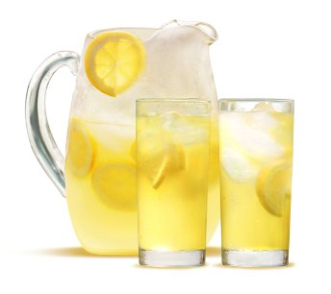
Warm-Up
Please complete the Google form warmup at tinyurl.com/92warmup

Slide 3
Today’s objectives
understand what variables are, and what it means for them to be independent or dependent
practice naming variables and labeling axes
complete the Function Carnival activity
reflect on our progress from today

Slide 4
Today’s Key Terms
variable
independent variable
dependent variable
Notes:
Write the terms on the board (mimicking the graphic organizer that kids will see in a second). → Talk about them first! (But don’t write anything yet)

Slide 5
Today’s Key Terms
variable - a quantity whose value can change. In algebra, variables are often represented by letters.
independent variable - a quantity whose value is not affected by any other variables in the situation; the quantity whose value the experimenter can control; the “cause” variable. Represented on the x-axis.
dependent variable - a quantity whose value depends on other factors; the “effect” variable. Represented on the y-axis.
Notes:
Put examples on the board (e.g. time spent studying affecting score on test). Also note: “8 hours of sleep” is NOT a variable (because its quantity can’t change) but “number of hours of sleep” is a variable because different people get different amounts of sleep.

Slide 6
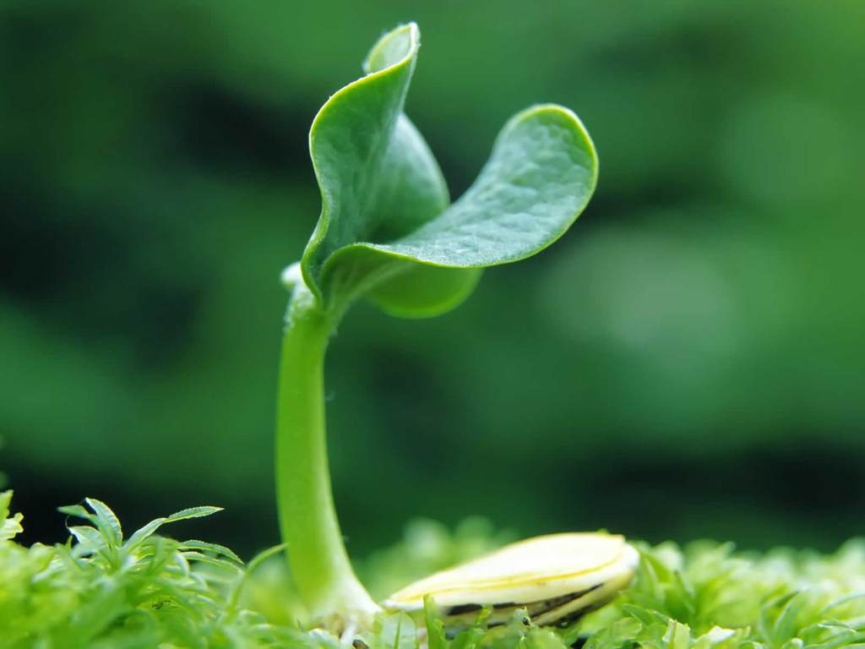
Example (I do)
A researcher is studying the amount of growth of plants relative to how many hours of sunlight the plants receive each day.
What’s the independent variable?
What’s the dependent variable?
How should I label the axes?

Slide 7
Example (We do)
A researcher wants to do a study how the number of hours of sleep affects a person’s score on an attention test.
What are the variables?
Which one is independent and which is dependent?
How would you label the axes?

Slide 8
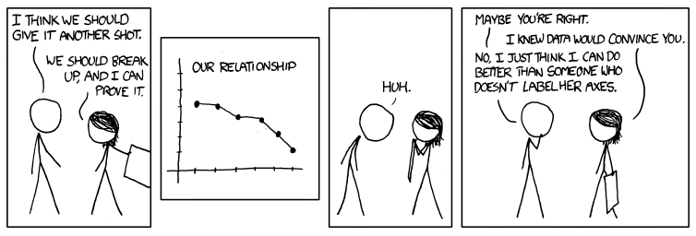
Labeling Axes is Important!!!
XKCD #833 by Randall Munroe

Slide 9
Group Practice Time!
Go to http://tinyurl.com/92variables to practice identifying the dependent and independent variables.
When you finish, move on to http://tinyurl.com/92axes for practice labeling your axes.
Talk to your group :)

Slide 10
Break
3-minute in class break!
Suggestion: Stand up, stretch, and high-five someone across the room from you

Slide 11
Group Activity
Head over to student.desmos.com.
Class code: vypd
Check out the demo with me, then go wild!!!
NOTE: pay attention to the independent and dependent variables! They can help you graph correctly :)
Notes:
Here I’ll demo the first few slides of the walkthrough, until kids get the interface. Watch the animation of the cannonball man, then on the next slide, point out the functionality I can do (try making a curve first, then play the video so kids see what it looks like with the 2 superimposed → then, show them that we can pause and put points at given places to get a more accurate graph! THEN, turn them loose on each one. ALSO, remind them of the independent and dependent variables concept!
I also plan to show students a few example graphs (with permission of the creators) so we can talk through them. realtime feedback I think is possible on the Desmos website, so I can also follow up with students as they’re creating their graph. → after hours reflection: It was very difficult to find time to put graphs up on the board. In retrospect, I would make the earlier parts of the lesson much shorter if possible, so kids could take more time on this and we could actually see graphs of other students. Might be most helpful to have students work in groups and view each other’s graphs that way, rather than on the white board.

Slide 12
Knowledge Mastery: Reflection
What ride was easiest to graph? Why was it easy?
What ride was the most difficult to graph? Why was it difficult?
What common mistakes did you notice on other people’s graphs?
What feedback from peers was helpful?
What advice would you give to people who do this in the future?

Slide 13
Reflection
In your group: What was one big takeaway for you from today’s lesson? (i.e. something you learned)
Whole class: How did we do on the norms?
one voice / follow directions
leave no Bulldog behind
Notes:
* Might also be nice to do a “post” reflection on how confident students feel about the independent/dependent variables after the lesson! Do this instead of the labeling your axes part?

