Slide 1
Graphing Stories
Day 1: Movie, Intro, Pictionary

Slide 2
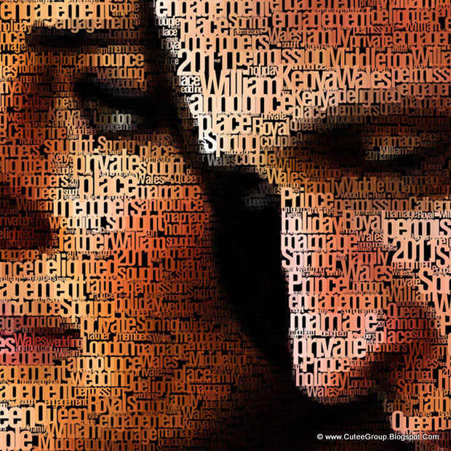
Warm-Up
Quickwrite: What do you think people mean when they say “A picture is worth a thousand words?” Do you agree with this statement?

Slide 3
Today’s Objectives
describe a real-world situation using math
understand what modeling with math means and why it’s useful
get an overview of the Graphing Stories project
begin sharpening our graphing and communication skills

Slide 4
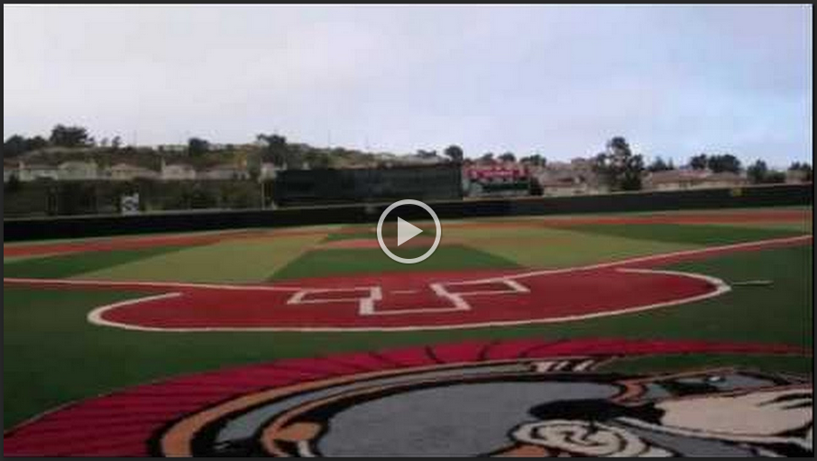
Watch the 15-Second Video:

Slide 5
This time, watch for quantities we could measure:
Notes:
Students watch for quantities; we make a list on the board of quantities we could measure. We try to refine the list: which quantities change over time? Which do not? Of those that change, which change smoothly? Which in a stepwise fashion?

Slide 6
Now, notice his distance from the pitcher’s mound:
Notes:
We notice, then try to describe using words - is this quantity changing? How is it changing? What is the starting distance? What’s the ending distance? etc.

Slide 7
We’ve reached the limit of words to describe! Let’s turn to math :)
On your paper, please sketch a graph of Mr. Miller’s distance from the pitcher’s mound throughout his run.
1) decide which quantities are of interest
2) label your axes (which quantity do you think belongs on the x-axis? on the y-axis?)
3) scale your axes
4) sketch your graph

Slide 8
As you go...
do your best to make a graph that accurately describes the situation
BUT, your graph doesn’t have to be mathematically perfect (that’s why it’s called a sketch)
we will share our graphs with our group and have a chance to refine them

Slide 9
Let’s view some graphs!
What’s good about each one?
Did your own graph look similar to each example? Why or why not?
Notes:
Here I think I’ll select a few (perhaps 1 per group / perhaps less than that) and ask students if I can show their work to the class because of [specific good thing] about their graph that I want everyone to see. IN CLASS BREAK AFTER THIS

Slide 10
Models, models, models...
What are some examples of models? (non-math context)
Why do people use models? (non-math context)
What are some examples of mathematical models?
Why do people use mathematical models?

Slide 11
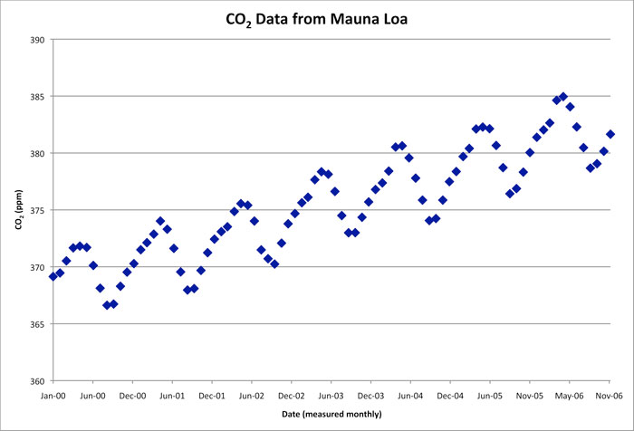
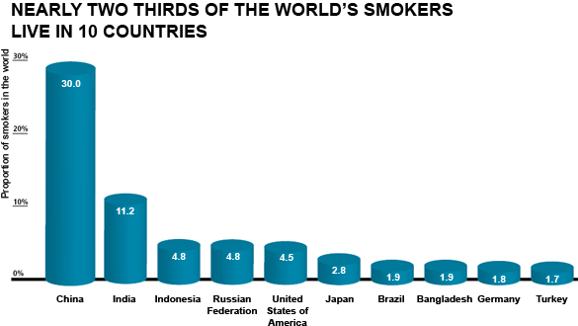
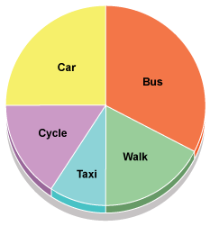
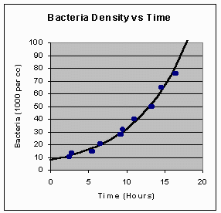
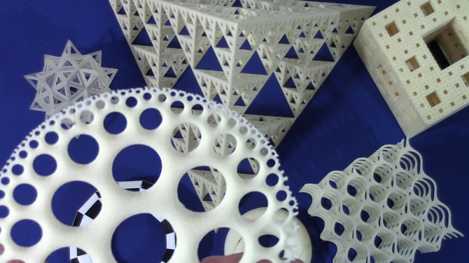
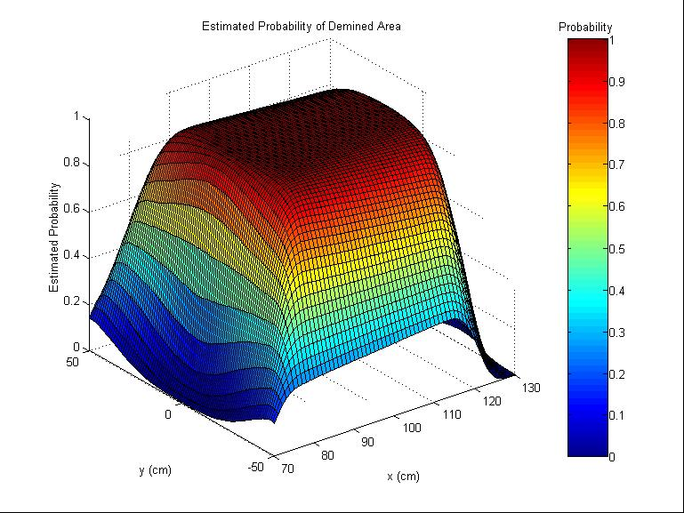
Examples of mathematical models

Slide 12
What’s the connection?
In this project, you will be creating your own “graphing story” - a 15-second video that shows a quantity changing over time. You’ll also create a graph and explanation to go with it.

Slide 13
Cognitive skills in this project:
Justifying / Constructing an Explanation
Making Connections and Inferences
Modeling
Precision
Your goal throughout the year
is GROWTH in your cognitive skills!
Notes:
I think we’ll just briefly discuss the meaning of each of these skills today. I’ll also point out that we have just talked some about making mathematical models, so they should be primed for what happens next :)

Slide 14
Level 1: Graphing Pictionary
→ Your group is a team.
→ One person in your team must describe the graph, the other two must attempt to draw it on their cards.
→ If a member of your team gets the graph right, you ALL receive a point!
(Each round lasts 1 minute!)

Slide 15
Good job!!!
What strategies worked well for your group?
communication (the “describer”)
drawing (the “grapher”)
What strategies did you try that didn’t work well? How did you communicate as a group to change them?

Slide 16
Group Reflection on the process of class today
What is one big takeaway for you today? (i.e. something you learned!) (group discussion)
How did we do as a class today? (whole class discussion)
“one voice” / “follow directions”
“everyone grows every day”
“leave no Bulldog behind”
Notes:
Katie Goddard is a great resource for this type of reflection; she does these with her students and they are awesome :)

