Slide 1
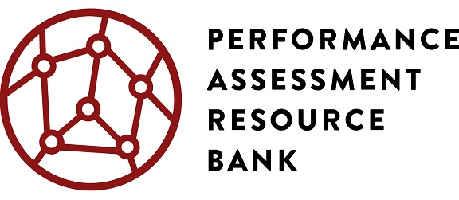
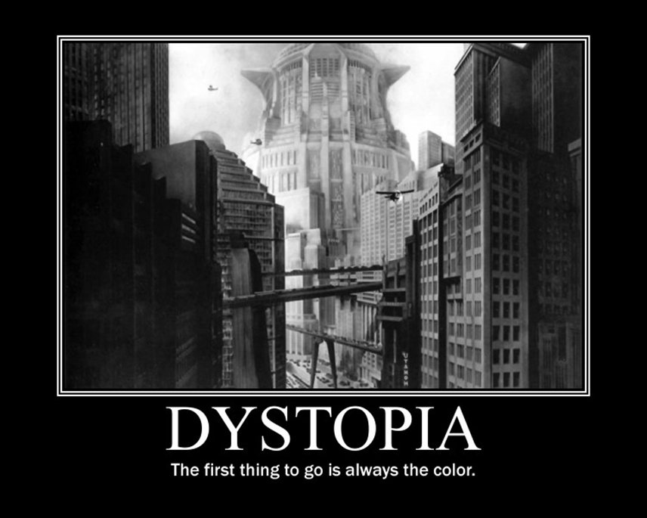
Welcome To Dystopia!
Innovation Lab Network Performance Assessment Project
© 2016 by Summit Public Schools. This work is licensed under a Creative Commons Attribution 4.0 International Public License and should be attributed as follows: “Dystopian Narrative was authored by Summit Public Schools.”

Slide 2
Dystopian Narrative Project
Innovation Lab Network Performance Assessment Project
Final Product: Your own creative written narrative (story) about a dystopian society
© 2016 by Summit Public Schools. This work is licensed under a Creative Commons Attribution 4.0 International Public License and should be attributed as follows: “Dystopian Narrative was authored by Summit Public Schools.”

Slide 3
Our Goal for Today
Innovation Lab Network Performance Assessment Project
Create a shared, working definition of dystopian society
Create a shared, working definition of dystopian story
© 2016 by Summit Public Schools. This work is licensed under a Creative Commons Attribution 4.0 International Public License and should be attributed as follows: “Dystopian Narrative was authored by Summit Public Schools.”

Slide 4
Directions
Innovation Lab Network Performance Assessment Project
Watch a series of film clips about dystopian societies.
Take notes on the elements of the dystopian societies that you observe.
Compare notes and create a definition together.
© 2016 by Summit Public Schools. This work is licensed under a Creative Commons Attribution 4.0 International Public License and should be attributed as follows: “Dystopian Narrative was authored by Summit Public Schools.”

Slide 5
V for Vendetta
Innovation Lab Network Performance Assessment Project
© 2016 by Summit Public Schools. This work is licensed under a Creative Commons Attribution 4.0 International Public License and should be attributed as follows: “Dystopian Narrative was authored by Summit Public Schools.”

Slide 6
Children of Men
Innovation Lab Network Performance Assessment Project
© 2016 by Summit Public Schools. This work is licensed under a Creative Commons Attribution 4.0 International Public License and should be attributed as follows: “Dystopian Narrative was authored by Summit Public Schools.”

Slide 7
The Hunger Games
Innovation Lab Network Performance Assessment Project
© 2016 by Summit Public Schools. This work is licensed under a Creative Commons Attribution 4.0 International Public License and should be attributed as follows: “Dystopian Narrative was authored by Summit Public Schools.”

Slide 8
Divergent
Innovation Lab Network Performance Assessment Project
© 2016 by Summit Public Schools. This work is licensed under a Creative Commons Attribution 4.0 International Public License and should be attributed as follows: “Dystopian Narrative was authored by Summit Public Schools.”

Slide 9
With your small group …
Innovation Lab Network Performance Assessment Project
Compare what you noticed about each film clip.
Create definitions for dystopian society and dystopian story that are as detailed as possible but still include all of the examples you have seen
© 2016 by Summit Public Schools. This work is licensed under a Creative Commons Attribution 4.0 International Public License and should be attributed as follows: “Dystopian Narrative was authored by Summit Public Schools.”

Slide 10
The Group Hopper
Innovation Lab Network Performance Assessment Project
© 2016 by Summit Public Schools. This work is licensed under a Creative Commons Attribution 4.0 International Public License and should be attributed as follows: “Dystopian Narrative was authored by Summit Public Schools.”

Slide 11
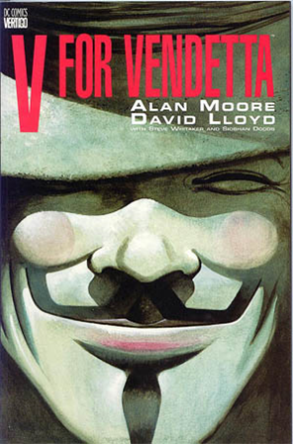
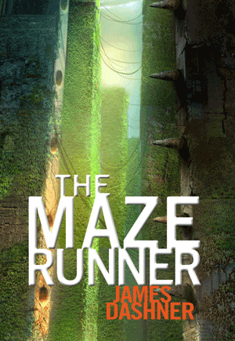
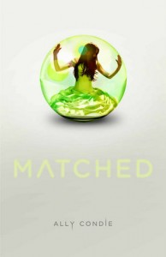
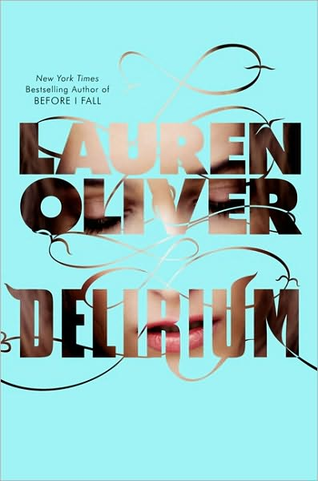
Dystopian Novels are IN!
Innovation Lab Network Performance Assessment Project
© 2016 by Summit Public Schools. This work is licensed under a Creative Commons Attribution 4.0 International Public License and should be attributed as follows: “Dystopian Narrative was authored by Summit Public Schools.”

Slide 12
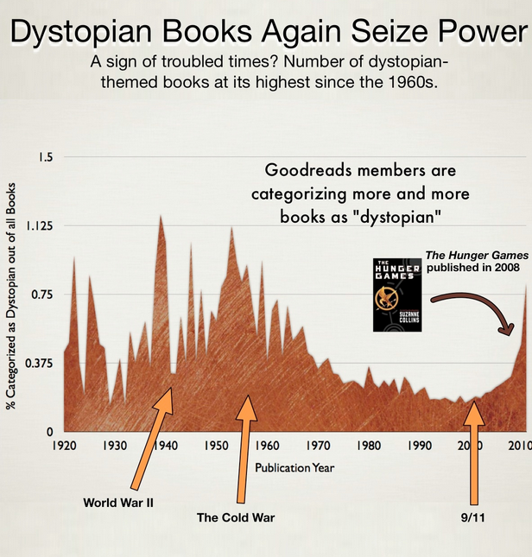
Innovation Lab Network Performance Assessment Project
© 2016 by Summit Public Schools. This work is licensed under a Creative Commons Attribution 4.0 International Public License and should be attributed as follows: “Dystopian Narrative was authored by Summit Public Schools.”

Slide 13
Write-Pair-Share
Innovation Lab Network Performance Assessment Project
When have dystopian stories been most popular? What else was happening in the world at this time?
Why are dystopian stories so popular in the 2010s?
Why is it important for us to read some of the earliest dystopian novels?
© 2016 by Summit Public Schools. This work is licensed under a Creative Commons Attribution 4.0 International Public License and should be attributed as follows: “Dystopian Narrative was authored by Summit Public Schools.”

Slide 14
In a dystopia, you have no choices.
Innovation Lab Network Performance Assessment Project
For this project, you get to choose between THREE novels.
Each novel is awesome in its own way, but it may not be awesome for everybody.
Today: research your options and submit your preferences.
© 2016 by Summit Public Schools. This work is licensed under a Creative Commons Attribution 4.0 International Public License and should be attributed as follows: “Dystopian Narrative was authored by Summit Public Schools.”

Slide 15
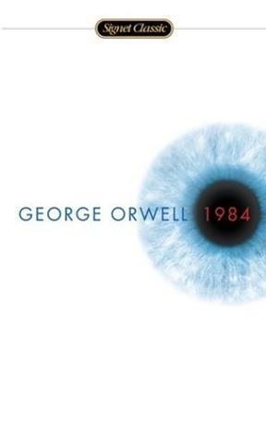
1984, George Orwell
Innovation Lab Network Performance Assessment Project
Background:
Takes place in London in 1984. Involves an oppressive, totalitarian government that spies on its people and rewrites history to fit its own needs.
© 2016 by Summit Public Schools. This work is licensed under a Creative Commons Attribution 4.0 International Public License and should be attributed as follows: “Dystopian Narrative was authored by Summit Public Schools.”

Slide 16
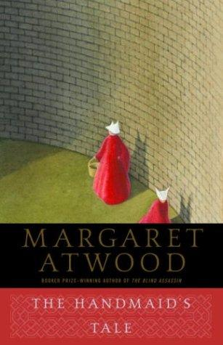
The Handmaid’s Tale, Margaret Atwood
Innovation Lab Network Performance Assessment Project
Background:
Takes place in a future version of the United States now known as the Republic of Gilead. Women have been made second-class citizens, with some (known as handmaids) used only to procreate.
© 2016 by Summit Public Schools. This work is licensed under a Creative Commons Attribution 4.0 International Public License and should be attributed as follows: “Dystopian Narrative was authored by Summit Public Schools.”

Slide 17
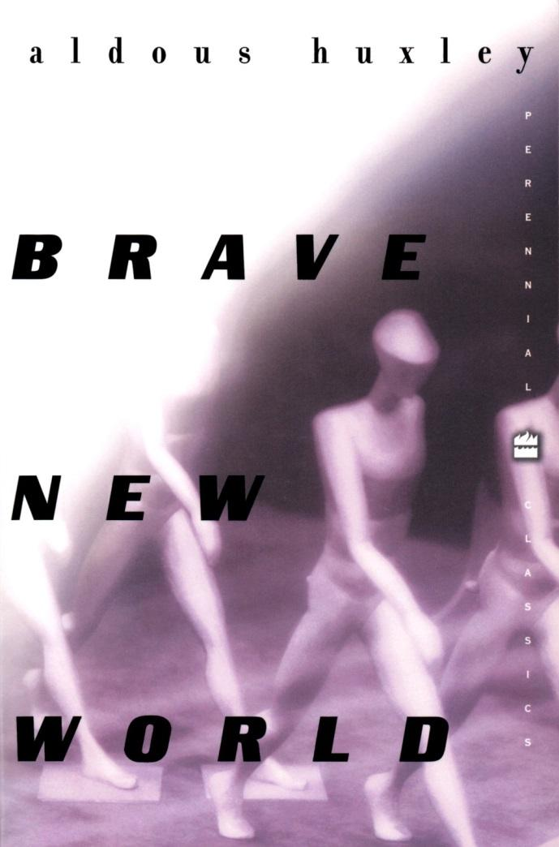
Brave New World, Aldous Huxley
Innovation Lab Network Performance Assessment Project
CHALLENGE OPTION
Background:
Set in another future vision of London, in this one, humans are grown inside bottles, brainwashed in their sleep and separated into castes according to their intelligence.
© 2016 by Summit Public Schools. This work is licensed under a Creative Commons Attribution 4.0 International Public License and should be attributed as follows: “Dystopian Narrative was authored by Summit Public Schools.”

