Slide 1
Making Connections and Inferences

Slide 2
Whodunit?
Individually read the following story and use the clues to try to figure out what happened:
http://tinyurl.com/coolmickey
Notes:
Answer: Mickey could have frozen the poison into the center of the ice cubes. That way he knew the drink would be safe for a few minutes, until the ice began to melt. He figured that drinking from her glass and then leaving would give him a great alibi!

Slide 3
Making Connections
Figuring out what happened in the past based on what you can see now
Use evidence to make inferences
facts, observations
educated guess

Slide 4
Rubric
2 | 3 | 4 | 5
Makes surface-level inferences that are only generally based on evidence or are too broad, with minimal connection between a specific example and the larger idea. | Makes inferences that are based on evidence but may be partially formed with gaps in explaining the connection of a specific example to the larger idea. | Makes relevant inferences based on evidence and attempts to identify the larger significance of the inference. Connections between a specific example and the larger idea are clear and appropriate. | Makes clear and relevant inferences based on evidence and partially explains the larger significance of the inference. Connections to the larger idea are made through multiple examples but may have some gaps in explanation or may not be fully developed.
Identify evidence and make an inference
Explain how you know - why does your inference make sense?
Connect to bigger picture

Slide 5
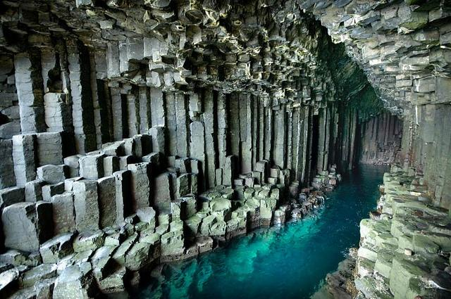
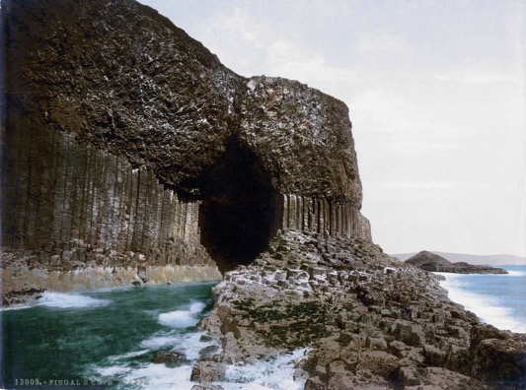
Fingal’s Cave
Staffa, Scotland

Slide 6
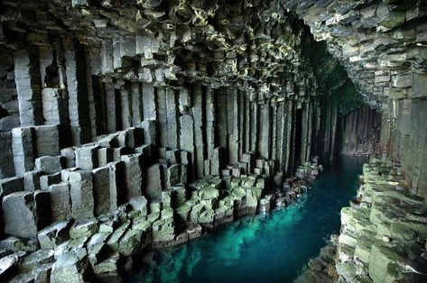
Level 2
Evidence (what do we see?):
pillars of rock (solid lava)
blocky pattern
Inference (what
happened?):
blocky pillars formed
from lava slowly cooling

Slide 7
Level 3
Evidence: Pillars of solidified lava in a blocky pattern
Inference: Hot lava slowly cooled
Explanation (why does my inference make sense?):
Lava cracks into long, hexagonal forms when it cools slowly (like mud cracking in the sun)

Slide 8
Level 4
Evidence: Pillars of solidified lava in a blocky pattern
Inference: Hot lava slowly cooled
Explanation: Lava cracks into long, hexagonal forms when it cools slowly (like mud cracking in the sun)
Bigger Picture (step back and zoom out!):
There must have been active volcanoes in the area that Scotland is now when the cave began to form

Slide 9
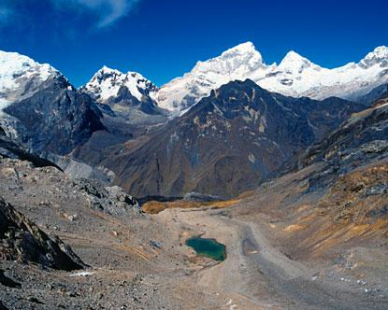
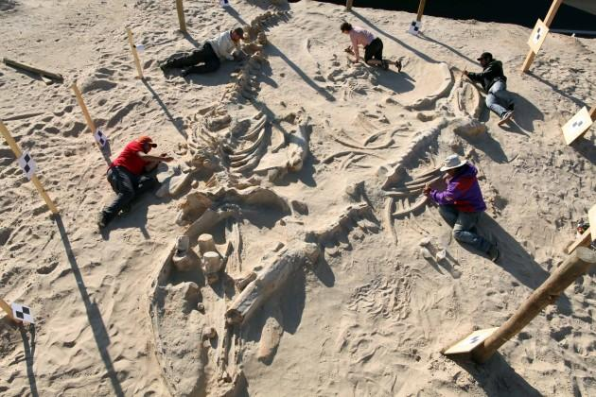
Let’s try it together:
Fossil of extinct whale
Andes Mountains (Chile)

Slide 10
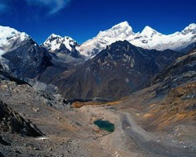
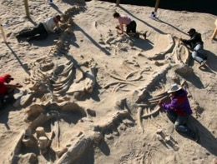
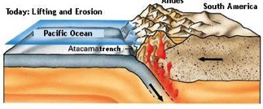
Pair - Share
Evidence:
Inference:
Extinct whale fossil in
Andes mountains
The land that makes up the mountains used to be under the
ocean
Explanation:
Whales live in the ocean. Since the whale is now extinct, it must have lived long ago. When it died, it must have settled to the bottom of the ocean.
Bigger Picture:
The Andes mountains must have risen from the sea as a result of the oceanic crust subducting under the continental crust.

Slide 11
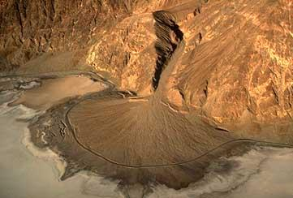
Practice on Deposition!
Evidence (what do you see?)
Inference (what happened?)
Explanation (why does my inference make sense?)
Bigger Picture (step back and zoom out!)
How could you show this in a comic?

