Slide 1
Warm Up
Reflect in the PLP…
Title: Health Smoothie Launch
Question:
Define healthy. What does it mean to be healthy?

Slide 2
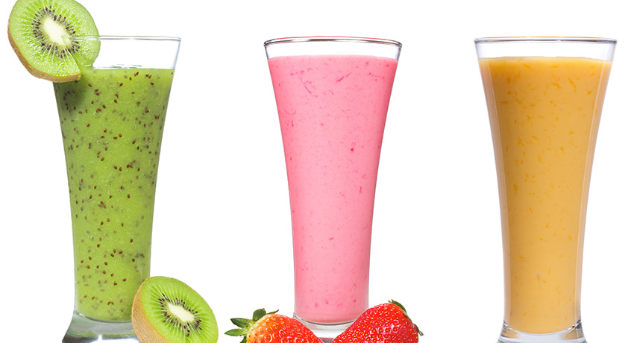
Creating the Ultimate Health Smoothie
Mythbusters 7th Grade

Slide 3
Objectives
I understand expectations of Project Time
I can describe what the end product of this project will look like
I can define “Point of View”
I understand how I’m being assessed during this project

Slide 4
Agenda
Introduction to Project Time
Project Description
Point of View Workshop
Reflection

Slide 5
Project Time Expectations
Why do we have Project Time?
To build your Cognitive Skills by working on a project
These skills are what helps make you college ready!

Slide 6
Project Time Expectations
What does Project Time look like?
Sometimes in big room, sometimes separated
Mostly working in groups & pairs, but not always
Activities as a whole class and smaller workshops
Workshops will help you complete the project to the best of your ability and are tailored to what you need

Slide 7
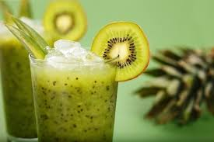

Slide 8
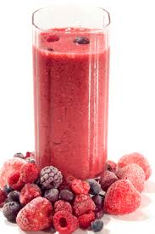
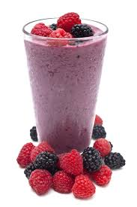
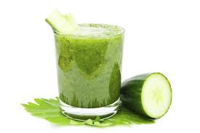
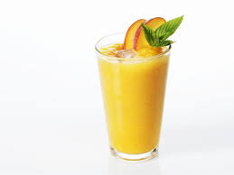
Health Smoothie Project
Tuesday | Wednesday | Thursday | Friday
Introduction to Project Product: Reflection in PLP POV WS | Nutrition Discussion Product: Discussion Contributions | Nutrition Calculations Product: Hand Written Calcuations | Nutrition Graphs Product: Google Excel Graphs
Notes:
View Health Smoothie Project in PLP

Slide 9
Health Smoothie Project
Things you should know…
12 days
You’re creating the ultimate health smoothie based on nutrition information
Final Product: Brochure and Smoothie!

Slide 10
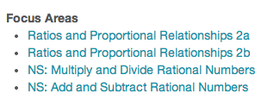
Helpful Playlists

Slide 11
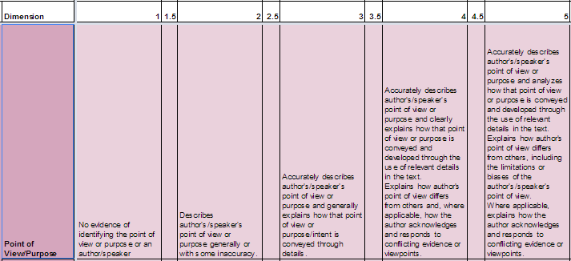
Cog Skill: Purpose & Point of View
This is one of 5 cognitive skills assessed!

Slide 12
What does this mean??
Identify the author’s perspective (their point of view) and purpose (their goal)
Prove how the author is trying to reach that goal with evidence
Compare different author’s perspectives

Slide 13
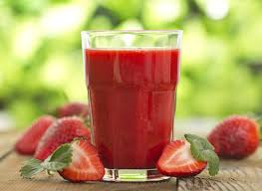
Point of View Workshop
Directions:
Read the Men’s Health Article
Fill out the Nutrition Readings table (first row)

Slide 14
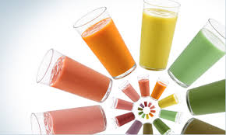
Reflection in PLP
What have you eaten so far today?
Was this a “healthy” meal? Why or why not?

