Slide 2
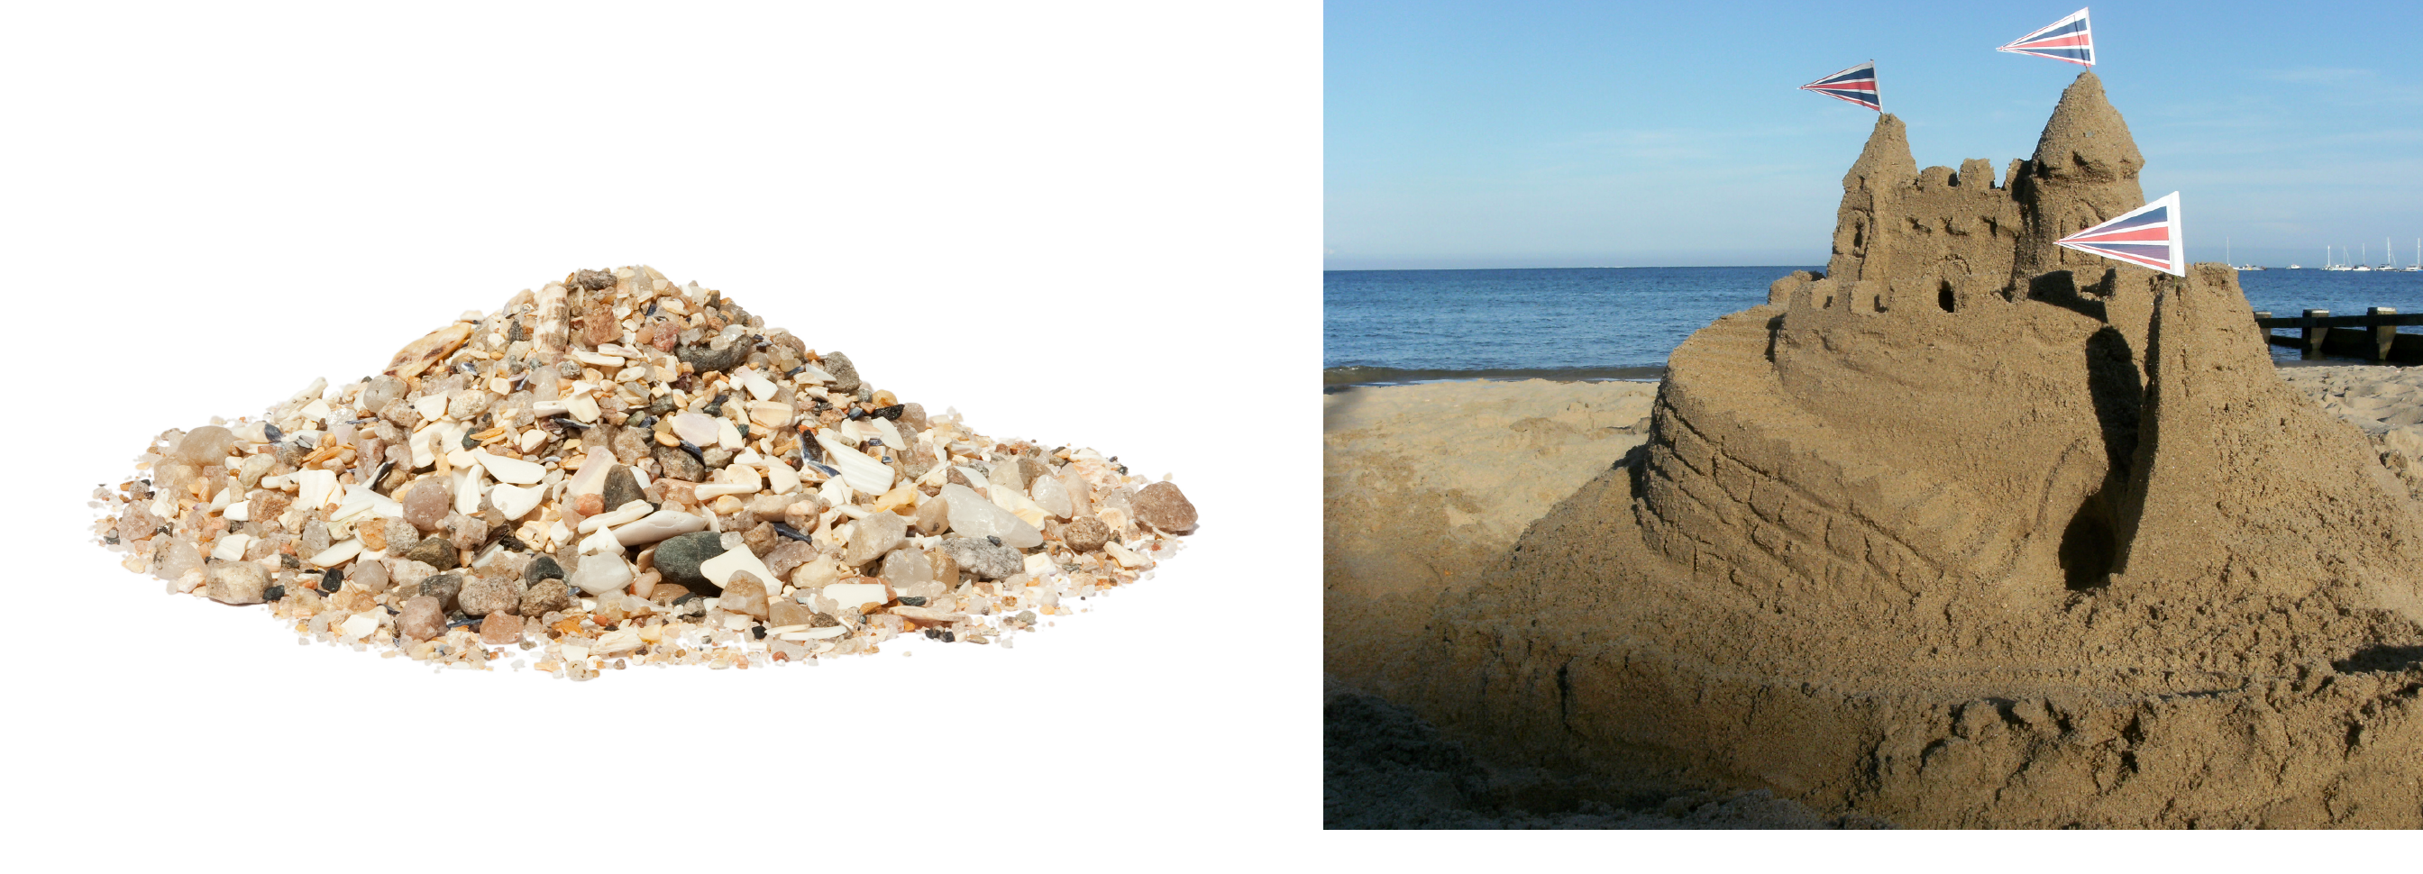
Particle
A Particle is a small piece of a whole.
Sand particles make up a sand castle.

Slide 3
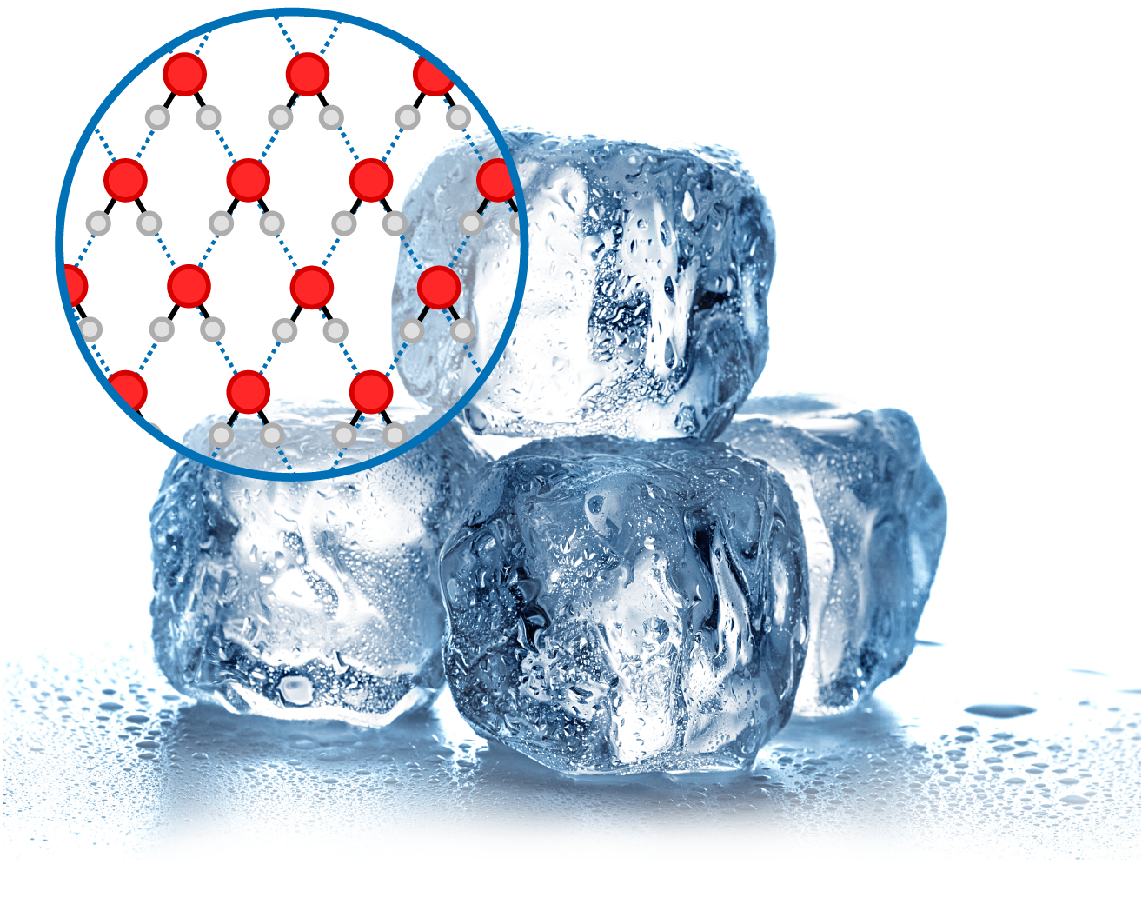
Particle
A Particle is a small piece of a whole.
Water Particle
Ice

Slide 4
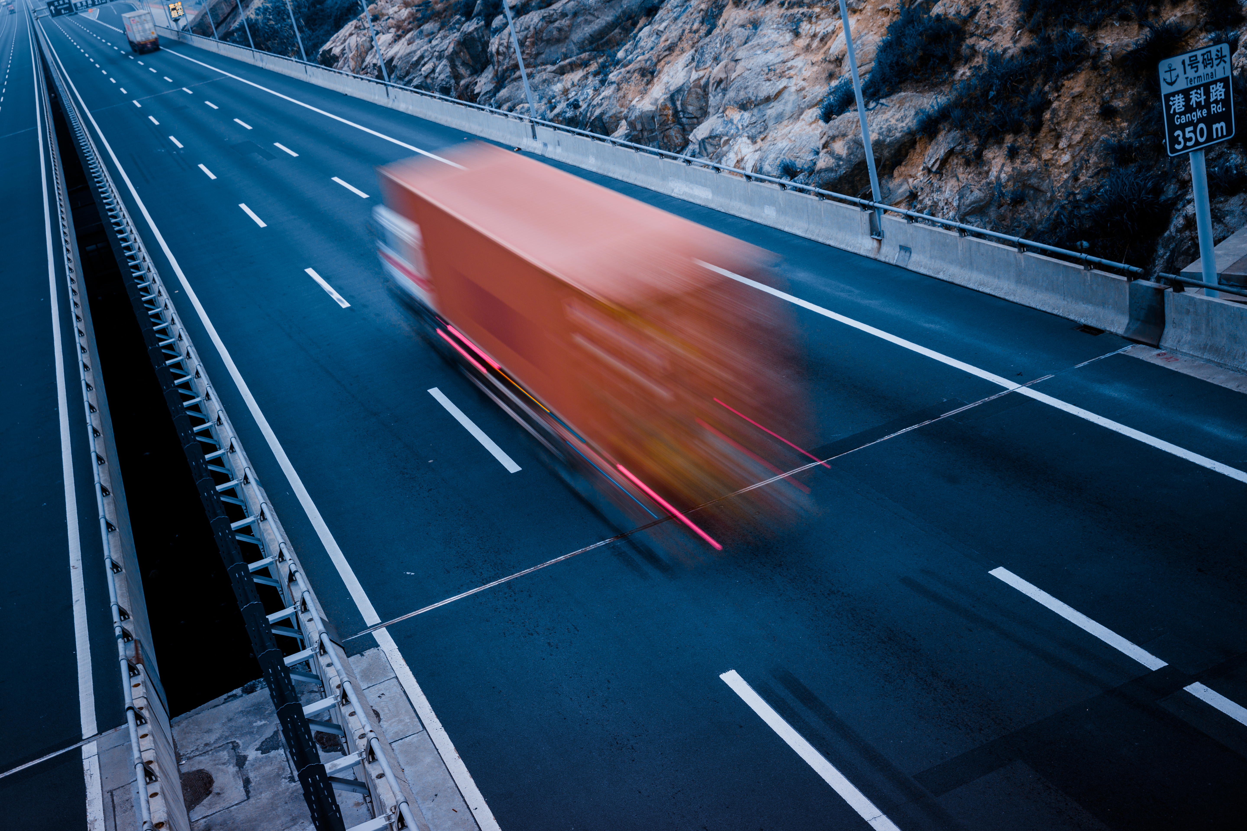
Kinetic Energy
Kinetic energy is energy of motion.

Slide 5
Kinetic Energy
Kinetic energy is energy of motion.

Slide 6
Temperature
Temperature is the AVERAGE amount of kinetic energy in a system
Temperature—measure of how hot or cold something is.
A thermometer measures the temperature.
Low Temperature
High Temperature

Slide 7
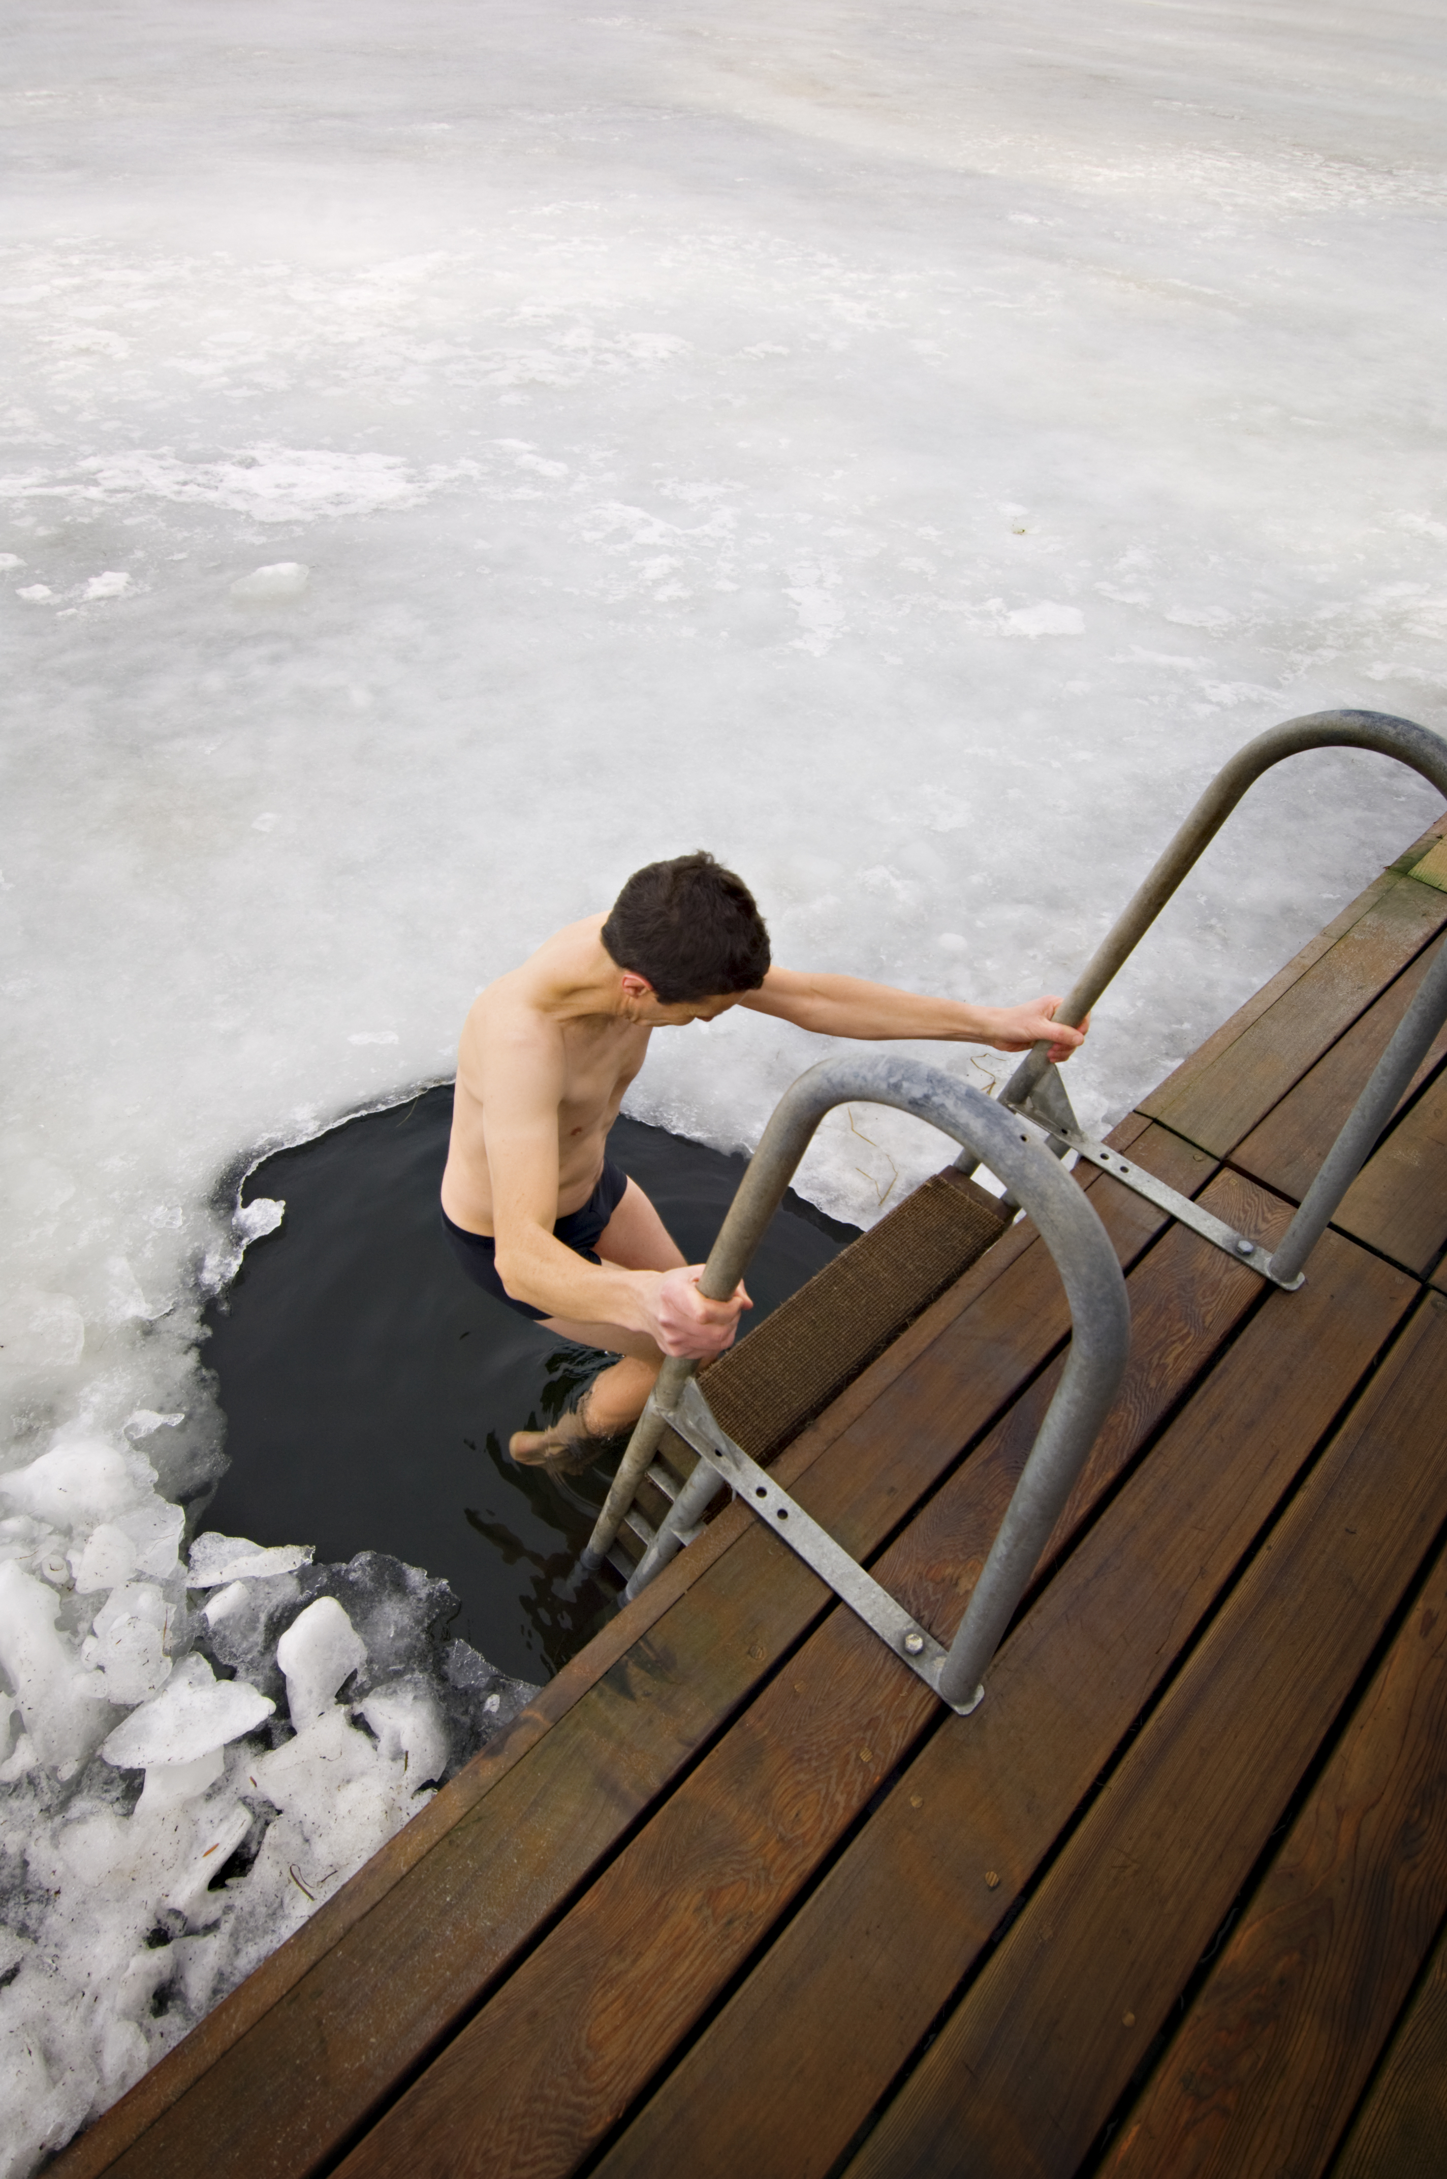
Temperature
Temperature is the AVERAGE amount of kinetic energy in a system.
98.6°F
29.0°F

Slide 8
Thermal Energy
Thermal Energy is the TOTAL amount of kinetic energy of all the particles in a system.
Less Thermal Energy
More Thermal Energy
Add heat
Molecular motion
Molecular motion

Slide 9
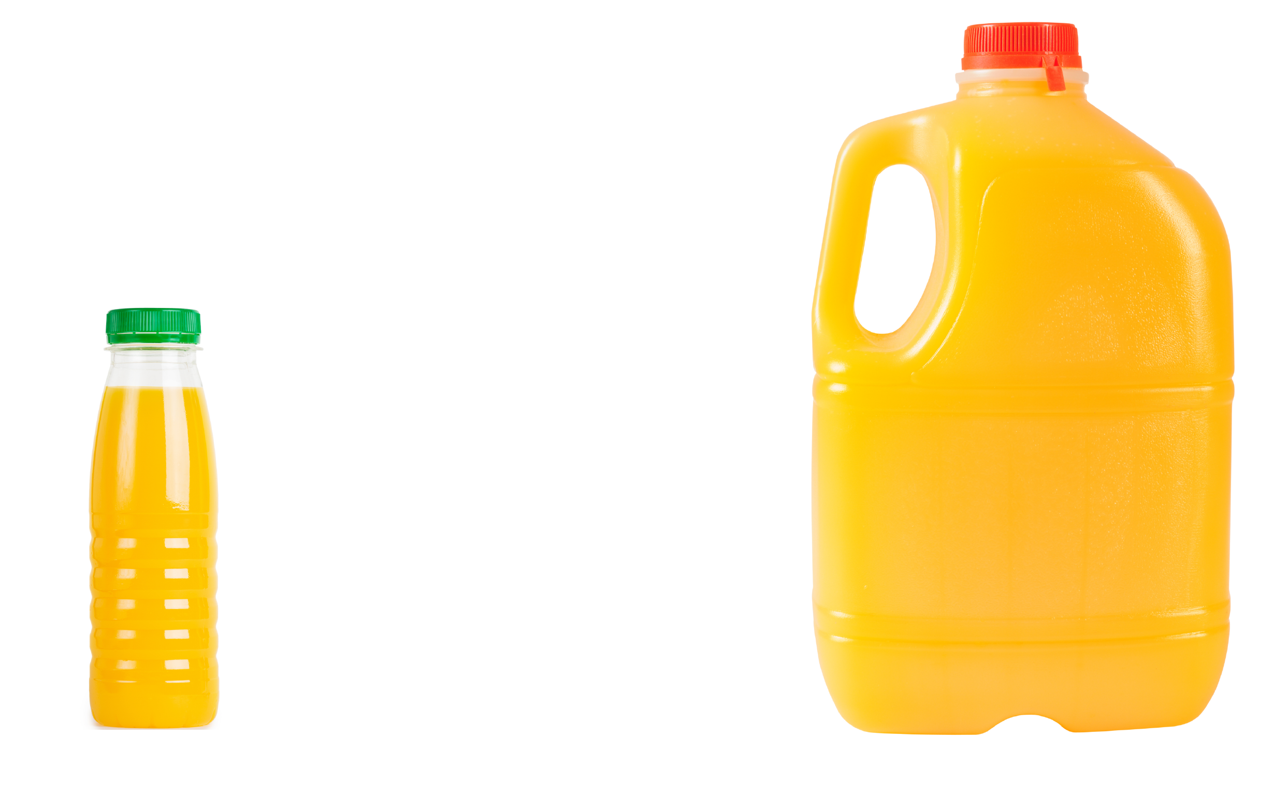
Thermal Energy
Thermal Energy is the TOTAL amount of kinetic energy of all the particles in a system.
40°C
40°C
Less Thermal Energy
More Thermal Energy

Slide 10
Thermal Energy
Thermal Energy is the TOTAL amount of kinetic energy of all the particles in a system.

Slide 11
Heat
Heat is the movement of Thermal Energy from a hotter area to a cooler area.
We will be using the term…
THERMAL ENERGY TRANSFER instead of HEAT in this unit.
THERMAL ENERGY TRANSFER

Slide 12
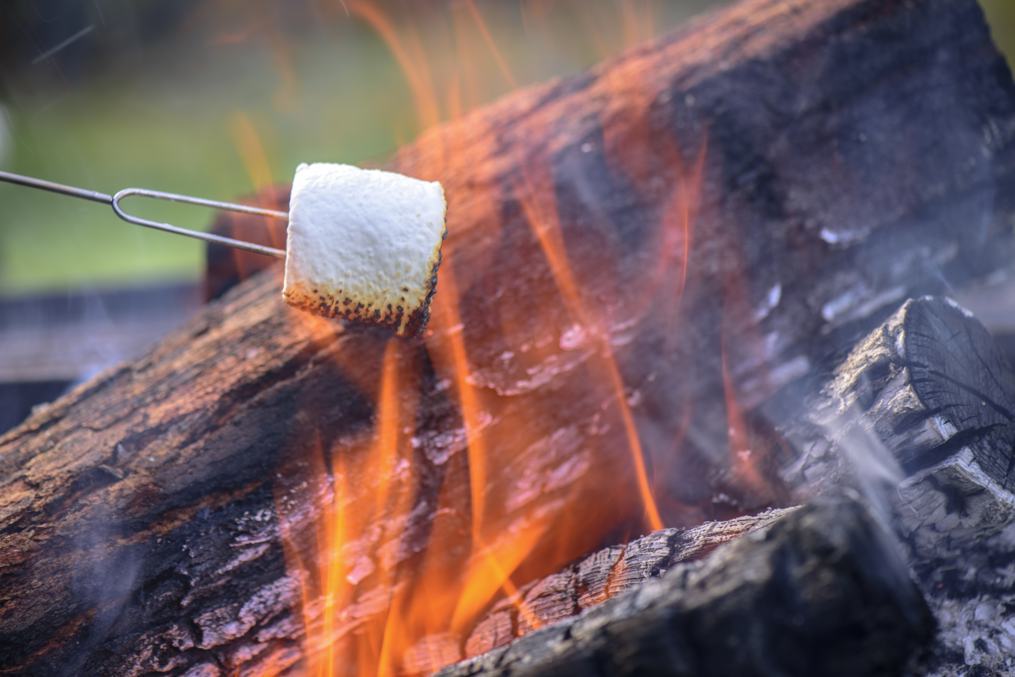
Heat
Heat is the movement of Thermal Energy from a hotter area to a cooler area.
We will be using the term…
THERMAL ENERGY TRANSFER instead of HEAT in this unit.

