Slide 2
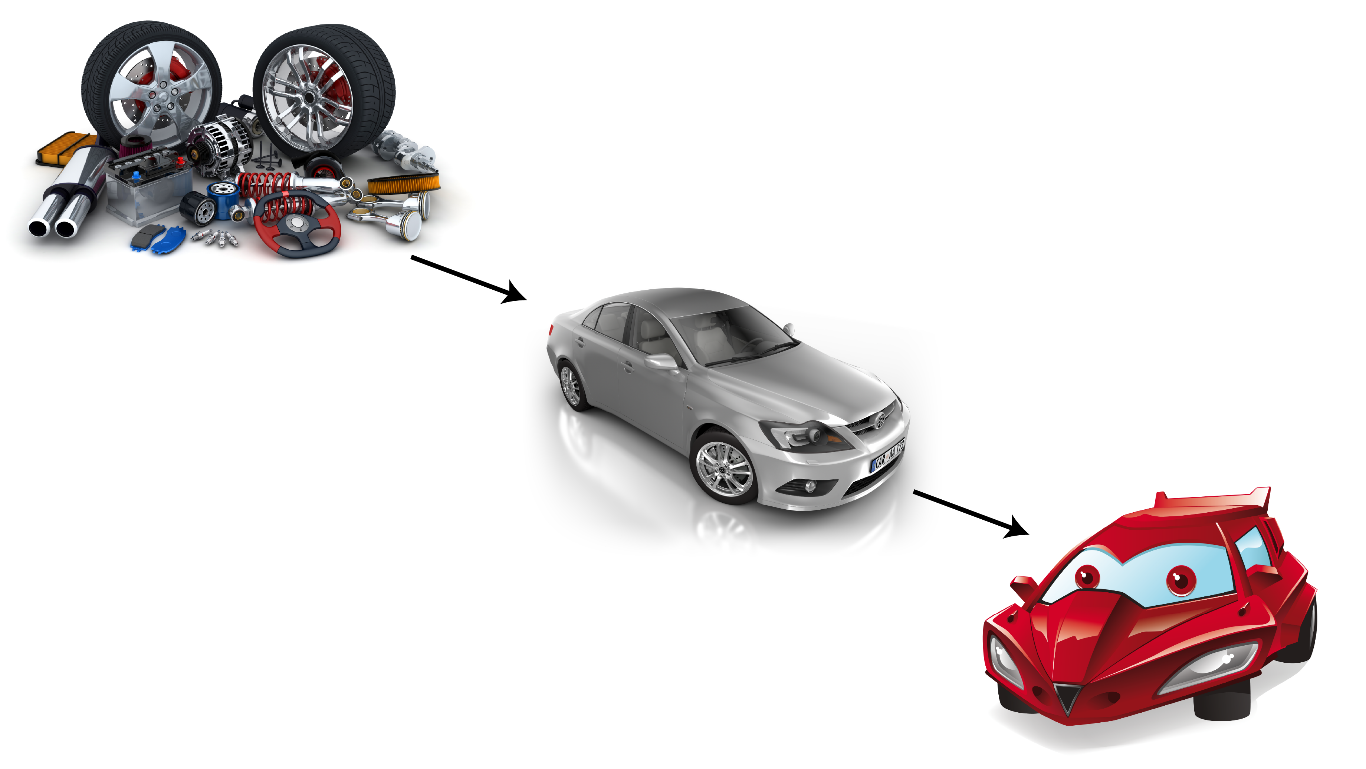
Collections, Systems, and Models

Slide 3
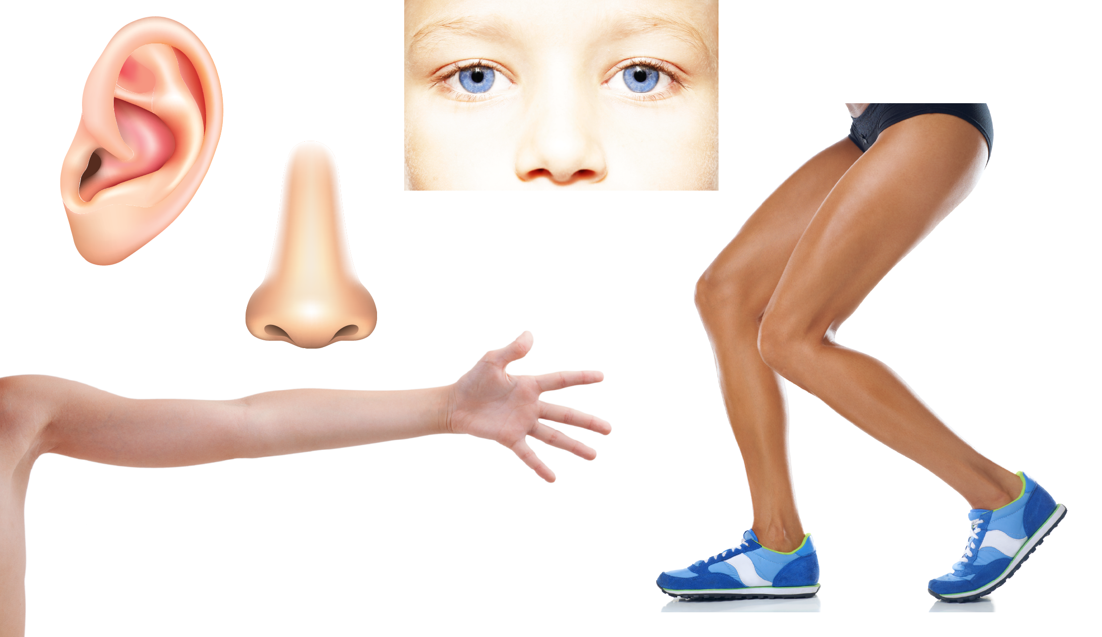
What would we call these?
Can they do jobs or functions by themselves?

Slide 4
When you put them all together…
… you get a body system!
A Nose Working in a System
One Body System
Many Body System

Slide 5
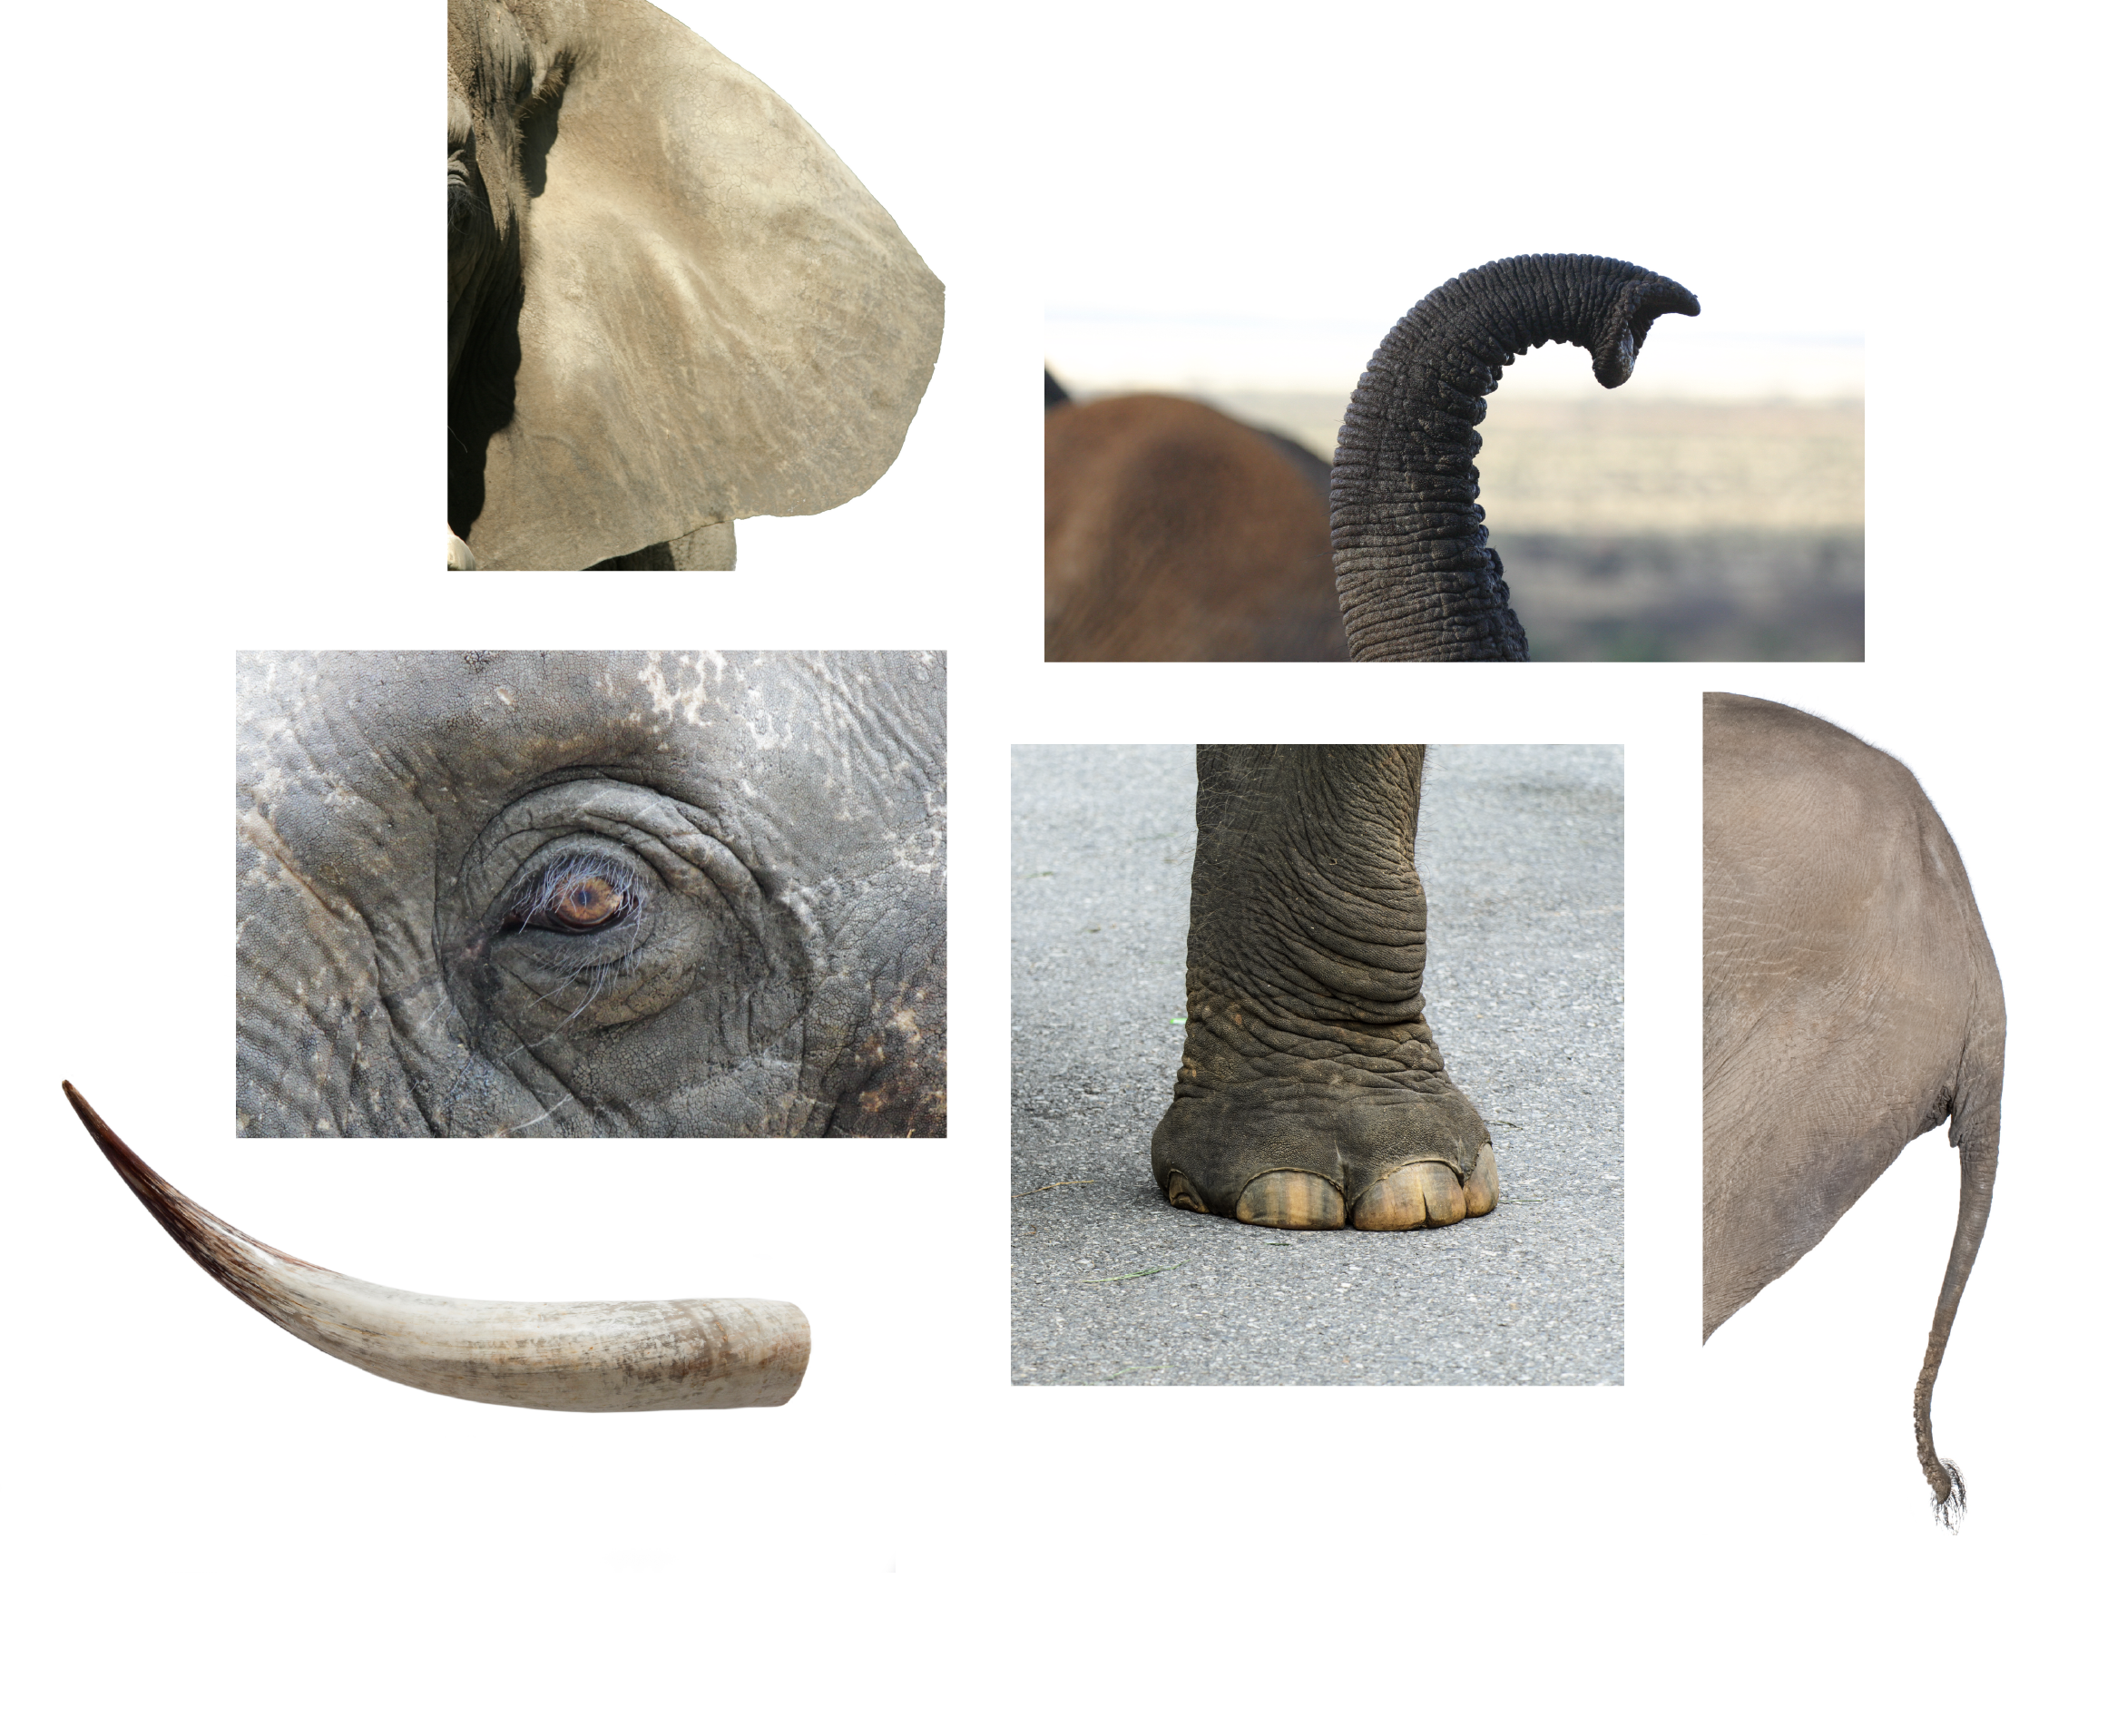
Collection

Slide 6
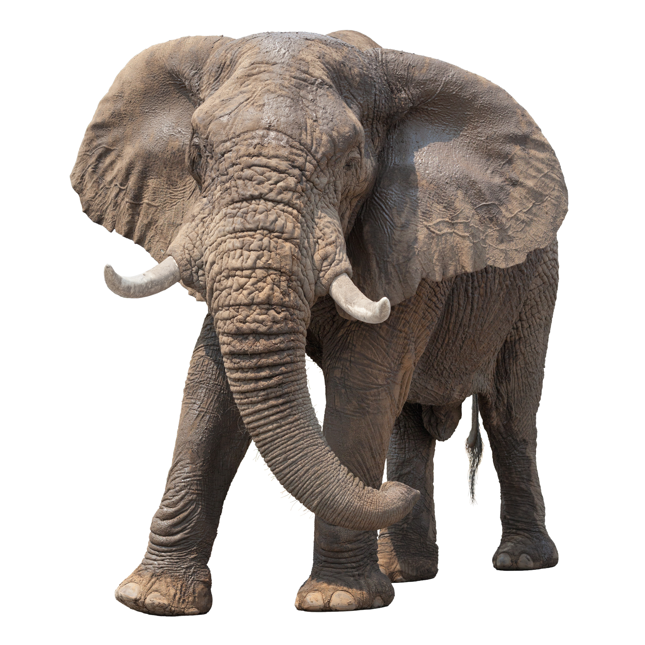
System
Ears
Eyes
Tusks
Legs
Tail
A group of interacting elements forming a complex whole.

Slide 7
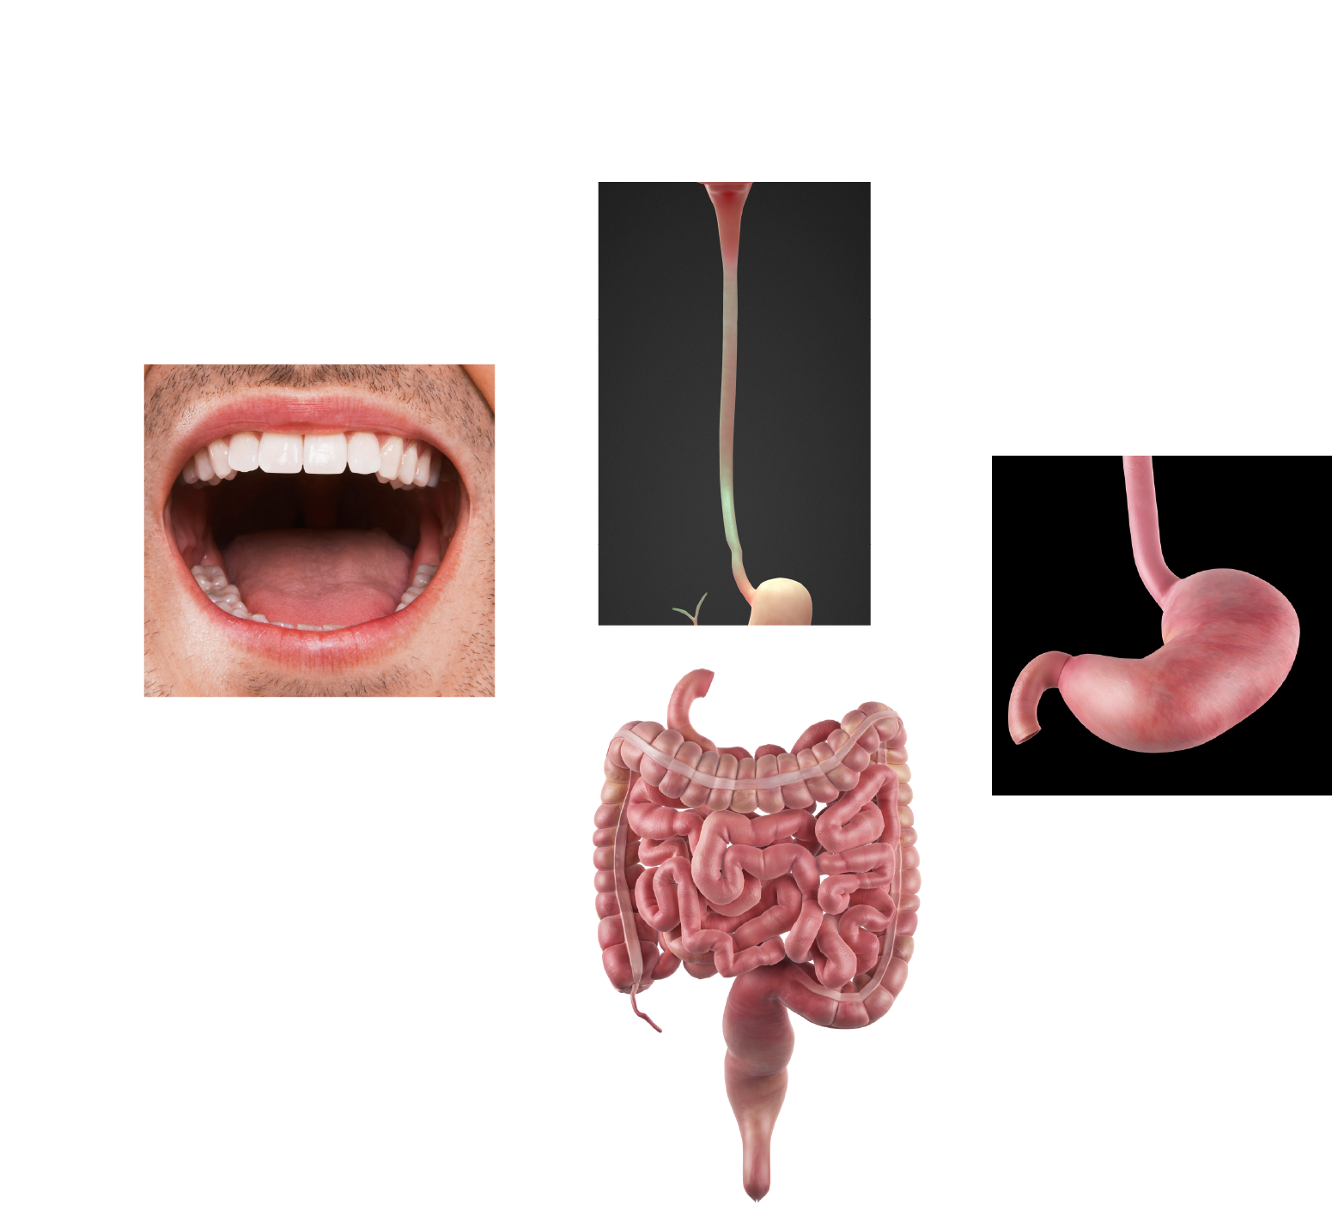
Collection

Slide 8
System
A group of organs working together to accomplish one function.

Slide 9
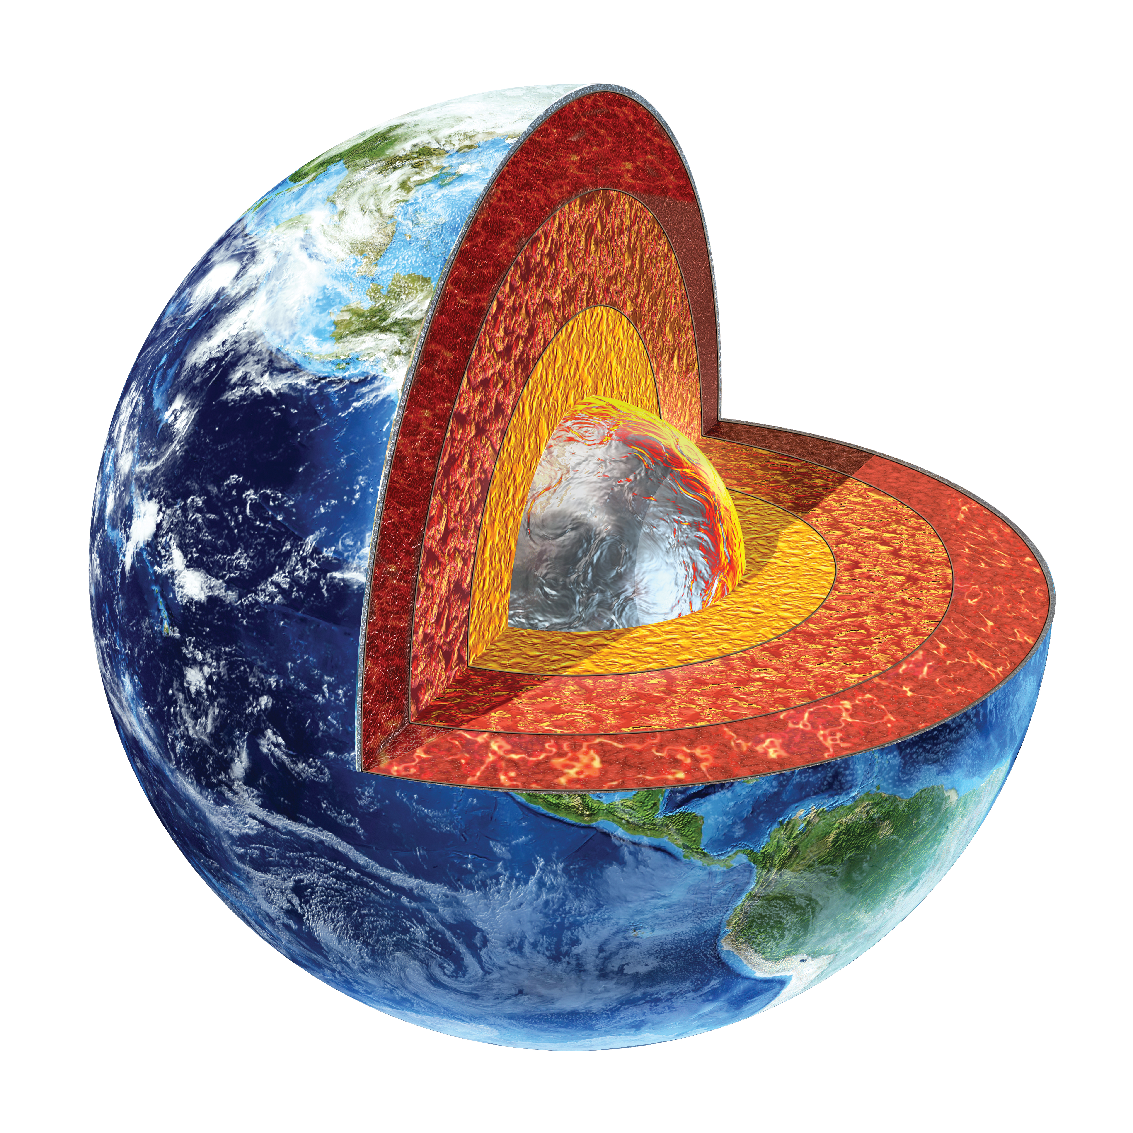
A model is…
… a tool that makes something easier to understand.
Models come in many forms:
Diagrams
Drawings
Physical Replicas
Mathematical Representations
Computer Simulations

Slide 10
Diagram Model
Model of DNA Including Labels

Slide 11
Another Diagram Model
(An Invention)

Slide 12
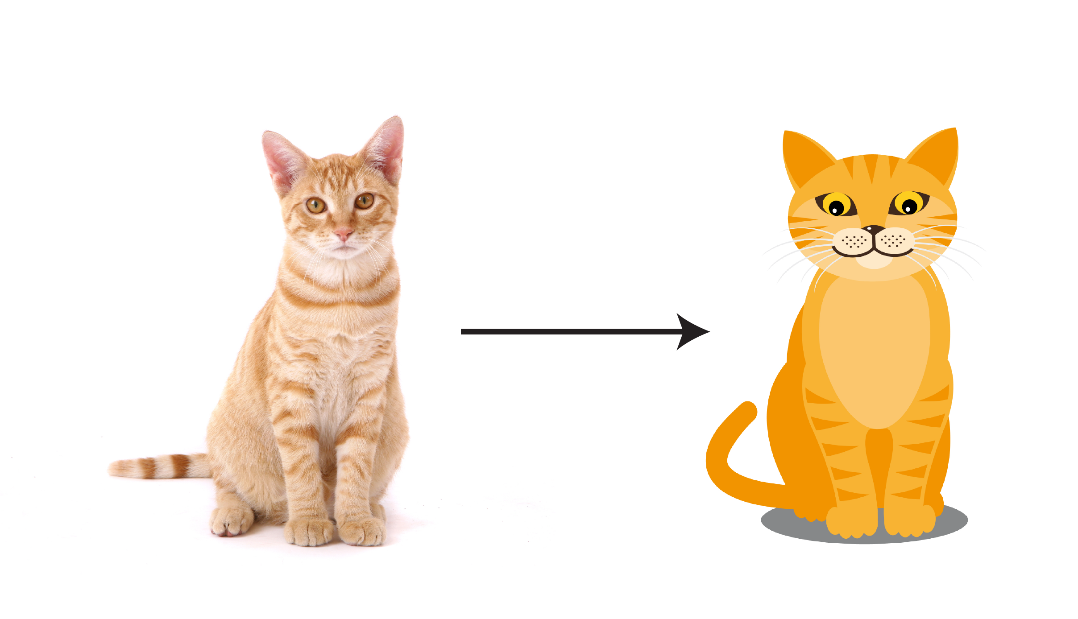
Drawing Model

Slide 13
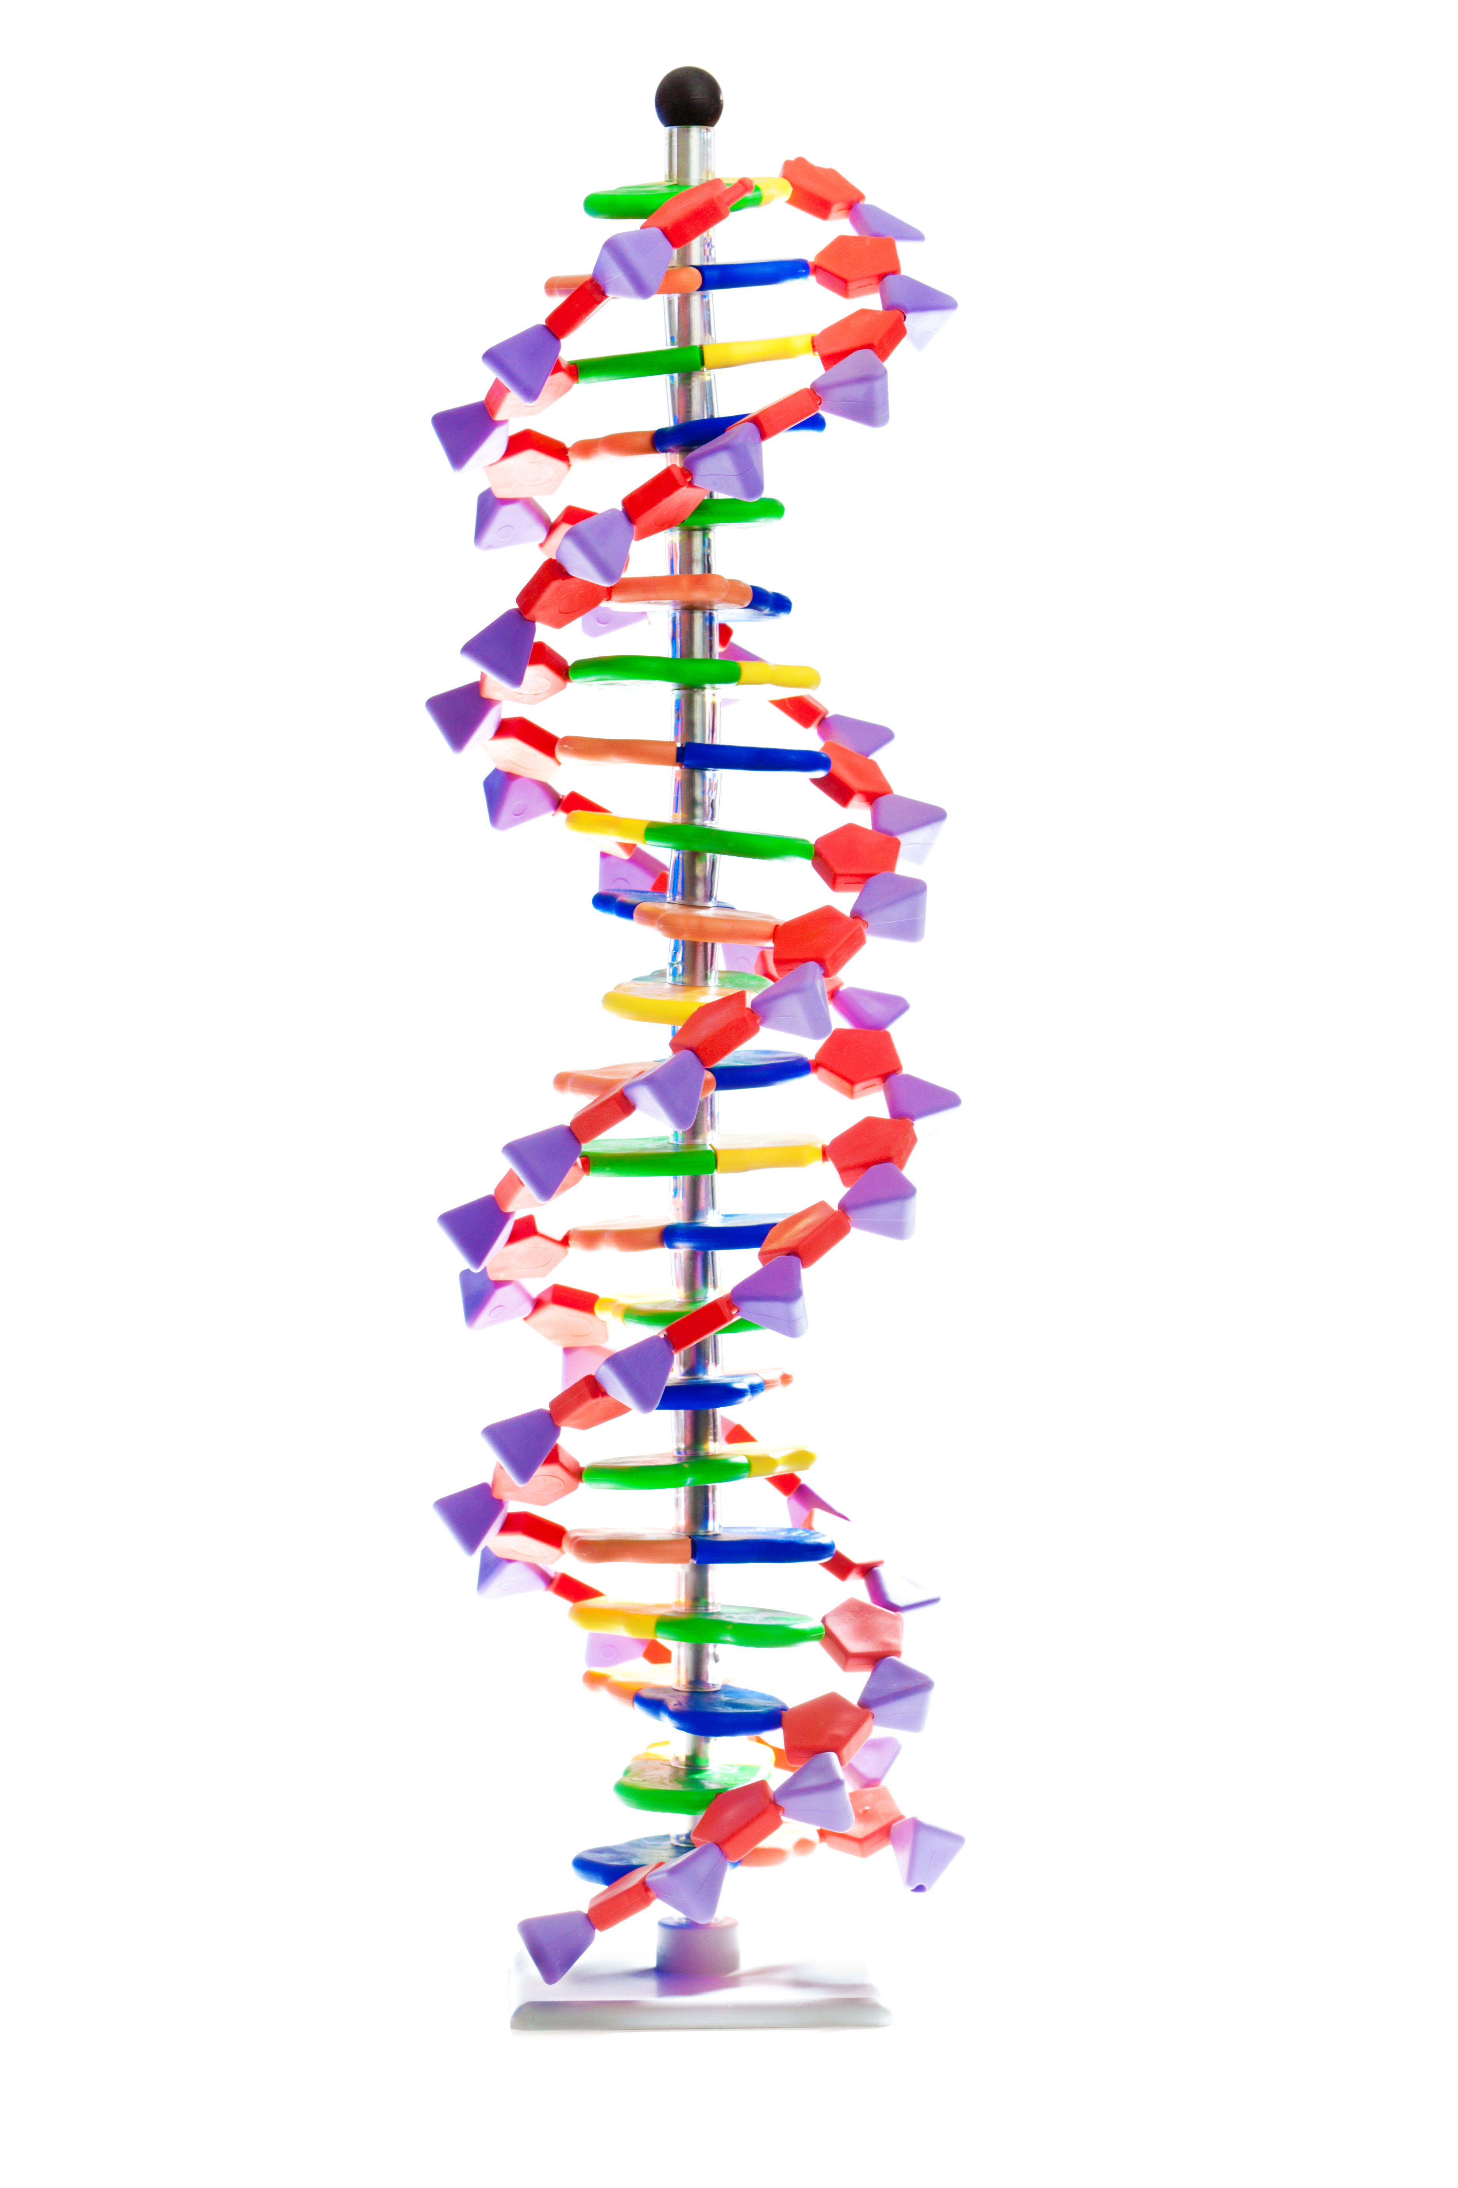
Physical Replica Model
DNA:
Deoxyribonucleic Acid

Slide 14
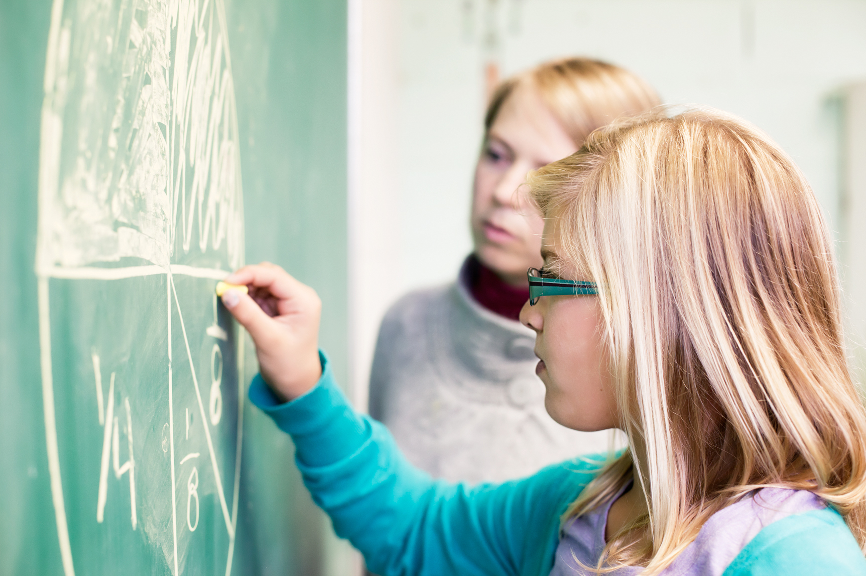
Mathematical Model

Slide 15
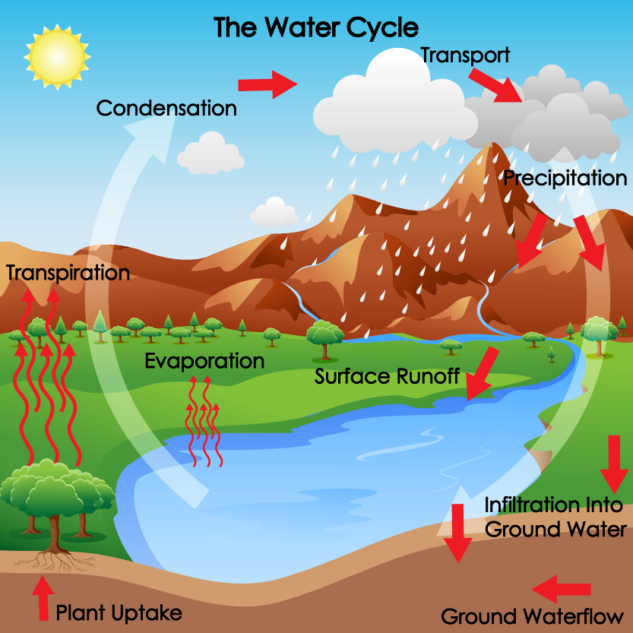
Models help people visualize, understand, and
scientifically explain the subject or phenomenon.
The Water Cycle Model includes labels

Slide 16
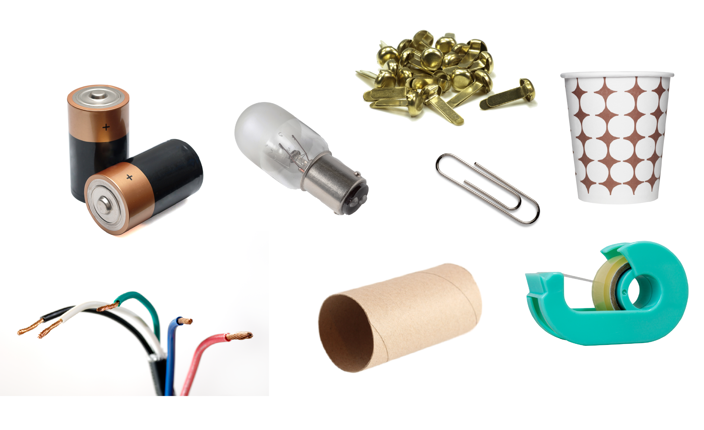
Now it is time to be an engineer!
Use the collection of items at your table to build
a flashlight model.

