Slide 2
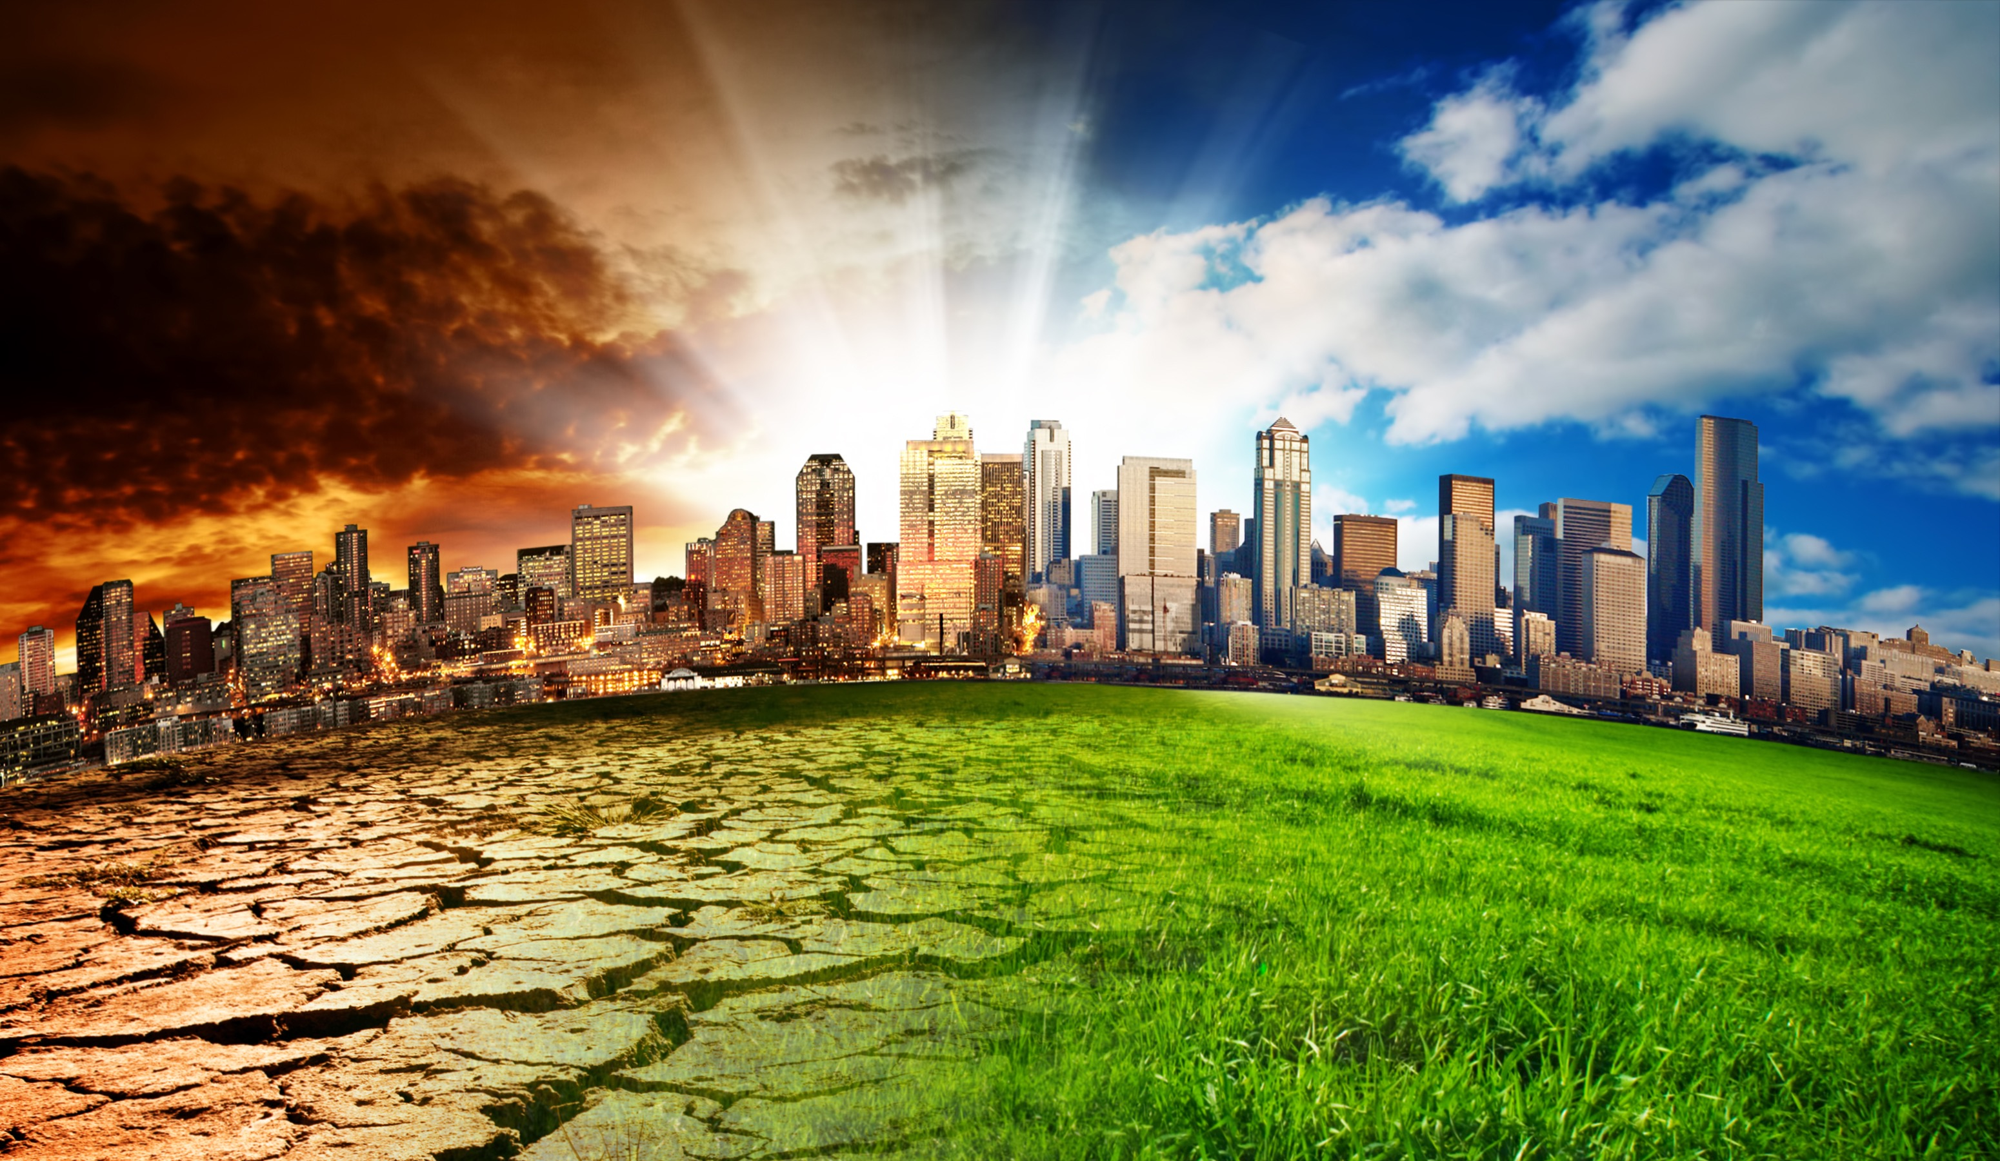

Slide 3
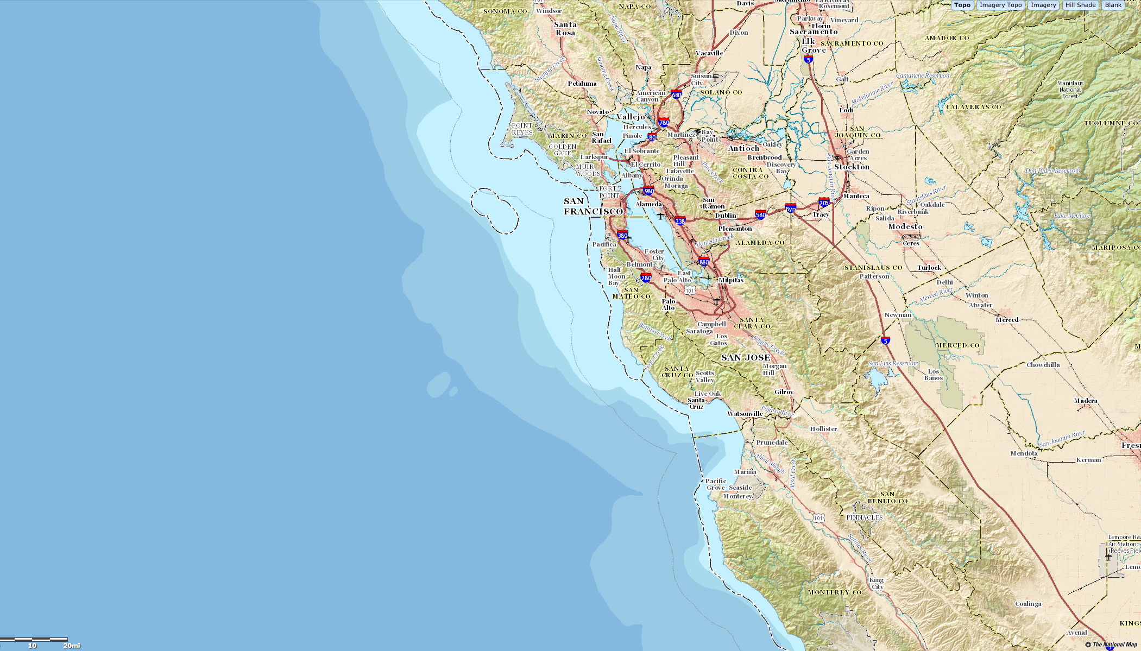
Sea Level Rise
Credit: USGS

Slide 4
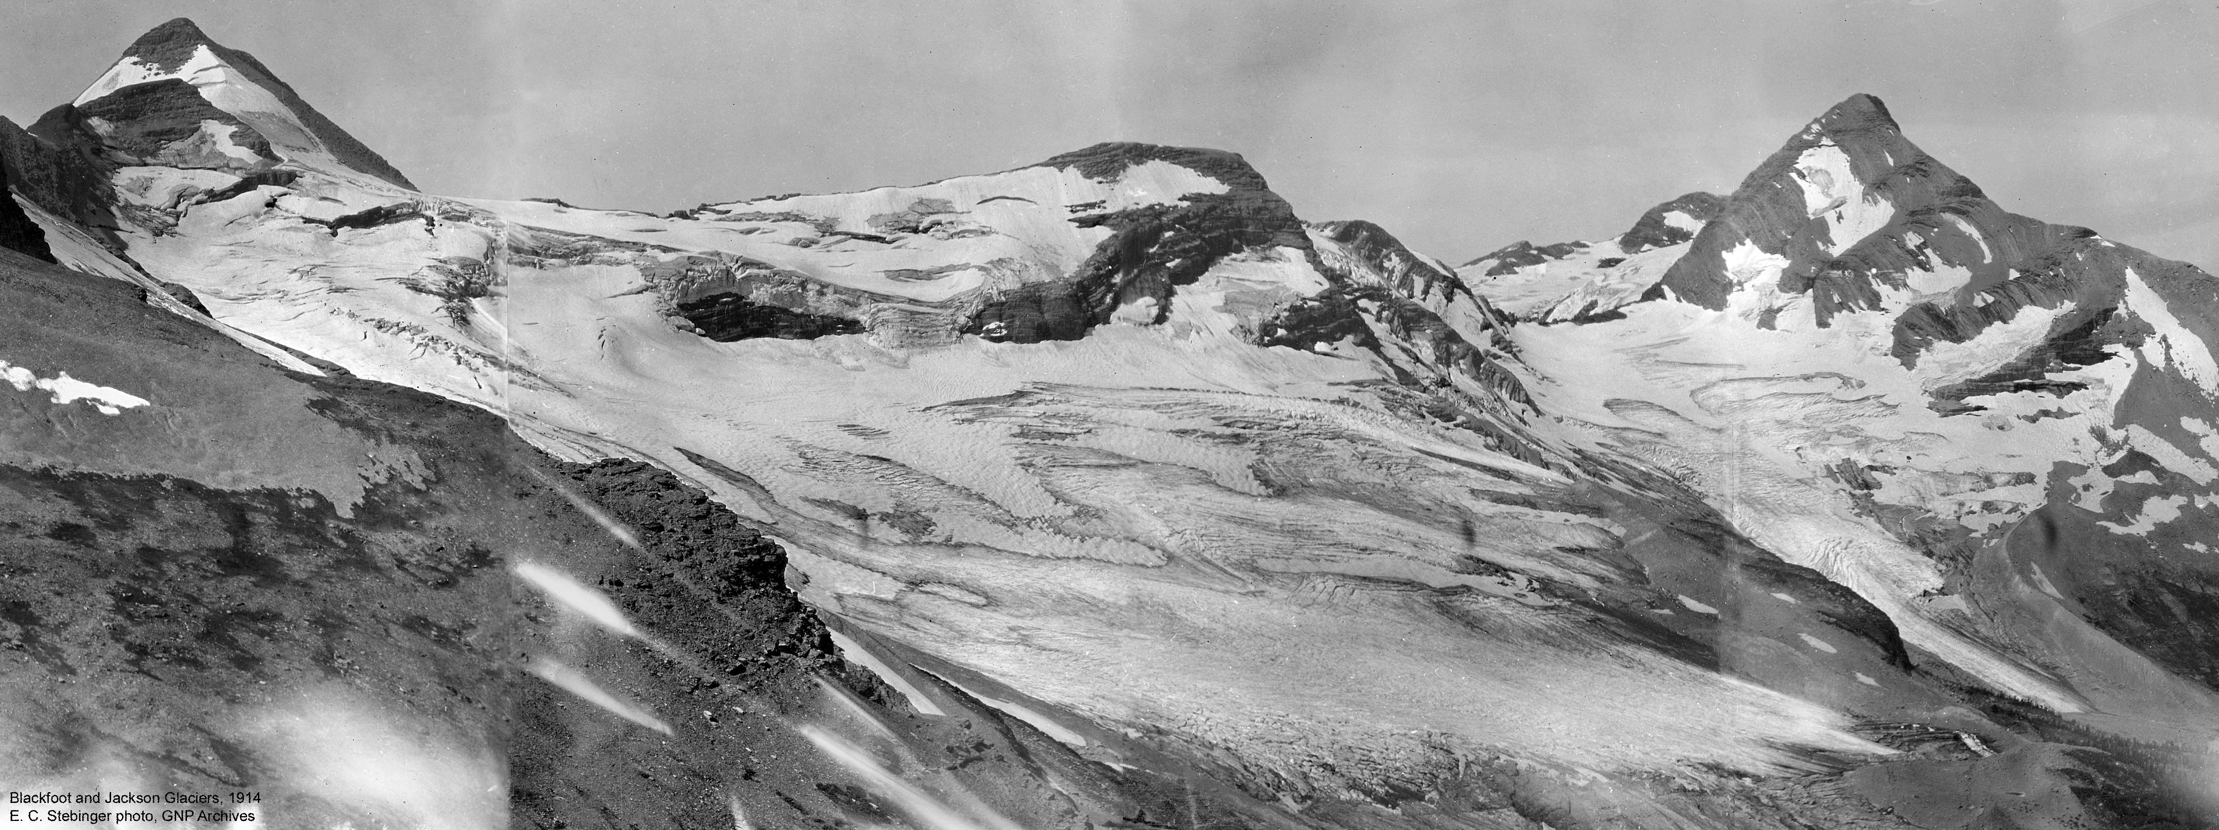
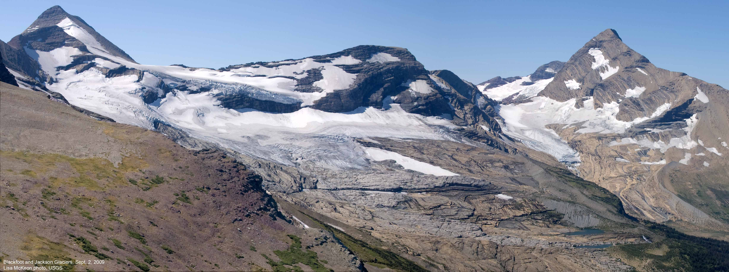
Melting Glaciers
1914
2008
Credit: NOAA

Slide 5
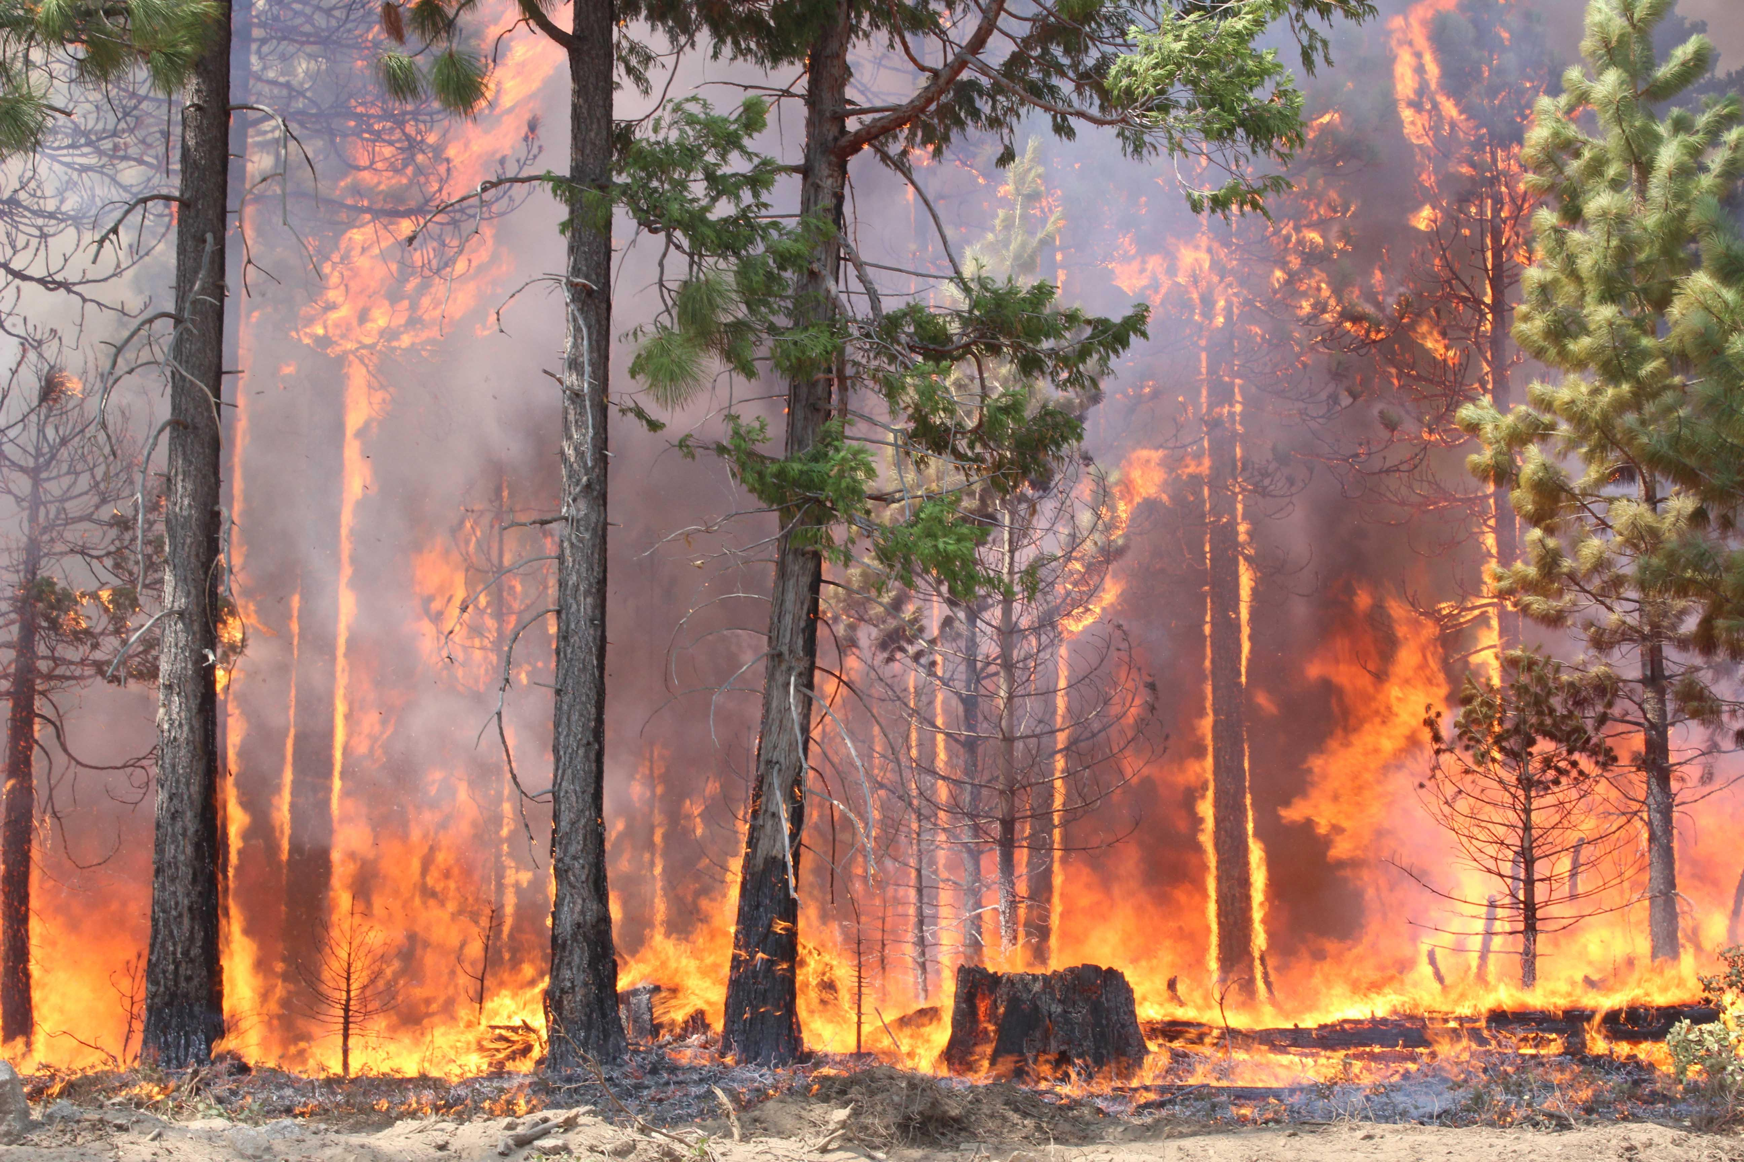
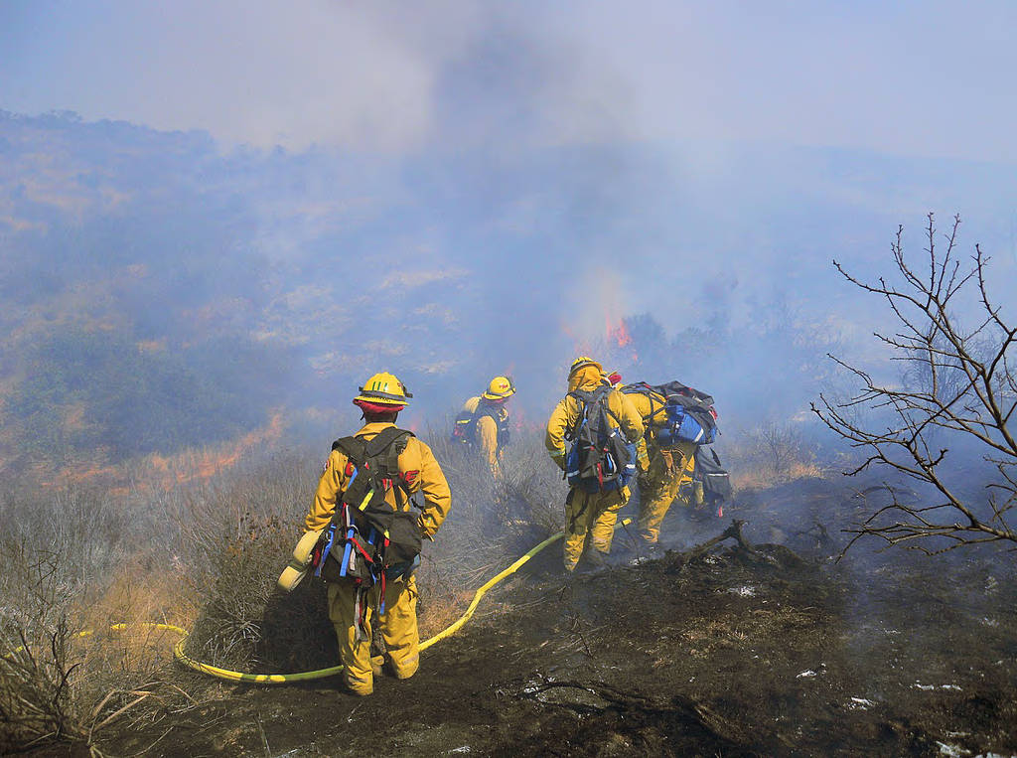
Wildfires
Credit: USFWS

Slide 6
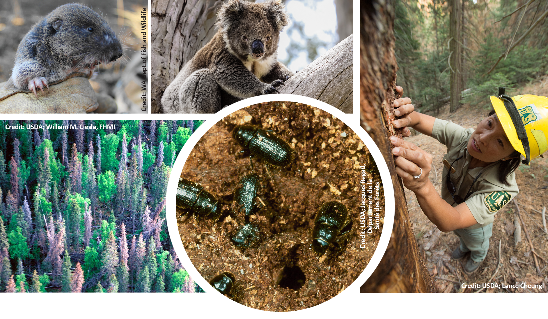
Effects on Animals
bark beetle destruction
bark beetles

Slide 7
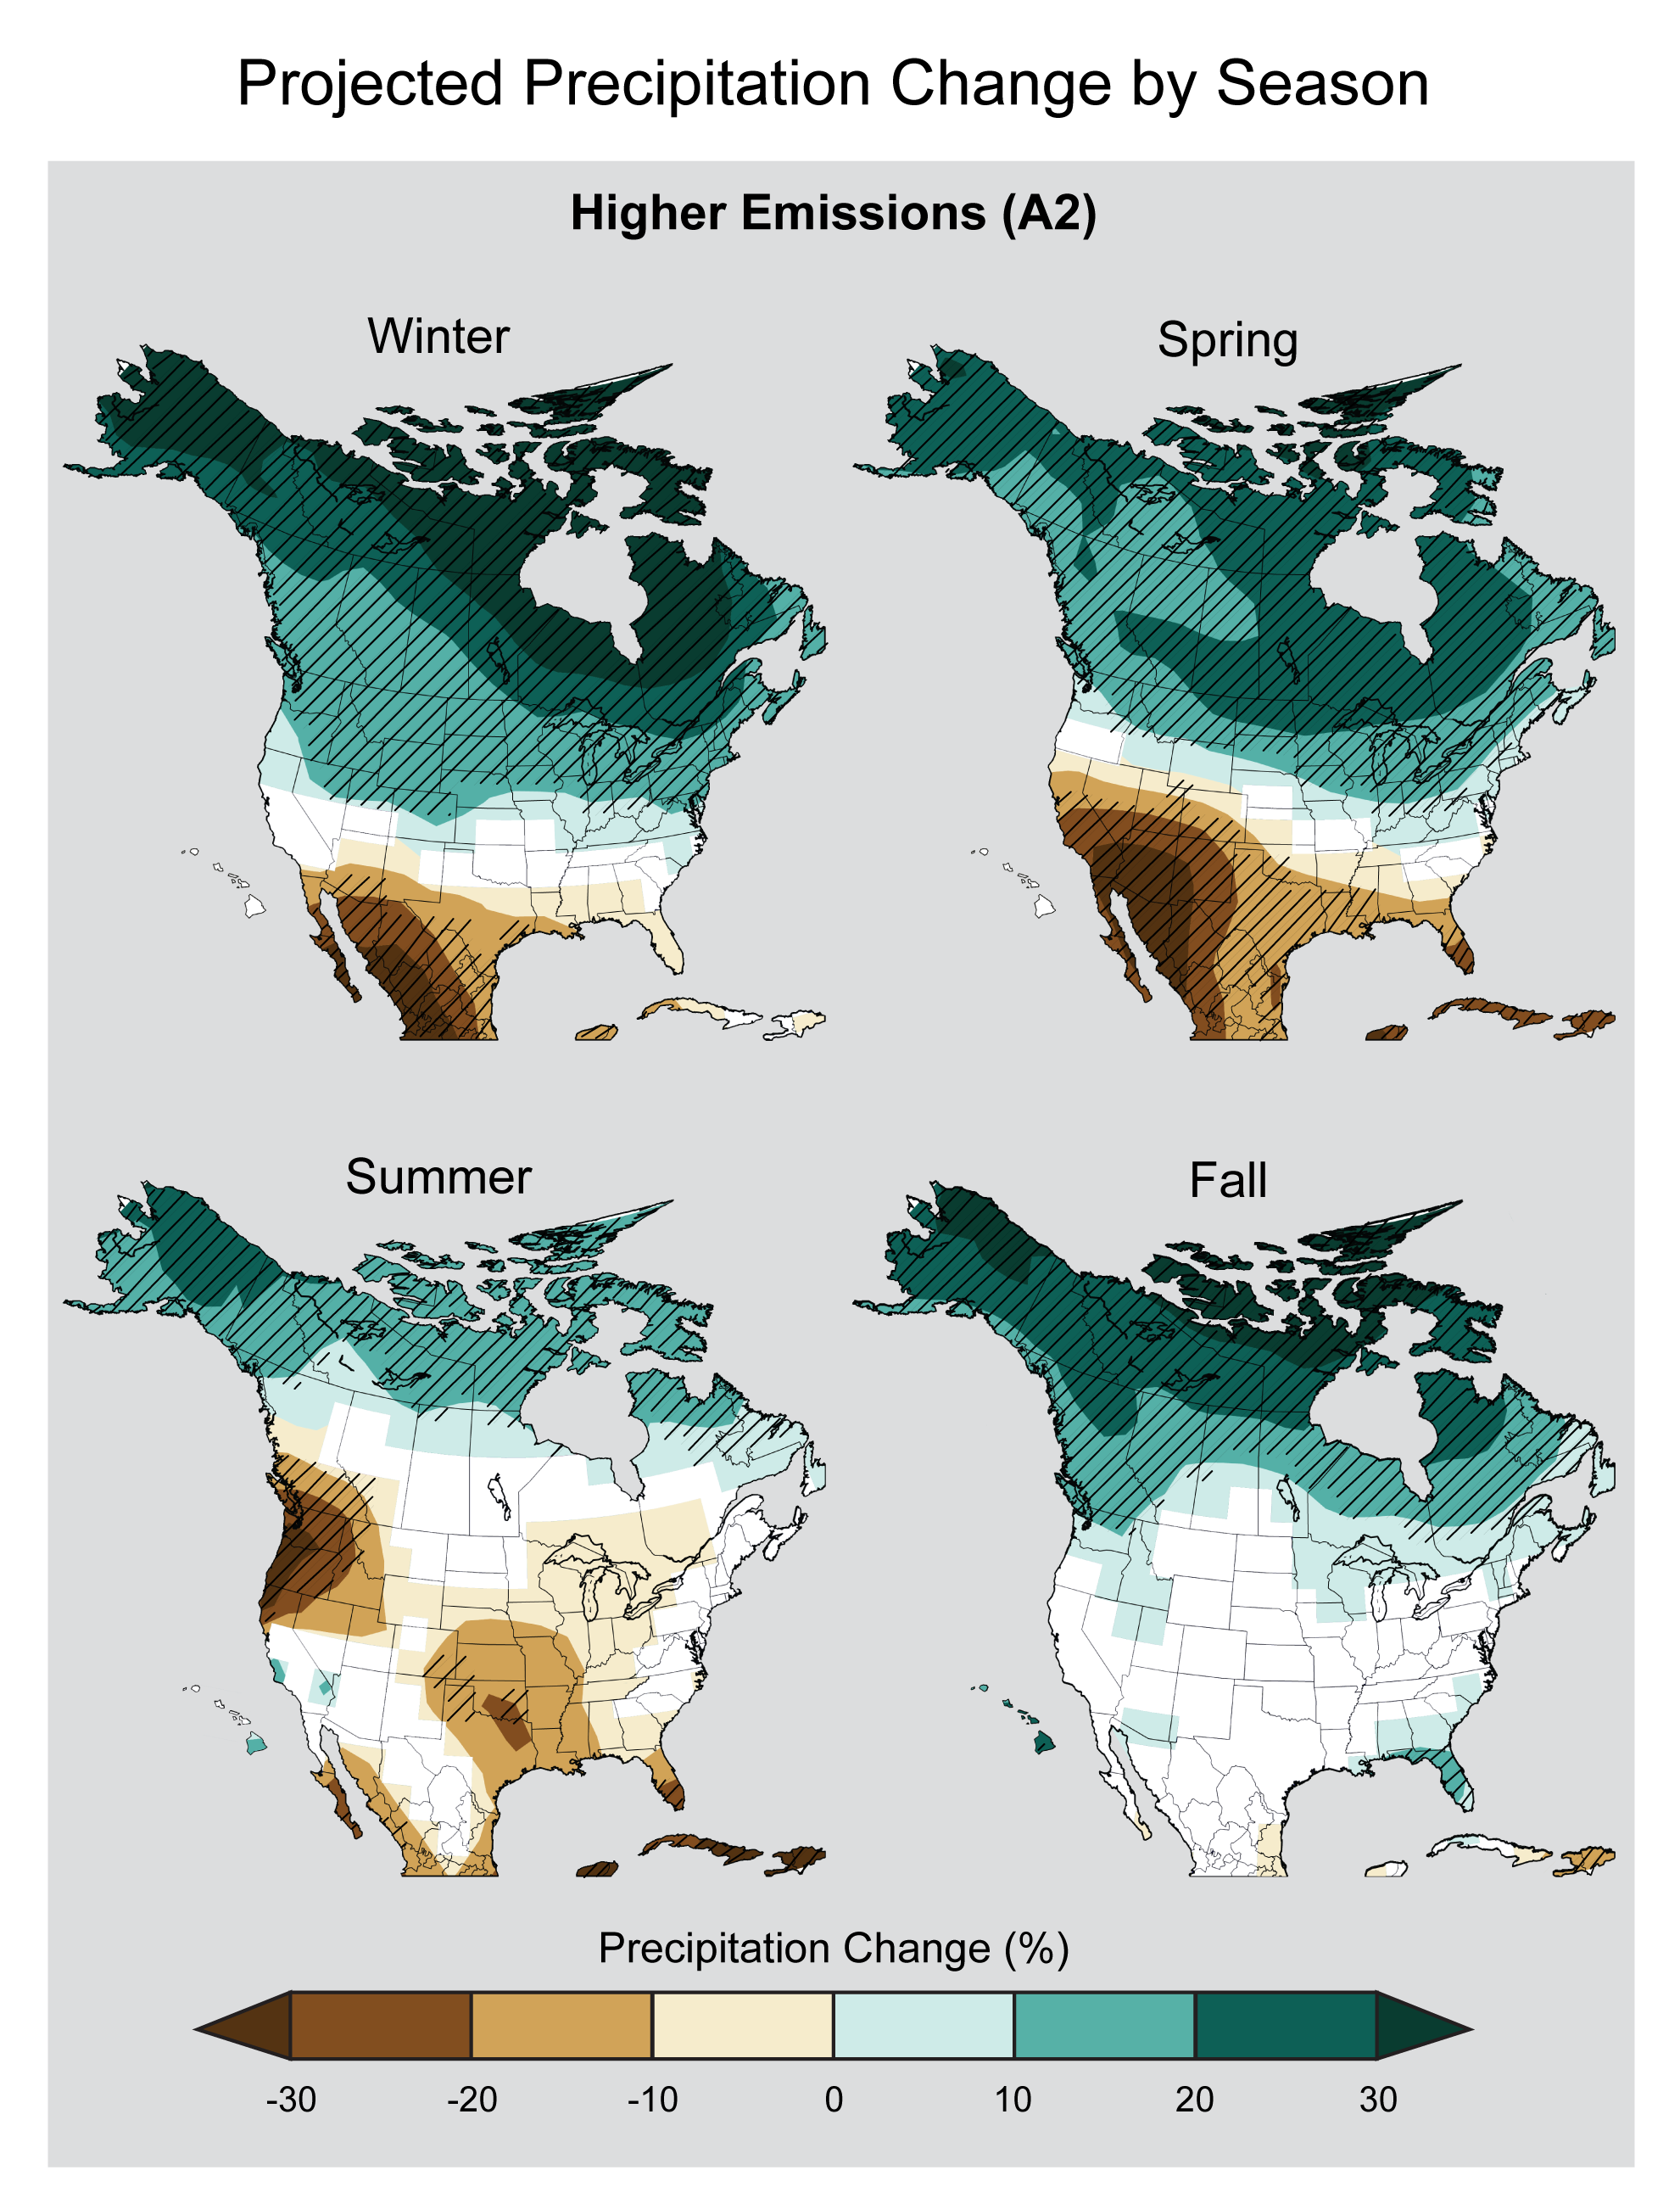
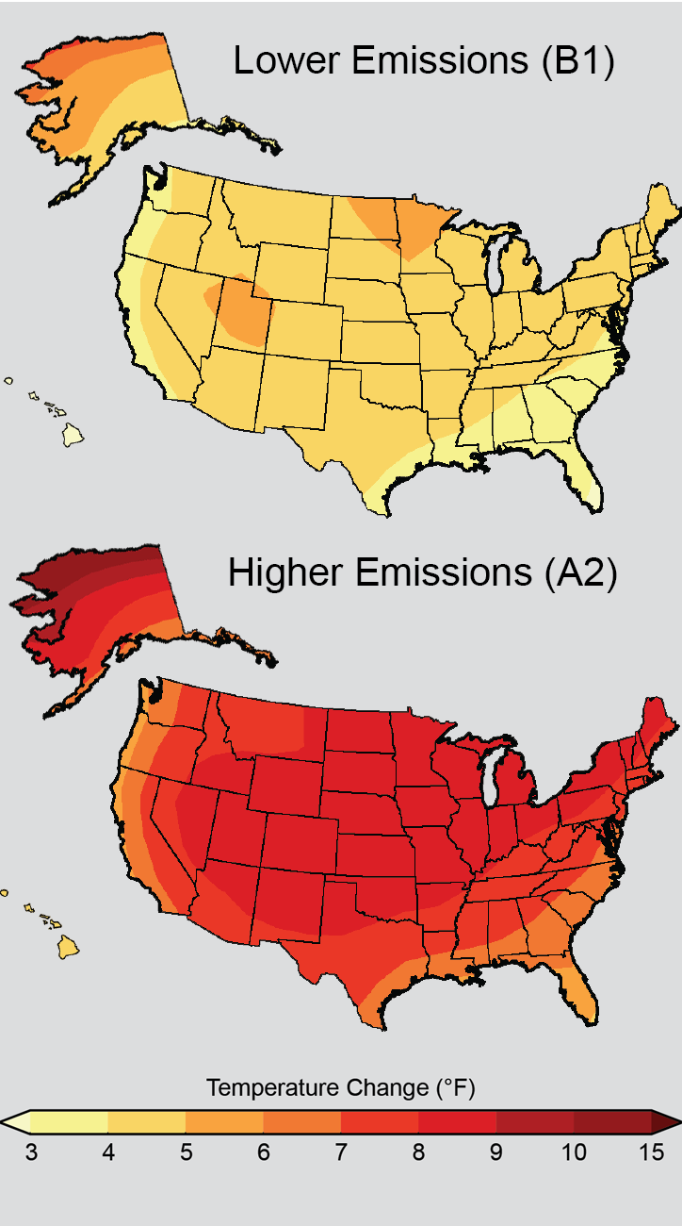
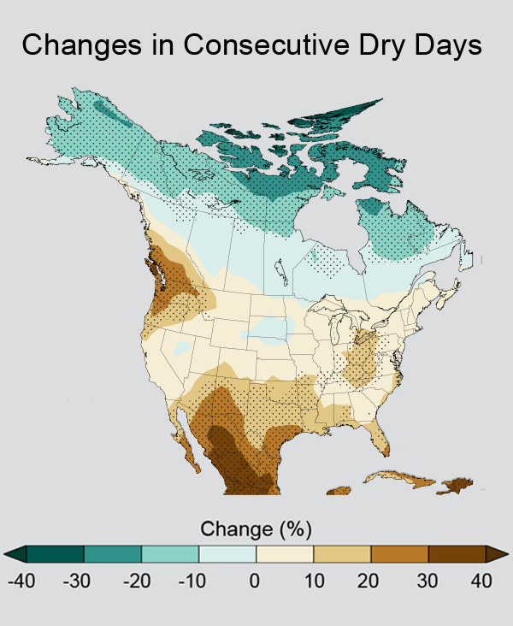
Extreme Weather Events
Credit: NOAA NCDC / CICS-NC

Slide 8
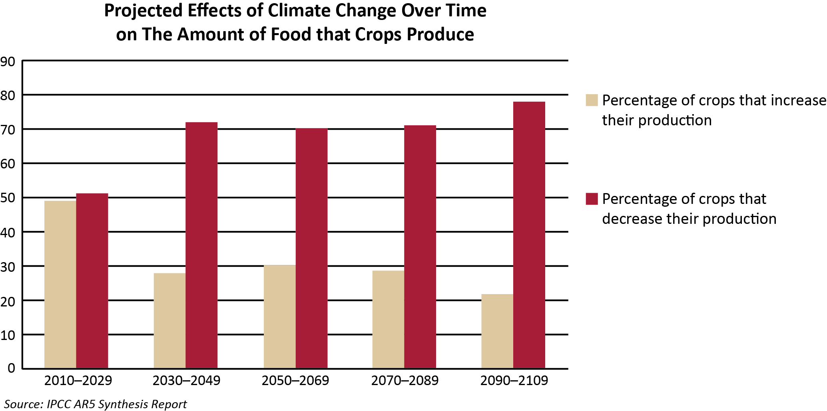
Food Production

Slide 9
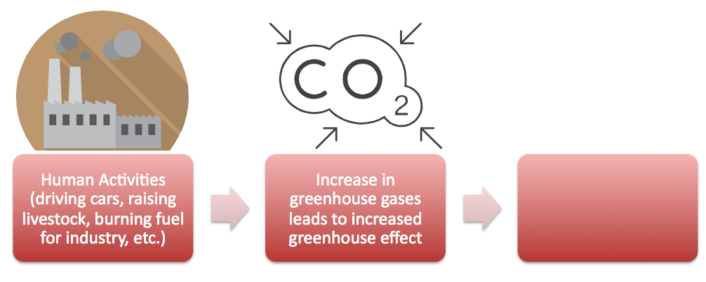
Causes of Climate Change

Slide 10
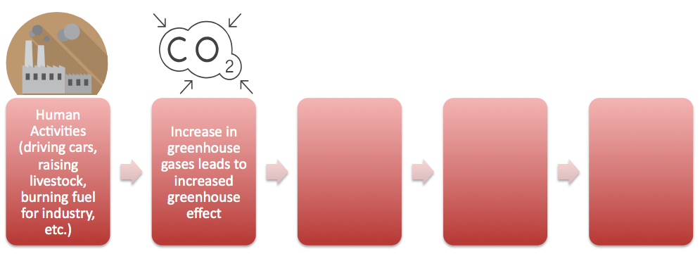
Causes and Effects of Climate Change
(Effect on Nature)
(Effect on Humans)

Slide 11
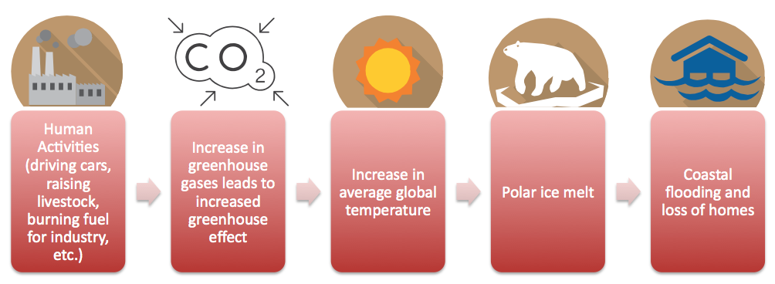
Causes and Effects of Climate Change
(Effect on Nature)
(Effect on Humans)

