Slide 2
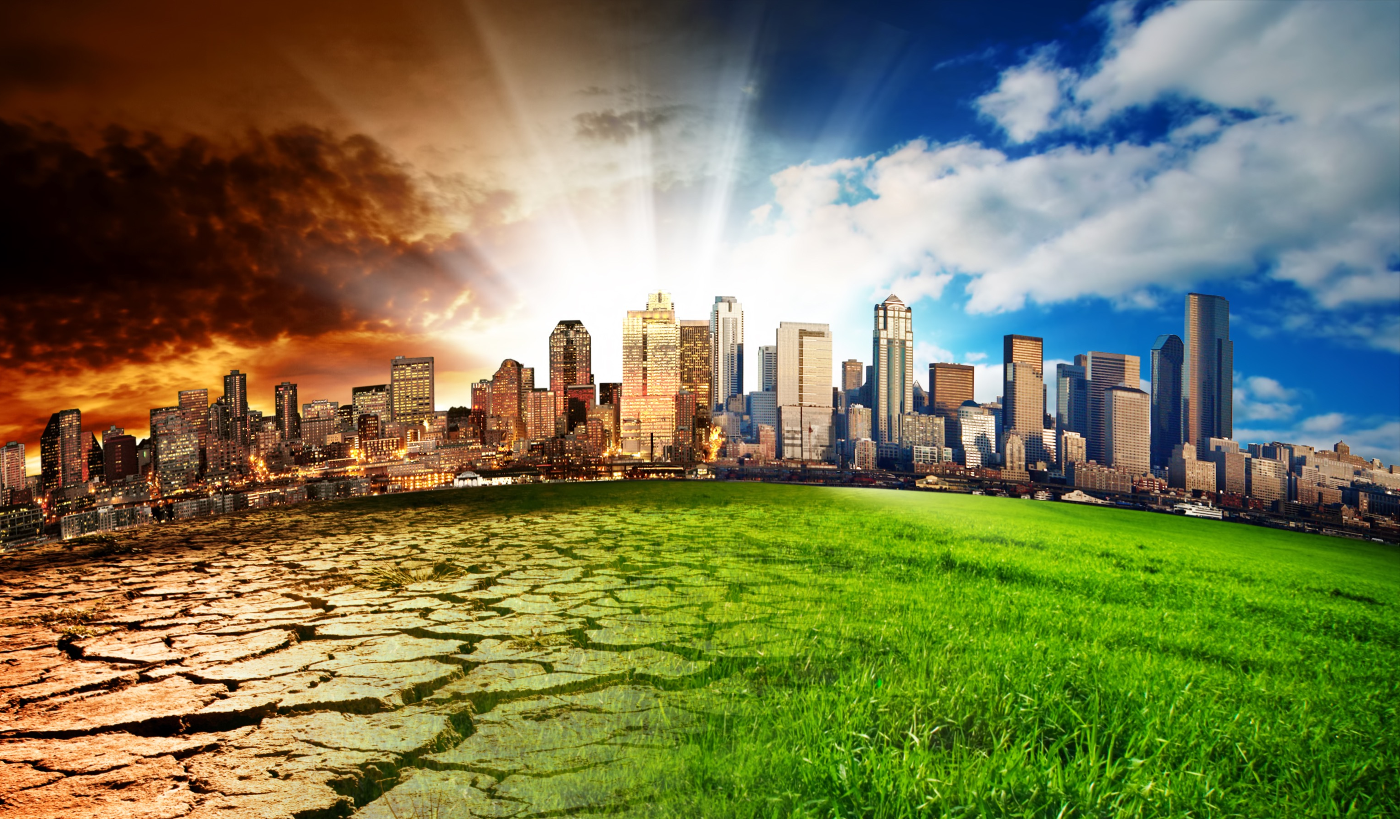

Slide 3
Part I: The Claim
Two students are discussing what has caused the increase in temperature in the last century (100 in years).

Slide 4
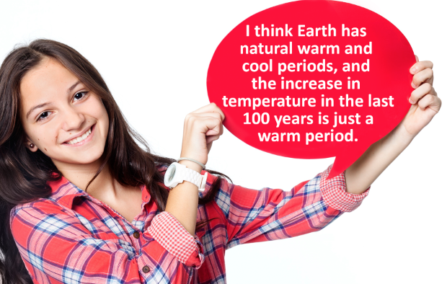
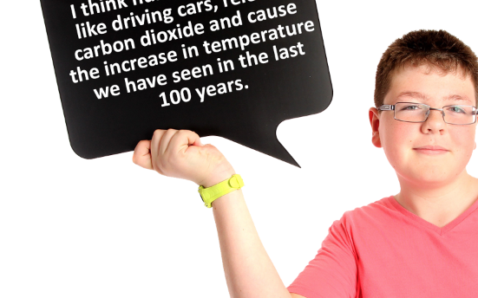
Part II: What Do We Still Need to Know?
 | Destiny | Emilio
Know from Task 1
Need to Know |  | Is more carbon dioxide being made now than in the past? Are humans responsible?

Slide 5
Part III: Collect Evidence
To support a claim, we need evidence!!!

Slide 6
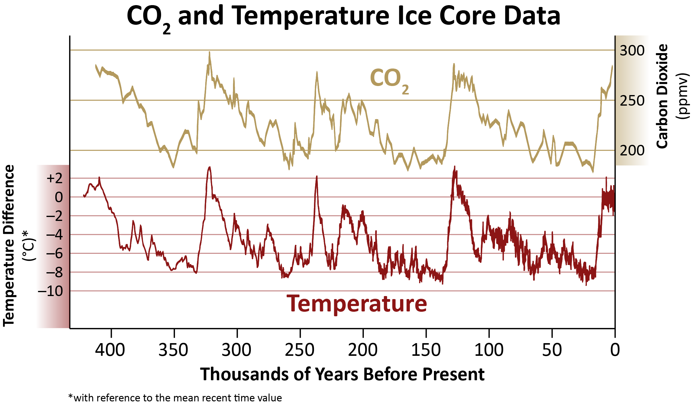
Climate Readings to the Present
Data: Petit, J.R., et al., 2001, Vostok Ice Core Data for 420,000 Years, IGBP PAGES/World Data Center for Paleoclimatology Data Contribution Series #2001-076. NOAA/NGDC Paleoclimatology Program, Boulder CO, USA. https://www1.ncdc.noaa.gov/pub/data/paleo/icecore/antarctica/vostok/deutnat.txt, …/co2nat.txt
Notes:
These graphs show the recent carbon dioxide level. Previous highs have been surpassed by a great deal.
There is natural variation, but we have disturbed the system to cause unnatural variation.
Given that temperature lags a bit behind carbon dioxide emissions, we can expect to see temperature increases in the future.

Slide 7
How do we know about the climate from thousands of years ago?
Notes:
How we know about climate in the distant past so that we can compare it to our current climate.

Slide 8
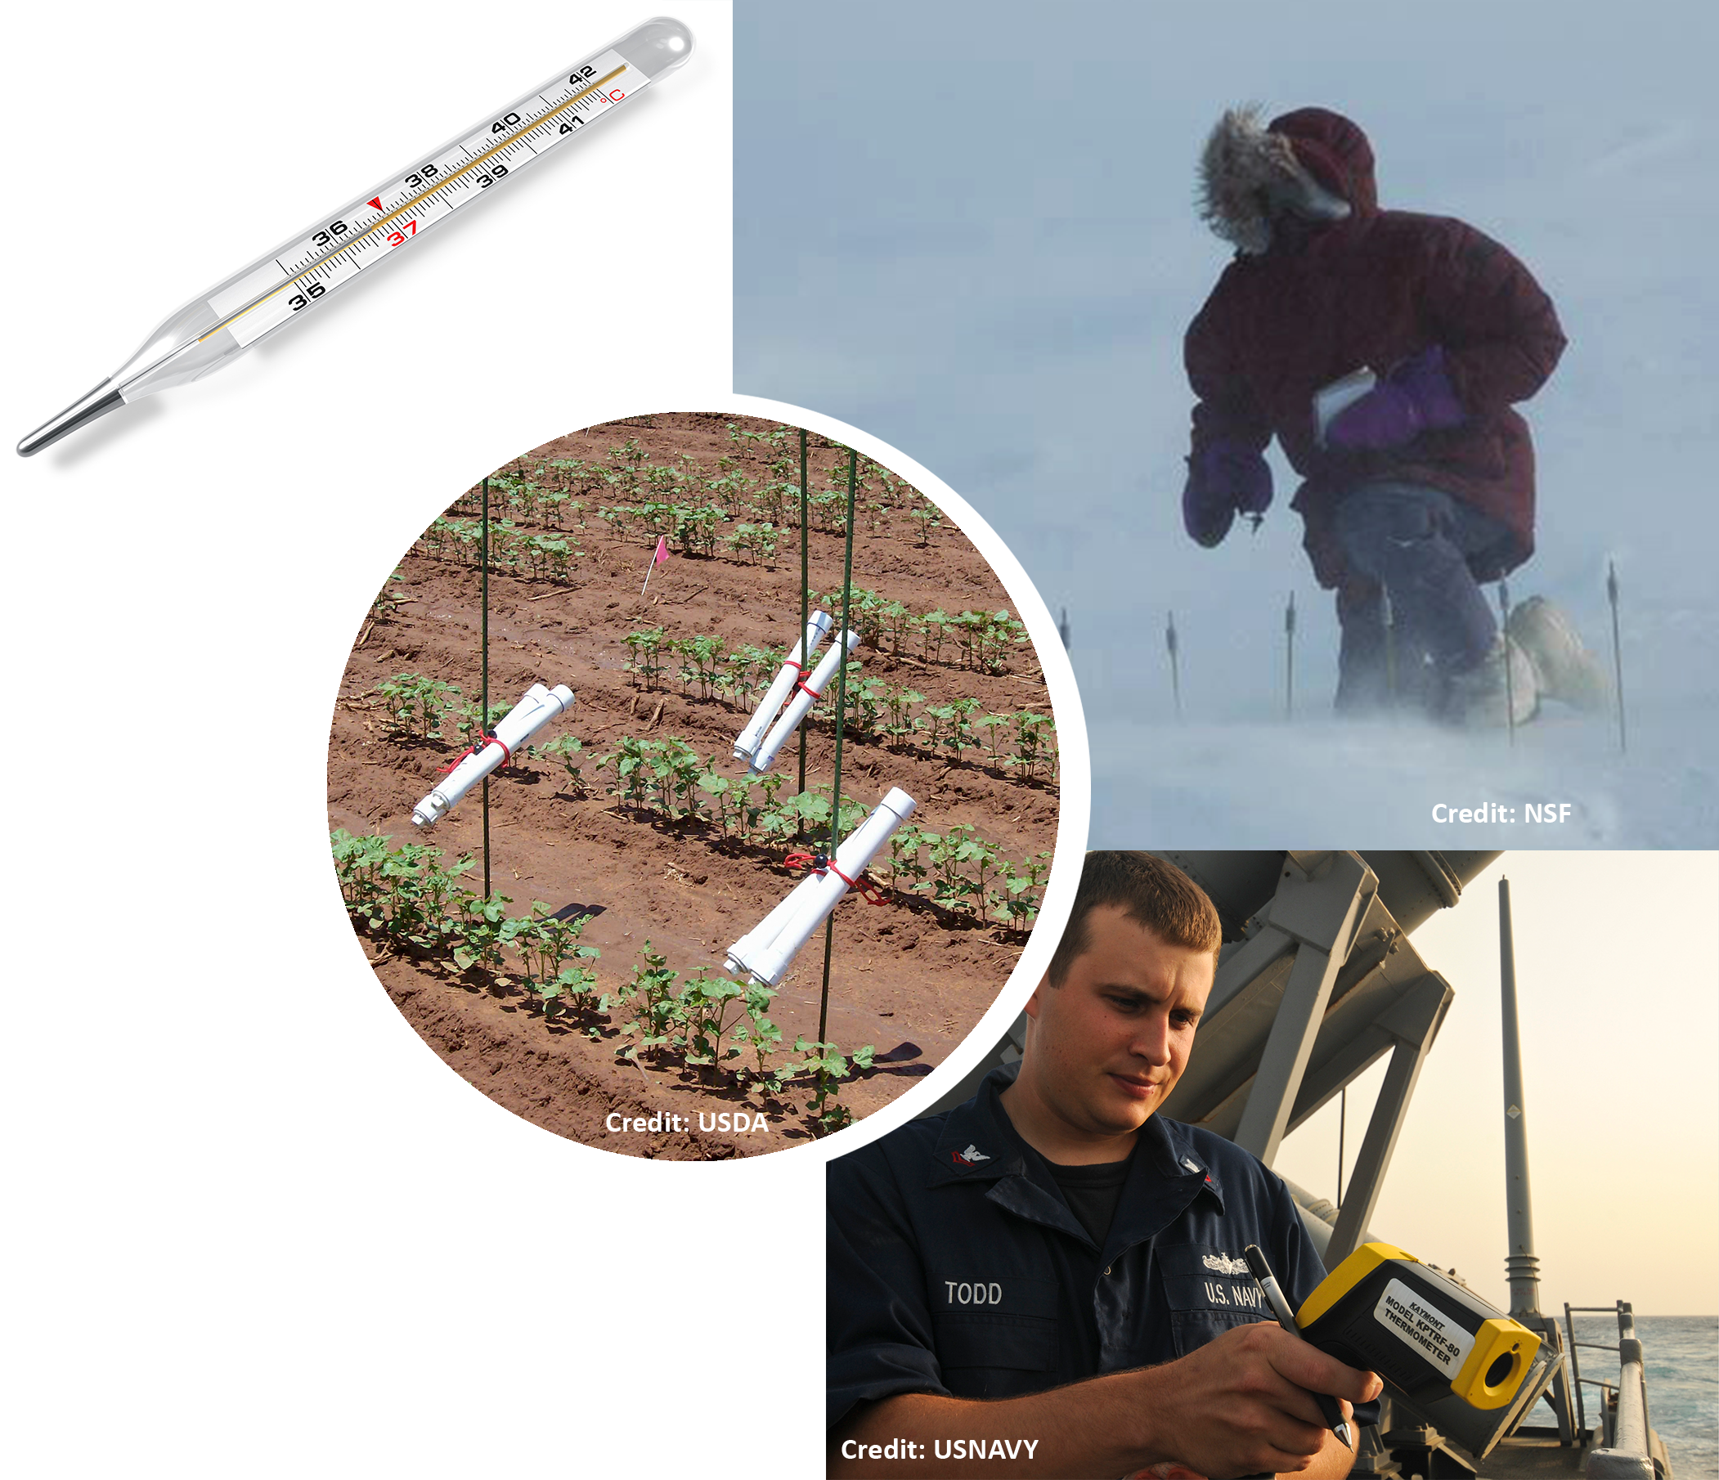
Measuring Devices
Thermometers were not invented until 1724.
Other climate measuring devices were not invented until much later.
Notes:
Thermometers are only a couple of hundred years old, but we have data for hundreds of thousands of years. What do you think they use?

Slide 9
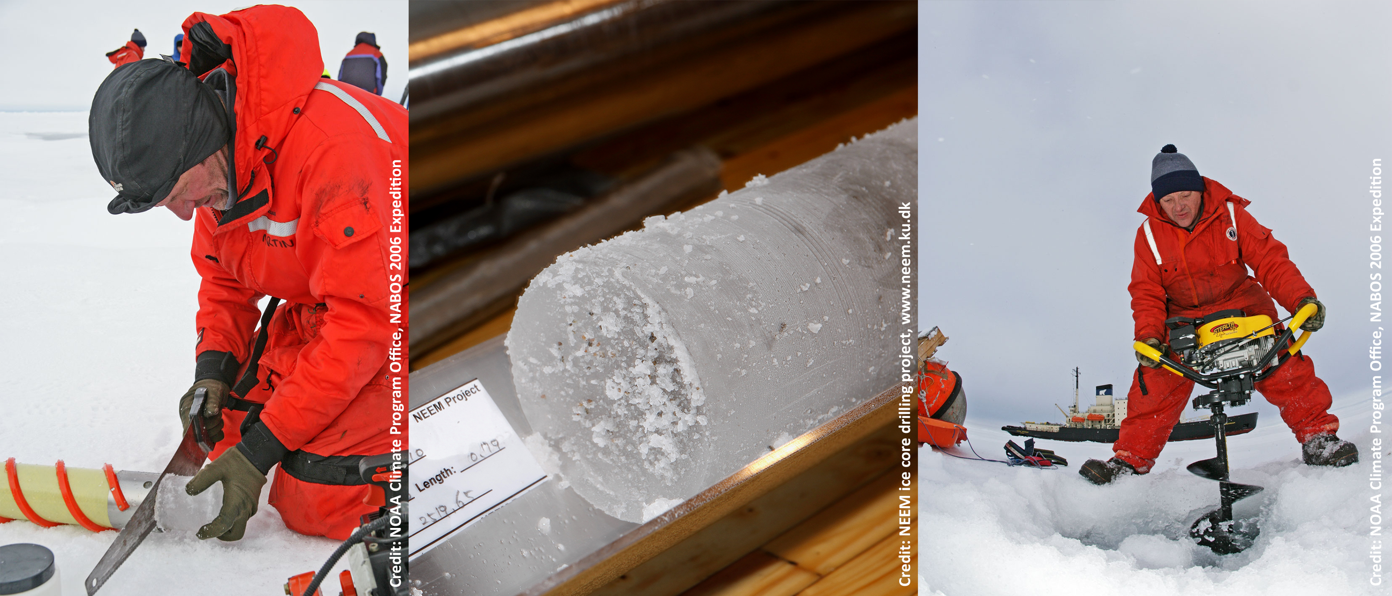
Source of Data: Ice Cores!
Earth Operator's Manual: CO₂ in the Ice Core Record
Notes:
Play video: http://earththeoperatorsmanual.com/segment/5

Slide 10
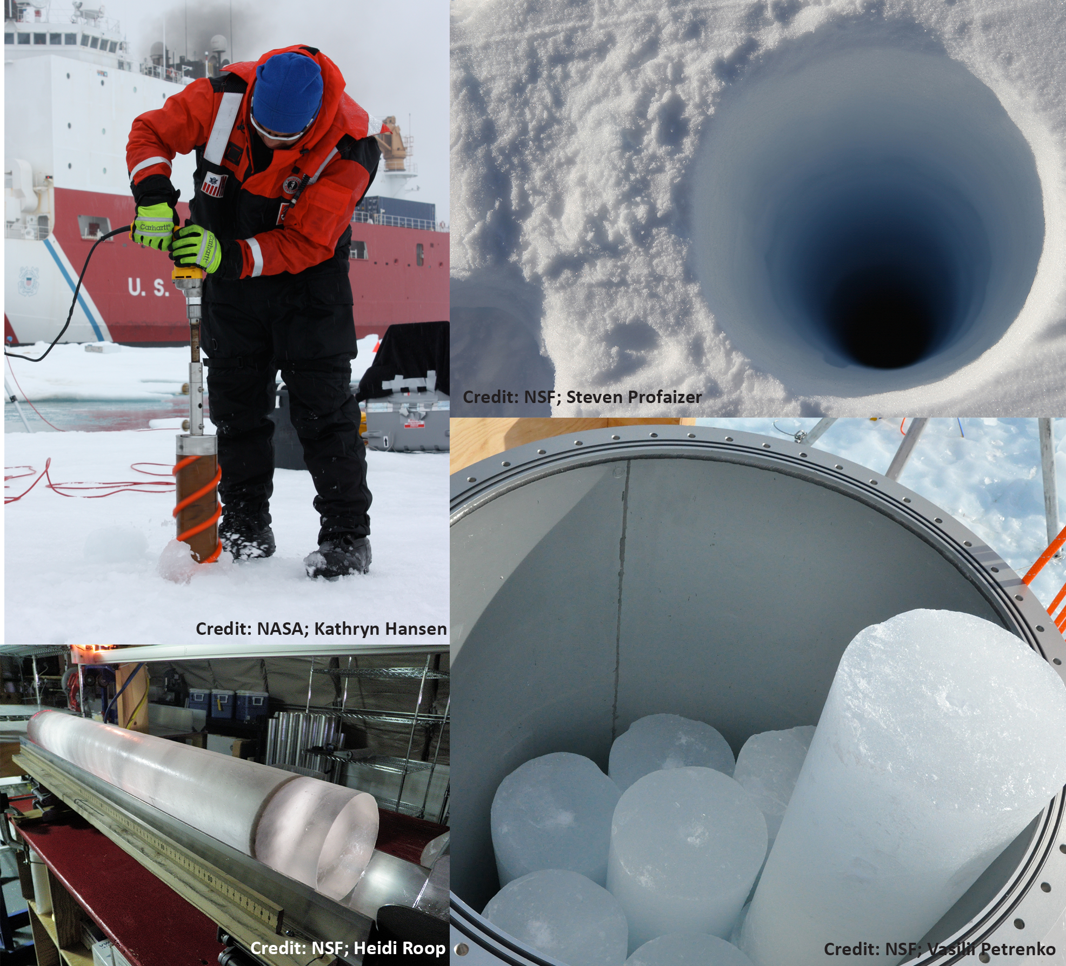
Ice Cores
Drilling into glacial ice allows scientists to see back in time.
Each winter new snow fall packs on top of previous snow. This creates a new band each year.

Slide 11
Dating Ice Cores
Ice cores are like tree rings.
Summer ice appears light.
Winter ice appears dark.
How many years do you see?
Credit: USGS; National Ice Core Laboratory
Notes:
The summer bands appear white because the snow experiences 24 hours of sunlight in the polar regions. This changes the texture compared to the 0 hours of sunlight that it receives in the winter.

Slide 12
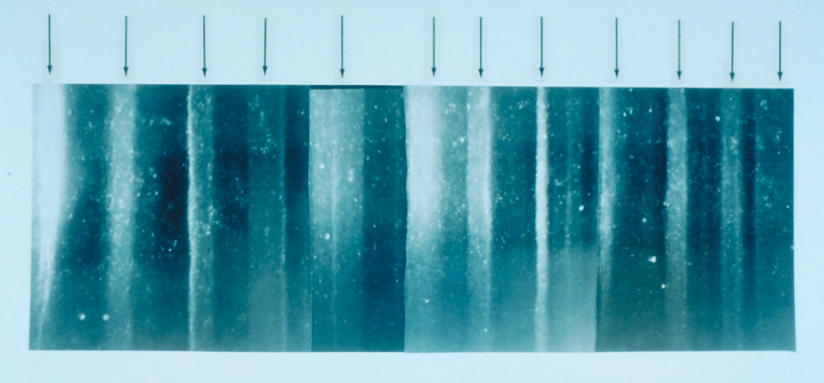
Dating Ice Cores
This ice core shows 12 years.
Credit: Anthony Gow; USACE, Cold Regions Research and Engineering Lab

Slide 13
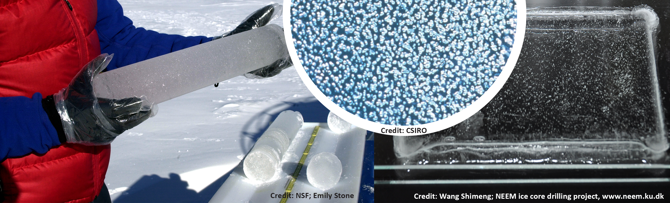
Air Bubbles
Air bubbles in the ice trap pollen and the atmosphere, which is made of gases.
These bubbles help scientists know what the climate was like thousands of years ago.
Notes:
In the ice, the water molecules (H2O) have oxygen atoms of different isotopes. The ratio of the amount of one oxygen isotope to another oxygen isotope is used as a proxy for temperature. Scientists can measure the isotope ratio of the ice to determine the past temperature.
Pollen and dust particles are used to infer more about the conditions at that time.
There are gas bubbles trapped in the ice also. This gas can be analyzed to determine the amount of greenhouse gases that were in the atmosphere long ago. This is how scientists can measure the amount of carbon dioxide in the atmosphere.

Slide 14
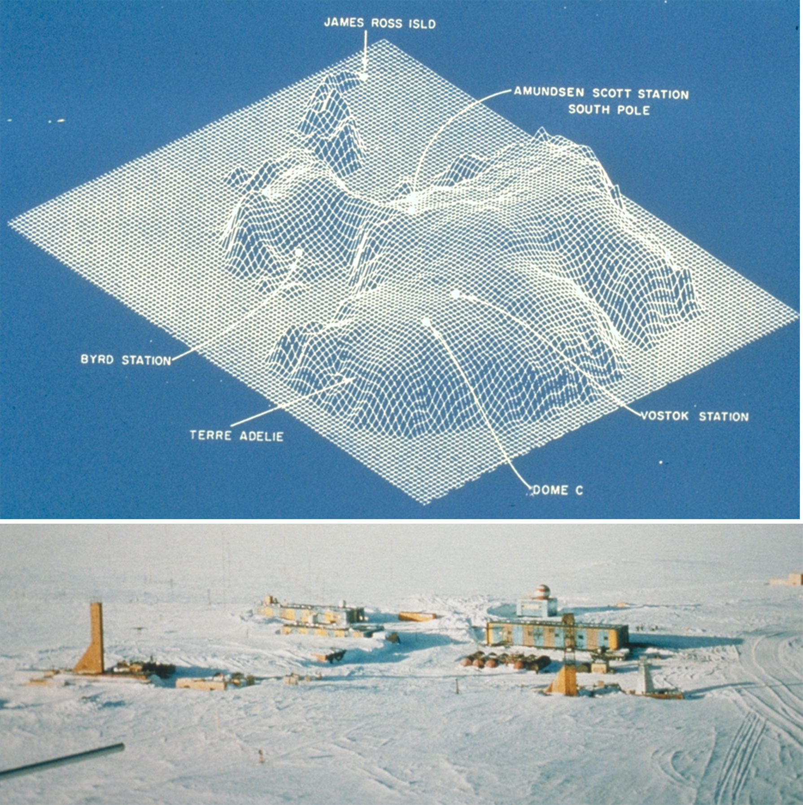
The Vostok Ice Core
The Vostok Ice Core is a Russian Station near the South Pole.
The ice cores there have produced climate data for the past 420,000 years!
VOSTOK
STATION
Credit: Todd Sowers, LDEO, Columbia University, NY,
NOAA Paleoclimatology Program / Dept of Commerce
Notes:
The ice cores can be taken from thousands of feet deep, but the length of the core depends on the length of the drill bit. Most drill bits are 4-6 meters long so scientists get extremely long ice cores (over 2000 meters) from increments of 4-6 meters.

Slide 15
Evidence from Graphs
Examine the graphs and other pieces of evidence.
Discuss with your group and answer the questions on the Climate Change Evidence Analysis Chart.
Decide whether each piece of evidence supports or refutes Destiny’s and Emilio’s claims.
Notes:
You may choose to have each group analyze all the graphs or have each group focus on just one and share the information with the class.
Then briefly go through each graph and the story that it tells.

Slide 16
Graph 1 • Climate Readings to the Present
Data: Petit, J.R., et al., 2001, Vostok Ice Core Data for 420,000 Years, IGBP PAGES/World Data Center for Paleoclimatology Data Contribution Series #2001-076. NOAA/NGDC Paleoclimatology Program, Boulder CO, USA. https://www1.ncdc.noaa.gov/pub/data/paleo/icecore/antarctica/vostok/deutnat.txt, …/co2nat.txt
Notes:
Return to this graph regarding climate and CO2 in the past
Go step by step through the graph so students can interpret it.
First look at the axes and what is being graphed. Describe what the graph is about in own words (this isn’t the analysis… but it helps get acquainted with the graph and students will have to describe what the graph is communicating in their own words). Note that 0 is present (maybe write this on the board)
Provide some criteria for analysis.
Describe patterns (repetitions) using axes labels
Describe exceptions to patterns… are there parts of the graph that are different than the pattern?
If there is no pattern, say there is no pattern
Provide some sentence starters
If there are patterns: “As _________ increases/decreases, ___________ increases/decreases…”
If there are exceptions to patterns: “However, from (some part of the graph)… (difference in the pattern.” Look for peaks.
These graphs show the recent carbon dioxide level. Previous highs have been surpassed by a great deal.
There is natural variation, but we have disturbed the system to cause unnatural variation.
Given that temperature lags a bit behind carbon dioxide emissions, we can expect to see temperature increases in the future.

Slide 17
Where are the greenhouse gases coming from?
As shown in the video, CO₂ is a waste product of burning fossil fuels (cars, factories, coal plants).
There are also natural causes for the release of CO₂ into the atmosphere:
Methane from cows
Volcanoes
Natural cycles of CO₂ to and from ocean and air, and land and air

Slide 18
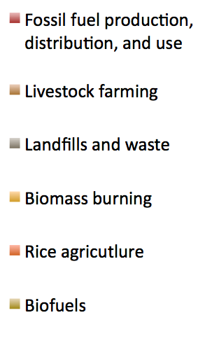
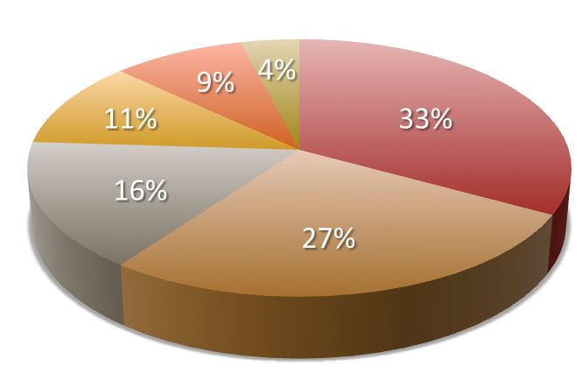
Sources of Methane
9%
4%
11%
33%

Slide 19
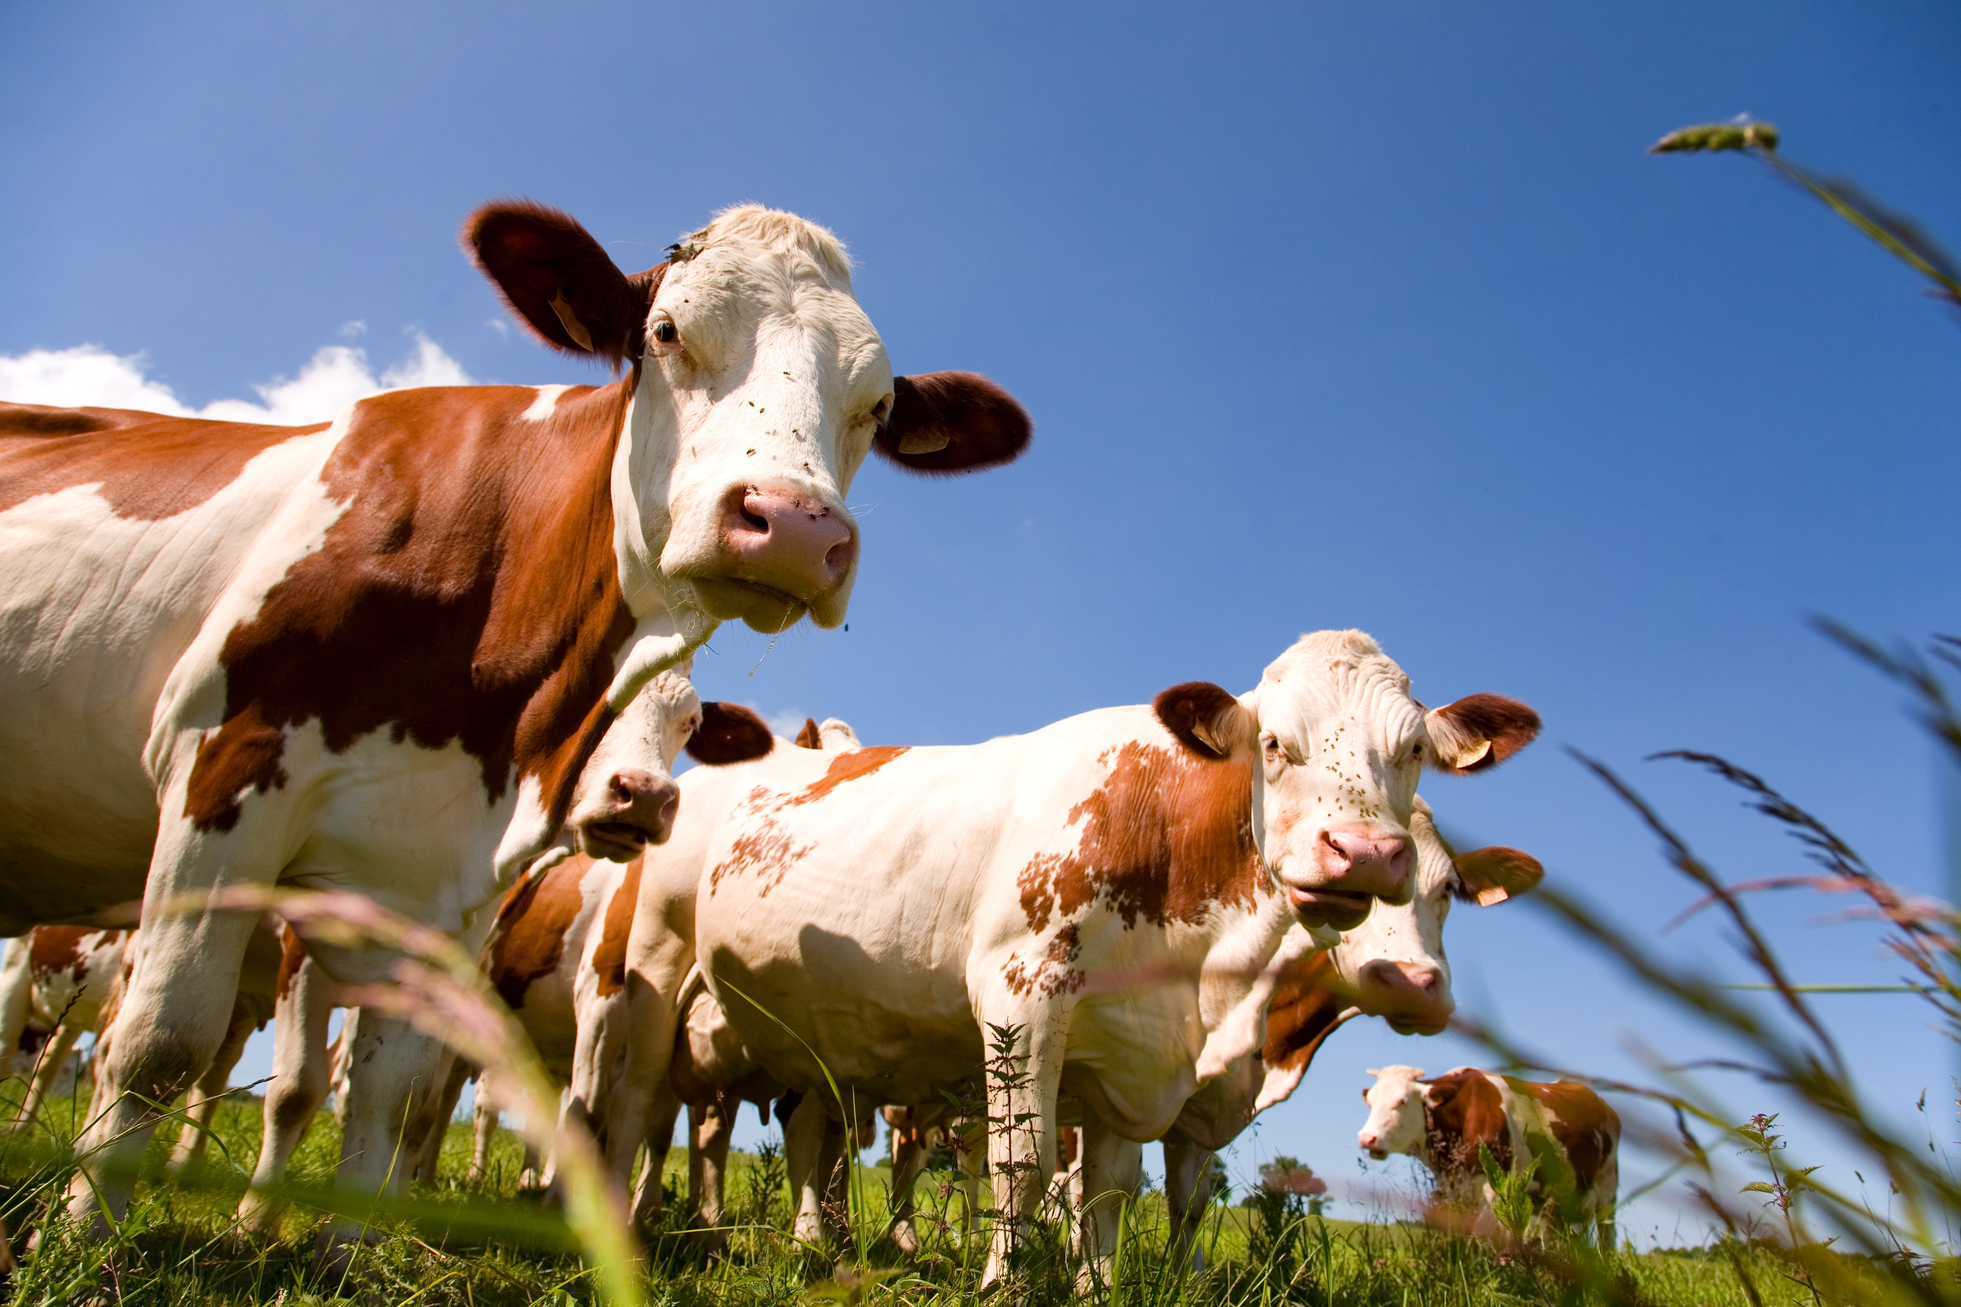
Livestock

Slide 20
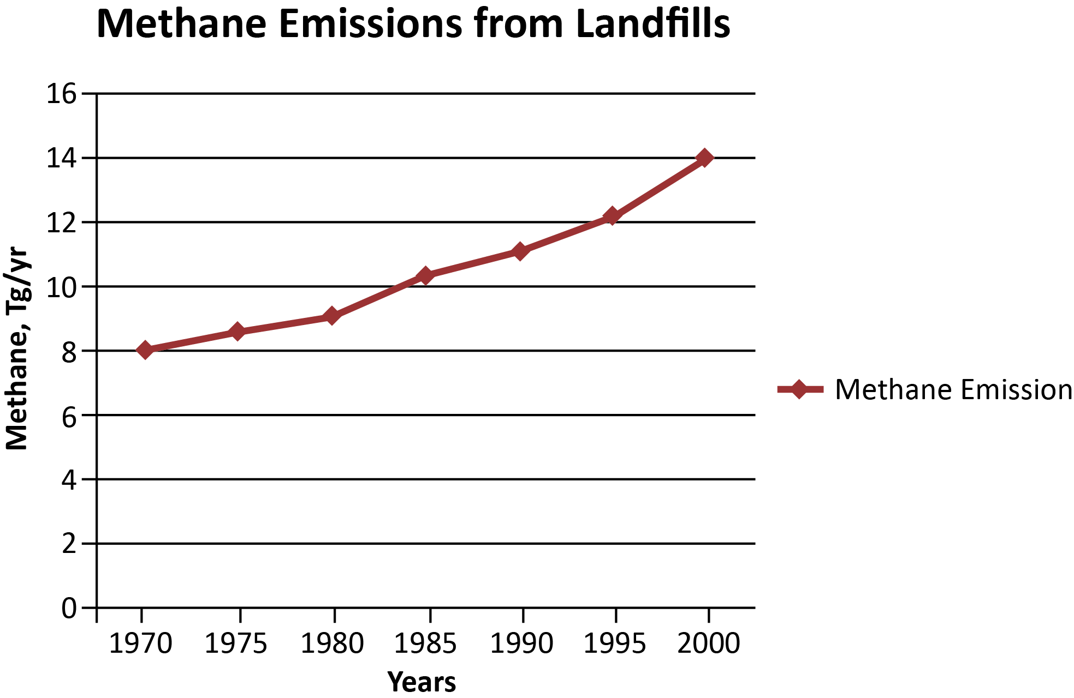
Methane Emissions from Landfills in Asia

Slide 21
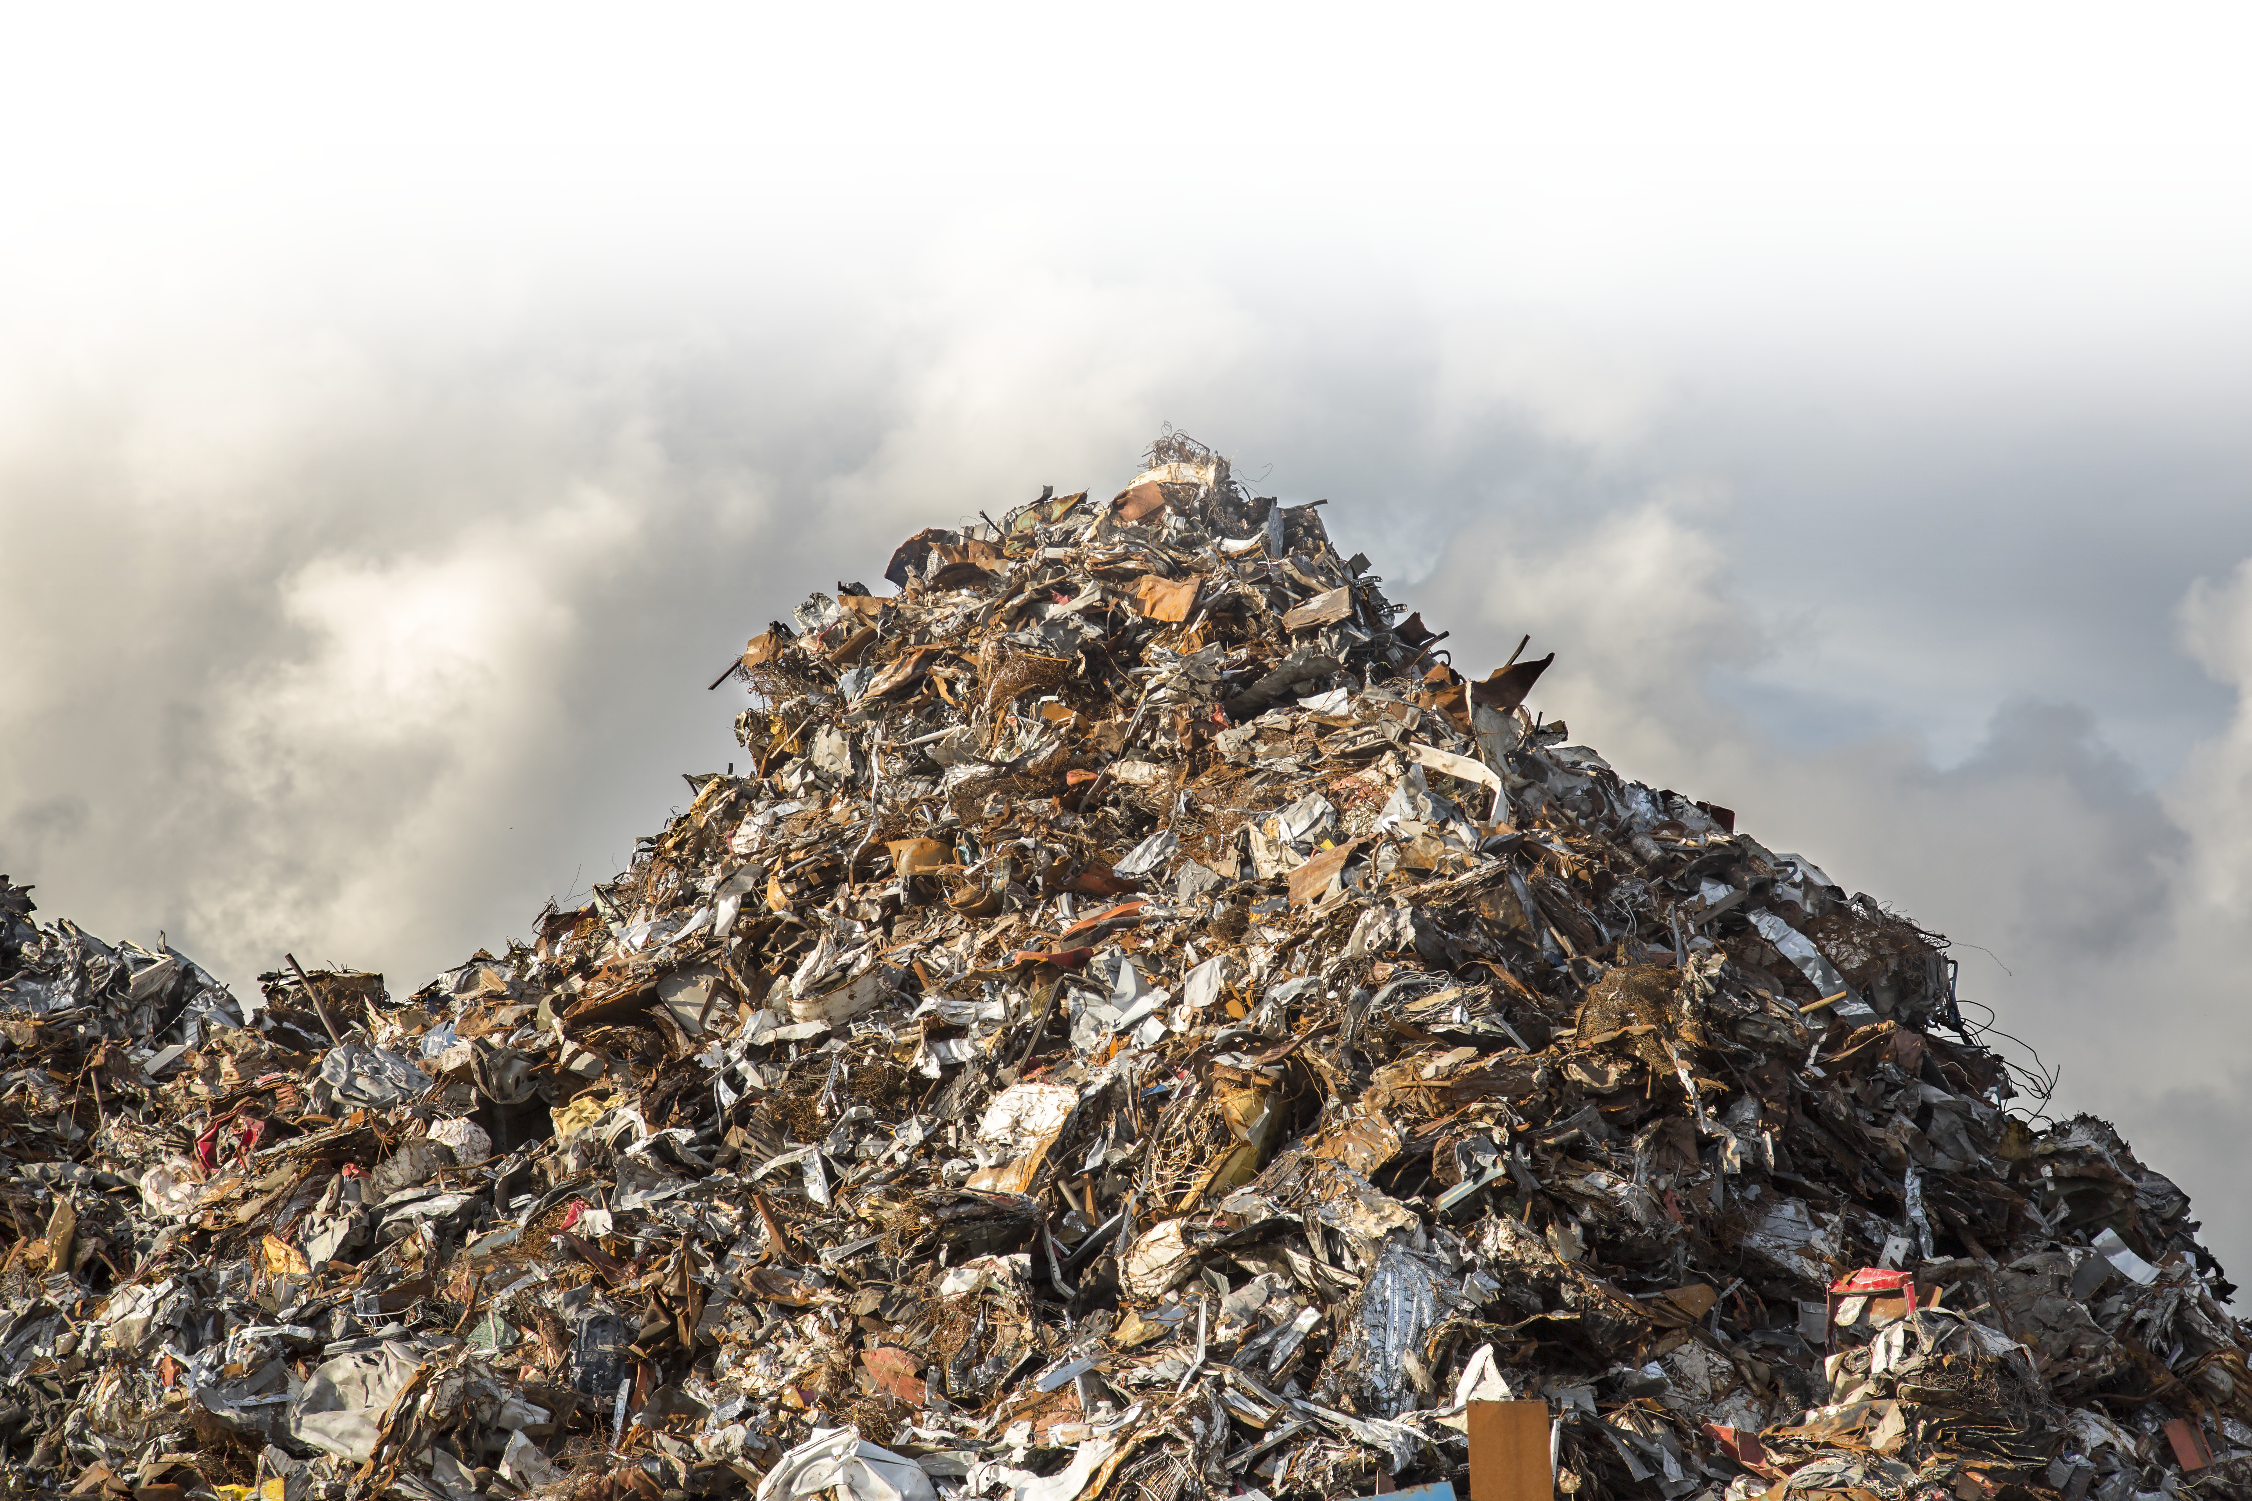
Methane from Landfills

Slide 22
Evidence Conclusions
In the past, the global temperature on Earth has been as high as it is today, but conditions were far different from the conditions we have today. For example, there were no ice caps at the poles.
In the past, it took thousands of years for the global temperature to change 2–3°. Recently, significant change has occurred in just 100 years.
The carbon dioxide level has not been this high in the last 420,000 years—although it was much higher millions of years ago.
There is a lag in how long it takes the temperature to change after a rise in CO₂. Thus, if CO₂ keeps increasing, temperatures are virtually certain to surpass highs of the past 420,000 years.

Slide 24
Part IV: The Argument
Claim
Evidence
Reasoning
Counterclaim
Refute the counterclaim
Notes:
Review with students the structure of an “argument”

Slide 25
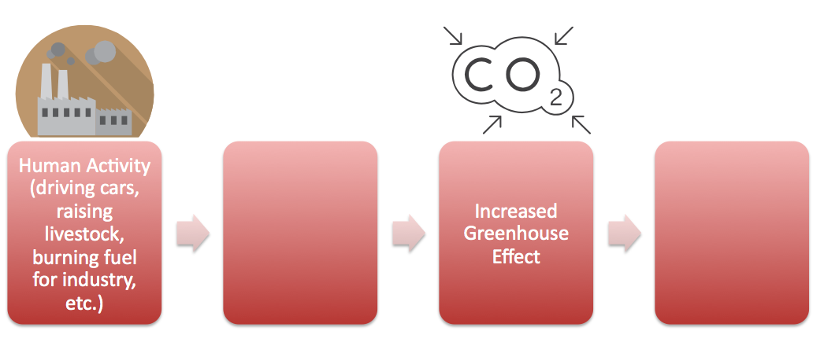
Part V: Chain of Cause and Effect
Human Activity (driving cars, raising livestock, burning fuel for industry, etc.)
Increased Greenhouse Effect
Notes:
Review with students the structure of an “argument”

Slide 26
Part III: Addendum (Optional)
Sample Ice Core Sketch
Notes:
Remind students the oldest data is on the bottom and the most recent data is on the top.
The sketch is lacking a “key”. What might that look like?

Slide 28
Climate Reading to the Present
Data: Petit, J.R., et al., 2001, Vostok Ice Core Data for 420,000 Years, IGBP PAGES/World Data Center for Paleoclimatology Data Contribution Series #2001-076. NOAA/NGDC Paleoclimatology Program, Boulder CO, USA. https://www1.ncdc.noaa.gov/pub/data/paleo/icecore/antarctica/vostok/deutnat.txt, …/co2nat.txt
Notes:
Return to this graph regarding climate and CO2 in the past
Go step by step through the graph so students can interpret it.
First look at the axes and what is being graphed. Describe what the graph is about in own words (this isn’t the analysis… but it helps get acquainted with the graph and students will have to describe what the graph is communicating in their own words). Note that 0 is present (maybe write this on the board)
Provide some criteria for analysis.
Describe patterns (repetitions) using axes labels
Describe exceptions to patterns… are there parts of the graph that are different than the pattern?
If there is no pattern, say there is no pattern
Provide some sentence starters
If there are patterns: “As _________ increases/decreases, ___________ increases/decreases…”
If there are exceptions to patterns: “However, from (some part of the graph)… (difference in the pattern.” Look for peaks.
These graphs show the recent carbon dioxide level. Previous highs have been surpassed by a great deal.
There is natural variation, but we have disturbed the system to cause unnatural variation.
Given that temperature lags a bit behind carbon dioxide emissions, we can expect to see temperature increases in the future.

Slide 29
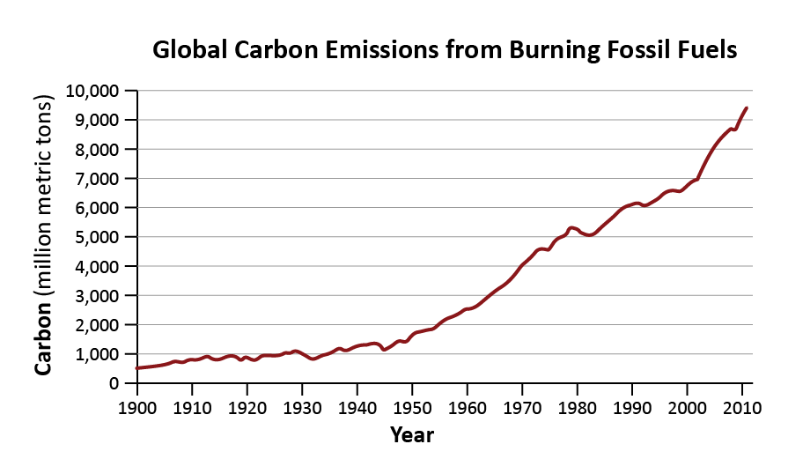
Graph 4 • Global Carbon Emissions from Burning Fossil Fuels*
*Examples of fossil fuels are coal, oil, natural gas, gasoline.
Credit: EPA; Source: Boden, T.A., Marland, G., and Andres R.J. (2015). Global, Regional, and National Fossil-Fuel CO2 Emissions. Carbon Dioxide Information Analysis Center, Oak Ridge National Laboratory, U.S. Department of Energy, doi 10.3334/CDIAC/00001_V2015.

Slide 30
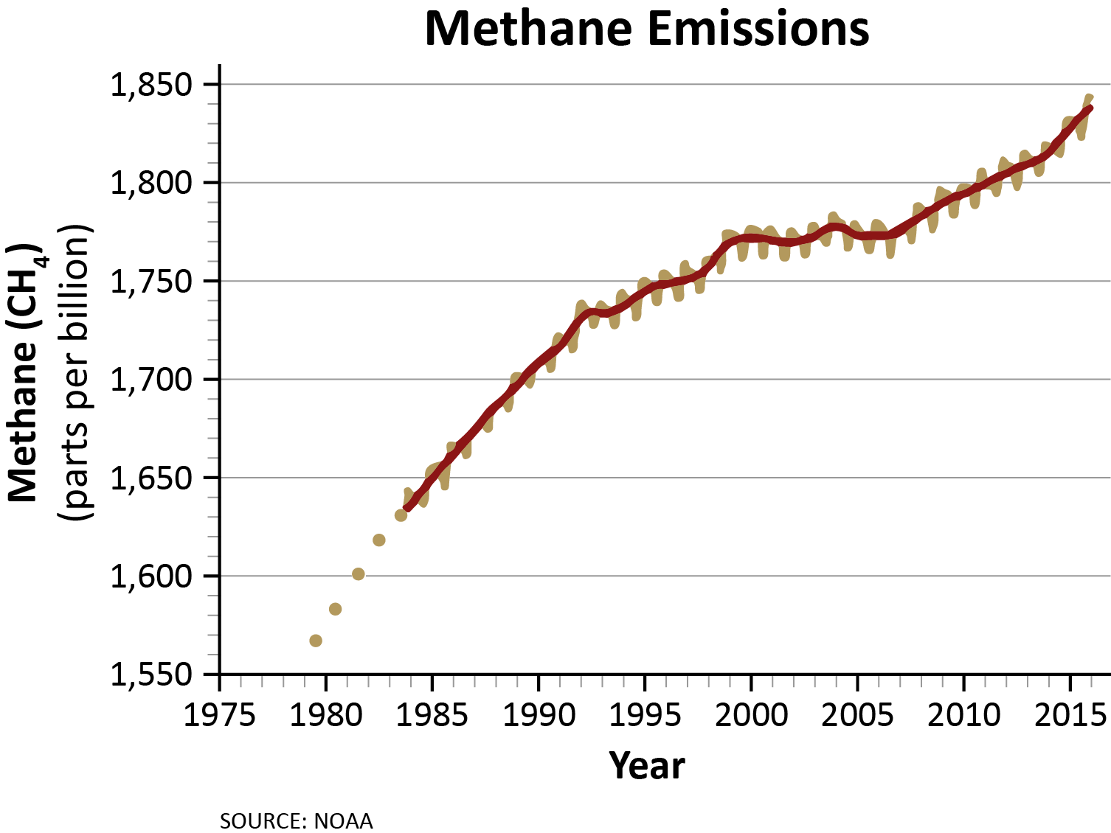
Graph 5 • Methane Emissions*
*Methane results from the production and transportation of fossil fuels, breakdown of wastes in our landfills (dumps), and cow flatulence.
SOURCE: NOAA

Slide 31
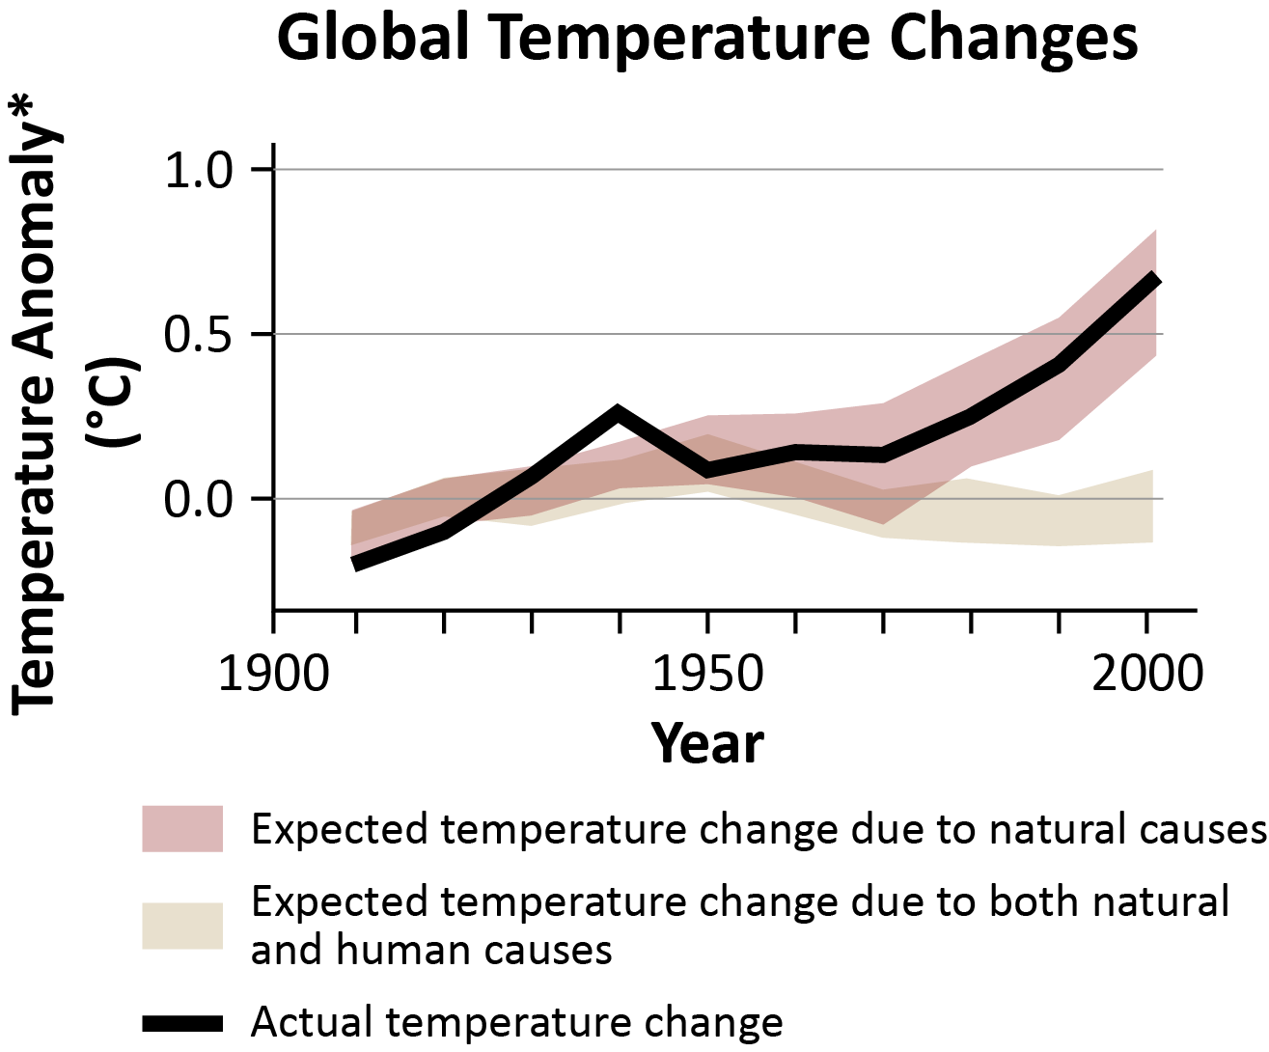
Graph 2 • Global Temperature
*Anomaly means “different from normal.”
Source: IPCC 2007: WGI-AR4

Slide 32
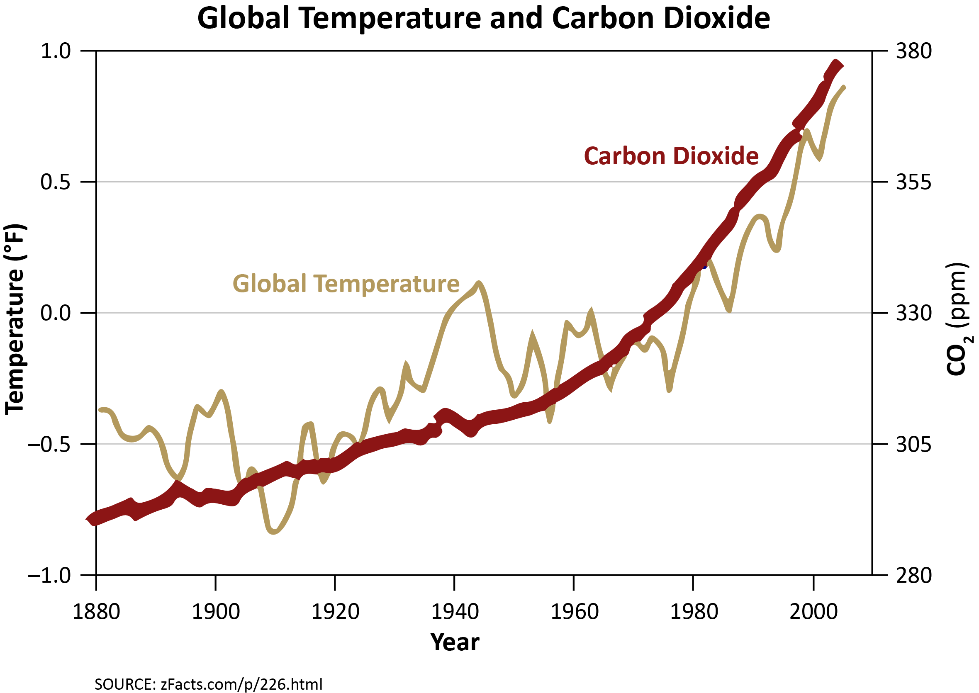
Graph 3 • Global Temperature and Carbon Dioxide

Slide 33
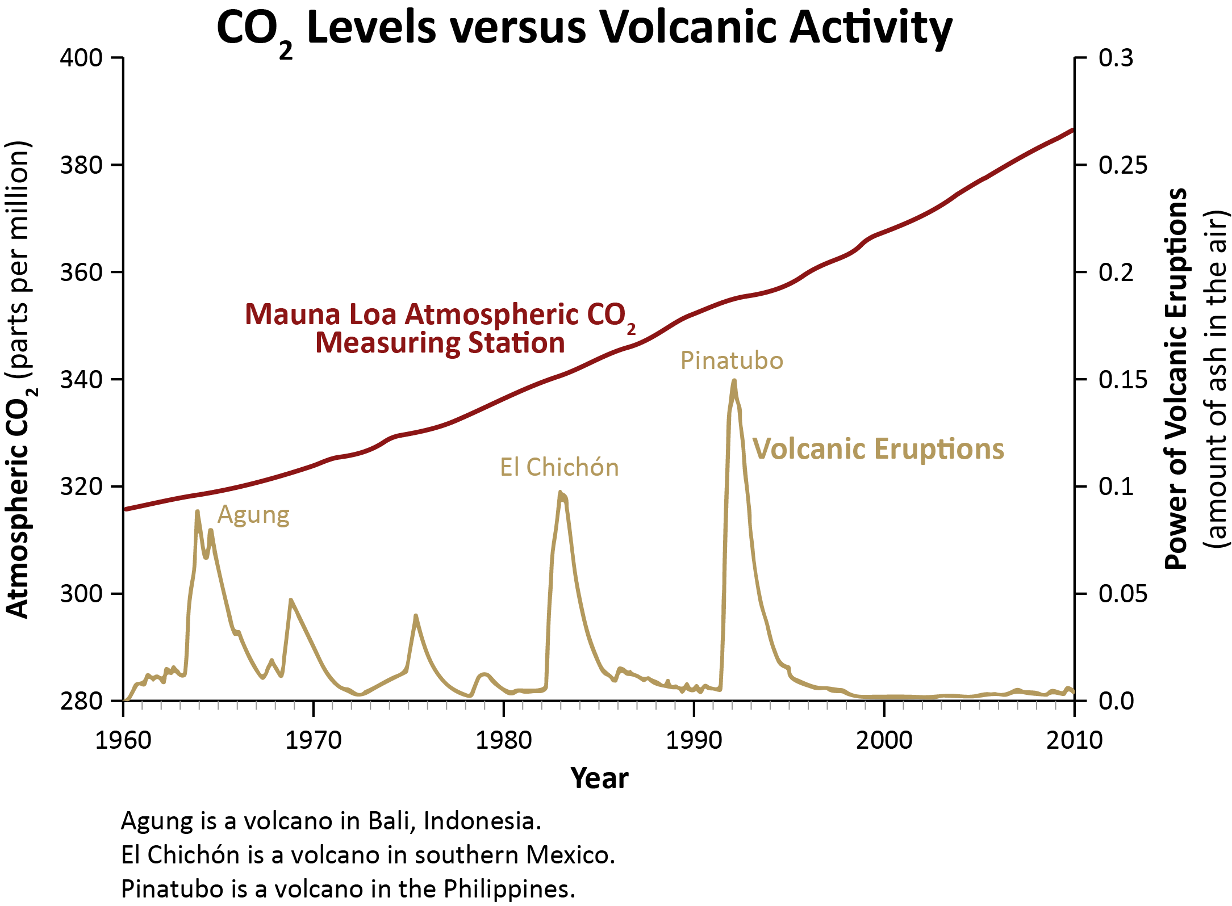
Graph 6 • CO₂ and Volcanic Eruptions
Data: NOAA ESRL; NASA GISS

