Slide 2
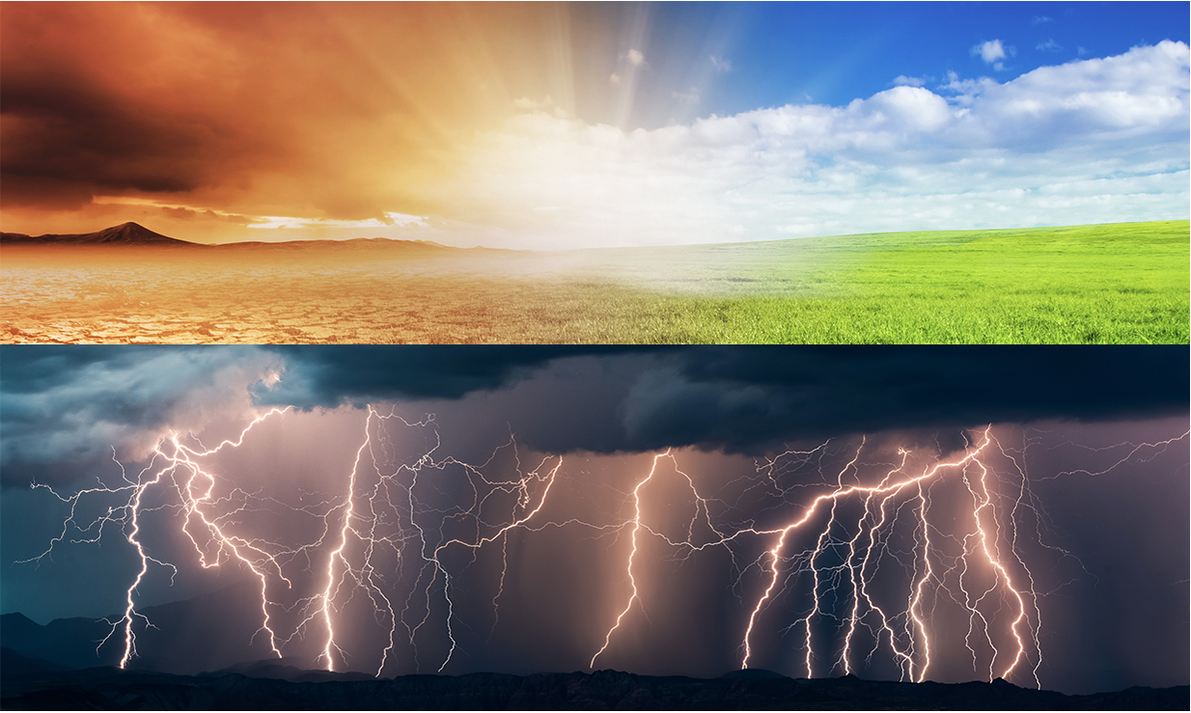

Slide 3
You may have heard of greenhouse gases. In this presentation, you will learn more about them and focus on these questions:
What are the greenhouse gases?
Where do they come from?
How do they work?
Notes:
DAY 1 KWL CHART
Over the next few days we will be investigating the different greenhouse gases and where they are from. Start with a KWL chart in order to determine what students already know.

Slide 4
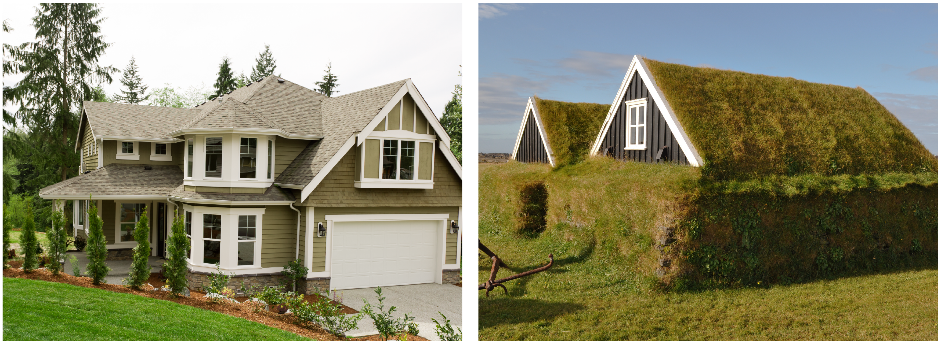
What is a greenhouse?
A house that is green?
A sod house?
A house that is green?
Notes:
Defining a greenhouse. Some students may know that a greenhouse is used to grow plants and that it is warmer inside than outside. But, some might not distinguish a green house from a greenhouse.
(Internal Note: did not include image of The White House because it did not correspond to the text.)

Slide 5
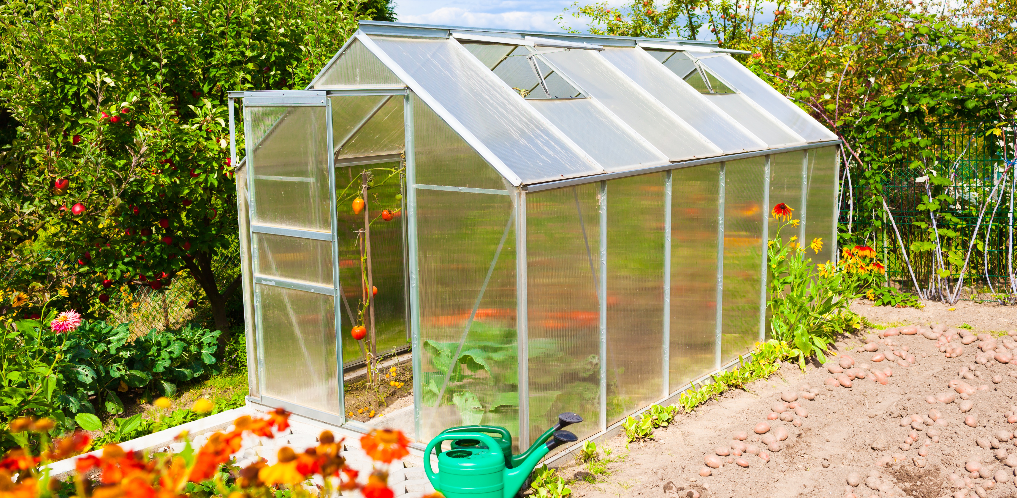
A Greenhouse
Notes:
A greenhouse in this definition is a house used to trap the sun’s energy in order to extend the growing season or grow plants in areas that would otherwise be too cold. We use this idea as a way to think about how sun’s energy is trapped in our atmosphere. The difference is that the Earth is not surrounded by glass, but by invisible gas that is also able to trap energy and heat.

Slide 6
What is the greenhouse effect?
Notes:
Students might also have experienced this feeling when they get into a car on a hot day. It feels much warmer inside the car because of the trapped air. So, it is different than the greenhouse effect but a connection to their experience. Students might be able come up with other examples as well.
Air in the car is trapped and can’t get out. On Earth, there is no physical boundary, so it is the gases that actually work to hold the heat. After these three slides students should be able to fill out the graphic organizer comparing and contrasting a greenhouse with the “greenhouse effect”

Slide 7
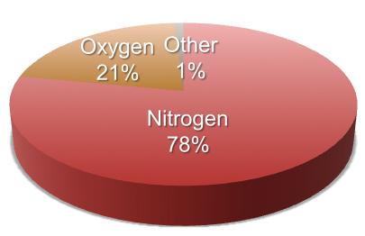
Composition of the Earth’s Atmosphere
Nitrogen (N₂) = 78%
Oxygen( O₂) = 21%
Other = 1.0%
Argon (Ar)
Carbon Dioxide (CO₂)
Methane (CH₄)
Nitrous Oxide (NO₂)
Ozone (O₃)
Hydrogen (H)
Notes:
Most of our atmosphere is nitrogen and oxygen, neither of which is a greenhouse gas. Compare this to the Goldilocks effect. The GHGs in our atmosphere are less than 0.1% of the total amount of gas in the atmosphere and yet they are what make our planet inhabitable. Without the small amount of greenhouse gases, the average temperature on the planet would be 0 degrees F
There is a major misconception that the hole in the ozone layer is the primary reason for climate change. It is correct to say that the ozone hole has a small effect on climate change, but is not the main cause. The other connection between these issues is that CFCs and their non-ozone-destroying replacements are very potent greenhouse gases, which also contribute to climate change. Students may or may not bring up these ideas in their discussion.

Slide 8
The “Goldilocks Principle”
Credit: NASA
 | Venus | Earth | Mars
Surface Pressure Relative to Earth (bars) | 90 | 1 | 0.007
Major Greenhouse Gases (GHG) | CO₂ | H₂O, CO₂ | CO₂
Temperature If No GHG (°C) | –46 | –18 | –57
Actual Temperature (°C) | 477 | 15 | –47
Temperature Change Due to GHG | +523 | +33 | +10
Mars is too cold, Venus is too hot, but the Earth is just right!
Notes:
Why is the greenhouse effect so important? This slide compares the temperatures on the three planets with and without greenhouse gases. All of them do experience warmer temperatures with the gases. The next slide is specifically the Earth and temperatures are reported in Fahrenheit (which might be more familiar to the students).
Recent calculations by NASA actually put the temperature change due to GHGs at only 20 degrees, not the 33 degrees in the chart. This is mostly because of using a different albedo number to consider the effects of solar and longwave radiation on the planetary albedo. The changed number is (-18 to -5) and is called the “atmosphere effect” of greenhouse gases, as opposed to the “enhanced atmospheric test” associated by the increase in greenhouse gases due to human activities.

Slide 9
What if Earth did not have greenhouse gases (GHG)?
Main Greenhouse Gases | CO₂ and H₂O
Temperature without GHG | –5°C (23°F)
Actual Average Temperature | 15°C (59°F)
Temperature Change Because of Greenhouse Gases | 20°C (68 °F)
Credit: NASA
Notes:
This is an example of why we want to have greenhouse gases. They make our planet inhabitable and bring the temperature up to a level humans can live in. It does not mean that the temperature everywhere on everyday is equal to 59 degrees, but just that there is a dramatic change because of the GHG. We know this because we can look at other planets (Mars and Venus usually) and compare their temperatures and atmospheres to ours.

Slide 10
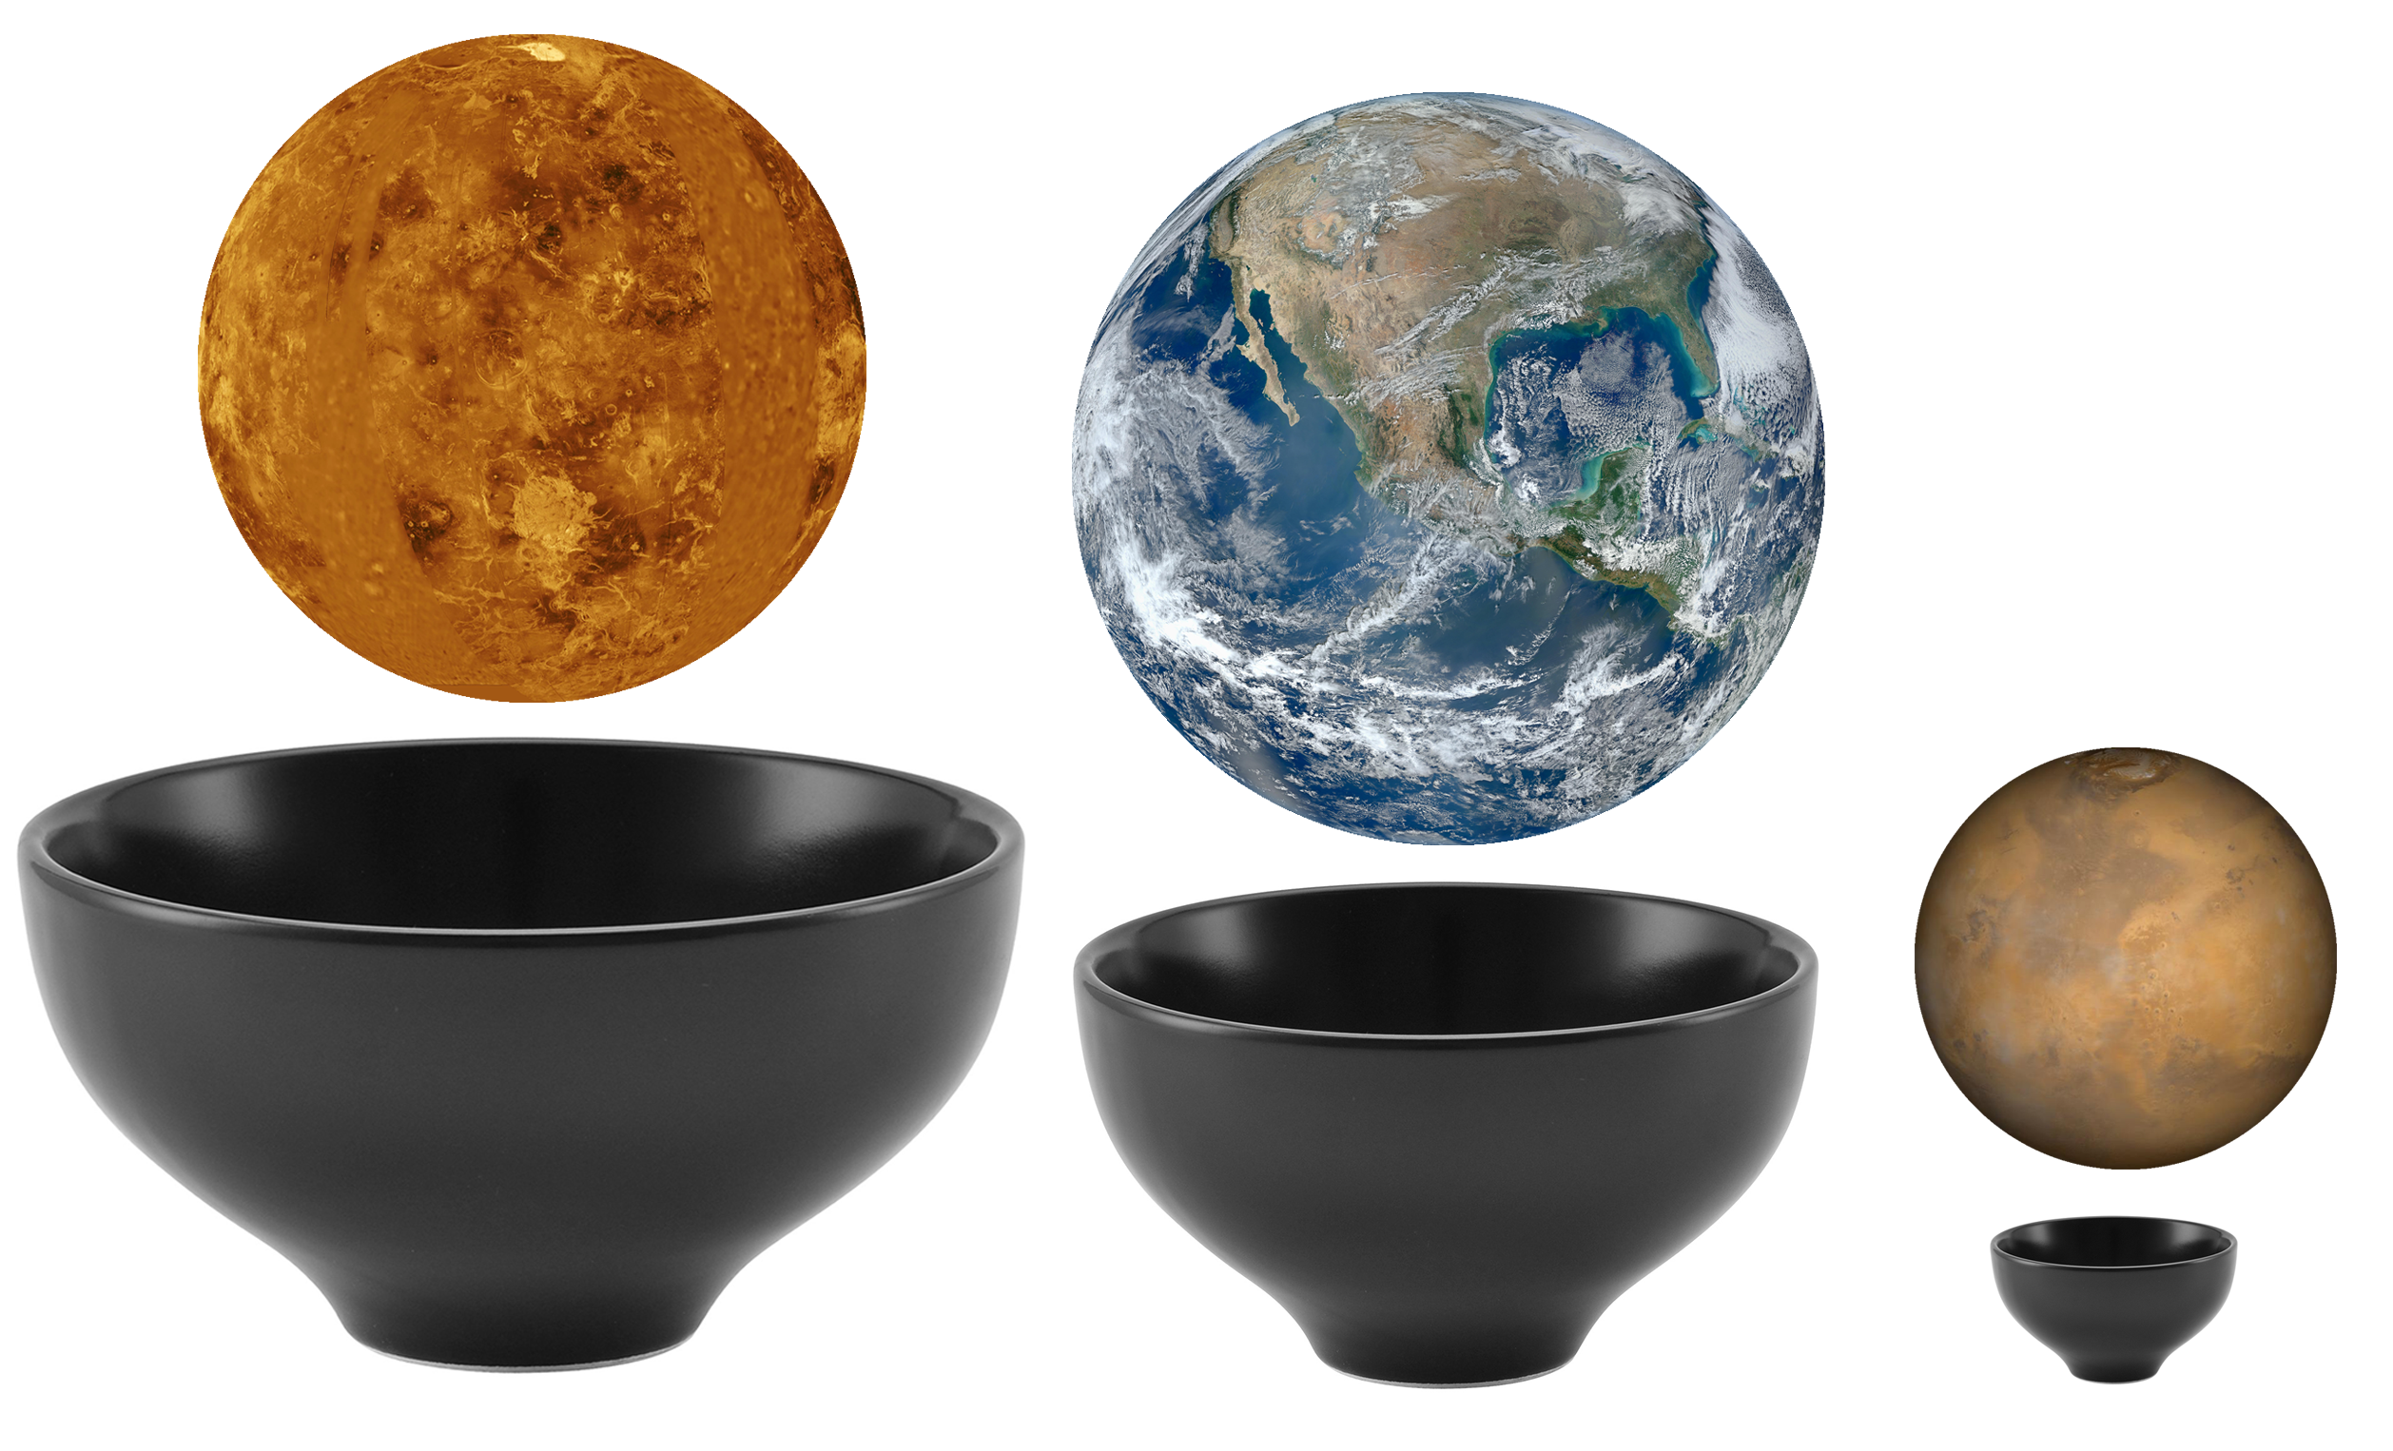
What if Earth did not have greenhouse gases (GHG)?
Credit (planets): NASA

Slide 11
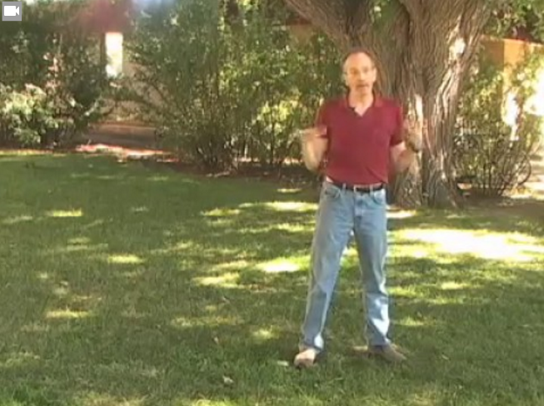
Why do some molecules absorb (or trap) lots of
heat while other don’t?
Notes:
OPTIONAL:
This video (Task 1 Slide 11 Activity 1 Effect of CO2 – VIDEO.mp4) is optional but can be really helpful. It goes into more depth about what some molecules absorb more energy than others.
BACKGROUND

Slide 13
Notes:
Use this slide to relate back to and debrief the lab. What are the comparisons between the greenhouse gas lab and this picture?
Ask students for similarities and differences. There is space on their lab notes to write their comments.

Slide 14
Notes:
This is a picture of the numbers that give us the greenhouse effect. This gives a more detailed description of of where the energy goes. Explain that most of the solar irradiation reaching the lower atmosphere is visible light, but there are other wavelengths present as well. Some of the gases (including water vapor) in the atmosphere reflect incoming solar irradiation, some allow it to pass through to the Earth’s surface (where it is absorbed), and some absorb it.
The radiation (mostly visible light) that is absorbed in the atmosphere or by the Earth’s surface is re-emitted as long wave infrared energy (heat). When long wave radiation interacts with the atmosphere, different molecules will reflect, absorb, or allow it to pass through to space. Point out that the passing of long wave radiation from the Earth’s surface to the atmosphere, back to the Earth’s surface and so on is the fate of large quantities of solar irradiation and a major positive forcing. So the atmospheric gases that allow visible light to pass through but then absorb and re-emit long wave radiation are of huge interest to us (they can be thought of as like the car’s windshield), we call these “greenhouse gases” because they create a “greenhouse effect” in the Earth’s atmosphere.

