Slide 2
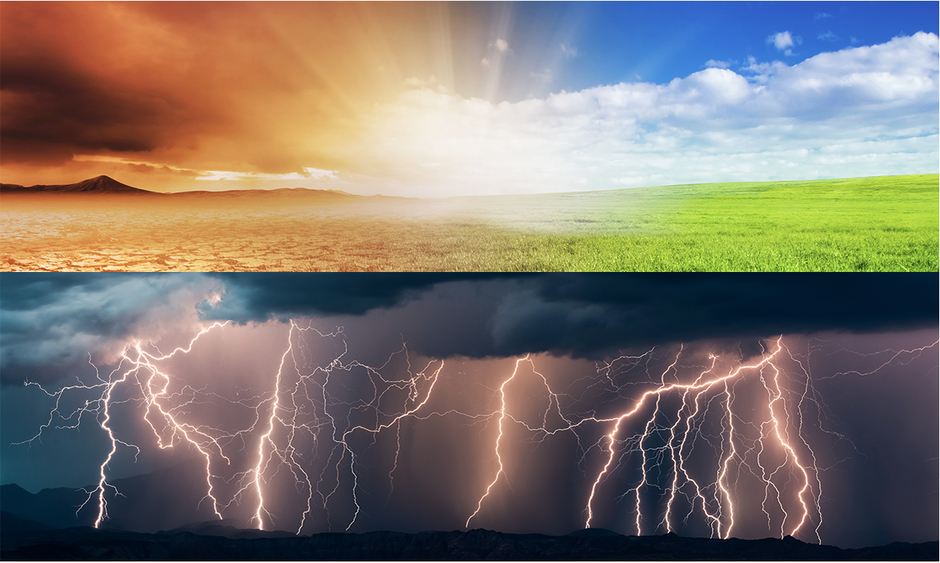
Notes:
We often hear the words climate and weather, but we fail to realize the relationship between weather and the climate system. In order to understand the climate system, it is important to understand what a “system” is.
It might be helpful to provide an example: Think about a bicycle. If you took the bike apart and had each of the pieces laying in your driveway, the bicycle would not be very useful. However, when the pieces are assembled, even though no new pieces are added, the bicycle allows you to travel great distances in a short amount of time. You can think of the bicycle as a system. It has many parts that work together to produce something new—in this case, a mode of transportation.
Climate systems are similar. The climate system is made up of many different factors including the Earth’s water, clouds, atmosphere, and temperature that work together to produce weather.

Slide 3
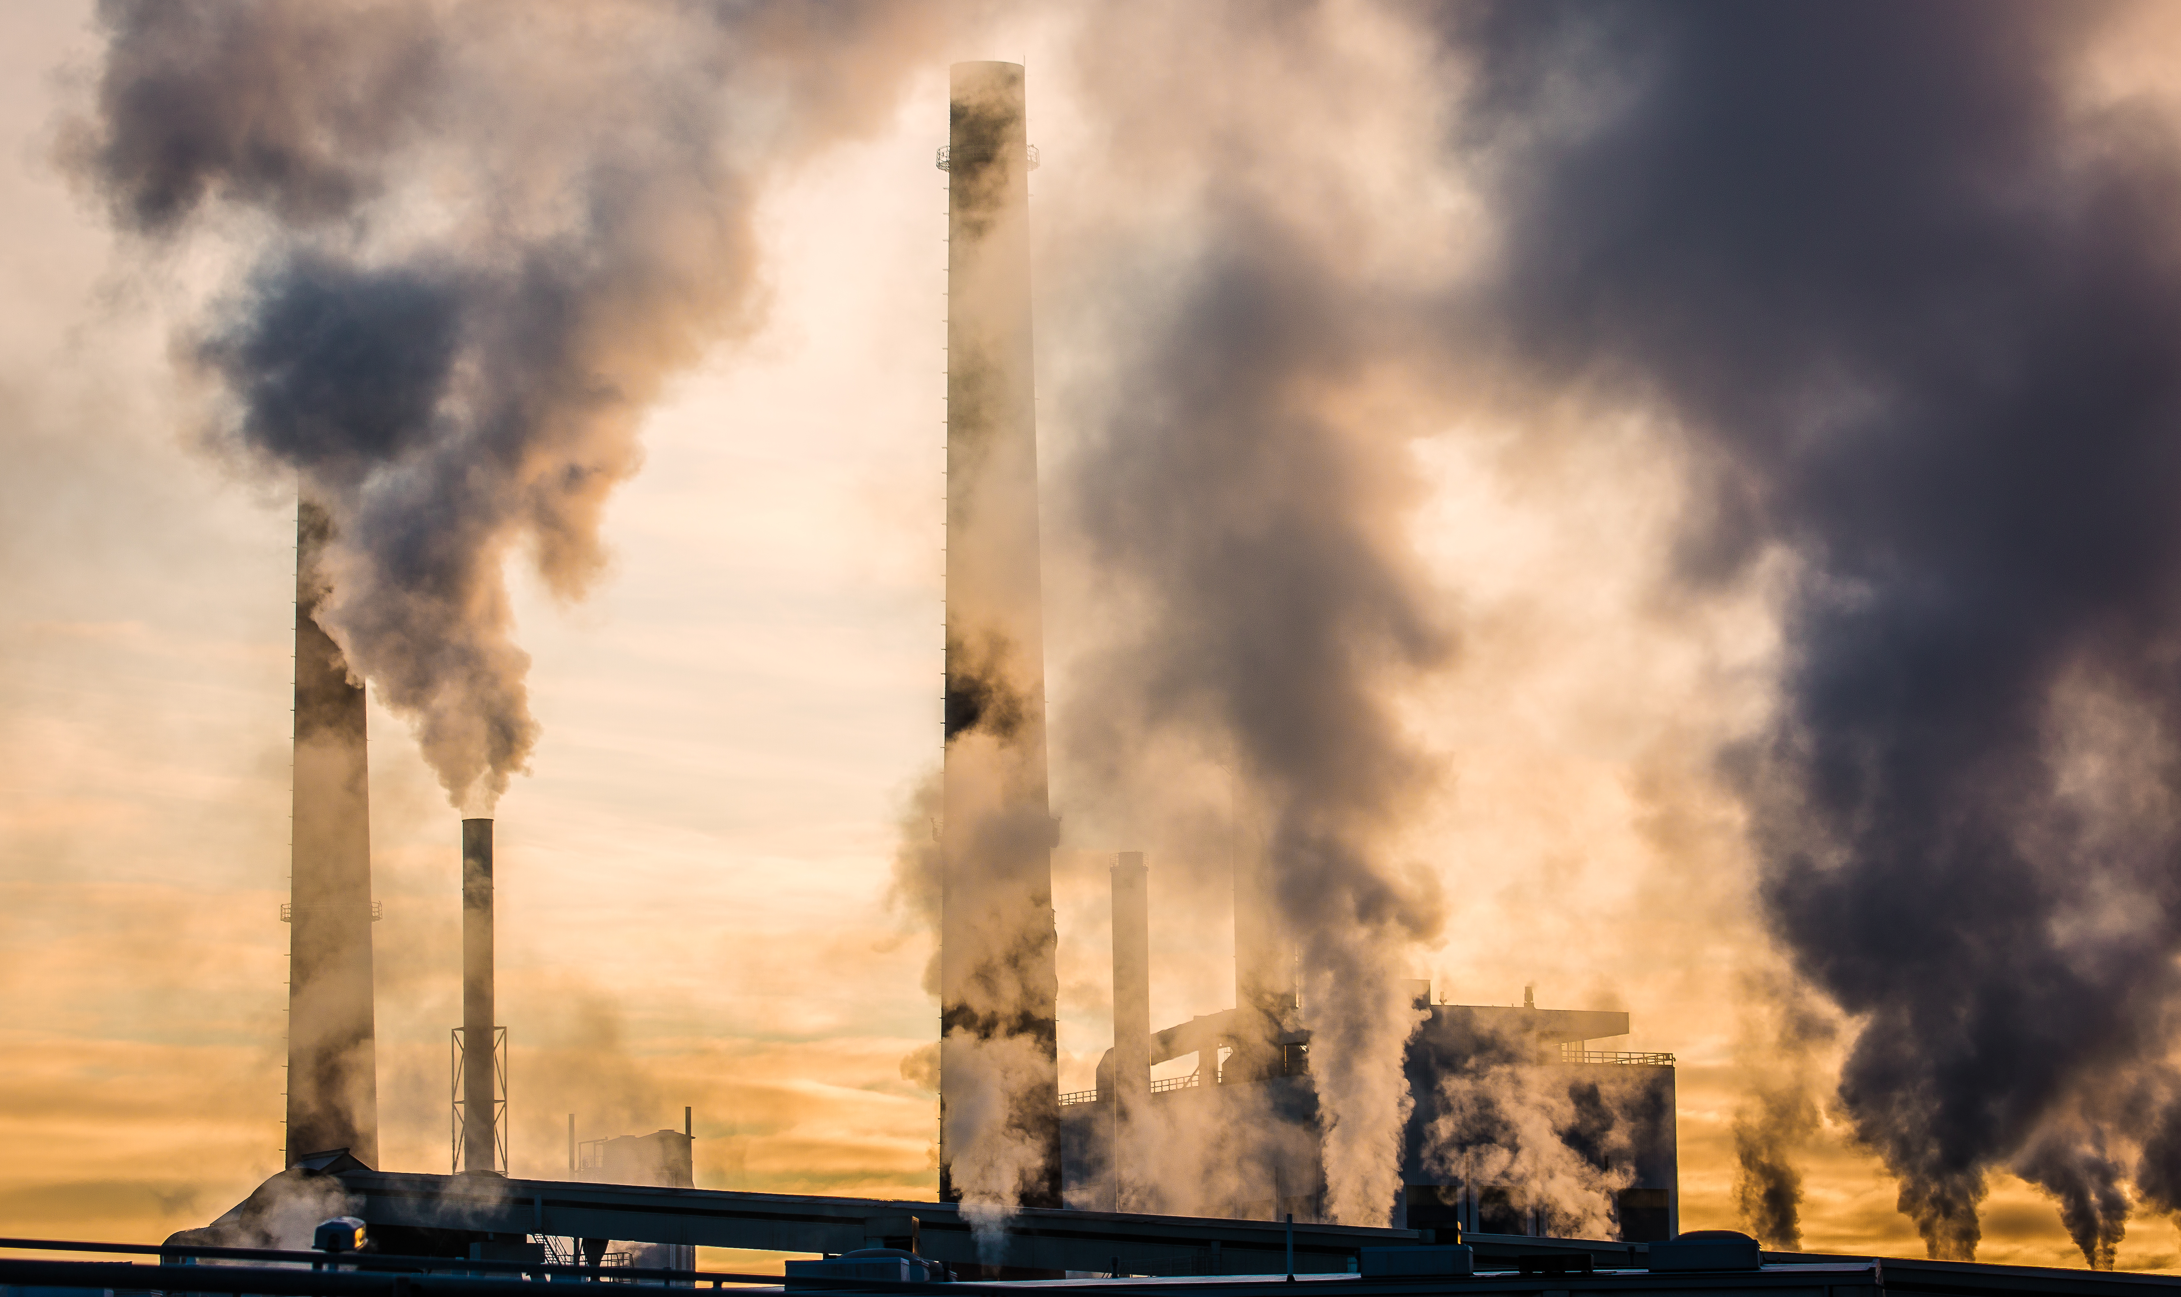
Part 1: What is Climate Change?

Slide 5
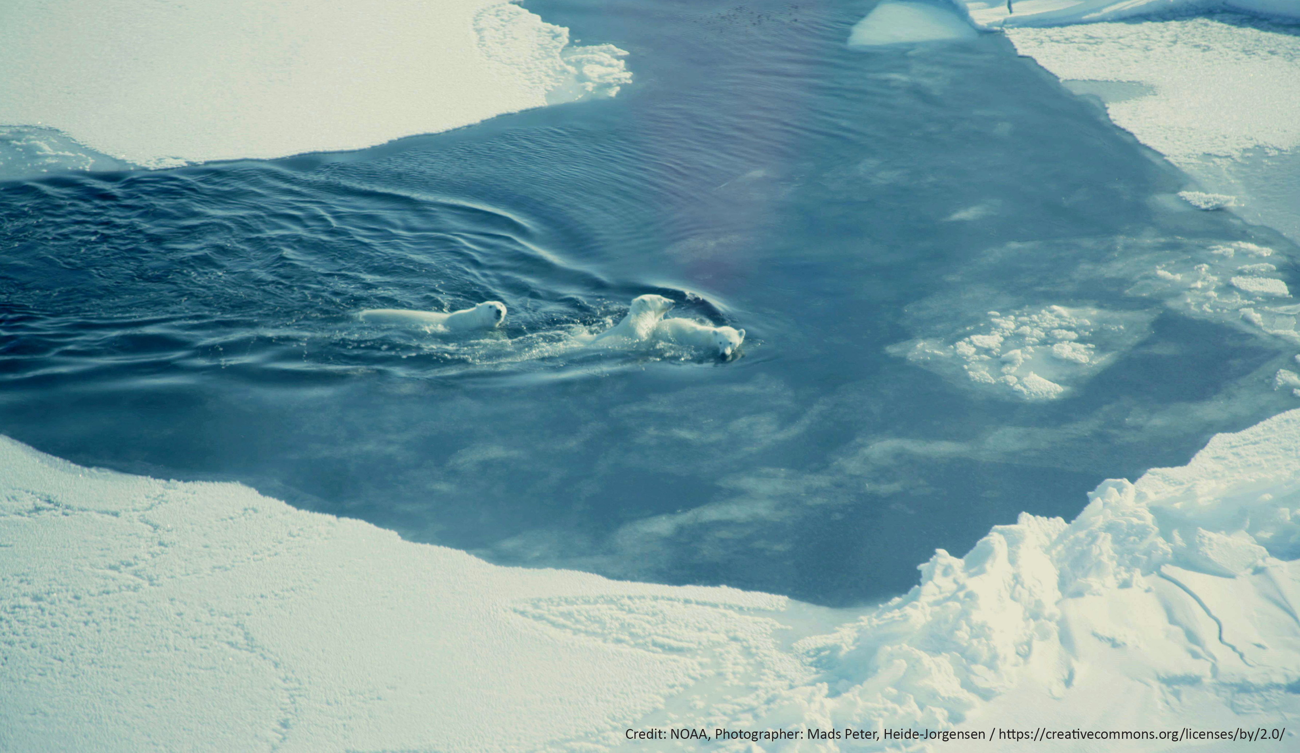

Slide 7
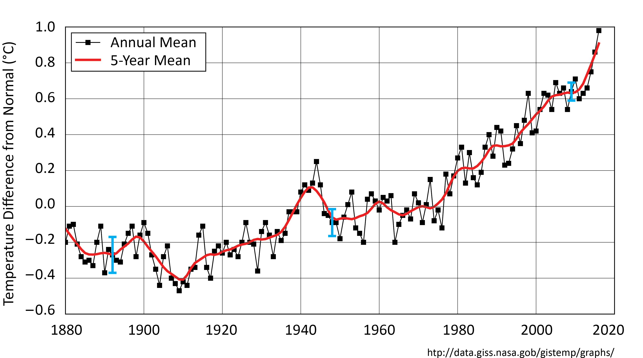
Studying Climate Involves Long-Term Trends
Global Mean Surface Air Temperature
Year
Notes:
Looking at weather change involves only days, weeks, or months. Studying climate change requires studying long-term trends, often 30, 50, or 100 years.
(Students don’t need to understand this graph, but they should recognize the time frame that shows the climate. This graph will come up again in LP 4.)

Slide 8
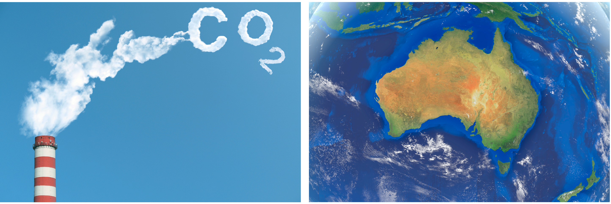
So What Is Climate Change?
What Is Climate Change? (cause and effects of climate change in Australia)
Climate Change (according to a kid)
Notes:
Cause and Effects of Climate Change in Australia: https://youtu.be/ko6GNA58YOA
Climate Change (according to a kid): https://youtu.be/Sv7OHfpIRfU

Slide 9
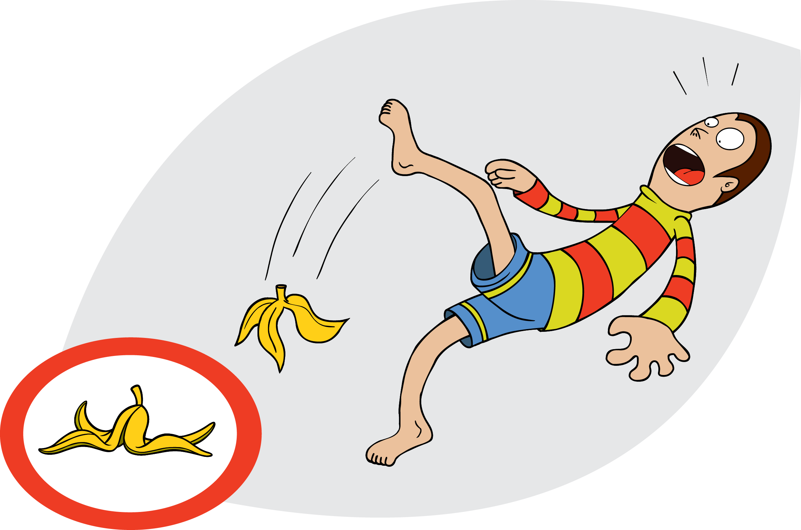
Cause and Effect

Slide 10
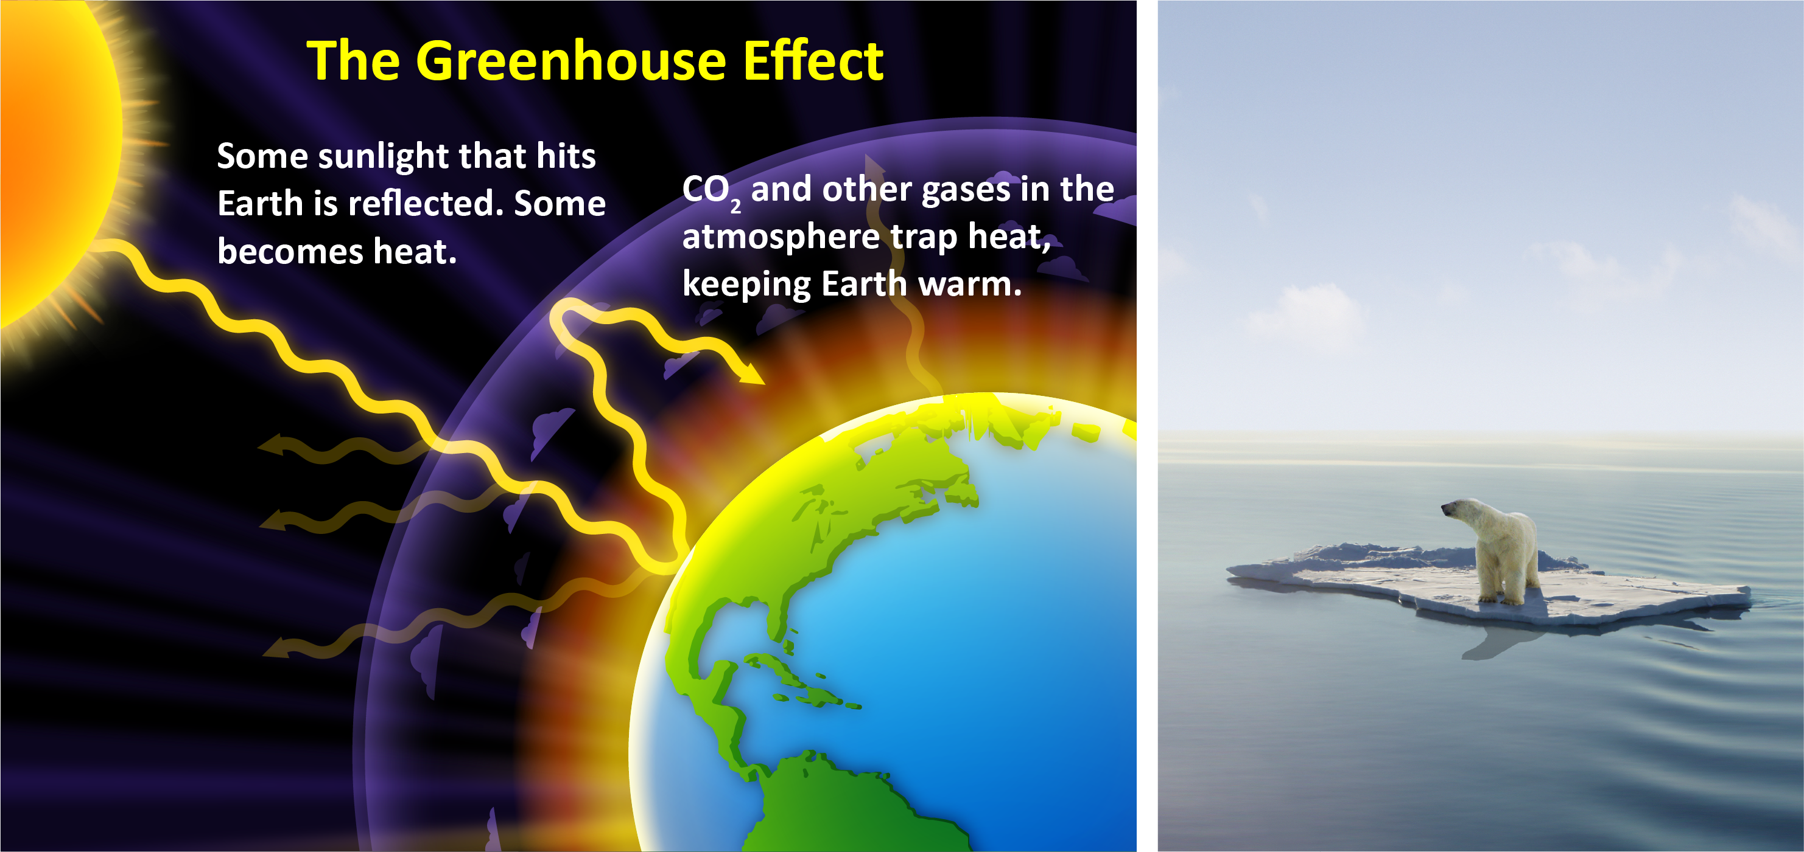
Cause and Effect: Climate Change
Cause
Effect

Slide 11
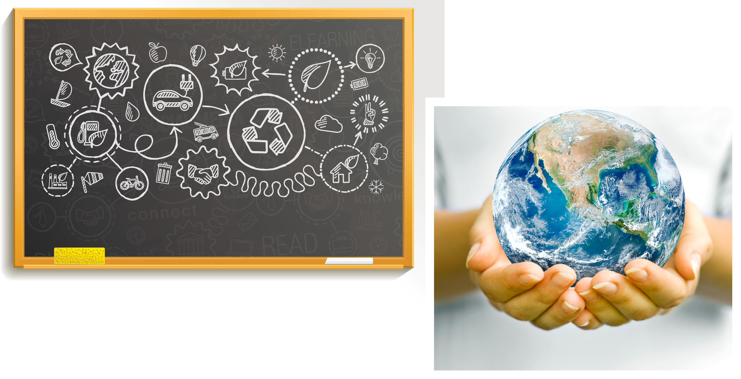
School Board Action Plan
A school board is looking for proposals to reduce their school’s impact on climate change.

Slide 12
The world needs your help!
Dreaming in Green

Slide 13
What do you still need to know in order to help?

