Slide 2
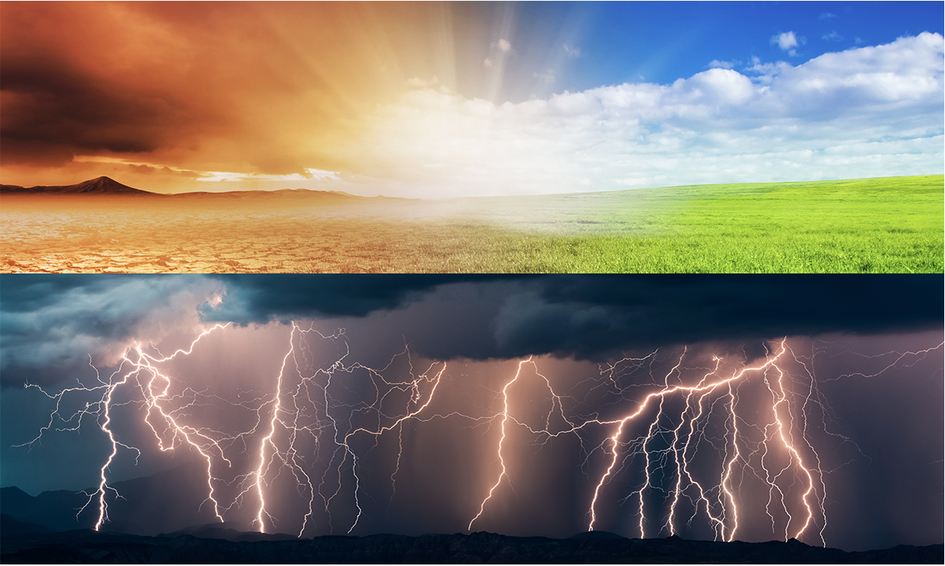
Weather vs. Climate
Notes:
We often hear the words climate and weather, but we often fail to realize the relationship between weather and the climate system. In order to understand the climate system, it is important to understand what a ‘system’ is. It might be helpful to use an illustration. Think about a bicycle. If you took the bike apart and had each of the pieces laying in your driveway, the bicycle would not be very useful. However, when the pieces are assembled, even though no new pieces are added, the bicycle allows you to travel great distances in a short amount of time. You can think of the bicycle as a system. It has many parts that work together to produce something new – in this case a mode of transportation. Climate systems are similar. The climate system is made up of many different factors including the Earth’s water, clouds, atmosphere, and temperature that work together to produce weather.

Slide 3
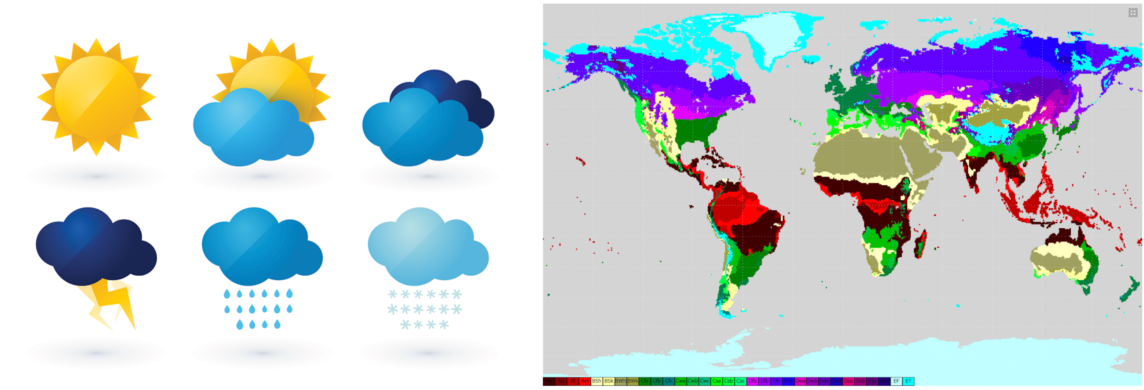
What is the difference between weather and climate?
Weather vs. Climate
What is weather? What is climate?
Credit: NOAA
Notes:
Show the follwing clips:
Weather Vs Climate presented by Climate Central (https://youtu.be/1s8eGd7THoo)
Weather Vs Climate presented by the Intergovenmental Panel on Climate Change (IPCC) (https://youtu.be/ukIIA2D0BUU)
Discuss as a class

Slide 4
Studying Climate Involves Long-Term Trends
Weather vs. Climate
Global Mean Estimates Based on Land and Ocean Data
Credit: NASA
Notes:
Looking at weather change involves only days, weeks, or months. Studying climate change requires studying long-term trends, often times 30, 50, or 100 years.
(Students don’t need to understand this graph, but they should just recognize the time frame that shows the climate. This graph will come up again in LP 4)

Slide 5
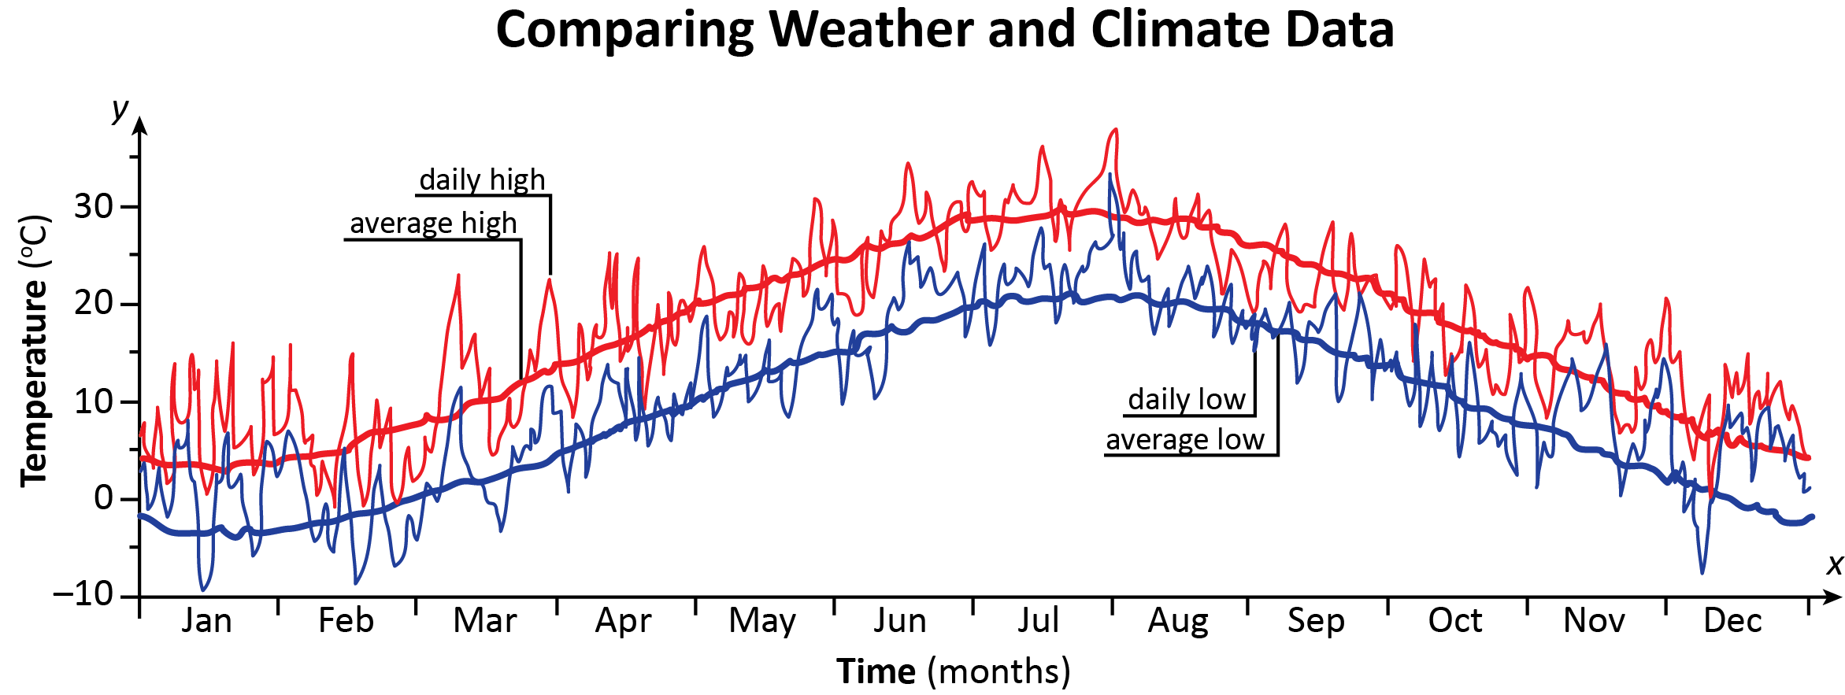
Comparing Weather and Climate Data
Weather vs. Climate
What does this graph show you?
Notes:
Here is a graph that relates the climate and weather.
Have students work in pairs to look at the graph to understand that weather is an expression of the climate system. It might be helpful to scaffold it in the following way:
Define the x and y-axis. What do they represent?
What does an individual point on this graph represent?
What do the two different colors represent? (Notice that long-term averages, here the climate, is represented by the thick red (highs) and blue (lows) lines.)
What is the trend in the thick lines?
What is the trend in the wavy lines?
Which lines do you think represent weather and which represent climate?
Have students summarize the graph: what does this graph tell you about the relationship between weather and climate? (Each day’s or months weather may not be exactly like the long-term climate, but it fluctuates with the trend shown by the climate line.)
At this point, tell students that climate is usually measured in 30 year periods. This is not an exact number, but is rather a convention used by scientist.

Slide 6
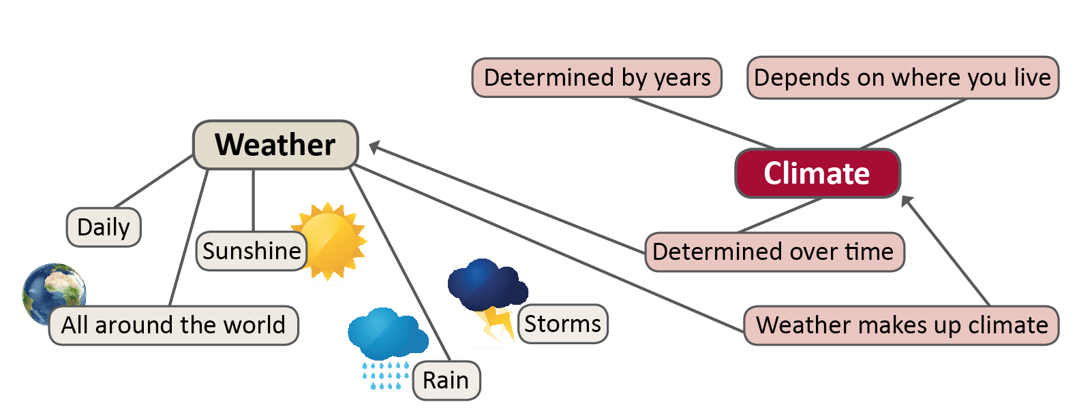
Weather and Climate and Climate Change
If the climate changes, then everything connected to climate will change.
Weather vs. Climate

Slide 7
Why is climate important?
Notes:
Weather and climate are the same phenomenon just at at different SCALE. Explain what the word scale means.
Ask students why understanding the climate system might be important.
Once you connect the weather system to climate. Ask how the weather affects decisions that students make.

Slide 8
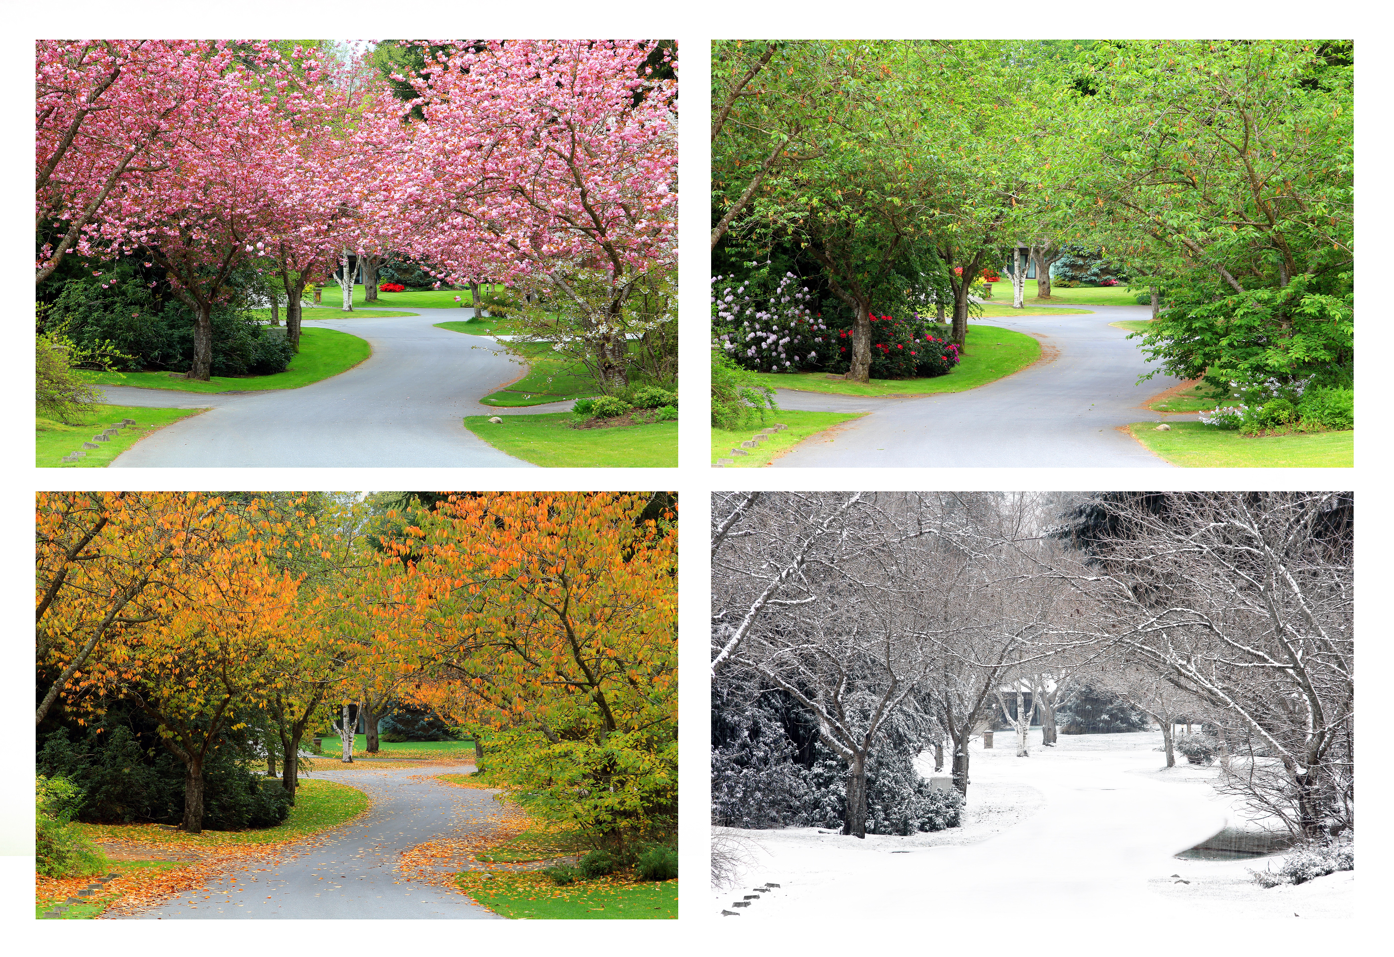
Discuss
What is the climate like in your area in the fall? Winter? Spring? Summer?
How does the climate in your area support farming, industry, tourism, recreation, sports, and activities that you like to do?
What might happen if the climate in your area changed?
Notes:
Foreshadowing: Explain that generally the climate "works" for the people and animals there. For the most part, people, plants and other animals have adjusted over hundreds and thousands of year to their climate: people don't farm in Death Valley, people go to the mountains to ski, and they build dikes if flooding often occurs. This notion will arise again as they begin to think about the effects/consequences of climate change on their community.

